Slide 1





Delivering Excellence in Software Engineering
EPAM Systems Inc
EPAM POWER POINT TITLE
Node.js with Bootstrap, Express, React and Redux
Fabian Jaramillo
Sub Topic

Slide 2
Node.js with Bootstrap, Express, React and Redux
Agenda
React
What is it?
How works?
Why is so popular?
Gulp
What is it?
How to install it?
How to use it?
React from Node.js
What is it?
How works?

Slide 3
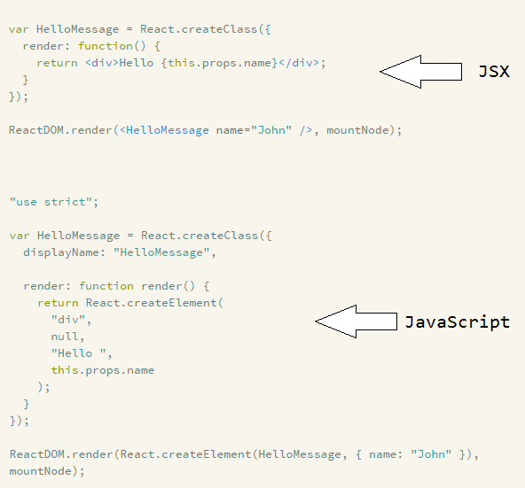
Node.js with Bootstrap, Express, React and Redux
React
What is it?
React is one JavaScript library to build interfaces based on components, implements a virtual-DOM to make changes in the DOM faster.
React allow you to work in JSX or JS; JSX is mix language between JavaScript and XML, at the end React will always run JavaScript code. All the components in JSX should be compile to JavaScript.

Slide 4
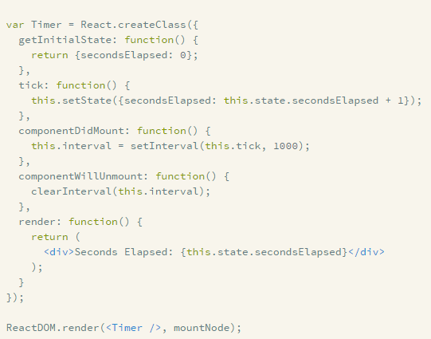

Node.js with Bootstrap, Express, React and Redux
React
How Works?
React give you the option to create encapsulated components with their own state to reuse all your components easily.

Slide 5

Node.js with Bootstrap, Express, React and Redux
React
Why is so popular?
I found these points as the most important things to think about it when you want to use React:
Simple and Clean
Small library with better performance with the DOM
Component based
Great value for large projects reusing all the components

Slide 6
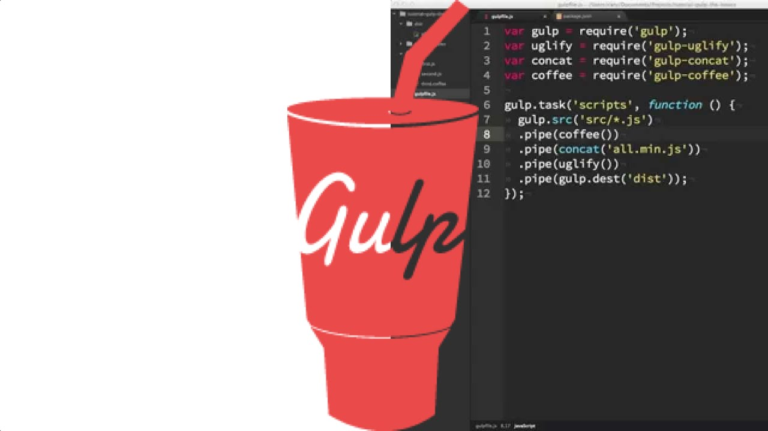
Node.js with Bootstrap, Express, React and Redux
GULP
What is it?
Toolkit to manage the workflow of your development automatically with tasks.
How to install it?
To add Gulp to you app just run this command in your root folder.
“npm install –save-dev gulp”

Slide 7

NodeJS with Bootstrap, Express, React and Redux
How Works?

Slide 8
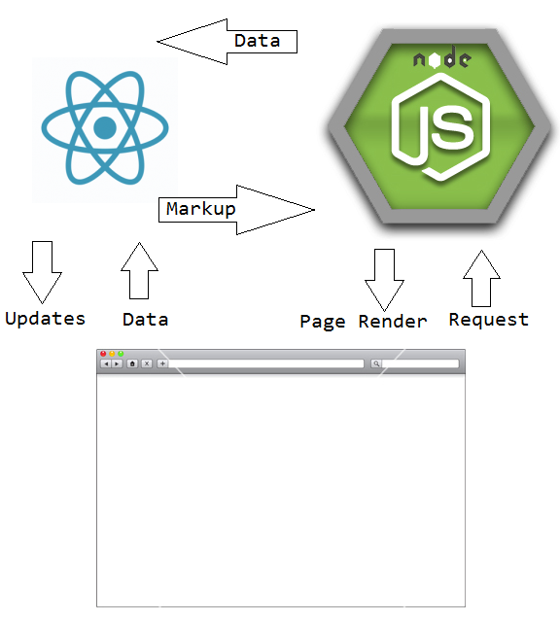
Node.js with Bootstrap, Express, React and Redux
React from Node.js
What is it?
You could use Node.js and React to build your components in the server side, with this React will create a string representation of your component doing the render process faster for the browser.
How works?
Basically we should execute React on server and React on client, with this React will identify the component was build on Server side and will create all the events needed.
Let’s see one example… Time to code ☺

Slide 9
Node.js with Bootstrap, Express, React and Redux
LINKS
https://facebook.github.io/react/
http://gulpjs.com/
https://www.terlici.com/2015/03/18/fast-react-loading-server-rendering.html
http://www.joshfinnie.com/blog/reactjs-tutorial-part-1/
https://codepen.io/damianfabian/pen/PGZzBv

Slide 10




Delivering Excellence in Software Engineering
EPAM Systems, Shenzhen
Fabian Jaramillo
Senior Developer
EPAM Systems Inc.
Shenzhen, China
Fabian_Jaramillo_ordonez@epam.com
Notes:
10

