Slide 1





Delivering Excellence in Software Engineering
EPAM Systems Inc
EPAM POWER POINT TITLE
Node.js with Bootstrap, Express, React and Redux
Fabian Jaramillo
Sub Topic

Slide 2
Node.js with Bootstrap, Express, React and Redux
Agenda
Creating a Web Page
Understanding Template Engines
Installing Libraries
Understanding Routes
Installing Manual Libraries

Slide 3
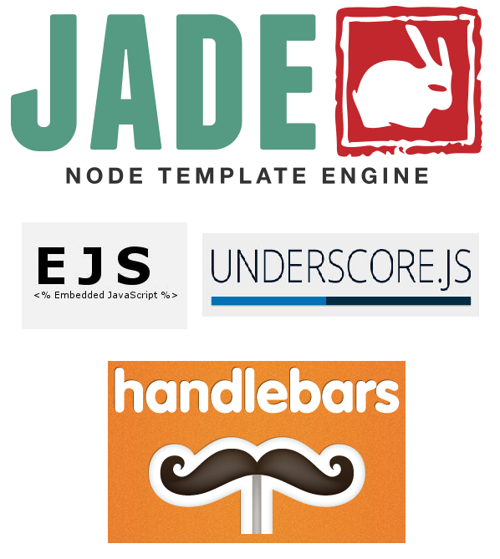
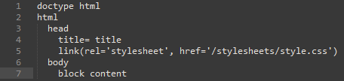
Node.js with Bootstrap, Express, React and Redux
Template Engines
What is it?
Express now ask you to setup a default template engine to create your HTML pages.
Template engines basically help you to create semantic templates to build your HTML pages.

Slide 4
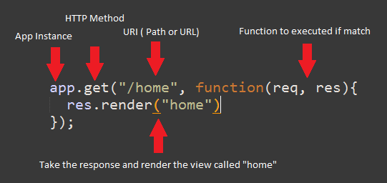
Node.js with Bootstrap, Express, React and Redux
Understanding Routes
HTTP Verbs
The HTTP verbs basically are the actions or methods
that we are available to use as a resources from the
server. The most common verbs are:
GET (Read)
POST (Create)
PUT (Update/Replace)
PATCH (Update/Modify)
DELETE (Delete)
If you want to know more about verbs and Rest API’s you could go to http://www.restapitutorial.com/lessons/httpmethods.html

Slide 5
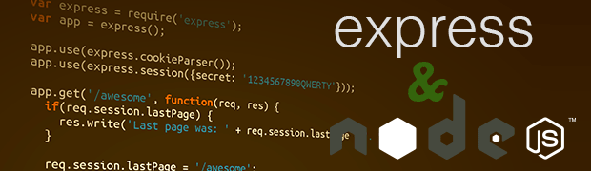
NodeJS with Bootstrap, Express, React and Redux
Lets’ make some code ☺

Slide 6
Node.js with Bootstrap, Express, React and Redux
LINKS
http://handlebarsjs.com/
http://jade-lang.com/
https://www.npmjs.com/
http://yeoman.io/
https://expressjs.com/en/guide/routing.html

Slide 7




Delivering Excellence in Software Engineering
EPAM Systems, Shenzhen
Fabian Jaramillo
Senior Developer
EPAM Systems Inc.
Shenzhen, China
Fabian_Jaramillo_ordonez@epam.com
Notes:
7

