Slide 1





Delivering Excellence in Software Engineering
EPAM Systems Inc
EPAM POWER POINT TITLE
Node.js with Bootstrap, Express, React and Redux
Fabian Jaramillo
Sub Topic

Slide 2
Node.js with Bootstrap, Express, React and Redux
Agenda
Node.js
What is it?
How to Install it?
Express
What is it?
How to install it?
Package.json
What is it?
How to use it?
Creating a Simple Web Page

Slide 3
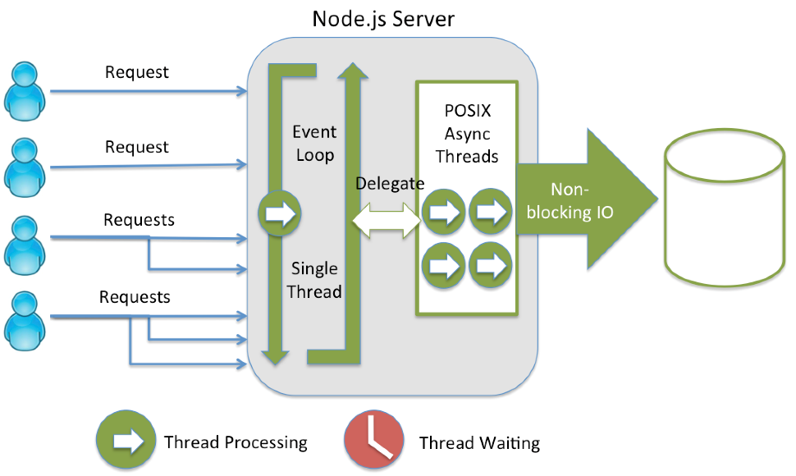
Node.js with Bootstrap, Express, React and Redux
Node.js
What is it?
The public definition by nodejs.org is “Node.js® is a JavaScript runtime built on Chrome's V8 JavaScript engine. Node.js uses an event-driven, non-blocking I/O model that makes it lightweight and efficient.”
My personal definition is that NodeJS is a set of tools that allow us to run Javascript in the server side taking approach of Chrome’s V8 engine.

Slide 4
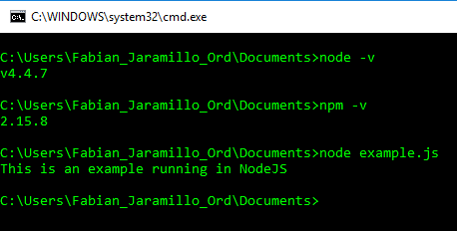
Node.js with Bootstrap, Express, React and Redux
Installing Node.js
Windows
Download installer from www.nodejs.org and follow the wizard.
Mac
Download package installer from www.nodejs.org and follow the wizard.
Linux
Go to https://nodejs.org/en/download/package-manager/ and find the correct installer for your distribution.

Slide 5
Node.js with Bootstrap, Express, React and Redux
NPM
What is it?
NPM is the initials of “Node Package Manager” and basically it’s a command line client that allow developers to install, publish, share and manage all their dependencies.
Using NPM
You could use NPM after install node.js , go to your console and try it, basic usage is:
npm [COMMAND] [--OPTIONS] [MODULES]
npm install --save MyModule

Slide 6
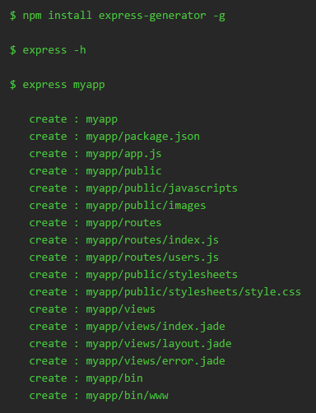
Node.js with Bootstrap, Express, React and Redux
Express
What is it?
Fast, minimalist and one of the most popular web frameworks for Node.js
Installing
To add Express to you app just install express using NPM in your root folder.
“npm install express”
Generator
Express has a generator to create express app easily, to get the generator just install the generator using NPM.
“npm install –g express-generator”

Slide 7
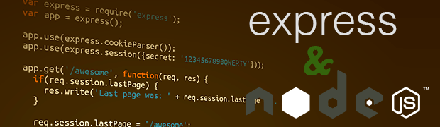
NodeJS with Bootstrap, Express, React and Redux
Lets’ make some code ☺

Slide 8
Node.js with Bootstrap, Express, React and Redux
LINKS
https://nodejs.org
http://expressjs.com/
http://javabeat.net/expressjs-bootstrap/
http://code.runnable.com/V-pPF7sQOr1TcLyi/hello-world-with-express-generator-for-node-js

Slide 9




Delivering Excellence in Software Engineering
EPAM Systems, Shenzhen
Fabian Jaramillo
Senior Developer
EPAM Systems Inc.
Shenzhen, China
Fabian_Jaramillo_ordonez@epam.com
Notes:
9

