Slide 1





Delivering Excellence in Software Engineering
EPAM Systems Inc
EPAM POWER POINT TITLE
Node.js with Bootstrap, Express, React and Redux
Fabian Jaramillo
Sub Topic

Slide 2
Node.js with Bootstrap, Express, React and Redux
Agenda
Creating a Web Page
Installing Libraries
Understanding Template Engines
Understanding Routes
Installing Manual Libraries

Slide 3
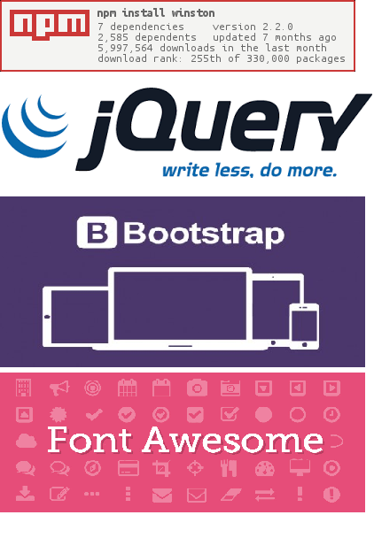
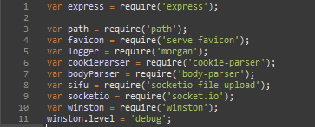
Node.js with Bootstrap, Express, React and Redux
Installing Libraries
How to do it?
You could install any library in NodeJS using NPM to install it, then require the library to use it in your code.

Slide 4
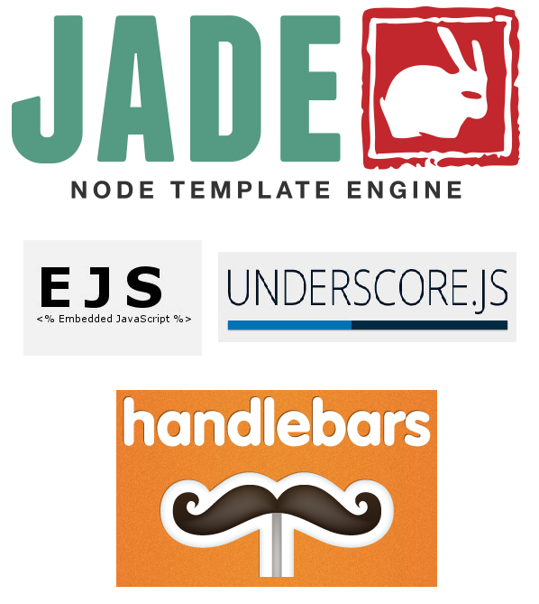
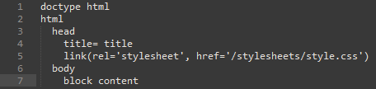
Node.js with Bootstrap, Express, React and Redux
Template Engines
What is it?
Express now ask you to setup a default template engine to create your HTML pages.
Template engines basically help you to create semantic templates to build your HTML pages.

Slide 5
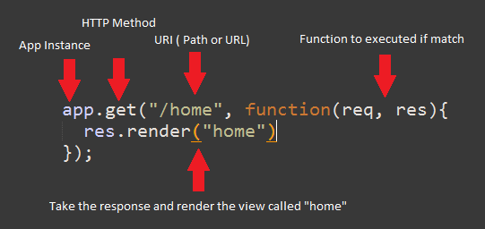
Node.js with Bootstrap, Express, React and Redux
Understanding Routes
HTTP Verbs
The HTTP verbs basically are the actions or methods
that we are available to use as a resources from the
server. The most common verbs are:
GET (Read)
POST (Create)
PUT (Update/Replace)
PATCH (Update/Modify)
DELETE (Delete)
If you want to know more about verbs and Rest API’s you could go to http://www.restapitutorial.com/lessons/httpmethods.html

Slide 6
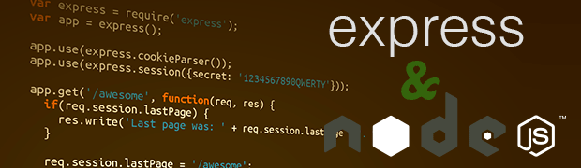
NodeJS with Bootstrap, Express, React and Redux
Lets’ make some code ☺

Slide 7
Node.js with Bootstrap, Express, React and Redux
LINKS
http://handlebarsjs.com/
http://jade-lang.com/
https://www.npmjs.com/
http://yeoman.io/
https://expressjs.com/en/guide/routing.html

Slide 8




Delivering Excellence in Software Engineering
EPAM Systems, Shenzhen
Fabian Jaramillo
Senior Developer
EPAM Systems Inc.
Shenzhen, China
Fabian_Jaramillo_ordonez@epam.com
Notes:
8

