Slide 1





Delivering Excellence in Software Engineering
EPAM Systems Inc
EPAM POWER POINT TITLE
Node.js with Bootstrap, Express, React and Redux
Fabian Jaramillo
Sub Topic

Slide 2
Node.js with Bootstrap, Express, React and Redux
Agenda
Browsersync
What is it?
How works?
Redux
What is it?
Understanding the Flow
How to use it?
React with Redux
Why?
How works?

Slide 3
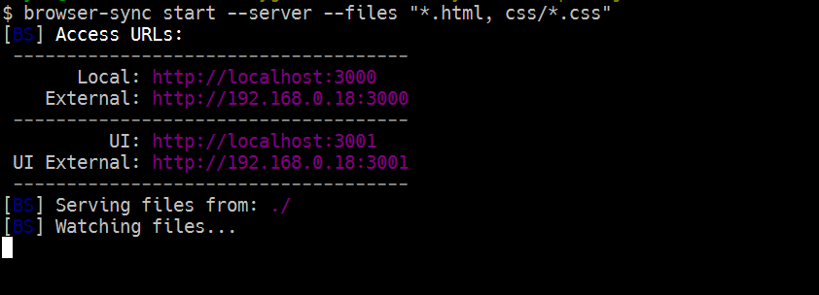
Node.js with Bootstrap, Express, React and Redux
Browsersync
What is it?
It’s a tool that help you out to work faster in your development process. Browsersync reload and keep synchronize all the browsers connected with your site.
How Works?
You could use Browsersync in stand-alone mode or with third parties like Gulp, Grunt, WebPack, etc. Browsersync will watch the files you configured and It will inject the changes to all the browsers connected in case any files change.

Slide 4
Node.js with Bootstrap, Express, React and Redux
Redux
What is it?
I call Redux “The way”, Redux is a library that allow you to work with one simple and clear concept of how the workflow of your application will work. It has three rules or principles concepts:
The whole state of your app is stored in an object tree inside a single store.
The only way to change the state tree is to emit an action, an object describing what happened.
To specify how the actions transform the state tree, you write pure reducers.
CONTAINERS (Controller)
COMPONENTS (View)
ACTIONS (Functions)
REDUCERS (Routes)

Slide 5
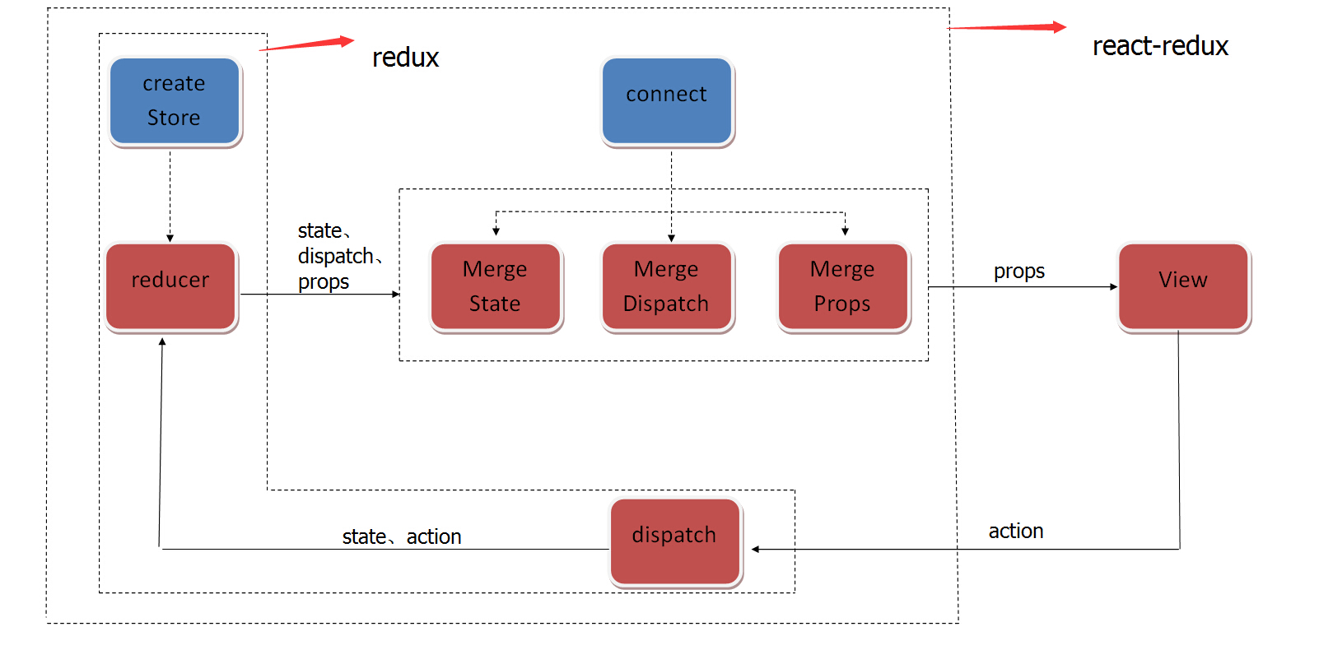
Node.js with Bootstrap, Express, React and Redux
Understanding the Flow

Slide 6
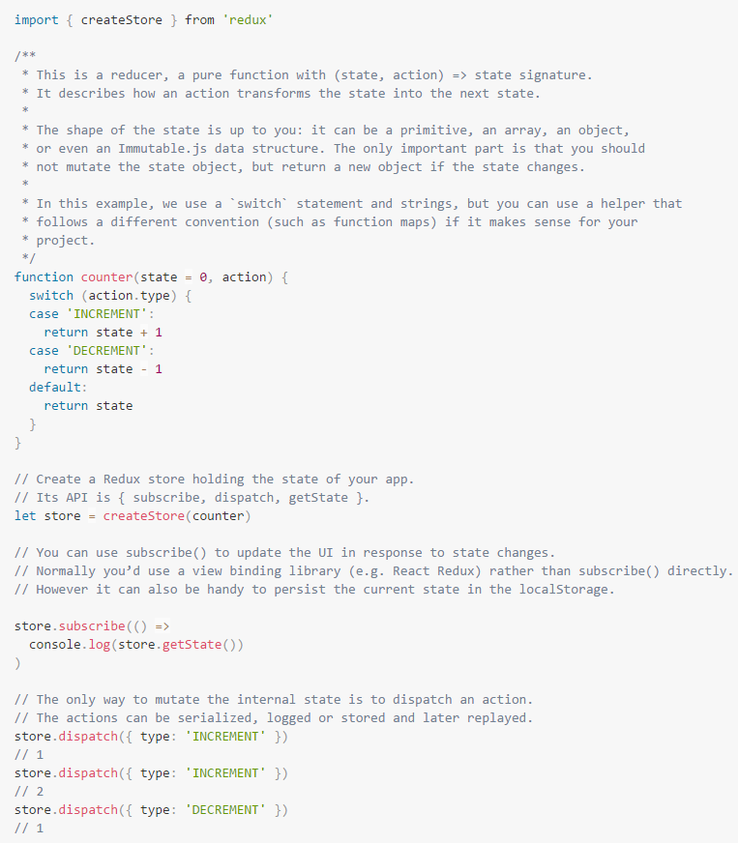
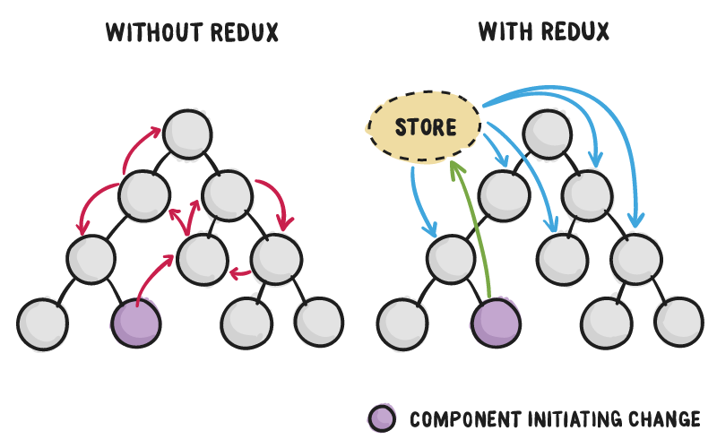
Node.js with Bootstrap, Express, React and Redux
How to Use it?
Redux is compatible with any other view libraries on the market, this is because Redux is only managing the flow of how the application is using a single store for all your components and defining how the state could be change it.

Slide 7

Node.js with Bootstrap, Express, React and Redux
React with Redux
Why?
React is really helpful to create components and reuse this in different ways, but when you have large applications, you will realize that control all those states, share properties and control the flow of events and data between the components could be a problem. That’s the main reason why Redux exists.

Slide 8
Node.js with Bootstrap, Express, React and Redux
LINKS
http://react-china.org/t/redux/2687/6
http://redux.js.org/index.html
https://facebook.github.io/react/
https://browsersync.io/
https://github.com/BrowserSync/recipes
https://github.com/reactjs/redux/blob/master/docs/basics/UsageWithReact.md
https://github.com/damianfabian/react-course
https://github.com/facebookincubator/create-react-app
https://github.com/DimitriMikadze/express-react-redux-starter
https://github.com/mxstbr/react-boilerplate

Slide 9




Delivering Excellence in Software Engineering
EPAM Systems, Shenzhen
Fabian Jaramillo
Senior Developer
EPAM Systems Inc.
Shenzhen, China
Fabian_Jaramillo_ordonez@epam.com
Notes:
9

