Slide 1
Git -
Some Typical Usage Scenarios

Slide 2
A Linear Development Workflow with Git
master
blob
git clone
<work>
git add
git commit
git log
git status
git diff
blob
blob
blob

Slide 3

What happens when you add (or remove) files
source: https://git-scm.com/book/en/v2/Getting-Started-Git-Basics

Slide 4
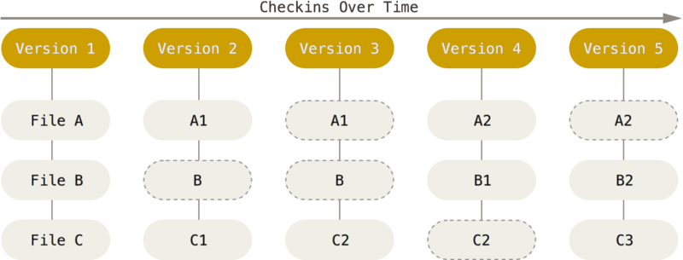
What happens when you commit
source: https://git-scm.com/book/en/v2/Getting-Started-Git-Basics

Slide 5
What happens when you pull or push
git pull
git push
source: https://git-scm.com/book/en/v2/Getting-Started-Git-Basics

Slide 6
Tagging
Git allows to assign symbolic names to versions and retrieve a version by tag
Typical uses:
  releases
  deployments
git tag depl-1-prod
<work>
…
git add
git commit
git tag feature1
master
23es
23es
feature1
23es
c343
depl-1-prod
c343
c343
a00b
a00b
a00b

Slide 7
Forking (Branching) and (Requesting) Pulls
User A starts a repo, User B and User C fork (at different times), work, and then generate pull requests
We have what we called “branching development”
23rt
master
master
master
23es
23es
23es
567a
23rt
23rt
23rt
567a
23es
7zdd
c343
c343
c343
d056
7zdd
7zdd
7zdd
d056
c343
a00b
a00b
a00b
a00b
c343
c343
c343
a00b

Slide 8
Merging
master
Merging is the process of putting together different branches
It allows to incorporate changes made in one branch in another branch
Conflicts might arise (same lines changed in both branches)
lk02
merge
98xs
merge
23rt
567a
23es
7zdd
d056
c343
a00b

Slide 9
Merging
Merging happens in one repository: other users need to pull changes to view the result
Merging is complex
  Example: four new functions in Branch A, three new functions in Branch B and three existing functions changed in A and B with calls to the new functions
Strategies to mitigate:
  Plan and organize the work
  Push, merge, and pull often

Slide 10
Branching
Branches can also be created “locally” (*)
Uses:
  separate concerns: one feature per branch
  hotfixes: e.g., fix a bug discovered in an old version
(*) In fact Git does not distinguish among repositories, Github does
git clone
<work>
git add
git commit
git branch v2
<work>
git add
git commit
git merge
v2
master
98ui
45rt
23es
23es
23es
v2b3
c343
c343
c343
a00b
a00b
a00b

Slide 11
Final remarks and some “homework”
Git is a best-practice, not a substitute for configuration management and management best-practices
There is no need for a central repository: https://git-scm.com/book/en/v2/Distributed-Git-Distributed-Workflows
Commands you might end up using, sooner or later:
  git amend
  git stash
  git blame
  git rebase

