Slide 1
Spoiler
Traditional planning techniques
  rely on structured and well defined processes
  work best in predictable environments
Software is not always developed in a predictable environment
Agile techniques try to overcome the limitations of traditional planning

Slide 2
Traditional
Planning and Scheduling

Slide 3
Planning
The process of deciding what activities have to be performed in a project
In software development you can define activities starting from the many different processes there are: waterfall, spiral, incremental, RUP, ...
Representations:
  Work Breakdown Structures
  Gantt Charts
  Activity diagrams

Slide 4
The Gantt Chart
A visual representation of the schedule of a project
Task/Activity: a represenation of the work to be performed
Deliverable: a concrete and measurable output of the project
Milestone: an important date of the project

Slide 5
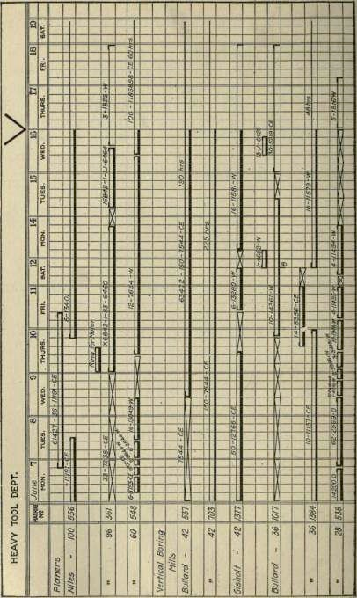
Example of Gantt Chart
Source: Clark, Wallace and Gantt, Henry, “The Gantt chart, a working tool of management”, The Ronald Press Company, New York, 1923 (available in digital format from various sources on the Internet)

Slide 6
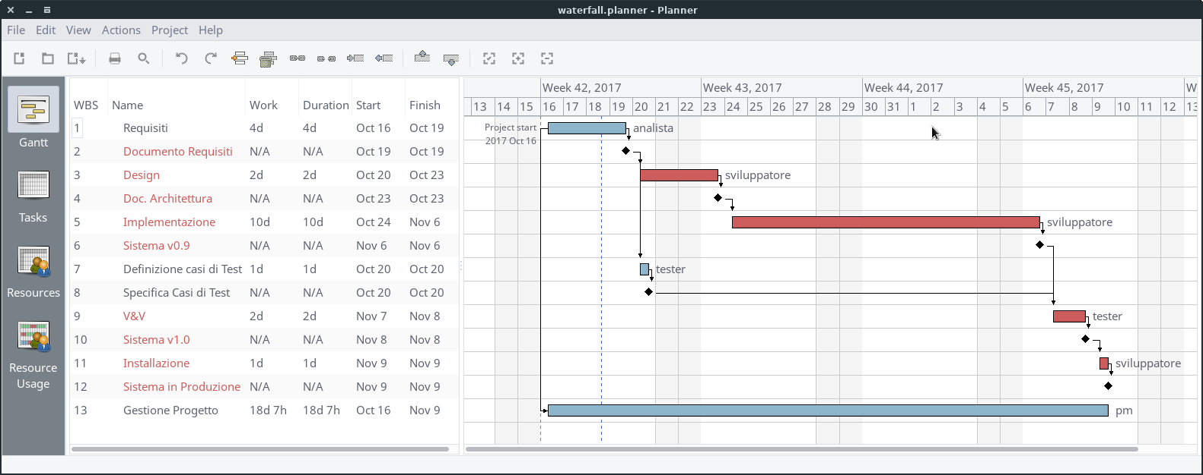
A modern example

Slide 7
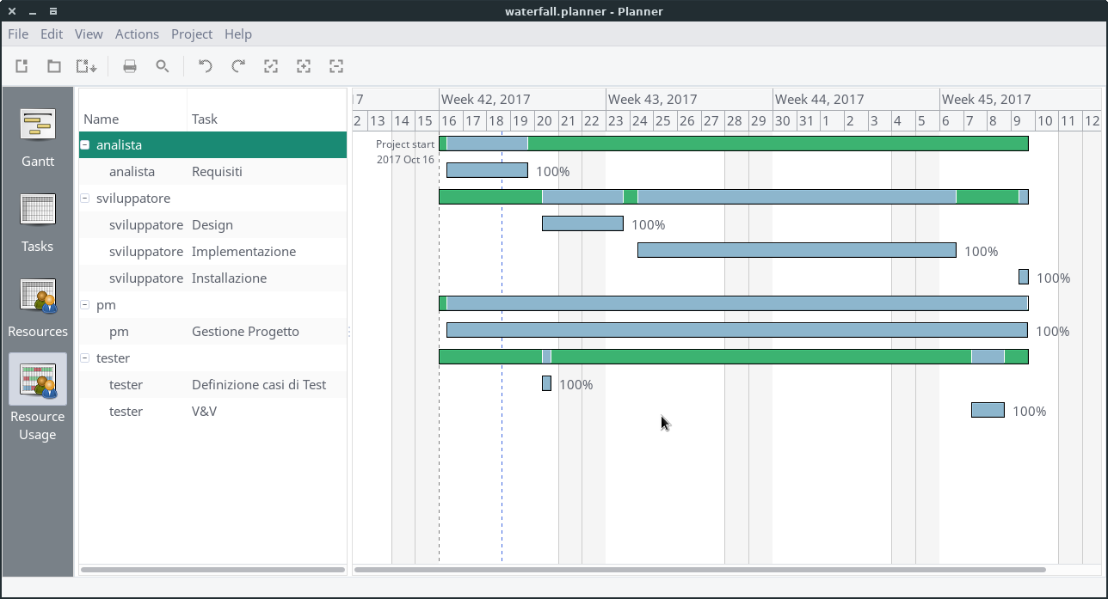
A modern example: Resource Usage

Slide 8
Scheduling
Effort (or work): the time an activity takes to be completed
Manpower: the effort that can be produced in a unit of (calendar) time
  Can be made of number of units and availability
Duration: how long an activity will last

Slide 9
Scheduling
Fix any of the two and you can compute the third
Fix one, variate the second and the third derives from the equation
Estimations are usually effort-driven
The formula is a simplification holding in certain reasonable ranges

Slide 10
The (Software) Estimation Process
Specification
of work
“Magic” Box
Effort
Scheduling
Equation
D, E, and M
“Magic” Box
  Experience
  Analogy
  Brainstorming
  Delphi
  Algorithms (function points/COCOMO)
Specification of work
  Software requirements

Slide 11
Weaknesses
The “chicken and egg” problem: no plan without requirements; no requirements without a plan (and a contract)
Software development and software maintenance are planned in a rather different way, although they are not so diverse in nature
The accuracy of your plans depends on the accuracy with which you estimate the effort. Reliable effort estimations are difficult

