Slide 1
Spoiler
Agile methodologies start out the need of better aligning software management practices to the peculiarities of software development
You can adopt XP, but it requires to embrace it all
Scrum presents a less intrusive alternative and is less invasive to adopt than other agile techniques

Slide 2
Agile Software Development

Slide 3
Motivation for Agile
Traditional approaches to control complexity in software development rely on superimposing structure on development
A natural trend from the Waterfall model that risks to end up in a bureaucratic structure
If change is intrinsic to software development, maybe processes that embrace change lead to a more natural way of working, simpler management, and better results

Slide 4
Agile Software Development
A group of SW development methodologies based on similar principles:
  A management process that encourages frequent inspection and adaptation
  Team work, self organization, accountability
  Rapid delivery of high-quality software
  A business approach that aligns development with customer needs and company goals

Slide 5
The Agile Manifesto
Individuals and interactions
Process and tools
over
Working software
Comprehensive documentation
over
Customer collaboration
Contract negotiation
over
Responding to change
Following a plan
over
http://agilemanifesto.org/

Slide 6
Some Consequences
Customer satisfaction
Working software delivered frequently
Working software is the principal measure of progress
Late changes in requirements = no problem
Close, daily cooperation
Face2Face & Co-location
Projects built around individuals
Attention to technical excellence and good design
Simplicity
Adaptation

Slide 7
Dynamic System Development Method
It starts from the experience of RAD (Rapid Application Development)
Key considerations:
  people are the key to project success
  change is inevitable
  no software is perfect the first time it is released
The project proceeds in cycles
Standardized and supported by a consortium

Slide 8
Extreme Programming
XP takes proven practices to the extreme
  If testing is good, let everybody test all the time
  If code reviews are good, review all the time
  If design is good, refactor all the time
  If integration testing is good, integrate all the time
  If simplicity is good, do the simplest thing that could possibly work
  If short iterations are good, make them really, really short
XP is based on:
  values
  practices
  process
Notes:
Take practices that have been proven to be good and take them to the extreme.

Slide 9
XP Values
Communication: open and honest
Feedback: honest and rapid (close the look quickly to make feedback effective)
Simplicity: K.I.S.S.
Courage: take the right decisions, even if they are difficult (if it can’t be done, say it!)

Slide 10
Some interesting XP practices
Test-driven development
  Write test-cases first
  All code must have unit tests
  All code must pass all unit tests before it can be released
  When a bug is found tests are created
  Acceptance tests are run often and the score is published
Pair-programming
  Two programmers, one keyboard
  Code ownership, training on the job
Refactor often
Integrate often

Slide 11
Some interesting XP practices
Do the simplest thing that could possibly work
Passes all the tests
No duplicate code
States every intention
Fewest possible classes and methods

Slide 12
SCRUM

Slide 13
Scrum Approach
A team approach in which all players move together towards the same goal, setting the rhythm and adapating to change similar to what happens in rugby

Slide 14
Scrum Principles
Built-in instability: broad goals and general strategic directions
Self-organizing project teams
Overlapping development phases
Multilearning, so that the team can learn both from internal and external sources and adapt quickly to changing conditions and environments.
Subtle control: steer the project without interfering too much (e.g., selecting the right people for the job, creating an open environment, tolerating and anticipating mistakes).
Organizational transfer of learning: by ensuring that the know-how acquired in a project is transferred and reused in other projects.

Slide 15
Scrum is popular
Different from XP (which is a “all or nothing” approach), Scrum is simpler to adopt (because it is
“closer” to a traditional approach)
It has been used by:
  Siemens, IBM, BBC, Time Warner, Google, Electronic Arts, Lockheed Martin, ...
It has been used in domains where Agile is not traditionally used:
  Fixed cost projects
  Life-critical systems
  Satellite control software

Slide 16
Scrum roles
Scrum Master
  Facilitator, ensures Scrum is applied and the team can operate and work
  Shields team from external interferences
Product owner
  Defines the features of the product, decides priorities, accepts or rejects work
Team
  Self organized, cross-functional, ideally full-time, small (5-9)

Slide 17
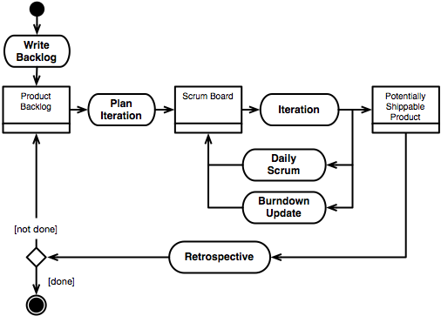
The Scrum process
source: www.spmbook.com

Slide 18
Scrum Sprints
Scrum projects make progress in a series of “sprints” lasting between 2 and 4 weeks
The product backlog defines what has to be developed using the “User Stories” paradigm
Product backlog items are allocated to the next sprint during sprint planning and developed during a sprint
No changes to the allocated items are possible during a sprint
Sprint durations reflect how long you can commit to avoiding changes in your project

Slide 19
The Product Backlog
The Product Backlog defines what is to be developed using the user story format
User stories are annotated with priority and size
User stories: see specific presentation
Priority: set by the Product Owner
Size: specified in story points and determined by the team, often using the Planning Poker (a variant of the Delphi Technique)

Slide 20
User Stories Estimation
Effort:
  simpler for people accustomed to traditional software development practices
  Less effective than story points
Story points:
  abstract dimensionless measurements
  provide a relative ordering of user stories
  allows to compute velocity (how fast the team implements story points) and, therefore, to the number of story points allocatable in a sprint
  defines an “algebra” of story points (10 story points require the same time as two 5 story points user stories)

Slide 21
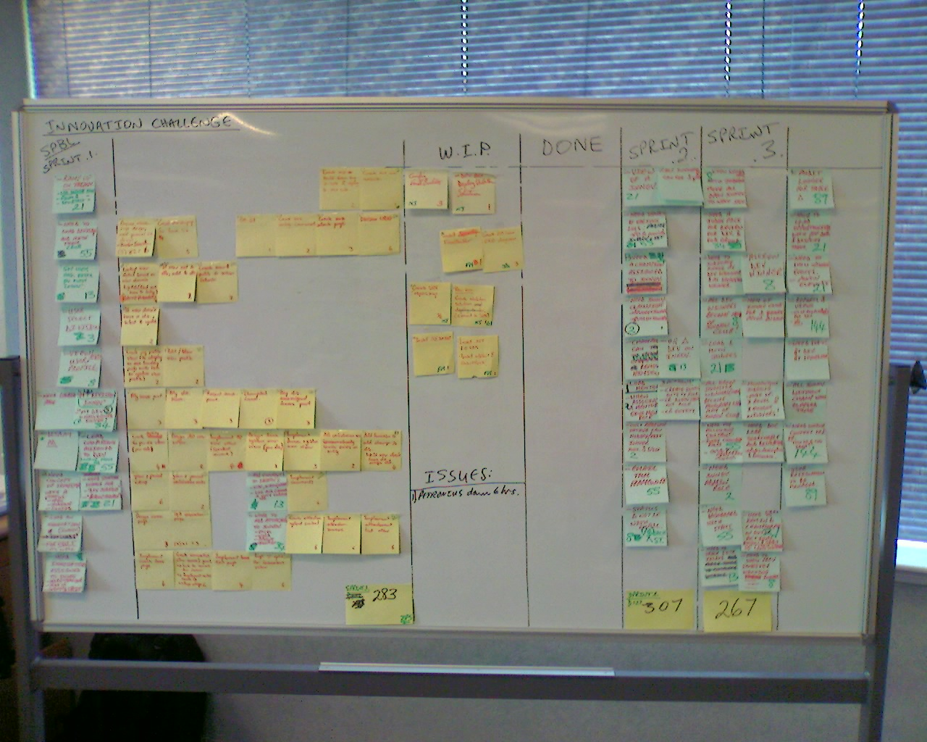
Sprint Execution
At the beginning of the sprint, the user stories allocated for the sprint are put on a whiteboard
Individuals choose which stories to take in charge and in what order
The board keeps track of the status of each user story
https://scrum4you.files.wordpress.com/2008/09/img007.jpg

Slide 22
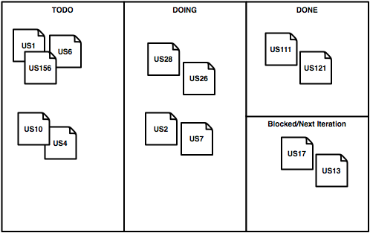
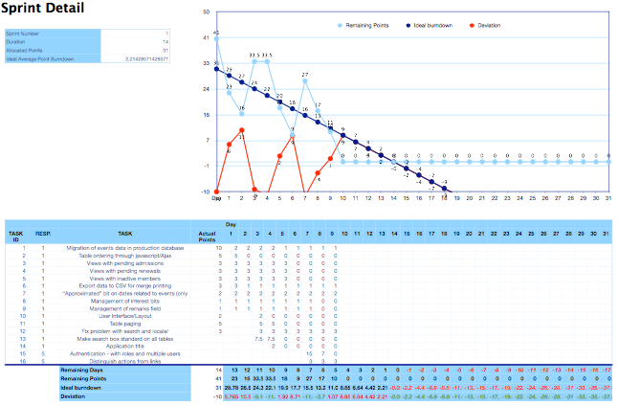
Sprint Tracking
Two main goals:
  Keep track of the work (todo, doing, done, blocked): use whiteboard and post-it
  Measure the team “velocity” (sprints of fixed length means velocity is the important measure)

Slide 23
Adapting/Computing Speed
Team speed is estimated according to historical data:
  Velocity tends to converge after a few sprints
  Initial estimation is a guess or uses effort
What if speed is higher than expected?
  Add stories!
What if speed is lower than expected?
  Remove stories!

Slide 24
Managing the Scrum Process
Three types of meetings to manage a sprint:
  Daily Scrum
  The Sprint Review
  Sprint Retrospective

Slide 25
The Daily Scrum
A daily 15-minutes stand-up meeting for the whole team (including product owner)
Everyone is invited (but only to listening)
Emphasizes commitment
Answer to three questions:
  What did you do yesterday?
  What will you do today?
  What is blocking your work? (impediments)
Impediments become the responsibility of the Scrum Master

Slide 26
The Sprint Review
Each sprint ends with a demoable product (potentially shippable product): a piece of software, a mockup, a manual, …
The Sprint Review has the goal of demoing the output of the sprint
Everyone participates
Informal if focuses on demos (rather than slides)

Slide 27
The Sprint Retrospective
After every sprint the team takes a look at what is and is not working
Not very long: 15–30 minutes
Whole team participates
One approach is start-stop-continue:
  What we need to start doing
  What we should stop doing
  What we should continue doing

Slide 28
Scrum: Software Development Practices
According to Cohn, SCRUM entails the adoption of some practices typical of Agile processes such as
  Pair programming
  Test-first approach
  Automated testing and integration
  Refactoring
... they are not necessary, but make Scrum more effective

Slide 29
Critiques to Agile Methodologies
Too many changes = higher costs
“Scope creep” beyond what is agreed at the beginning of the project
Requirements continuously updated
No “Big Design” upfront
Customer representative = single point of failure
Generates stress
Risk of non-technical representative dictating technical choices

