Slide 1
A high-level intro to
Object Oriented Programming

Slide 2
A long time ago… in a computer far, far away
10 let x=7
20 gosub 100
30 let x=9
40 gosub 100
50 goto 200
100 print x, x *x
110 return
200 end
Difficult to comprehend:
  Error-prone
  Lower confidence
  More difficult to maintain
Mitigation strategies:
  Documentation
  Better syntax, type checking
  Structured programming
  Object Orientation
Source: https://people.eecs.berkeley.edu/~bh/pdf/v2ch06.pdf

Slide 3
Better Syntax and Type Checking
Improve the language syntax so that some common errors are avoided or recognized by the compiler
DO 10 I=1.10
Each data has a type and each function accepts and returns specific types
if (a = 3)

Slide 4
Structured Programming
ALGOL58, ALGOL60
Constructs:
  Sequence
  Repetition
  Selection
Functions/Subroutines
Complex data structures (records, structs)
COMMENT define the sieve data structure;
INTEGER ARRAY candidates[0:1000];
INTEGER i,j,k;
COMMENT 1000 to protect against strict evaluation of AND ;
FOR i := 0 STEP 1 UNTIL 1000 DO
BEGIN
COMMENT everything is potentially prime until proven otherwise ;
candidates[i] := 1;
END;
Source: http://cs.ecs.baylor.edu/~maurer/SieveE/Algol60.htm

Slide 5
Object Oriented Programming
Some remaining weaknesses:
  Access to global state (“where did this variable change?”)
  Data and computation are completely distinct (consider, for instance, perimeter(polygon p))
Object oriented programming puts together data and computation in self-contained units
Advantages:
  Separation of concerns
  Reuse
  Organization of work
  ...

Slide 6
Classes and Objects
An object contains both data and methods that manipulate that data
The data represent the state of the object
Data can also describe the relationships between this object and other objects
Every object belongs to (is an instance of) a class
The class describes the fields and the methods of an object
You use the class’s constructor to build objects out of a class

Slide 7
Common characteristics and differences in OO
Encapsulation
Inheritance
Polymorphism
Abstraction
What is an object? 1.+(2)
Method invocation:
message passing or subroutine?
Inheritance: multiple or single?

Slide 8
Writing an application using an OO language
Identify the objects (classes) and the interfaces they provide (domain analysis is a useful starting point)
Identify the relationship among objects (for instance, using a class diagram)
Orchestrate objects creation and methods invocation to implement the application logic

Slide 9
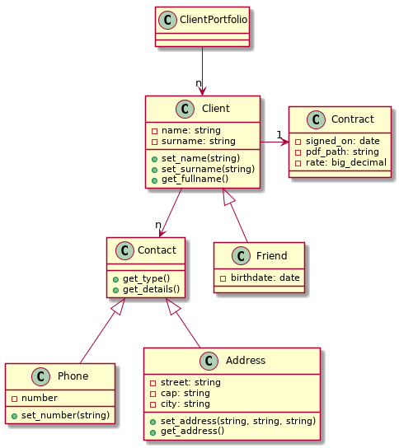
A simple example
I want to manage my client portfolio
The client portfolio is made of person(s)
Each client has one or more contacts
Each client has a contract
Friends are special clients who get a discounted rate (what a friend am I!)

Slide 10
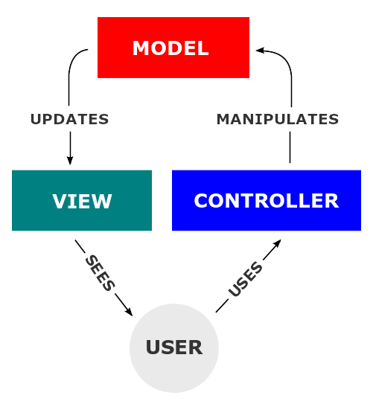
MVC: Model View Controller
Certain OO patterns repeat again and again
One pattern widely used is the MVC (model, view, controller)
The Gamma book contains many other patterns
Source: https://en.wikipedia.org/wiki/File:MVC-Process.svg

