Slide 1

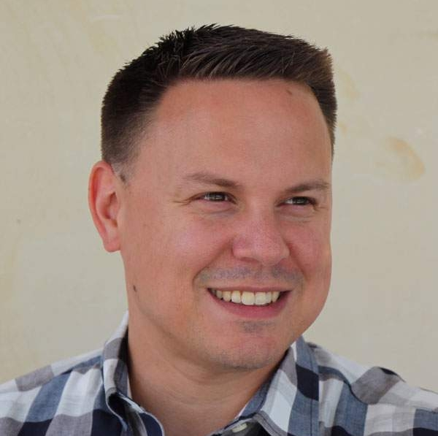

Getting to 100:
Fixing Your Anthology Ally Errors
Damian Sian
Adjunct professor
School of Communication and Information, Library Sciences
Rutgers University – New Brunswick

Slide 2
Agenda
Background and housekeeping
Presenter introduction
Workshop structure
Scope of the challenge and technology limitations
Hands-on activities
Text alternatives
Color
Structure (headings and tables)
Links
Video captions
Flashing blinking

Slide 3
Section one: Presenter introduction
Who the hell does this guy think he is anyway?

Slide 4
Covered in section one
Meet your workshop facilitator, Damian Sian and learn about his:
Work history
Credentials
Background in accessibility
Important highlights in the field of accessibility

Slide 5




Work history
Damian has worked in the accessibility field for 14 years for institutions such as Princeton University and Prudential Financial.
He teaches an Introduction to Web Accessibility course at Rutgers University on the New Brunswick campus.
Damian currently serves as a Principal Engineering Program Manager at Adobe on the Product Equity team.

Slide 6

Credentials
Damian has just about all the accessibility credentials one can obtain from the International Association of Accessibility Professionals (IAAP).
Certified Practitioner of Accessibility Core Competencies (CPACC)
Web Accessibility Specialist (WAS)
Certified Practitioner of Web Accessibility (CPWA)
Accessible Document Specialist (ADS)
Working on a UX Design accessibility certification IAAP and curriculum with TeachAccess.

Slide 7
Background in accessibility
Front-end development (HTML and mostly React)
Document accessibility (30 years in communications industry)
Automated and manual testing (including building tools and process)
Triage and remediation with globally distributed teams
Assistive technologies (screen reader and voice control)
Compliance, governance, and resource for legal
Process and policy creation and enforcement
Enablement and training (corporate adult learning)
Curriculum and certification development

Slide 8
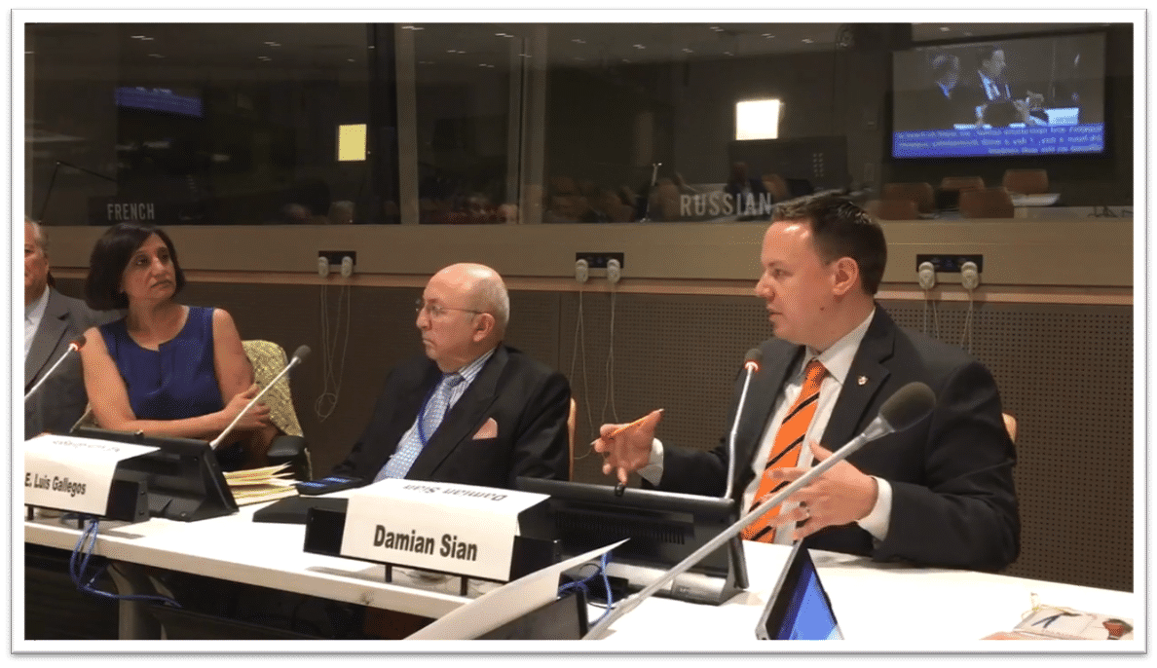
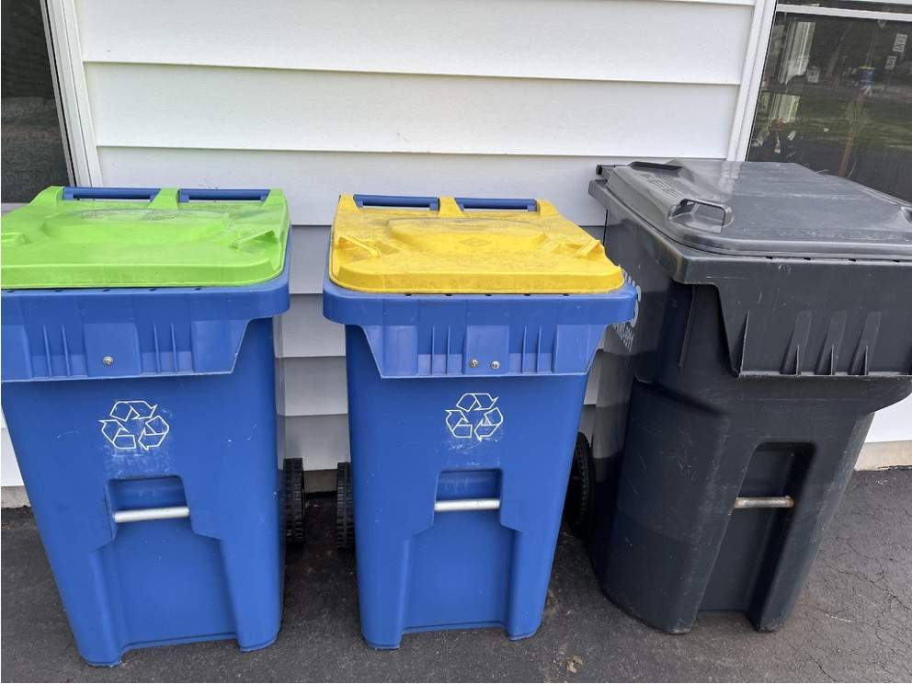
Two important highlights
Speaking at the United Nations was pretty cool.
But my recycling bins are by far my proudest achievement.

Slide 9
Section two: Workshop structure
How we’ll facilitate our interactive this interactive journey.

Slide 10
Covered in section two
This is how we’ll work together today.
Where to find your sample files
Following along in Canvas LMS Ally tool
The website resource
Room for questions/challenges

Slide 11
Sample files
Download the zip package here, or go the website and download the samples there, your choice.
Wherever possible, a file is provided for you to place into the Canvas LMS.
We will trigger automated errors and learn how to resolve them.
We will also expose where automated testing is lacking.
Damian will demonstrate assistive technology throughout.
You are not required to use assistive technology to follow along.
You will need MS Word, MS PowerPoint, and Acrobat Professional if you intend to follow along with all the topics today.
You will need access to an instance of Canvas if you intend to follow along (a test course would be the best if you have one).

Slide 12
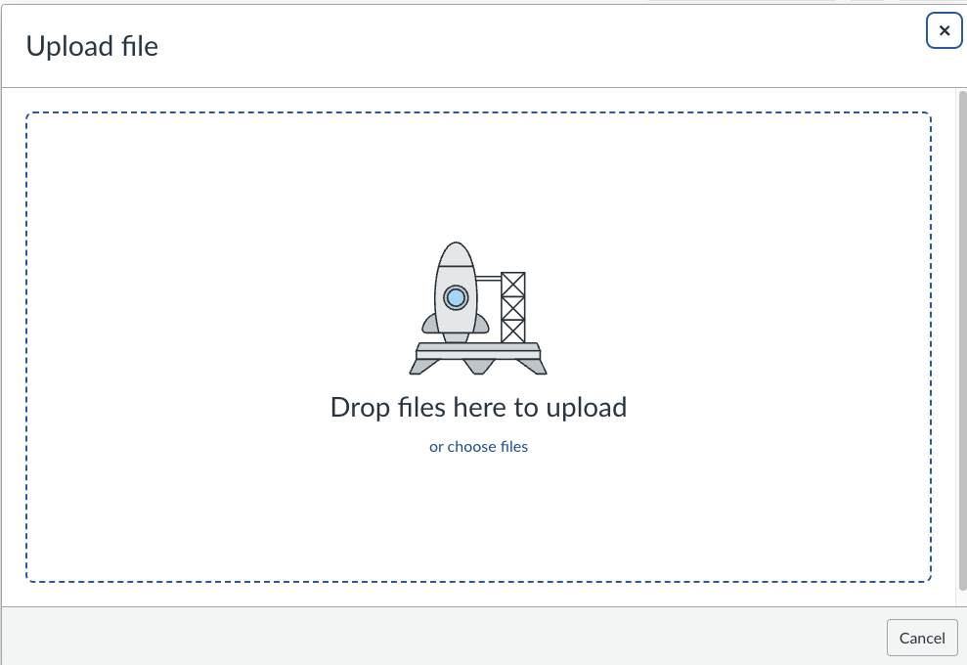
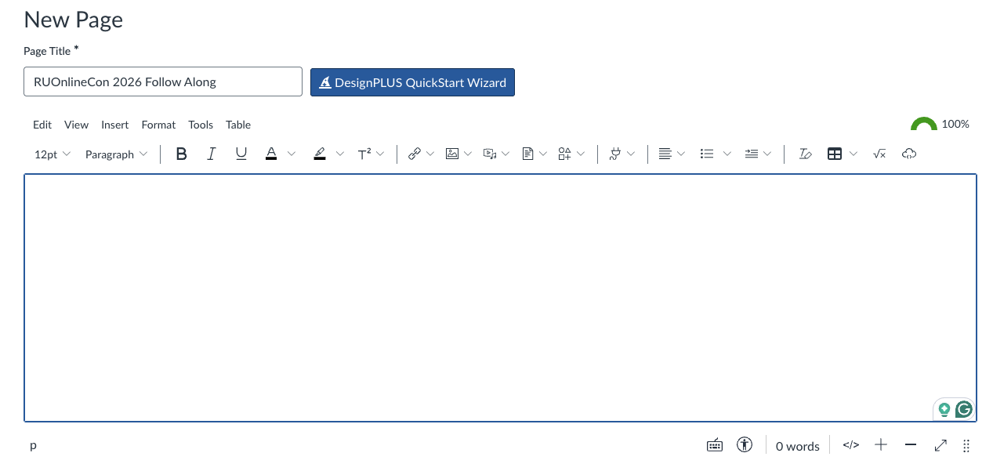
Following along Canvas
File upload function
Rich Content Editor (RCE)
You’re encouraged to create a new Page in your Canvas instance where we can play and make a mess.
You’re encouraged to create a folder in your files section of Canvas, so you don’t muddy your existing file structure in your course.

Slide 13
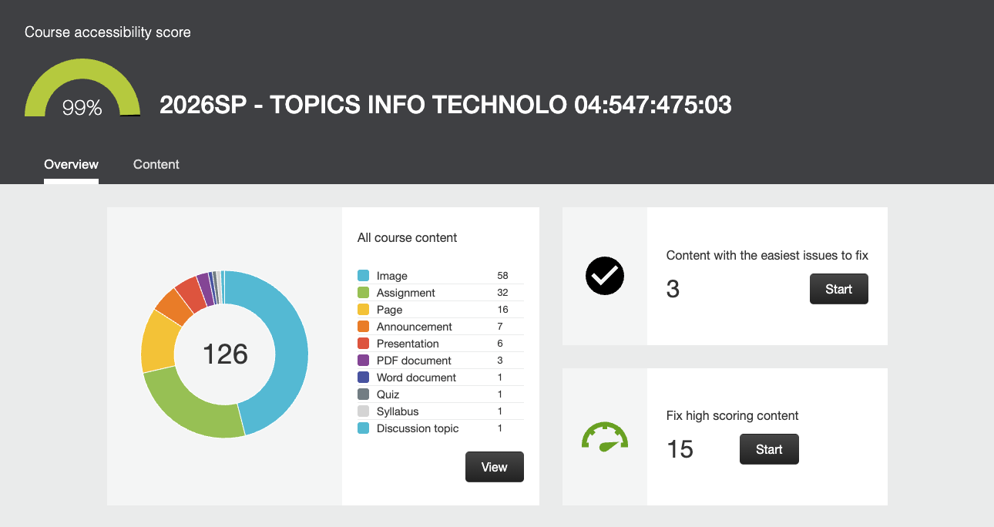
Accessibility dashboard
We will be looking at the course accessibility score and dashboard in Canvas as well.

Slide 14
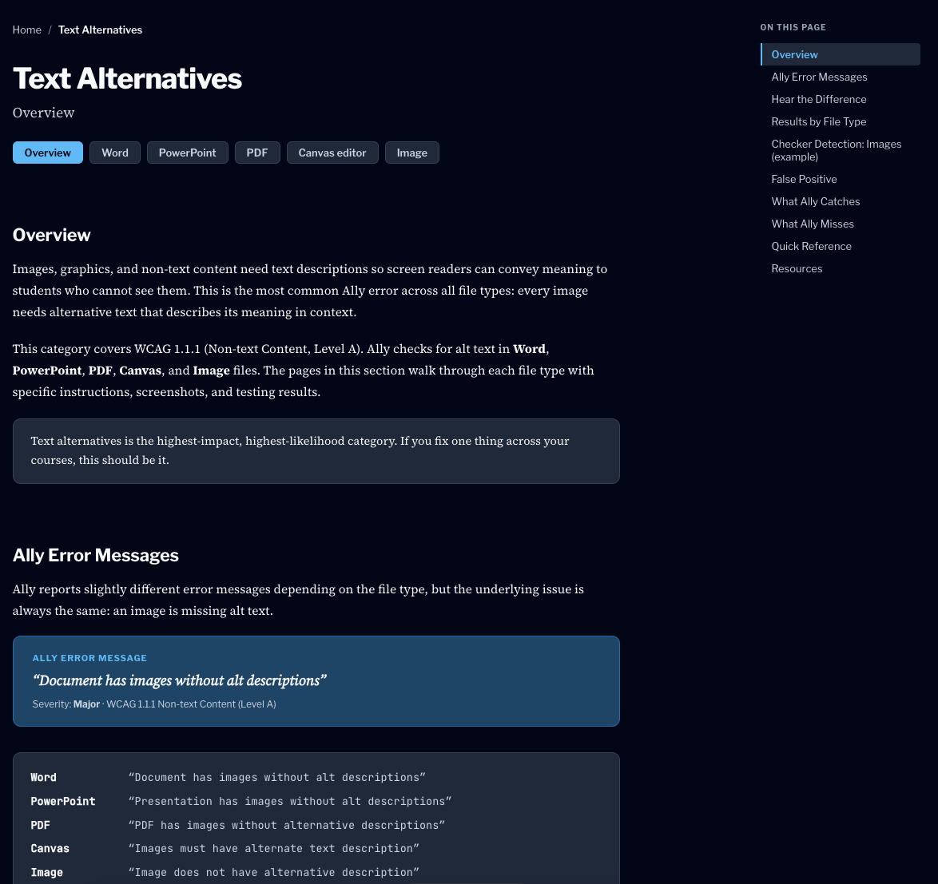
Website reference resource
In addition to this deck, a website is available to you that is a 1:1 match of the content in this workshop complete with:
The sample files
Explanations of the tests
Shortcomings of Ally
Impact on students with disabilities
Example outputs from screen readers
Step-by-step guides on how to fix issues as shown here today

Slide 15
DRAFT – Getting help in real-time
Hopefully, someone can monitor the chat.
You have deck and the website resource as well.

Slide 16
Section three: Scope of the challenge
The scope and limitations of automated testing.

Slide 17
Covered in section three
To come.
What is Ally actually testing?
What is it missing?
What is it getting wrong (false positives)?
Tractibility

Slide 18
What is Ally actually testing?
Content type | Number of tests
Rich content editor | 54
Image files | 4
PDF documents | 14
Word documents | 11
PowerPoint presentations | 8
Total | 91
Source: Anthology help accessibility checklist

Slide 19
What’s missing – alt text use case
Type of test | Ally | MS Office | Acrobat
No text alternative | ✓ | ✓ | ✓
AI-generated text alternative | X | ✓ | X
Should be decorative (divider line) | X | X | X
Vague alt text (2026 sales chart) | X | X | X
Dense alt text (>120 char) | False positive | n/a | n/a
File name as alt text (logo.png) | ✓ | ✓ | X
Gibberish (alskjshdsflh) | X | X | X
Placeholder (image) | X | X | X

Slide 20
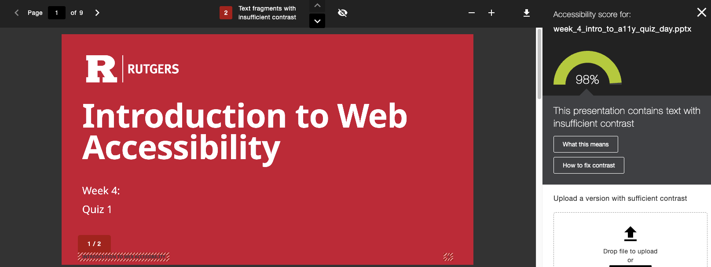
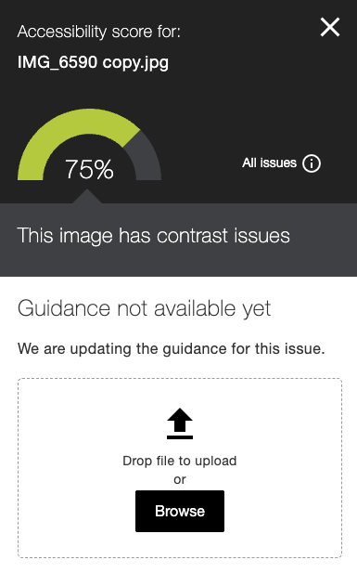
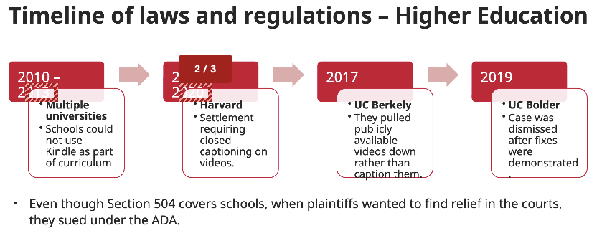
False positives
Image contrast
Contrast checks require information like font size and usage (i.e., text or graphic).
There may be ways to determine those factors, but the tool is NOT doing that today.
This feature is entirely unreliable and these results can largely be ignored.
Text contrast PowerPoint files
Ally is rendering the PPTX files and in that rendering its misinterpreting colors and some text gets wrapped.

Slide 21
Where they exceed expectation
Links

Slide 22
Tractability

Slide 23
Section three: Text alternatives
High likelihood of occurrence, high impact for non-conformance.

Slide 24
Covered in section four
To come.
Overview
Impact to students with disabilities
Forcing errors in Ally (using sample files)
Fixing issues (fixing sample files)

Slide 25
Overview
Concept
Images, graphics, and non-text content need text descriptions so screen readers can convey meaning to students who cannot see them.
Severity and likelihood
High likelihood
High severity
What content gets tested?
Word documents
PowerPoint presentations
PDF documents
Canvas Rich Content Editor (RCE)
Image uploads
Associated WCAG
SC 1.1.1:Non-text Content (Level A)

Slide 26
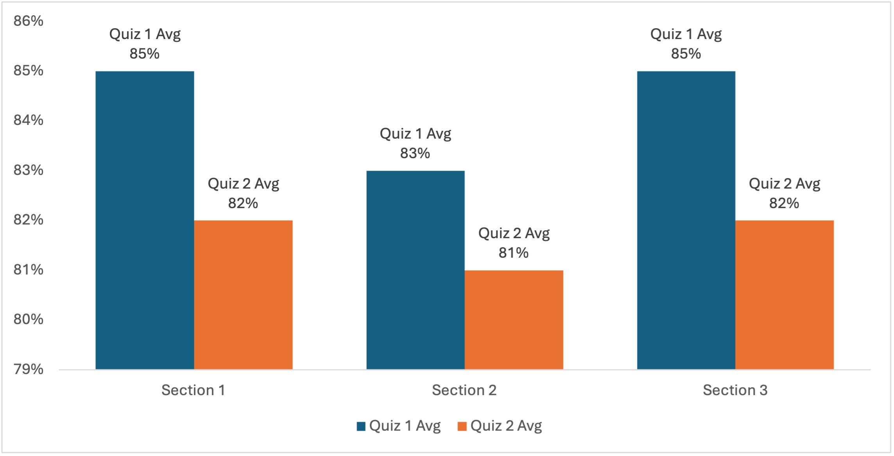

Student impact – alt text
With no alt text
What’s happening – the screen reader reads the file name as there was no text alternative provided.
With good alt text
What’s happening – the screen reader provides full context to the image’s purpose and managing.
Alt text should be
“Grouped bar graph comparing Quiz 1 and Quiz 2 averages across three sections. Section 1: 85% and 82%. Section 2: 83% and 81%. Section 3: 85% and 82%.”

Slide 27
Forcing errors
Type of test | Ally | MS Office | Acrobat
No text alternative | ✓ | ✓ | ✓
AI-generated text alternative | X | ✓ | X
Should be decorative (divider line) | X | X | X
Vague alt text (2026 sales chart) | X | X | X
Dense alt text (>120 char) | False positive | n/a | n/a
File name as alt text (logo.png) | ✓ | ✓ | X
Gibberish (alskjshdsflh) | X | X | X
Placeholder (image) | X | X | X

Slide 28
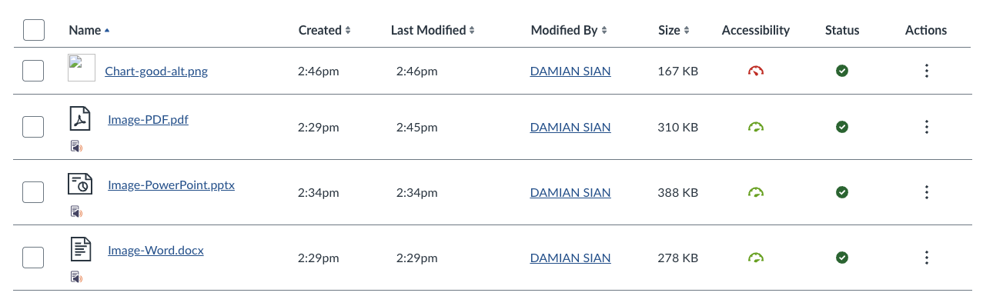
Alt text samples to Canvas Files
Move the alt text samples over to Canvas.
System analyzes files on the fly.
Results show inline next to files, and in the Accessibility Dashboard.
Hover over an icon to see score.

Slide 29
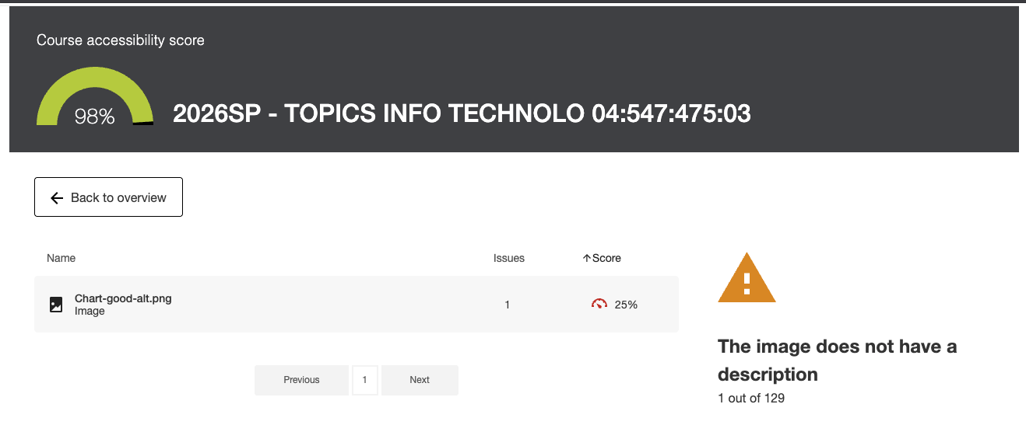
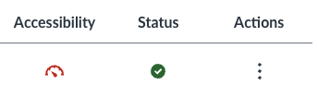
Fix image upload alt text
Fix from either dashboard or Files.
Select the red dashboard icon pointing to low 25%.

Slide 30
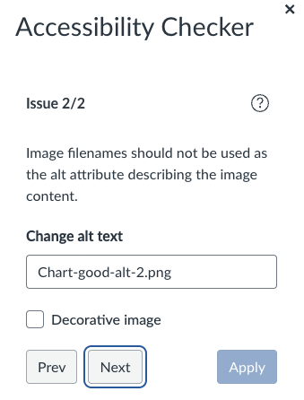
Adding images in Canvas editor
The system will allow you to upload images without alt text unfortunately.
The system will default to using the file name of the image as its alt text.
This will show up on your Accessibility Dashboard impacting your overall score.

Slide 31
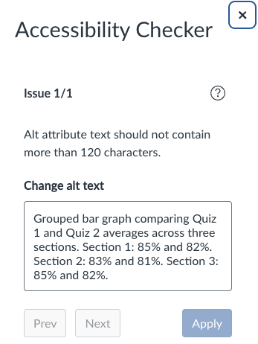
False positive dense alt text
In the Rich Content Editor, Ally will incorrectly state that “Alt attribute text should not contain more than 120 characters.”
This is false and has been noted to Anthology.
This false positive will not appear on your Accessibility Dashboard, only in the editor screen.

Slide 32
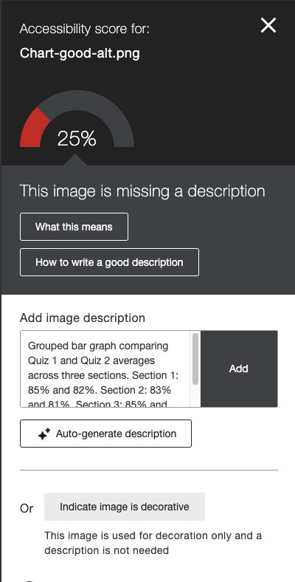
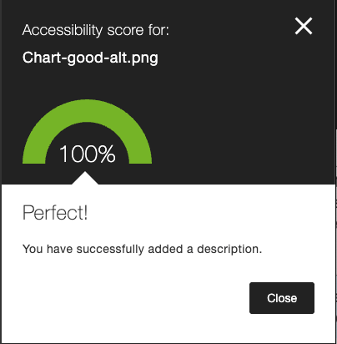
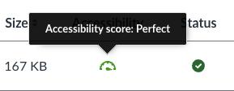
Fix image upload alt text – continued
Use this text:
Grouped bar graph comparing Quiz 1 and Quiz 2 averages across three sections. Section 1: 85% and 82%. Section 2: 83% and 81%. Section 3: 85% and 82%.
Select Add.
Issue is resolved.
Using auto-generate is a good first step, but any text alternative must be human generated or human reviewed/edited.
This image cannot be marked decorative.

Slide 33
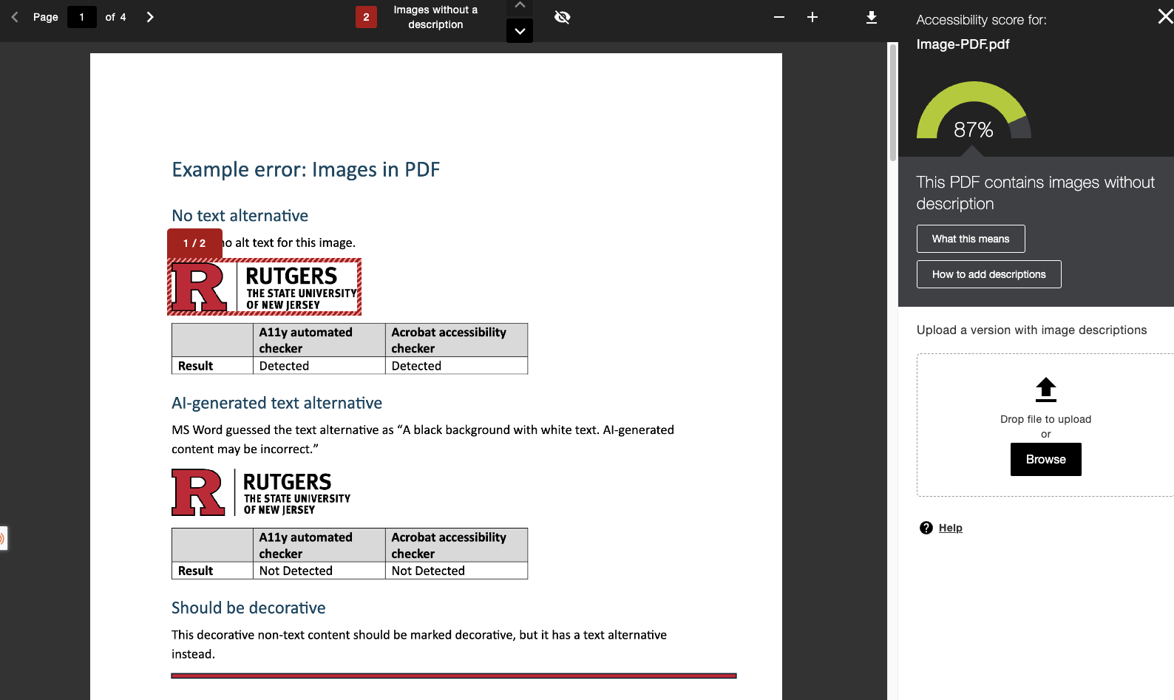
Fix alt text in PDF
Review issue from Files interface or the Accessibility Dashboard.
To fix issue, we will use Acrobat Pro.

Slide 34
Document uploads alt text detection
Same detection will be made in Word, PowerPoint, and PDF documents.
To fix the issues, we’ll need to fix in the documents, and re-upload them.

