Slide 1
OlaFresh website
Scope

Slide 2
Description
Food delivery service
User chooses food by country/region
Allergies/diets are taken into account
Choice based on distance from user address
User can choose delivery time (e.g. ASAP, in two hours,...)
Pay on delivery

Slide 3
Business concepts
Customer/user: the end consumer, the person who will use the services of the website to order food.
Resto owner: the owner of the restaurant (invisible to the customer) who takes care of dish preparation. He has access to functionalities like following the orders, gets alerts when urgent orders (e.g. ASAP delivery) are coming in and can see reviews by customers and propose new dishes to be added to the system.
Admin: This is the superuser access for OlaFresh. They can add new dishes, moderate the comments and replies, see sale statistics.

Slide 4
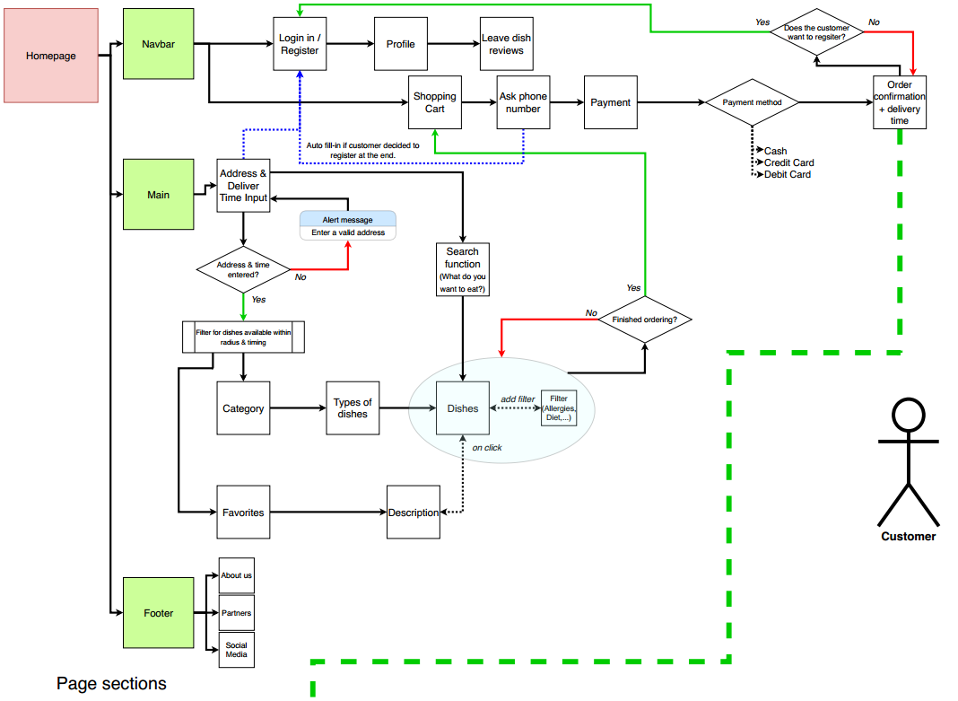

Slide 5
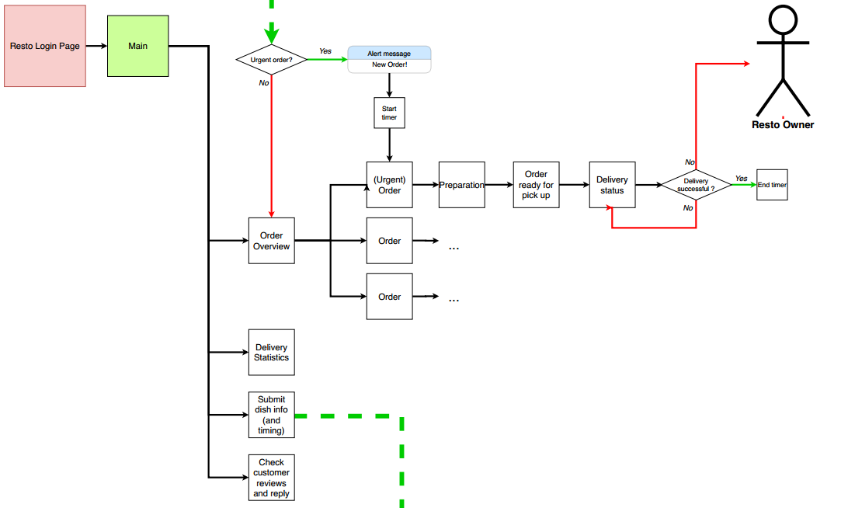

Slide 6
