Slide 1



Strat. Consultancy Project I & Data Analytics
Dr. Damien Dupré
damien.dupre@dcu.ie
Assistant Professor - Business Research Methods

Slide 2
Quantitative vs. Qualitative

Slide 3
Previously, we have seen...
How to transform and subset data with SQL queries
How to transform and visualise data with Excel
How to visualise, model and communicate data with JAMOVI
How to visualise and communicate data with Tableau

Slide 4
Previously, we have seen...
In general, through the lecture we have seen variables:
Made of character strings (usually interpreted as categorical but not always)
Made of numbers (usually interpreted as continuous but not always)

Slide 5
Theory and Hypotheses
Theory: Tentative explanations of facts and relationships in science
Hypothesis:
A prediction based on a theory
Tested to confirm or refute
Can be revised or abandoned
Hypotheses are designed to express relationships between variables.
“Hypothesis statements contain two or more variables that are measurable or potentially measurable and that specify how the variables are related” (Kerlinger, 1986)

Slide 6
Measurement Scales
Questionnaires/survey are made of multiple questions (also called items) related to the same theoretical construct/concept.
A score has to be calculated from all the items to produce the variable to analyse
Average of items (including reversed items)
Factor analysis

Slide 7
Reliability assessment
In order to measure the theoretical constructs/concepts of your model, you will have to select the best measurement scale made of multiple items.
Reliability assessment is performed every time a scale is used (Cronbach's alpha)

Slide 8
Cronbach's alpha in JAMOVI
Factor > Reliability Analysis
Overall correlation between items
Alpha has a value between 0 and 1
If higher than 0.7, items well correlated (they are measuring the same construct)
If lower than 0.7, items not correlated enough (they are measuring different constructs)

Slide 9
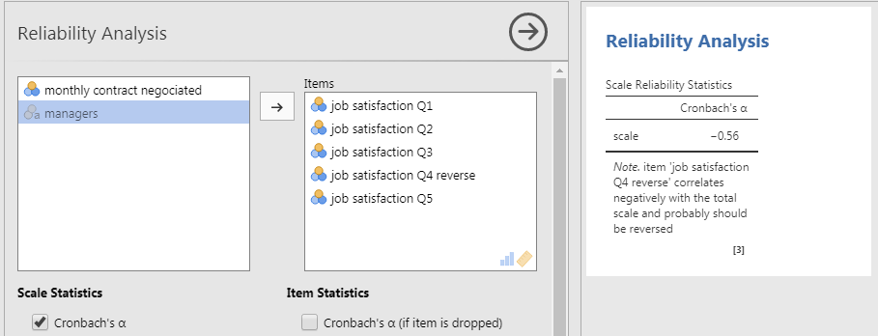
Cronbach's alpha in JAMOVI
Factor > Reliability Analysis
Example: Job Satisfaction Scale

Slide 10
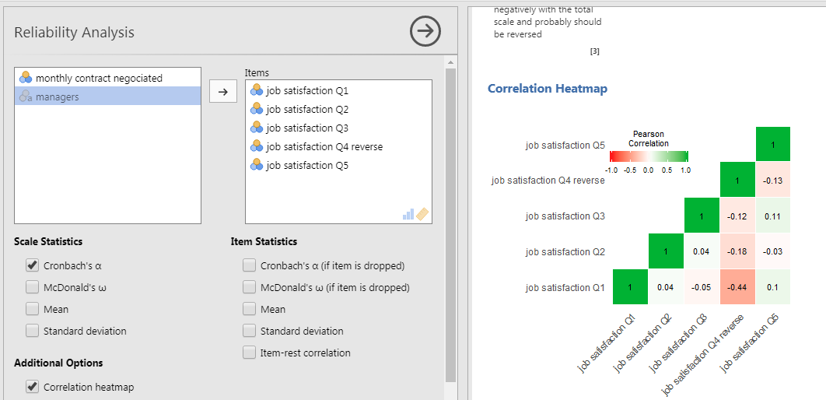
Cronbach's alpha in JAMOVI
If lower than 0.7, there is a problem

Slide 11
Cronbach's alpha in JAMOVI
Solutions:
Have a look at the correlation heatmap
If one item is negatively correlated with the others (values < 0 and red colour), this item is reversed and has to be recoded
Add the negatively correlated item to “Reverse Scaled Item”
Have a look at the Cronbach's alpha if item is dropped

Slide 12
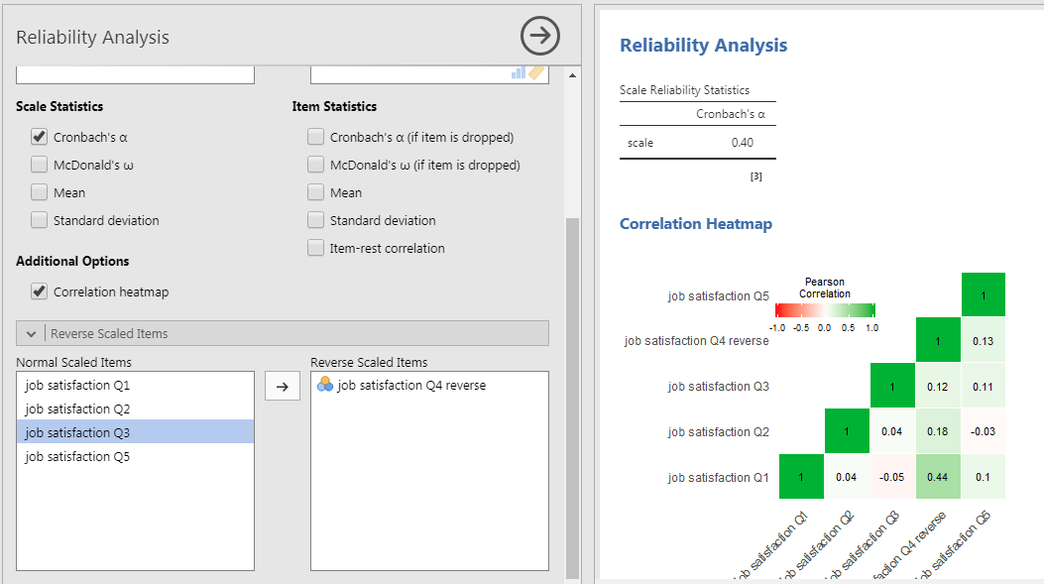
Cronbach's alpha in JAMOVI

Slide 13
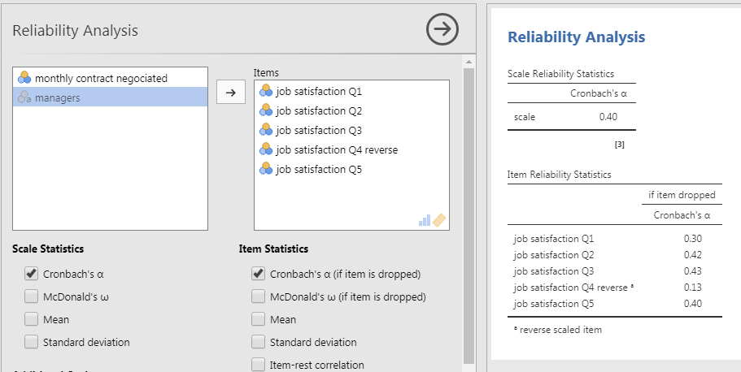
Cronbach's alpha in JAMOVI

Slide 14
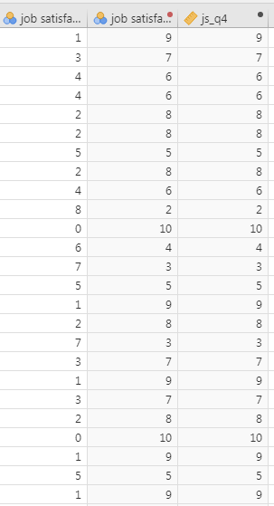
Manually Recode Variable
scale from 0 to 10:
0 becomes 10
1 becomes 9
...
10 becomes 0
Original Transform Compute

Slide 15
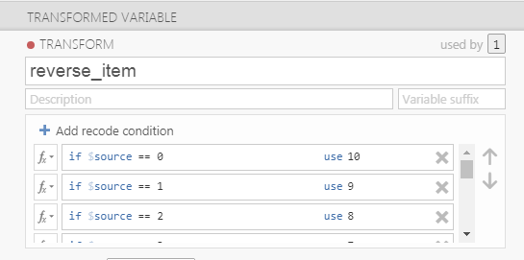
Manually Recode Variable
Manually Recode Variable (scale from 0 to 10):
Data > Transform: edit

Slide 16
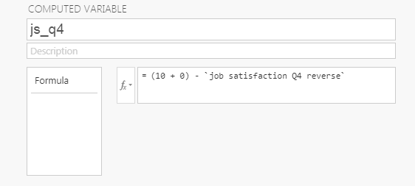
Manually Recode Variable
Manually Recode Variable (scale from 0 to 10):
Data > Compute Variable
= (max scale + min scale) - variable

Slide 17
Test maIN Effect

Slide 18
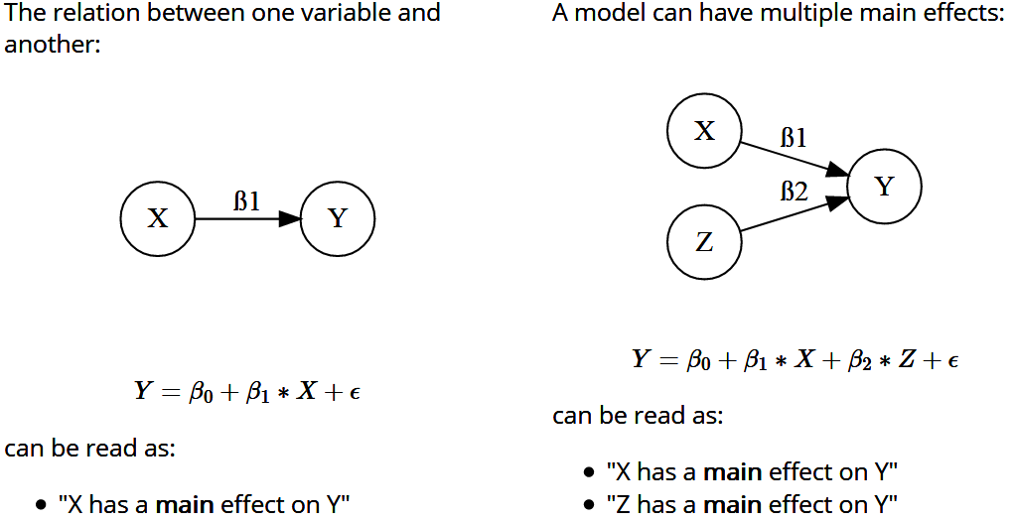
Main Effects

Slide 19
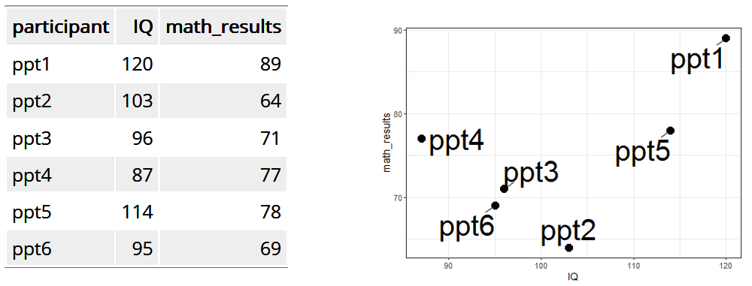
Basic Example
Is there a relationship between Results in Maths and IQ?

Slide 20
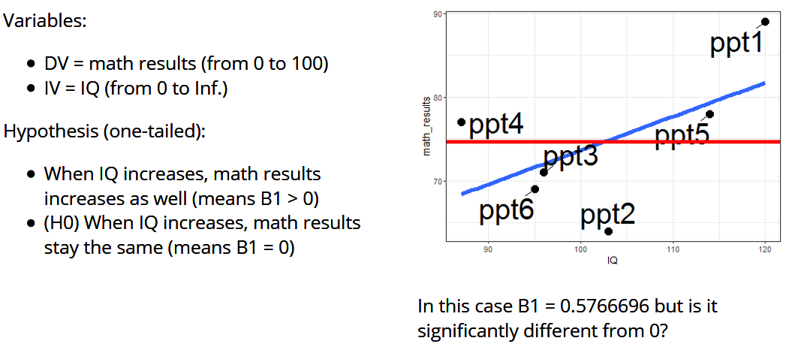
Basic Example

Slide 21
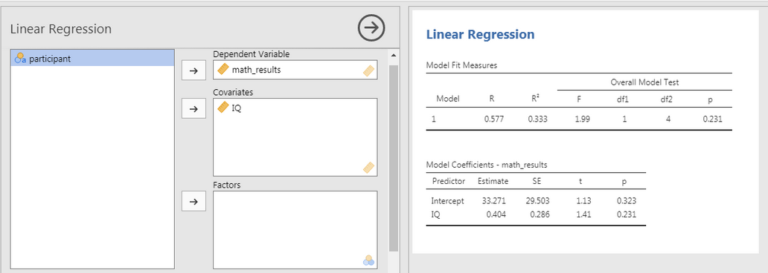
Basic Example
In JAMOVI:
Set variables as continuous
Analyses > Regression: math_results as DV and IQ as Covariates
Model Fit > Overall Model Test: F test

Slide 22
Basic Example
Two tables are shown:
Model Fit Measure evaluates the entire model
Model Coefficient evaluates each parameter one by one

Slide 23
Testing hyp. with categorical IV (2 modalities)

Slide 24
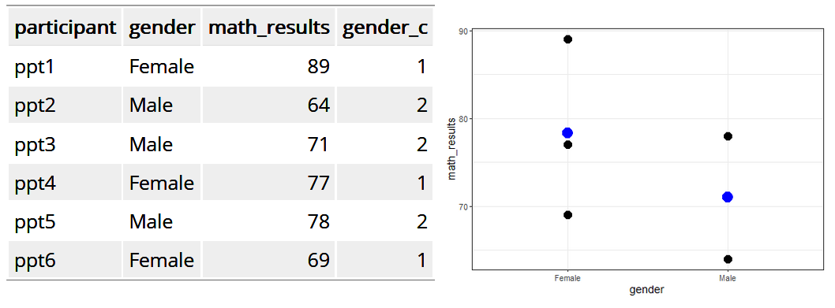
Testing hyp. with categorical IV

Slide 25
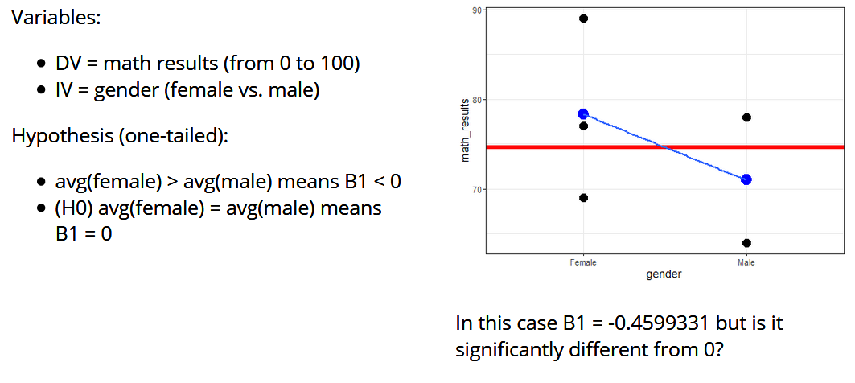
Testing hyp. with categorical IV

Slide 26
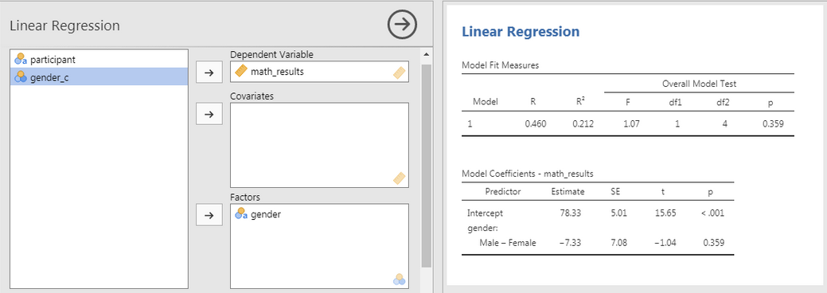
Testing hyp. with categorical IV
In JAMOVI:
Set variables as continuous
Analyses > Regression: math_results as DV and gender as Factors (or gender_c as Covariate)
Model Fit > Overall Model Test: F test

Slide 27
Testing hyp. with categorical IV (3+ modalities)

Slide 28
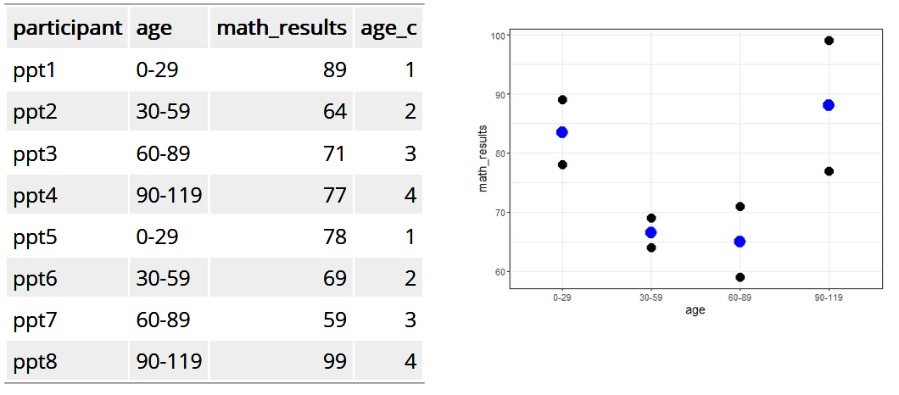
Testing hyp. with categorical IV

Slide 29
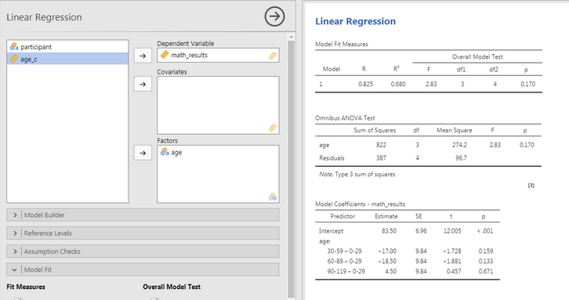
Testing hyp. with categorical IV
In JAMOVI:
Set variables as continuous
Analyses > Regression: math_results as DV and age as Factors
Model Fit > Overall Model Test: F test
Model Coefficient > Omnibus Test: ANOVA test

Slide 30
Testing hyp. with categorical IV
This time, Model Coefficient shows group comparisons of all the groups with a reference group.
Analysing Categorical IV with 3+ modalities is comparing each group with a reference.
To obtain an overall evaluation of all the groups, an ANOVA test is required.

Slide 31
Test Interaction Effect

Slide 32
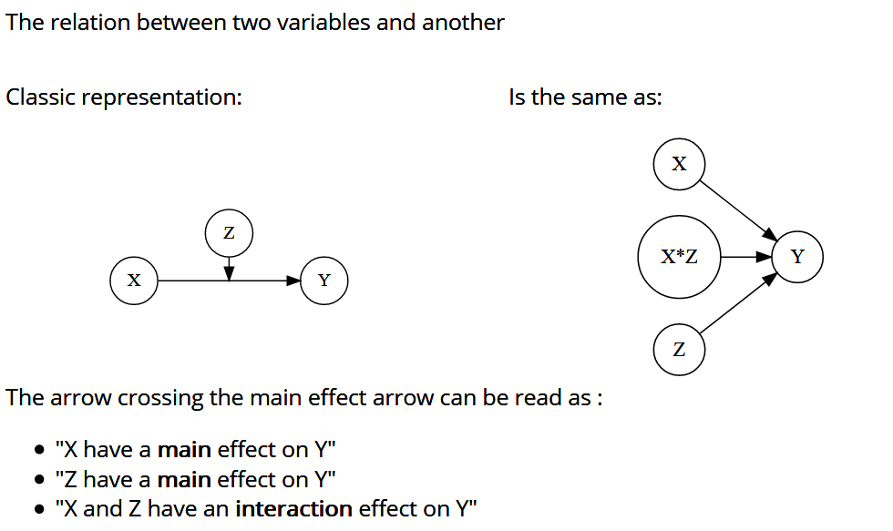
Interaction Effects

Slide 33
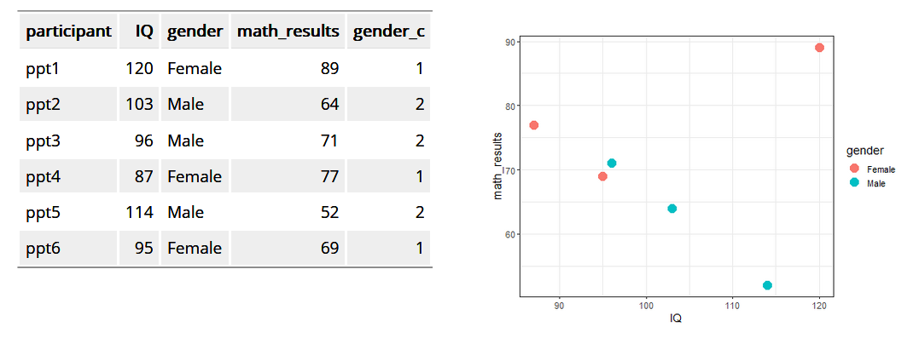
Interaction Effects

Slide 34
Interaction Effects
Hypothesis 1:
When IQ increases, math results increases as well
(H0) When IQ increases, math results stay the same
Hypothesis 2:
math results of males are higher than math results of females
(H0) math results of males are not different to math results of females
Hypothesis 3:
the effect of gender on math results increase when IQ increases
(H0) the effect of gender on math results stay the same when IQ increases

Slide 35
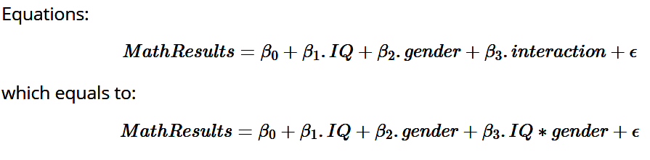
Interaction Effects

Slide 36
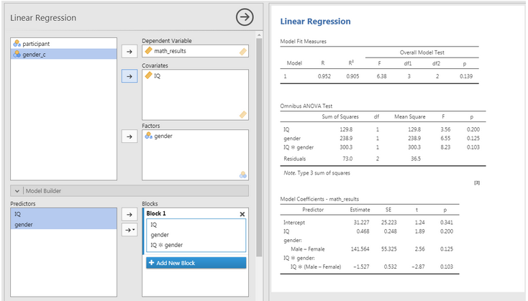
Interaction Effects
In JAMOVI:
Set variables as continuous
Analyses > Regression: math_results as DV, IQ as Covaiates and gender as Factors
Model Fit > Overall Model Test: F test
Model Coefficient > Omnibus Test: ANOVA test
Model Builder: select IQ and gender and pass them on the Blocks

Slide 37
Is Everything about scales?

Slide 38
Qualitative Research
Qualitative Techniques
Interviews
Focus Groups
Observation

Slide 39
Interviews

Slide 40
Interviews
Unstructured
no set agenda, no (or few) prepared questions
Semi-structured
Themes and questions known but questions and order may change depending on flow of interview
Structured
Predetermined standardised questions in consistent sequence

Slide 41
Interview Guide
Formulate
interview
questions
General
research
area
Specific
research
questions
Interview
topics
Associated issues
Who to interview – self selection
Interviewer’s/interviewee’s level of knowledge
Level of information supplied to interviewees
Appropriateness of location
Confidentiality
Recording
Researcher’s appearance – dress code
Approach to questioning – clarity and reducing bias
Use of critical incident technique: ask for examples
Review/revise
Interview questions
Pilot guide
Identify novel
issues
Revise interview
questions
Finalize guide

Slide 42
Kinds of Question
Introducing questions
`Please tell me about when your interest in X first began?'; `Have you ever . . .?'; `Why did you go to . . .?' .
Follow-up questions
getting the interviewee to elaborate his/her answer, such as `Could you say some more about that?'; `What do you mean by that . . .?'; ‘Can you give me an example…?’ even `Yeeees?‘
Probing questions
following up what has been said through direct questioning.
Specifying questions
`What did you do then?'; `How did X react to what you said?‘

Slide 43
Kinds of Question
Direct questions
`Do you find it easy to keep smiling when serving customers?'; `Are you happy with the amount of on-the-job training you have received?' Such questions are perhaps best left until towards the end of the interview, in order not to influence the direction of the interview too much.
Indirect questions
What do most people round here think of the ways that management treats its staff?', perhaps followed up by `Is that the way you feel too?', in order to get at the individual's own view.
Structuring questions
`I would now like to move on to a different topic‘.

Slide 44
Kinds of Question
Silence
allow pauses to signal that you want to give the interviewee the opportunity to reflect and amplify an answer.
Interpreting questions
`Do you mean that your leadership role has had to change from one of encouraging others to a more directive one?'; `Is it fair to say that what you are suggesting is that you don't mind being friendly towards customers most of the time, but when they are unpleasant or demanding you find it more difficult?‘
Leading questions
‘How have your experiences as a teacher affected you as a parent?’; ‘Did you believe that the recent lay-offs in your department were unnecessary?’ To be avoided

Slide 45
Criteria for Successful Interviewers
Knowledgeable: thoroughly familiar with the focus of the interview; pilot interviews are useful here.
Structuring: gives purpose for interview; rounds it off; asks whether interviewee has questions.
Clear: asks simple, easy, short questions; no jargon.
Gentle: lets people finish; gives them time to think; tolerates pauses.
Sensitive: listens attentively to what is said and how it is said; is empathetic in dealing with the interviewee.

Slide 46
Criteria for Successful Interviewers
Critical: is prepared to challenge what is said, for example, dealing with inconsistencies in interviewees' replies.
Remembering: relates what is said to what has previously been said.
Interpreting: clarifies and extends meanings of interviewees' statements, but without imposing meaning on them.
Balanced: does not talk too much, which may make the interviewee passive, and does not talk too little, which may result in the interviewee feeling he or she is not talking along the right lines.

Slide 47
FOCUS GROUPS

Slide 48
What Is the Focus Group Method?
The focus group method is a form of group research where:
There are several participants (in addition to the moderator/ facilitator)
There is an emphasis on questioning on a particular, fairly tightly defined topic
Emphasis on interaction within the group and the joint construction of meaning

Slide 49
Size of Groups
Typical group size is six to ten
More than eight difficult to manage
It is almost impossible to control for `no-shows' other than by consciously over-recruiting
Larger groups make it more difficult to stimulate discussion especially if people are reluctant to talk about a topic or have little experience of it

Slide 50
An Example of a Focus Group Agenda
Introduction (15 min)
Introduce yourself, the research and roles
Aim and format of the focus group
Conventions (confidentiality, speak one at a time, recordings, everybody’s views
Personal introduction of participants and their businesses
Introduce the first topic
Discussion Topics
Current trading climate (15 min)
Main challenges in the business environment (20 min)
Government policies and small firms (20 min)
Topical issues (20 min)

Slide 51
Focus Groups
Pros
Are flexible
Provide insights into people’s shared understandings of everyday life
The synergistic group effect
Candour of participants
Timing and cost
Cons
Difficult to organise
Researcher’s control is limited
Transcription of discussions can be difficult
Data difficult to analyse
Not always appropriate for participants

Slide 52
Analysing QUALITATIVE DATA

Slide 53
Working with interviews
Create questions according to hypotheses
Identify and recruit representative participants
Interview audio recording
Transcription
(speech to text)
Define Coding Scheme
Analyse Interview according to the coding scheme

Slide 54
Thematic Analysis
“working with data, organizing it, breaking it into manageable units, synthesising it, searching for patterns, discovering what is important and what is to be learned, and deciding what you will tell others.” (Bogdan and Biklen, 1982)
Objective
To determine the categories, relationships & assumptions that underpin respondents’ views of the world in general & of the subject matter of interest in particular

Slide 55
Coding Scheme
Codes are tags or categories attached to words, phrases, sentences or paragraphs connected to a category/theme.
Method of organising and structuring data according to issues and topics identified by research participants as being important to understanding the phenomenon of interest

Slide 56
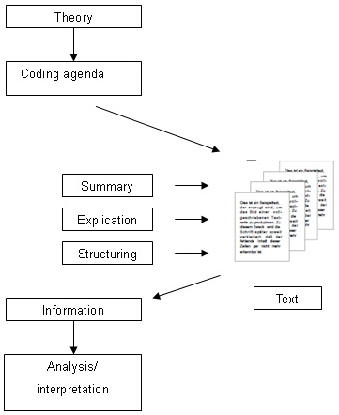
Coding Scheme

Slide 57
Coding Scheme
Code as soon as possible
Read through your initial set of transcripts
Do it again and create list of codes
Review and refine your codes
Consider more general theoretical ideas in relation to codes and data
Any one item or slice of data can and often should be coded in more than one way
Do not worry about generating what seem to be too many codes

Slide 58
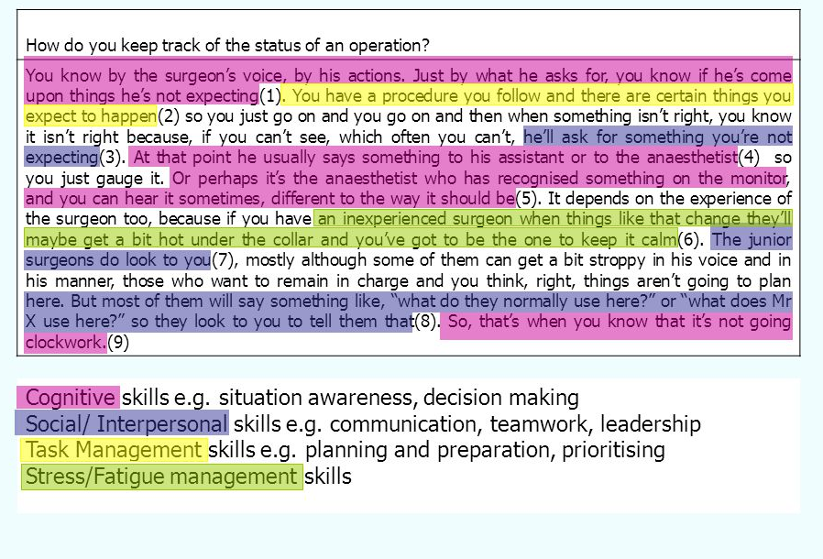
Coding Example

Slide 59
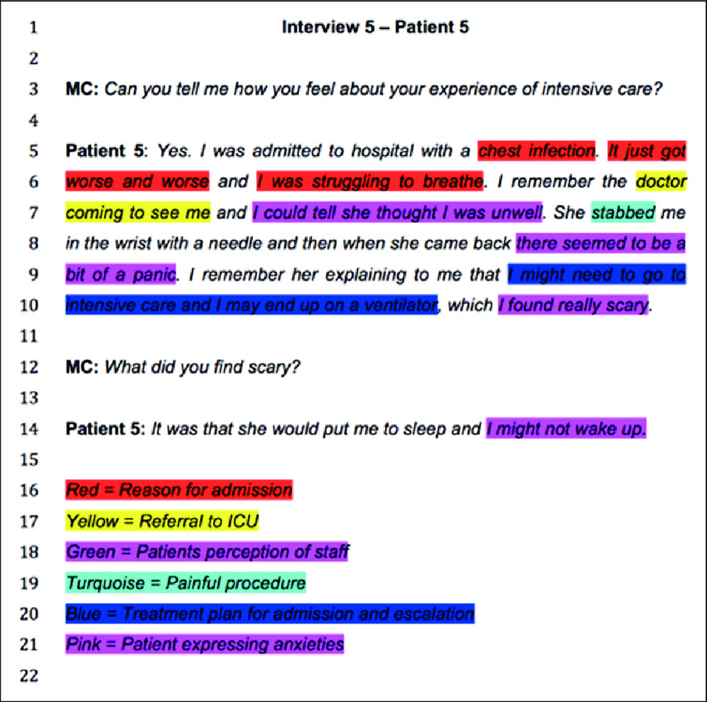
Coding Example

Slide 60
Interview analysis Example

Slide 61
Interview Analysis Example
Topic: Cultural engagement in a complex business environment

Slide 62
Interview Analysis Example
Categories | Questions
Briefing | Thank him/her for participation, introduce myself (name and profession), define the situation for the interviewee (confidentiality, recording, about 50 minutes, plus a short discussion afterwards), briefly state the purpose of the interview, and asking if the interviewee has any questions before the interview
Introduction | Can you tell me a bit about yourself, and your area of responsibility at Radiometer?
Internal complexity
Complexity 1 | How often do you find yourself in cross-cultural encounters?
Complexity 2 | In your experience, how might culture play a role when we talk about solving tasks? Could you give an example?
Intercultural Engagement
IE 1 | How do you feel about engaging in cross-cultural collaborations?
IE 2 | Can you describe a meeting with someone different from you that turned out just the way you wanted to?
Briefing | Are there any more things you would like to say before we end the interview? May I contact you, if further questions should arise? Thank you for your cooperation.

Slide 63
Internal complexity
Intercultural Engagement
Q: If you look at Radiometer as a whole, […] which role does culture play at Radiometer?
A: I don’t know how it was in the past, but I mean that Danaher culture is something that is very very much alive, very much focused on [hmhm], very much .. this is the right way this is ..ja very much sort of implies what is the wrong way [hmhm].There is a lot of that. In Danaher we think that, in Danaher we should do [hmhm], according to Danaher this is the way [hmhm] so there’s a lot of [hmhm] Danaher tools, Danaher thinking, Danaher compliance that is pulled into [hmhm] the system and that’s a lot of you know: Kaizen is the way of living or of our life. [hmhm] But you also have 11 uhm ..managerial roles […]
A: I think it’s an very American cultural thing you know [hmhm] where you .. you need to have you need to be part of the community [hmhm] but you can be very much yourself [hmhm] [ja] but you need to act within the frame of the community [ja] but then you can do whatever you like [hmhm] and how you [hmhm] how you do your own thinking [hmhm] where it’s sort of like ja many other cultural thinking is sort of like if you want to be living in France you need to French, talk the language, think the way all uhm … [hmhm] all the stuff there. [hmhm] I think it’s sort of the very American way of embracing every culture but we have some … [certain] ja some certain base [ja] that uhm trusting the constitution [Q starts to laugh] and all that stuff. You need to believe in this, but how you do it is very much up to yourself. [hmhm].

Slide 64
Internal complexity
Intercultural Engagement
Q: If you look at Radiometer as a whole, […] which role does culture play at Radiometer?
A: I don’t know how it was in the past, but I mean that Danaher culture is something that is very very much alive, very much focused on [hmhm], very much .. this is the right way this is ..ja very much sort of implies what is the wrong way [hmhm].There is a lot of that. In Danaher we think that, in Danaher we should do [hmhm], according to Danaher this is the way [hmhm] so there’s a lot of [hmhm] Danaher tools, Danaher thinking, Danaher compliance that is pulled into [hmhm] the system and that’s a lot of you know: Kaizen is the way of living or of our life. [hmhm] But you also have 11 uhm ..managerial roles […]
A: I think it’s an very American cultural thing you know [hmhm] where you .. you need to have you need to be part of the community [hmhm] but you can be very much yourself [hmhm] [ja] but you need to act within the frame of the community [ja] but then you can do whatever you like [hmhm] and how you [hmhm] how you do your own thinking [hmhm] where it’s sort of like ja many other cultural thinking is sort of like if you want to be living in France you need to French, talk the language, think the way all uhm … [hmhm] all the stuff there. [hmhm] I think it’s sort of the very American way of embracing every culture but we have some … [certain] ja some certain base [ja] that uhm trusting the constitution [Q starts to laugh] and all that stuff. You need to believe in this, but how you do it is very much up to yourself. [hmhm].

Slide 65
Internal complexity
Intercultural Engagement
Q: Now, if you think about your daily work [rearranging himself on the chair] which role does culture play? If any?
A: What role culture plays? [ja] [3 sec silence] Big question .. [Short exhale] everything and nothing. [hmhm] Uhm … culture is the .. the kit that kind of holds everything together or [hmhm] maybe it’s the foundation [hmhm] … if .. if I think about a job interview for example [ja] one of my checkpoints is, is this a potential cultural fit or misfit [hmhm]. You can, you can instantly see if someone .. or you cannot instantly see, but you can after a while [ja] you can have a feeling if if [ja] this is going to be a cultural fit. [ja] Assessed by historical facts of course this person has done something similar then it’s in the right environment [hmhm]. If this is someone that comes from a very uhm entrepreneur [hmhm] uhm environment [ja], it could be difficult to be in a lean company [ja] where things are not going as fast and [clicks 4 times with his fingers to indicate the pace] [hmhm] as other companies [hmhm]. So, we are we are in in a very lean company and and [ja] very process driven and [hmhm] we don’t take a lot of chances, so if if [hmhm] if it’s someone that is [hmhm] … really happy about taking risks [ja] and moving fast [ja], it could be [ja] a cultural misfit [hmhm]. So, that’s one of the things that’s really required if you want to be uhm .. happy in a job that you can fit into the culture or [ja] or you can have a job where the culture meets, the culture’s not …. the same [hmhm] in all departments [hmhm] that’s obvious. If you go to the production facilities [hmhm], they have a different subculture. They don’t uhm … I think it’s safe to say that they don’t love Danaher the way that other people do [hmhm]. We have these uhm yearly uhm surveys [hmhm] and uhm last time we did it I remember that some of these, especially [?09:51] came back with their question book or answer book and gave it to me and said: That question there is so stupid. [Q slight laugh] Why do I have to answer if I’m proud to work at Danaher? [hmhm] They don’t [ja] have a relationship [ja] to Danaher at all. [ja] They have a relationship to the production facilities and their colleagues [ja] and [ja] that’s [ja] that’s their their home turf [yes].

Slide 66
Internal complexity
Intercultural Engagement
Q: Now, if you think about your daily work [rearranging himself on the chair] which role does culture play? If any?
A: What role culture plays? [ja] [3 sec silence] Big question .. [Short exhale] everything and nothing. [hmhm] Uhm … culture is the .. the kit that kind of holds everything together or [hmhm] maybe it’s the foundation [hmhm] … if .. if I think about a job interview for example [ja] one of my checkpoints is, is this a potential cultural fit or misfit [hmhm]. You can, you can instantly see if someone .. or you cannot instantly see, but you can after a while [ja] you can have a feeling if if [ja] this is going to be a cultural fit. [ja] Assessed by historical facts of course this person has done something similar then it’s in the right environment [hmhm]. If this is someone that comes from a very uhm entrepreneur [hmhm] uhm environment [ja], it could be difficult to be in a lean company [ja] where things are not going as fast and [clicks 4 times with his fingers to indicate the pace] [hmhm] as other companies [hmhm]. So, we are we are in in a very lean company and and [ja] very process driven and [hmhm] we don’t take a lot of chances, so if if [hmhm] if it’s someone that is [hmhm] … really happy about taking risks [ja] and moving fast [ja], it could be [ja] a cultural misfit [hmhm]. So, that’s one of the things that’s really required if you want to be uhm .. happy in a job that you can fit into the culture or [ja] or you can have a job where the culture meets, the culture’s not …. the same [hmhm] in all departments [hmhm] that’s obvious. If you go to the production facilities [hmhm], they have a different subculture. They don’t uhm … I think it’s safe to say that they don’t love Danaher the way that other people do [hmhm]. We have these uhm yearly uhm surveys [hmhm] and uhm last time we did it I remember that some of these, especially [?09:51] came back with their question book or answer book and gave it to me and said: That question there is so stupid. [Q slight laugh] Why do I have to answer if I’m proud to work at Danaher? [hmhm] They don’t [ja] have a relationship [ja] to Danaher at all. [ja] They have a relationship to the production facilities and their colleagues [ja] and [ja] that’s [ja] that’s their their home turf [yes].

Slide 67
Internal complexity
Intercultural Engagement
Q: how .. on which levels – I know you named some – on which levels does culture play a role .. when we just talk solving tasks?
A: Could you give me an example what you mean?
Q: For example, I mean, you had that example with the meeting that things have a different structure [hmhm] for example it works differently, so even you [hmhm] just sit together and you want to solve a task and maybe talk about whatever product [hm] how to market it, culture plays a role, because expect, you expect it to .. you expected things to work differently than they actually did [hmhm] [There is Uhm ..] do you have an example like this?
A: [3 sec break] Uhm [5 sec break] no, that is probably the biggest one from my business [hm] organizational perspective [hmhm] Uhm …. [deep breath] there are a number of things, people wouldn’t do.[19:38]... I think the biggest example is … [hm] If you grow up in a society then [hm] you learn everything [hm], as somebody coming in hasn’t learned what’s normal in society [ja] so, and there are things that people forget they need to explain [hm]. When I arrived Uhm I came from a culture where unionism was for working class factory people [ja] Uhm [clearing his throat] unionism was Uhm frowned upon, was considered Uhm causing problems in industry [ja, ja] very few people belonged to unions unless you’re eh very uneducated [ja] and needed [ja] other people help you not be exploited [hmhm]. So, Uhm coming here, everybody’s in unions [Q: starts giggling] Probably the Queen’s in a union. [That might be] [Q: now laughing] but the whole idea of unions and ‘forening’ [yes] is this ‘fagforening’ og just ‘foreninger’ the groups [hm] EVERYTHING is in groups [hm] and it’s part that is deep rooted in the culture [hmhm]. The whole idea of .. it says the same, ‘fagforening’ is the Danish word the translation for ‘union’ [ja]. But then there is ‘haveforeningen’ and that’s just a ‘garden club’ [ja]. So, a club the same word for club and Uhm [ja] just any kind of group [hmhm] and a union [hmhm] that shows you how deeply rooted in the culture it is that everyone belongs to groups [ja, that’s an interesting point].

Slide 68
Internal complexity
Intercultural Engagement
Q: how .. on which levels – I know you named some – on which levels does culture play a role .. when we just talk solving tasks?
A: Could you give me an example what you mean?
Q: For example, I mean, you had that example with the meeting that things have a different structure [hmhm] for example it works differently, so even you [hmhm] just sit together and you want to solve a task and maybe talk about whatever product [hm] how to market it, culture plays a role, because expect, you expect it to .. you expected things to work differently than they actually did [hmhm] [There is Uhm ..] do you have an example like this?
A: [3 sec break] Uhm [5 sec break] no, that is probably the biggest one from my business [hm] organizational perspective [hmhm] Uhm …. [deep breath] there are a number of things, people wouldn’t do.[19:38]... I think the biggest example is … [hm] If you grow up in a society then [hm] you learn everything [hm], as somebody coming in hasn’t learned what’s normal in society [ja] so, and there are things that people forget they need to explain [hm]. When I arrived Uhm I came from a culture where unionism was for working class factory people [ja] Uhm [clearing his throat] unionism was Uhm frowned upon, was considered Uhm causing problems in industry [ja, ja] very few people belonged to unions unless you’re eh very uneducated [ja] and needed [ja] other people help you not be exploited [hmhm]. So, Uhm coming here, everybody’s in unions [Q: starts giggling] Probably the Queen’s in a union. [That might be] [Q: now laughing] but the whole idea of unions and ‘forening’ [yes] is this ‘fagforening’ og just ‘foreninger’ the groups [hm] EVERYTHING is in groups [hm] and it’s part that is deep rooted in the culture [hmhm]. The whole idea of .. it says the same, ‘fagforening’ is the Danish word the translation for ‘union’ [ja]. But then there is ‘haveforeningen’ and that’s just a ‘garden club’ [ja]. So, a club the same word for club and Uhm [ja] just any kind of group [hmhm] and a union [hmhm] that shows you how deeply rooted in the culture it is that everyone belongs to groups [ja, that’s an interesting point].

Slide 69
Qualitative Analysis Software

Slide 70
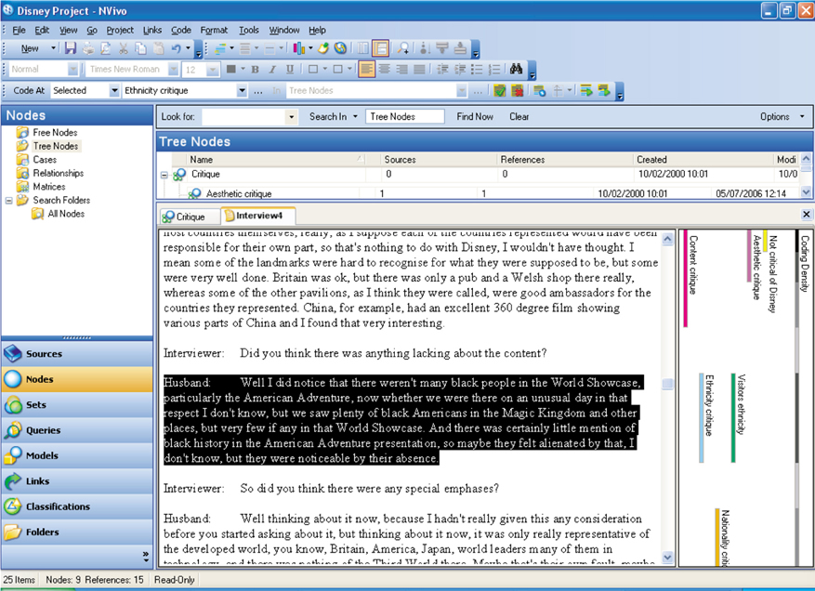
NVivo (not free)

Slide 71
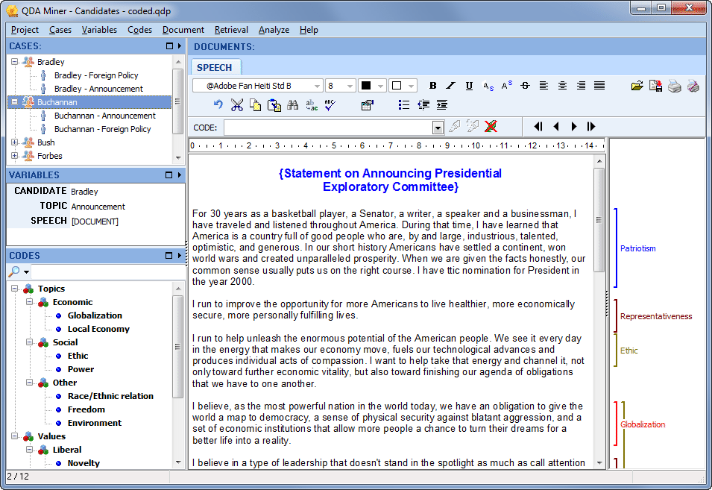
QDA Miner (free version)

Slide 72
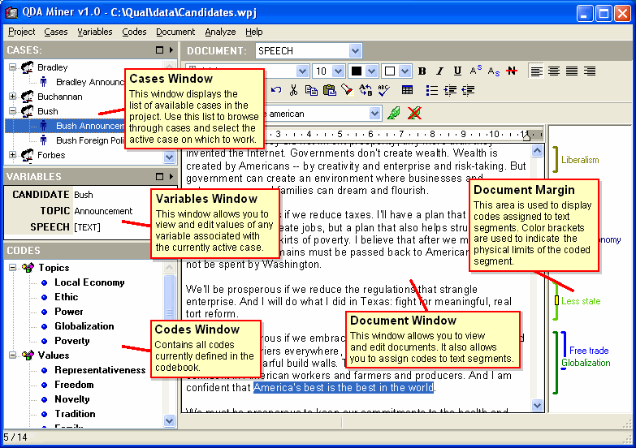
QDA Miner (free version)

Slide 73

Questions?

