Slide 1



Strat. Consultancy Project I & Data Analytics
MT5125 | MSc in Business Administration | 2020/2021
Dr. Damien Dupré
damien.dupre@dcu.ie
Assistant Professor - Business Research Methods

Slide 2
0. Introduction

Slide 3


Module Contact Details
Strategic Consultancy Project I
Dr. John Loonam john.loonam@dcu.ie
Data Analytics
Dr. Damien Dupré
damien.dupre@dcu.ie

Slide 4
About Me
Development of the DynEmo Facial Expression Database (Master)
Dynamic and spontaneous emotions
Assessed with self-reports and by observers
Analysis of Emotional User Experience of Innovative Tech. (Industrial PhD)
Understand users' acceptance of technologies from their emotional response
Based on multivariate self-reports
Evaluation of Emotions from Facial and Physiological Measures (Industrial PostDoc)
Applications to marketing, sports and automotive industries
Dynamic changes with trend extraction techniques (2 patents)
Performance Prediction using Machine Learning (Academic PostDoc)
Application to sport analytics
Big Data treatment (> 1 million users with activities recorded in the past 5 years)

Slide 5
Module Content
Introduction to Data Analytics (DD)
Growth of Big Data: Data Analytics for Business & Management Decision Making
Research Design (DD & JL)
Introduction to qualitative and quantitative research methods and skills
Writing a Research Proposal (JL)
Role of literature review; identifying a research question; making contributions to theory and practice

Slide 6
Module Content
Data Analysis Workshops (DD)
Qualitative/Quantitative data analysis
Data Interpretation (DD & JL)
Interpreting qualitative and quantitative data; data visualisation & reports
Group Presentations (JL)
Research Proposals; Feedback

Slide 7
Assessment Structure
100% Continuous divided in:
Strategic Consultancy Project (30%)
Group Assessment:
Presentation on Research Proposals (10%)
Written Research Proposal (20%)
Data Analytics (70%)
Individual Assessment: Data Analytic Report

Slide 8


Public
Sinead
Product Manager in a Multinational Company
Knowledge of Statistics from Previous Master Degree
Patrick
Business Development Manager in an Irish Unicorn
Master Microsoft Excel
They common aim: Scale up to understand and challenge analyses from their data team

Slide 9
Target
Skills & Knowledge
Short and Mid Term
Success in MT5125
Success in other MBA Modules
Data Analyst Expertise
Long Term

Slide 10
Learning Outcomes
Have insight into the concepts and role of big data and data analytics in business and in management decision making
Understand, evaluate and apply qualitative and quantitative research methods tools and techniques
Understand and interpret data visualisation outputs and analytics reports

Slide 11
Data Analytics Plan
Thur. 28/10/20 (2h)
Introduction, Data Storage and Access
Thur. 05/11/20 (2h)
Data Cleaning and Transformations
Sat. 12/12/20 (7h)
Descriptive Analytics and Interactive Dashboards
Sat. 27/02/21 (7h)
Inferential Statistics and Hypothesis Testing
Thur. 11/03/21 (2h)
Communication of Results

Slide 12
Data Analytic Assessment
Write-up a report fully documenting the results of a systematic quantitative analysis of a dataset (send to you by email in January)
This will require the use of a statistical software (SPSS, JAMOVI, ...)

Slide 13
Data Analytic Assessment
You will illustrate your understanding about the full quantitative analysis process including
running descriptive statistics, including tables and graphics
assessing multi-item scale internal reliability (Cronbach’s alpha)
using bivariate and multivariate inferential statistics

Slide 14
Assessment Deadline
Individual Assignments should be submitted to loop no later than June 21st 2021 by 12pm.
Individual assignment is to be submitted via MT5125’s Loop page.
Late assignments are not allowed

Slide 15
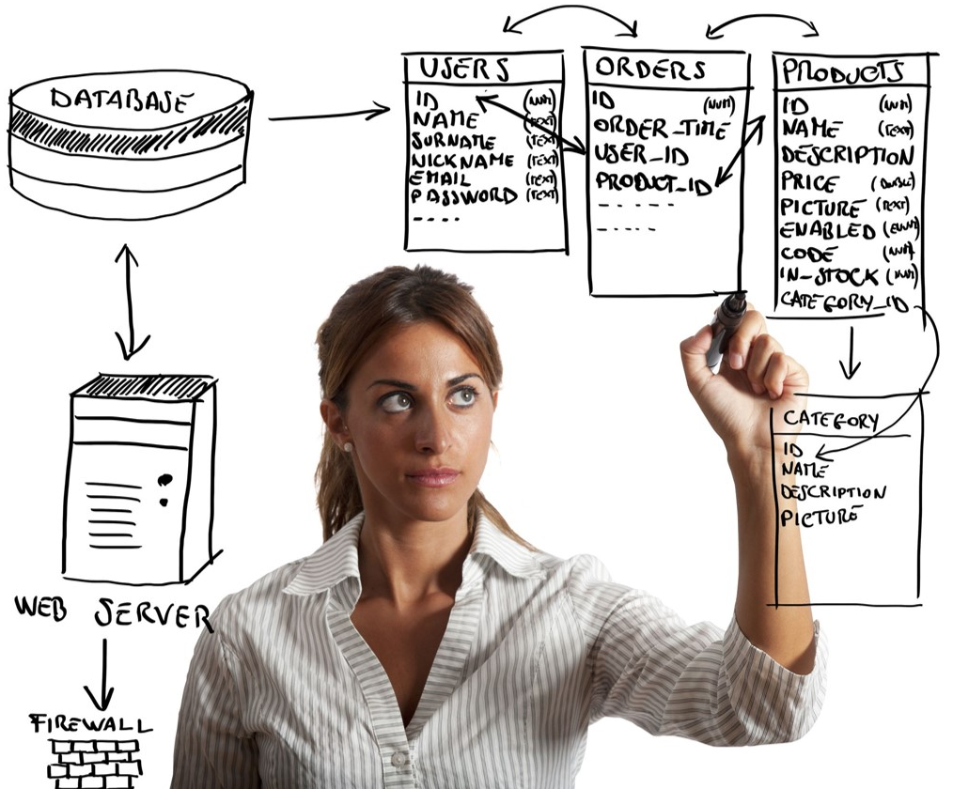
Questions?

