Slide 1



Multifidelity Finite Basis Physics Informed Neural Networks
By Damien Beecroft, Amanda Howard, & Panos Stinis

Slide 2

Introduction to Pinns
Suppose we want to solve a differential equation of the form
${u(t,x)}_{t}+N\left[u(t,x)\right]=0$for $x∈Ω,t∈\left[0,T\right]$,
$B[u\left(t,x\right)]=0$ for $x∈∂Ω$,
and $u\left(0,x\right)=u_{0}\left(x\right)$.
Here, $N$ and $B$ are placeholders for two differential operators.
Notes:
Physics informed neural networks (PINNs) learn the solution to a differential equation for one set of initial and boundary conditions.

Slide 3
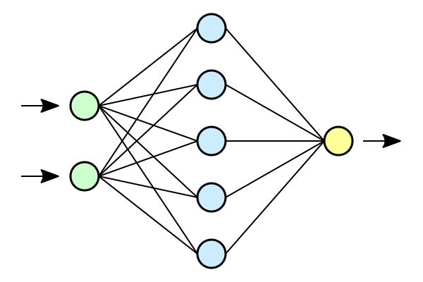










Introduction to Pinns
$$h$$
$$|h|$$
$$u\left(0,x\right)−u_{0}(x)$$
$$x$$
$$u$$
$$B[u(t,∂Ω)]$$
$$L$$
$$t$$
$${u(t,Ω)}_{t}−N[u(t,Ω)]$$
$$h←h − ε∇L$$

Slide 4
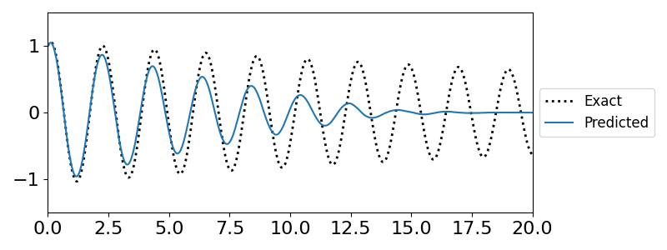
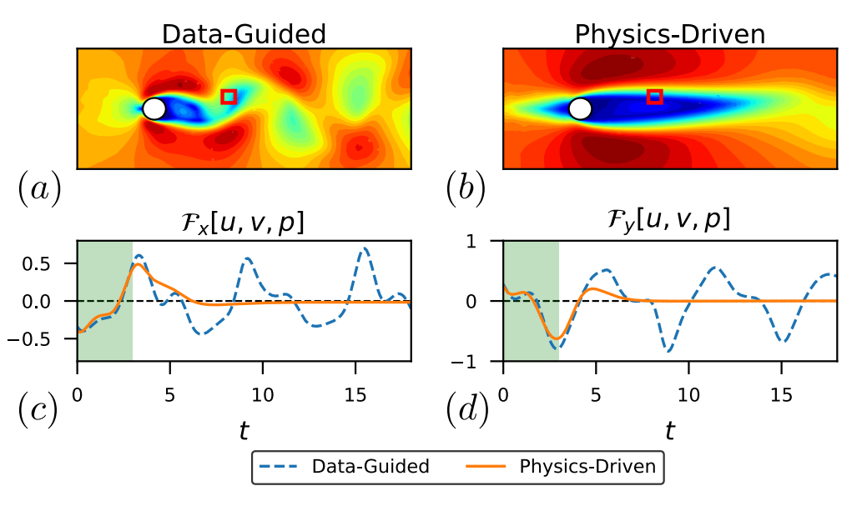
Challenges in training PInns
Difficulty representing high frequency solutions
Erroneous convergence to steady state solutions
Cite Fixed points in PINNs
Notes:
May want to find a prettier example
High frequency problems (cite spectral bias)
Converging to erroneous fixed points (cite fixed point paper)
PINNs have trouble converging to both high frequency solutions. What is more, they have a strong bias towards converging to non-physical fixed point solutions. These problems are related. The weights and biases of the network need to change significantly in order to capture the behavior of highly oscillatory solutions. Erroneous fixed point solutions are attractive because, despite violating the initial and boundary conditions, they inherently satisfy all other physical constraints.

Slide 5
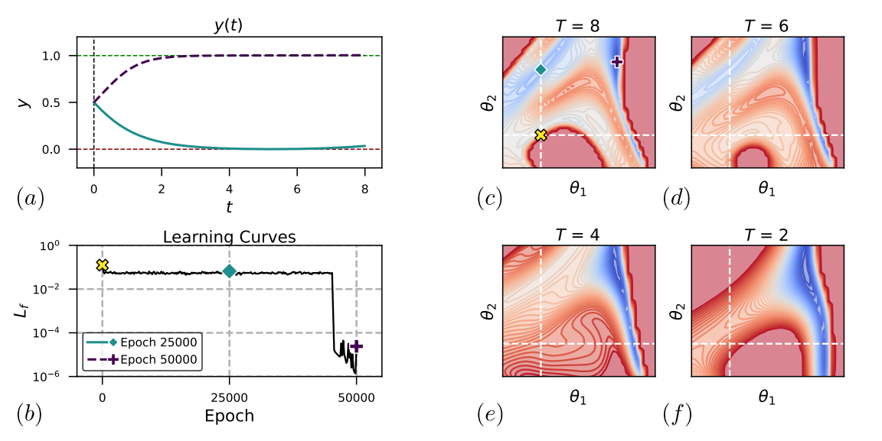
Why does this occur?
Non-physical fixed points can create saddle points or even local optima in the loss function
Cite Fixed points in PINNs
Notes:
- Neural networks are encouraged to find minimum norm solutions
- Satisfying one constraint may mean violating another

Slide 6
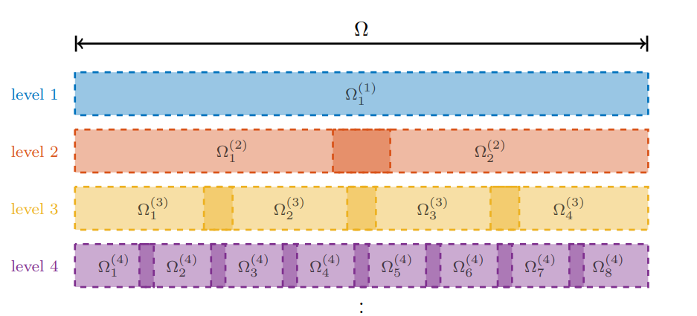
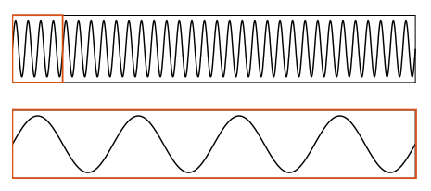
Finite Basis PINNs
Iteratively discretize the solution domain
Define a PINN on each subdomain
Define weight functions for each PINN that sum to one globally and have compact support

Slide 7
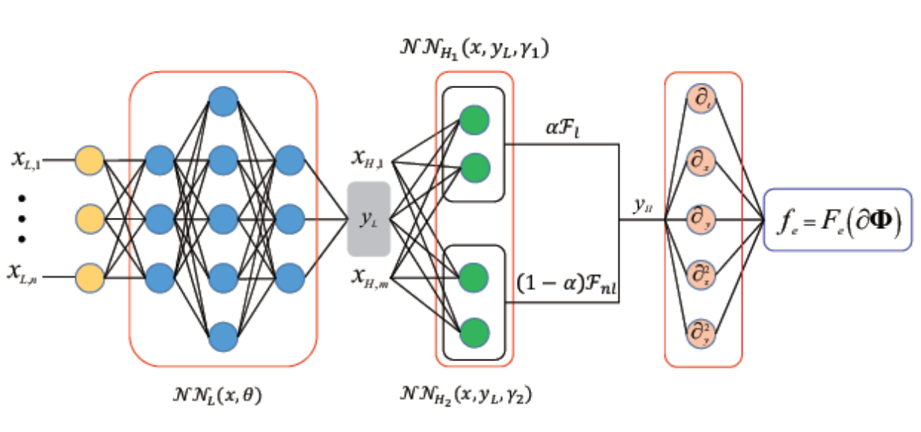
Multifidelity PINNs
Low-fidelity observation points
Low-fidelity network
Low fidelity approximation and high-fidelity collocation points
Lineear and nonlinear correlation networks
Notes:
Physics informed neural networks (PINNs) learn the solution to a differential equation for one set of initial and boundary conditions.

Slide 8
Potential solutions
Leverage physics theory to push the neural network towards the true solution
Notes:
The more that we know

