Slide 1



Multifidelity Finite Basis Physics Informed Neural Networks
By Damien Beecroft, Amanda Howard, Alex Heinlein, & Panos Stinis
Notes:
Hello, my name is Damien Beecroft. This summer I interned at Pacific Northwest National Lab on a project supervised by Amanda Howard and Panos Stinis in the U.S. Department of Energy, Advanced Scientific Computing Research program, under the Scalable, Efficient and Accelerated Causal Reasoning Operators, Graphs and Spikes for Earth and Embedded Systems (SEA-CROGS) project. In addition, we worked with Alex Heinlein, an Assistant Professor at the Delft Institute of Applied Mathematics. For this project I worked on was the development and testing of a new algorithm called multifidelity finite basis physics informed neural networks.

Slide 2

Introduction to Pinns
Suppose we want to solve a physics problem of the form
${u(t,x)}_{t}+N\left[u(t,x)\right]=0$for $x∈Ω,t∈\left[0,T\right]$,
$B[u\left(t,x\right)]=0$ for $x∈∂Ω$,
and $u\left(0,x\right)=u_{0}\left(x\right)$.
Here, $N$ and $B$ are placeholders for two spatial differential operators.
Notes:
I will begin by introducing the concept of a physics informed neural network for those that are unfamiliar with the concept. Suppose we have a differential equation defined by the following boundary and initial constraints. We have the dynamics in the first equation, then the boundary conditions, and then the initial conditions. Note that N and B can be arbitrary spatial differential operators.
Click

Slide 3
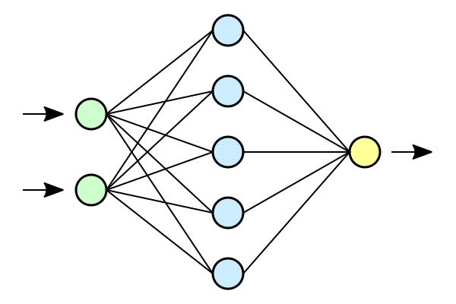










Introduction to Pinns
$$h$$
$$|h|$$
$$u\left(0,x\right)−u_{0}(x)$$
$$x$$
$$u$$
$$B[u(t,∂Ω)]$$
$$L$$
$$t$$
$${u(t,Ω)}_{t}−N[u(t,Ω)]$$
$$h←h − ε∇L$$
Notes:
We want to train a neural network to learn this differential equation. We take an untrained network and pass in the spatiotemporal coordinates where we would like to evaluate the differential equation. This gives us our initial approximation, u. Of course, this is not a very good approximation for the solution yet. We need to train.
Click
We compute how well our neural network approximates the true solution. This is a very simple task for the initial conditions. We use automatic differentiation to compute the loss of the boundary conditions and the differential equation. We also penalize the networks weights to avoid overfitting. The losses are all summed to get the total loss, L.
Click
We take the gradient of the total loss and use this to update the weights of the PINN.
Click

Slide 4
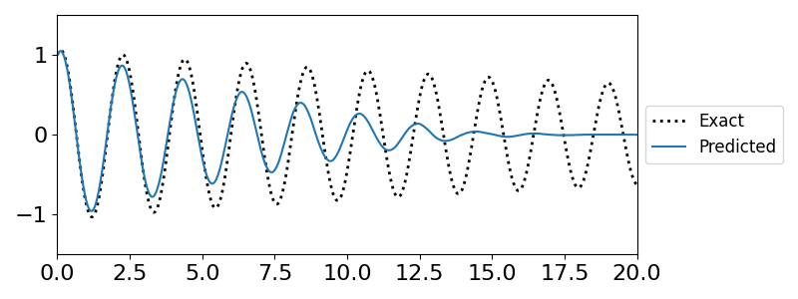
Challenges in training PInns
Difficulty representing high frequency solutions
Erroneous convergence to steady state solutions
Notes:
There are scenarios where PINNs struggle to converge to the true solution.
Click
If a differential equation has an oscillatory solution a PINN attempting to learn the dynamics will often converge to a non-physical fixed point solution. The weights and biases of the network need to change significantly in order to capture the behavior of highly oscillatory solutions. Erroneous fixed point solutions are attractive because, despite violating the initial or boundary conditions, they produce a small residual error.
We see an example of this behavior in the figure on the left. We are training a PINN to produce the solution of a slightly damped pendulum. The PINN understands that the solution should be oscillatory, but it converges to the fixed point far too quickly.
Click

Slide 5
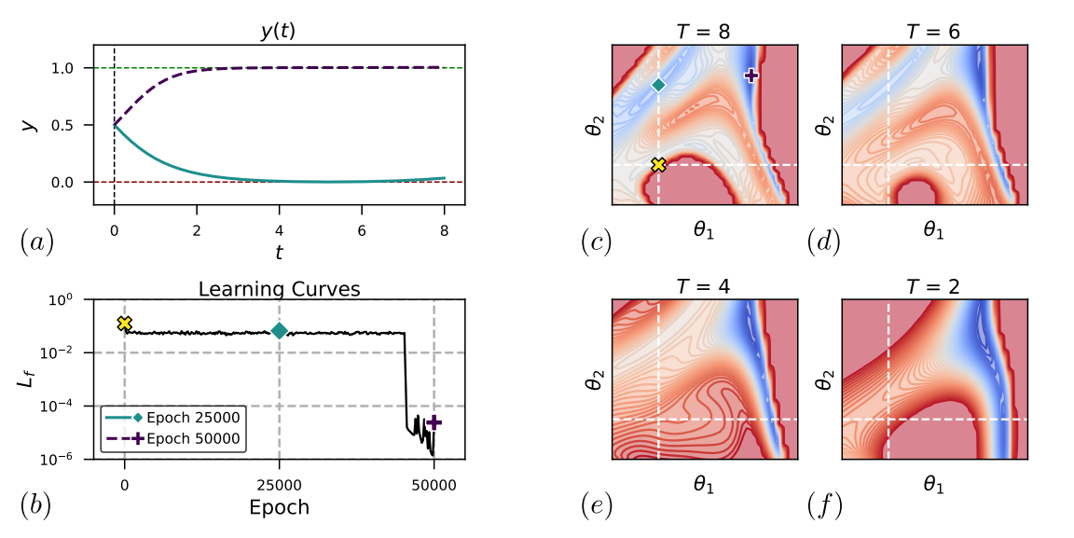
Why does this occur?
Non-physical fixed points can create saddle points or even local optima in the loss function
Rohrhofer et al. [1]
How do we overcome these convergence difficulties?
Notes:
Non-physical fixed points can create saddle points or even local optima in the loss function. This phenomena is well demonstrated in a paper called fixed points for PINNs. I have taken a figure from that paper that is particularly informative. They train a PINN to learn a differential equation with an unstable fixed point at 0 and a stable fixed point at 1. After training for 25,000 iterations, the PINN believes that the solution converges to the unstable fixed point. This is the blue line in figure (a). After another 25,000 iterations the loss drops sharply and the PINN correctly converges to the stable fixed point solution. We can see why this occurs from the topology of the loss landscape. We can see that as T increases a saddle point begins to form. This saddle point corresponds to the non-physical unstable fixed point solution.
Click
So, how do we overcome these convergence challenges?
Click

Slide 6
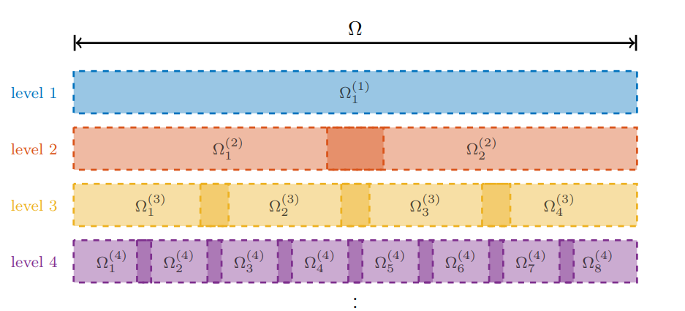
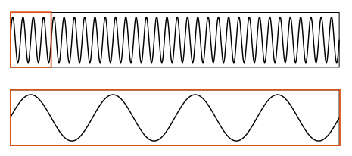
Finite Basis PINNs
Iteratively discretize the solution domain
Define a PINN on each subdomain
Define weight functions for each PINN that sum to one globally and have compact support
Dolean et al. [2]
Notes:
One idea for overcoming the convergence issues is to iteratively discretize the solution domain into a sequence of overlapping subdomains.
Click
We define a PINN on each subdomain
Click
And define weight functions on each subdomain that form a partition of unity and have compact support. This decreases the length scale of oscillations with respect to the PINN. This helps PINNs overcome the spectral bias that stops them from converging to oscillatory solutions. In the paper by Dolean et al., the PINN approximations on each level are averaged to get the final solution. In this research we change this aspect of the algorithm.
Click

Slide 7
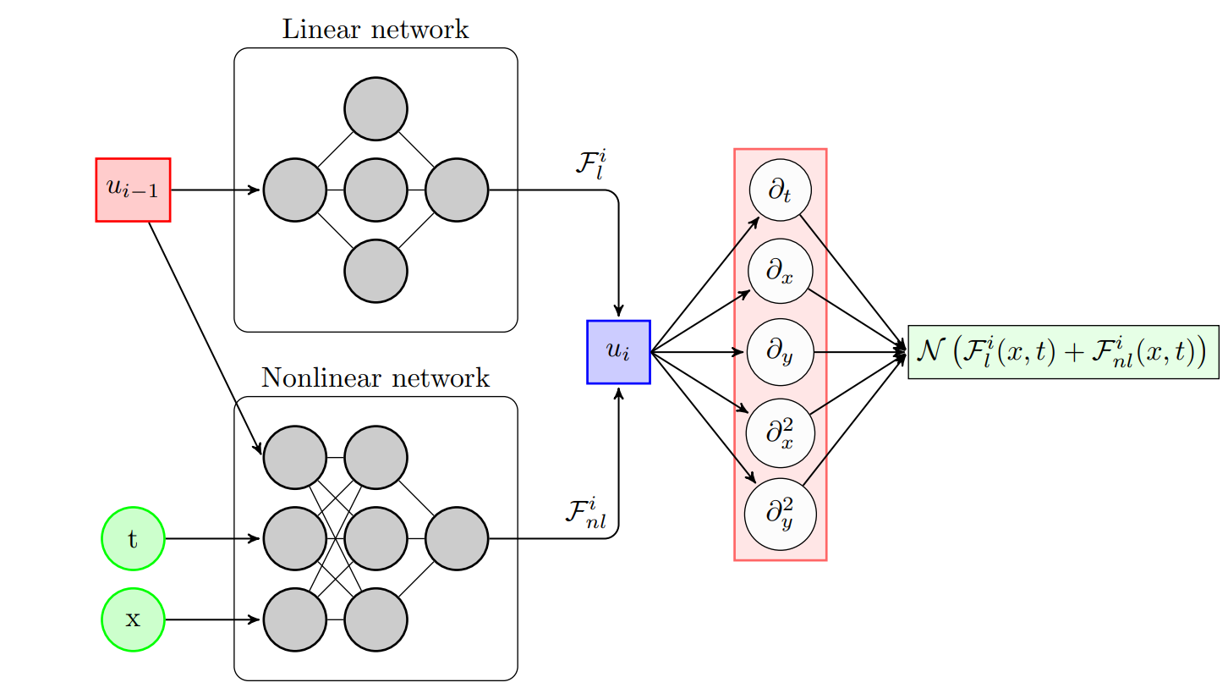
Multifidelity PINNs
Low fidelity predictions at collocation points
Collocation points
High fidelity prediction
Differential operator
Notes:
Instead of simply averaging all the levels together to get our final solution, we use lower levels as low fidelity approximations and feed this into a multifidelity network. We illustrate this more thoroughly here.
Click
We start with a low fidelity network.
Click
Into this network we feed a set of collocation points, x_L.
Click
This network outputs a low fidelity approximation, y_L, to the true solution.
Click
y_L and a set of new collocation points, x_H, are fed into the multifidelity network which is composed of a linear and nonlinear correlation network. This gives us our high fidelity approximation of the solution.
Click
This high fidelity solution is then passed into the differential operator to compute the residual and train the network
Click
Physics informed neural networks (PINNs) learn the solution to a differential equation for one set of initial and boundary conditions.

Slide 8
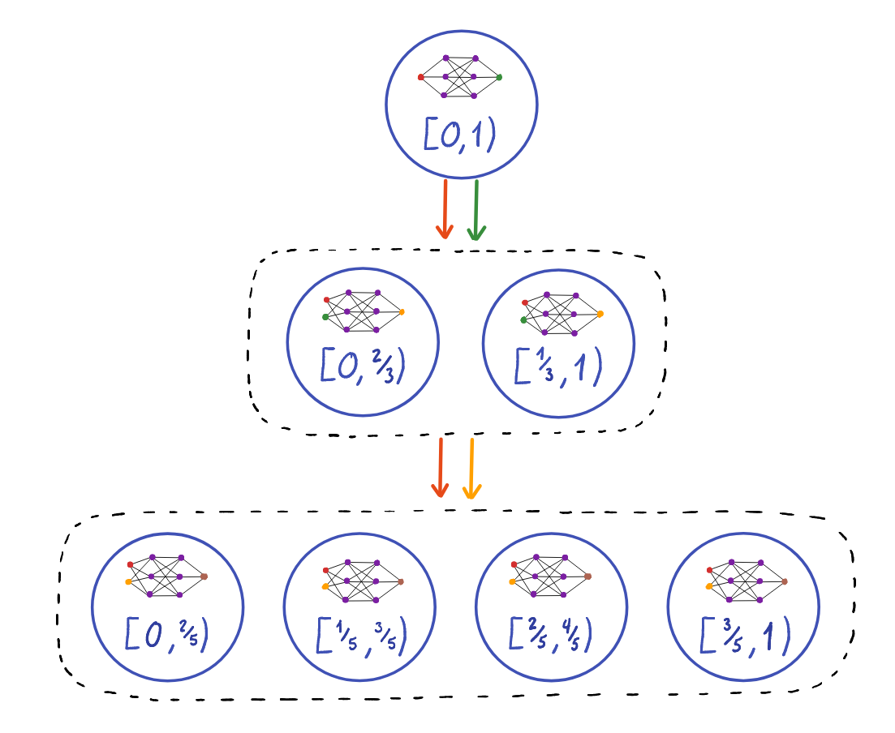
Multifidelity Finite Basis PINNs
Notes:
In this project, we combine the finite basis and the multifidelity PINNs in the following way. We start with a single fidelity PINN on the zeroth level. Once this is trained, we use it as a low fidelity approximation for the PINNs on the first level. These PINNs on the first level are defined on overlapping subdomains with weight functions, just as we described in the finite basis PINNs slide. The first level is then trained and used as a low fidelity approximation for the PINNs on the second level. This process is repeated until a desired level of accuracy is achieved.

Slide 9
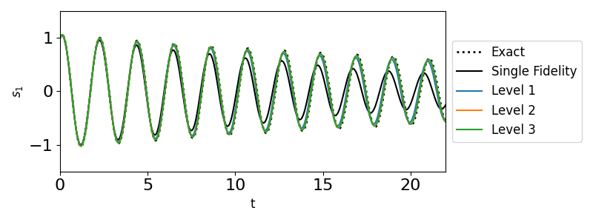
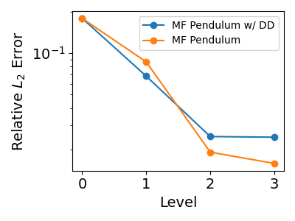
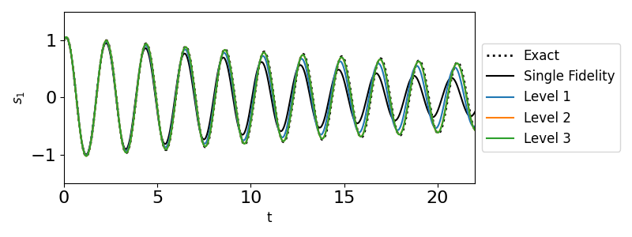

Pendulum Equation
$$\frac{ds_{1} }{dt}=s_{2}$$
$$\frac{ds_{2} }{dt}=\frac{1}{20}s_{2}−g\sin{(s_{1})}$$
Notes:
The more that we know

Slide 10
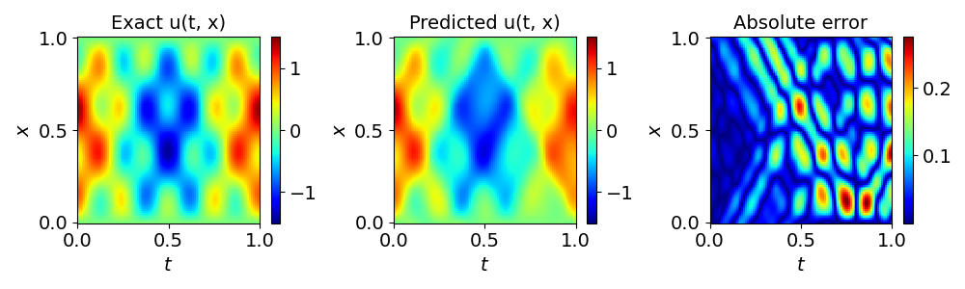
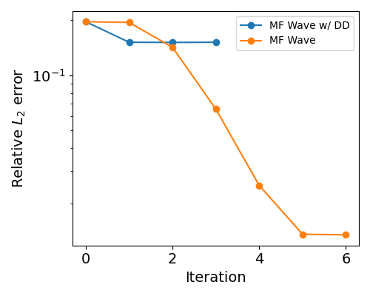
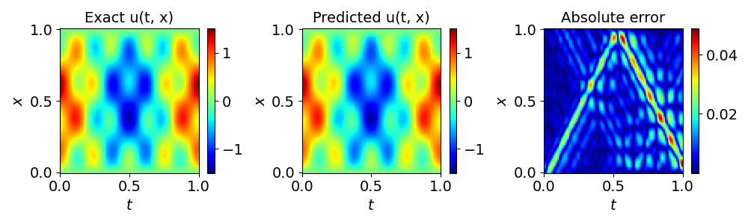

Wave equation
$$u_{tt}=4u_{xx}$$
$$u\left(0,x\right)= sin\left(πx\right)+2\sin{(4πx)}$$
$u\left(t,1\right)=0$ $u\left(t,0\right)=0$
Notes:
The more that we know

Slide 11
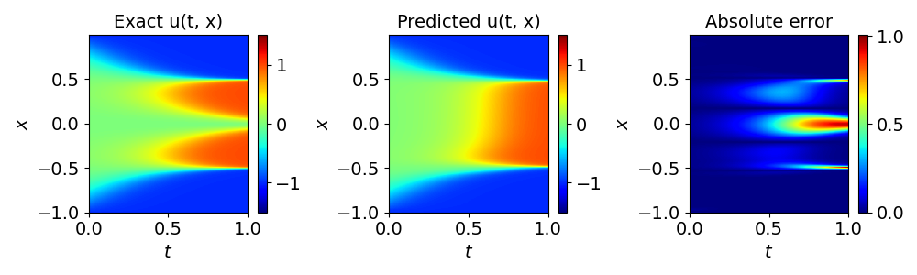
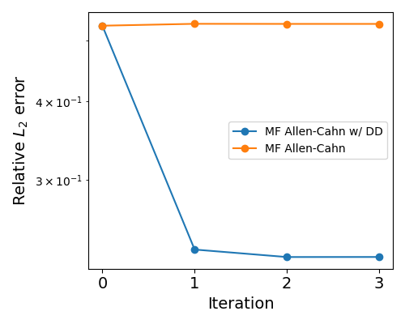
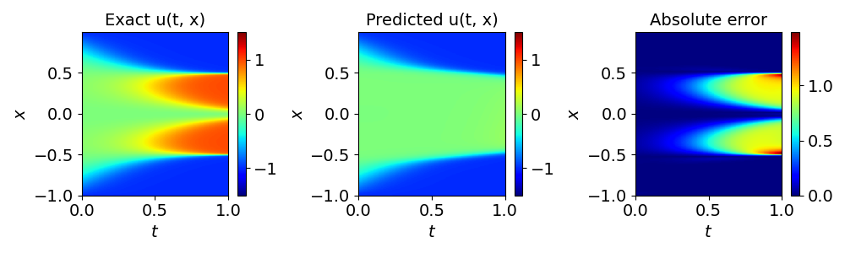

Allen-Cahn equation
$$u_{t}=\frac{u_{xx}}{10,000}+5u^{3}−5u$$
$$u\left(0,x\right)=x^{2}\cos{(πx)}$$
$$u\left(t,−1\right)=u(t,1)$$
Notes:
The more that we know

Slide 12
Acknowledgements
I acknowledge and appreciate the support from the National Science Foundation Mathematical Sciences Graduate Internship program. This project was completed with support from the U.S. Department of Energy, Advanced Scientific Computing Research program, under the Scalable, Efficient and Accelerated Causal Reasoning Operators, Graphs and Spikes for Earth and Embedded Systems (SEA-CROGS) project (Project No. 80278), The computational work was performed using PNNL Institutional Computing at Pacific Northwest National Laboratory. Pacific Northwest National Laboratory (PNNL) is a multi-program national laboratory operated for the U.S. Department of Energy (DOE) by Battelle Memorial Institute under Contract No. DE-AC05-76RL01830.
Notes:
The more that we know

Slide 13
References
Rohrhofer, F. M., Posch, S., Gößnitzer, C., & Geiger, B. C. (2022). On the role of fixed points of dynamical systems in training physics-informed neural networks. arXiv preprint arXiv:2203.13648.
Dolean, V., Heinlein, A., Mishra, S., & Moseley, B. (2023). Multilevel domain decomposition-based architectures for physics-informed neural networks. arXiv preprint arXiv:2306.05486.
Xuhui Meng, George Em Karniadakis, A composite neural network that learns from multi-fidelity data: Application to function approximation and inverse PDE problems, Journal of Computational Physics, Volume 401, 2020, 109020, ISSN 0021-9991, https://doi.org/10.1016/j.jcp.2019.109020.
Howard, A. A., Perego, M., Karniadakis, G. E., & Stinis, P. (2022). Multifidelity deep operator networks. arXiv preprint arXiv:2204.09157.
M. Raissi, P. Perdikaris, G.E. Karniadakis, Physics-informed neural networks: A deep learning framework for solving forward and inverse problems involving nonlinear partial differential equations, Journal of Computational Physics, Volume 378, 2019, Pages 686-707, ISSN 0021-9991, https://doi.org/10.1016/j.jcp.2018.10.045.
Notes:
The more that we know

