Slide 1



Multifidelity Finite Basis Physics Informed Neural Networks
By Damien Beecroft, Amanda Howard, & Panos Stinis

Slide 2

Introduction to Pinns
Suppose we want to solve a differential equation of the form
${u(t,x)}_{t}+N\left[u(t,x)\right]=0$for $x∈Ω,t∈\left[0,T\right]$,
$B[u\left(t,x\right)]=0$ for $x∈∂Ω$,
and $u\left(0,x\right)=u_{0}\left(x\right)$.
Here, $N$ and $B$ are placeholders for two differential operators.
Notes:
Physics informed neural networks (PINNs) learn the solution to a differential equation for one set of initial and boundary conditions.

Slide 3
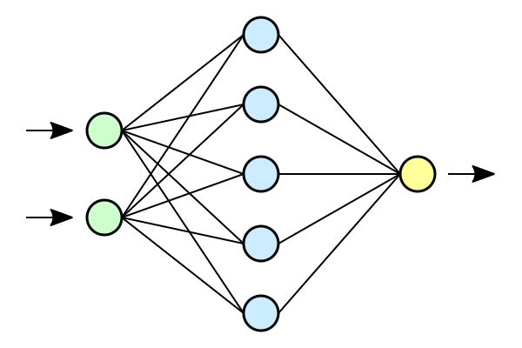









Introduction to Pinns
$$h$$
$$u\left(0,x\right)−u_{0}(x)$$
$$x$$
$$u$$
$$B[u(t,∂Ω)]$$
$$L$$
$$t$$
$${u(t,Ω)}_{t}−N[u(t,Ω)]$$
$$h←h − ε∇L$$

Slide 4
Challenges in training PInns

