Slide 1



Multifidelity Finite Basis Physics Informed Neural Networks
By Damien Beecroft, Amanda Howard, Alex Heinlein, & Panos Stinis
Notes:
Hello, my name is Damien Beecroft. This summer I interned at Pacific Northwest National Lab on a project supervised by Amanda Howard and Panos Stinis in the U.S. Department of Energy, Advanced Scientific Computing Research program, under the Scalable, Efficient and Accelerated Causal Reasoning Operators, Graphs and Spikes for Earth and Embedded Systems (SEA-CROGS) project. In addition, we worked with Alex Heinlein, an Assistant Professor at the Delft Institute of Applied Mathematics. For this project I worked on was the development and testing of a new algorithm called multifidelity finite basis physics informed neural networks.

Slide 2

Introduction to Pinns
Suppose we want to solve a physics problem of the form
${u(t,x)}_{t}+N\left[u(t,x)\right]=0$for $x∈Ω,t∈\left[0,T\right]$,
$B[u\left(t,x\right)]=0$ for $x∈∂Ω$,
and $u\left(0,x\right)=u_{0}\left(x\right)$.
Here, $N$ and $B$ are placeholders for two spatial differential operators.
Notes:
I will begin by introducing the concept of a physics informed neural network for those that are unfamiliar with the concept. Suppose we have a differential equation defined by the following boundary and initial constraints. We have the dynamics in the first equation, then the boundary conditions, and then the initial conditions. Note that N and B can be arbitrary spatial differential operators.
Click

Slide 3
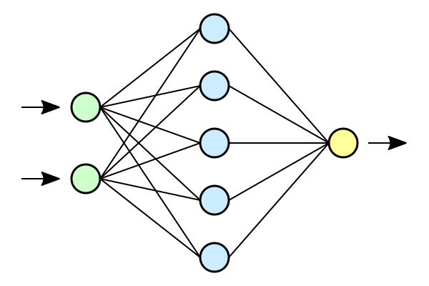










Introduction to Pinns
$$h$$
$$|h|$$
$$u\left(0,x\right)−u_{0}(x)$$
$$x$$
$$u$$
$$B[u(t,∂Ω)]$$
$$L$$
$$t$$
$${u(t,Ω)}_{t}−N[u(t,Ω)]$$
$$h←h − ε∇L$$
Notes:
We want to train a neural network to learn this differential equation. We take an untrained network and pass in the spatiotemporal coordinates where we would like to evaluate the differential equation. This gives us our initial approximation, u. Of course, this is not a very good approximation for the solution yet. We need to train.
Click
We compute how well our neural network approximates the true solution. This is a very simple task for the initial conditions. We use automatic differentiation to compute the loss of the boundary conditions and the differential equation. We also penalize the networks weights to avoid overfitting. The losses are all summed to get the total loss, L.
Click
We take the gradient of the total loss and use this to update the weights of the PINN.
Click

Slide 4
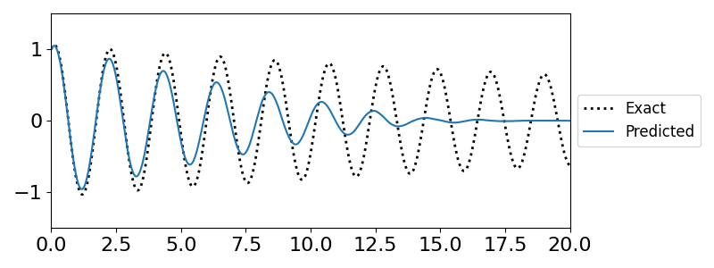
Challenges in training PInns
Difficulty representing high frequency solutions
Erroneous convergence to steady state solutions
Notes:
There are scenarios where PINNs struggle to converge to the true solution.
Click
If a differential equation has an oscillatory solution a PINN attempting to learn the dynamics will often converge to a non-physical fixed point solution. The weights and biases of the network need to change significantly in order to capture the behavior of highly oscillatory solutions. Erroneous fixed point solutions are attractive because, despite violating the initial or boundary conditions, they produce a small residual error.
We see an example of this behavior in the figure on the left. We are training a PINN to produce the solution of a slightly damped pendulum. The PINN understands that the solution should be oscillatory, but it converges to the fixed point far too quickly.
Click

Slide 5
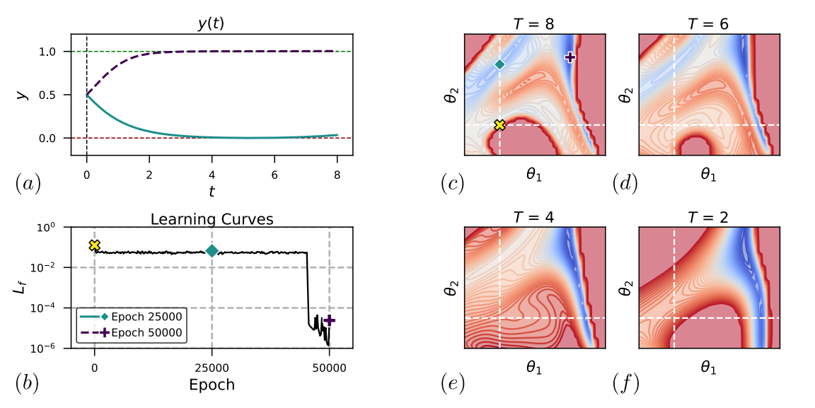
Why does this occur?
Non-physical fixed points can create saddle points or even local optima in the loss function
Rohrhofer et al. [1]
Notes:
- Neural networks are encouraged to find minimum norm solutions
- Satisfying one constraint may mean violating another

Slide 6
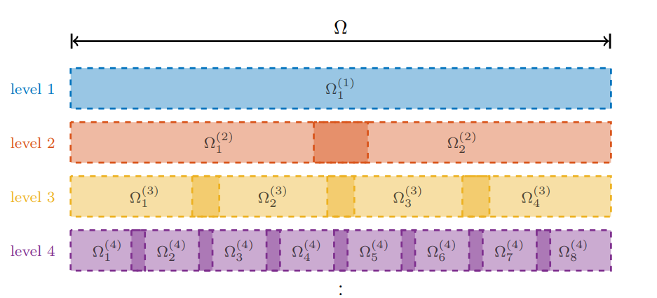
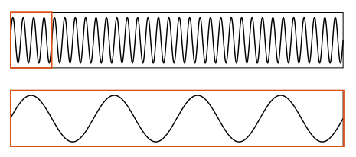
Finite Basis PINNs
Iteratively discretize the solution domain
Define a PINN on each subdomain
Define weight functions for each PINN that sum to one globally and have compact support
Dolean et al. [1]

Slide 7
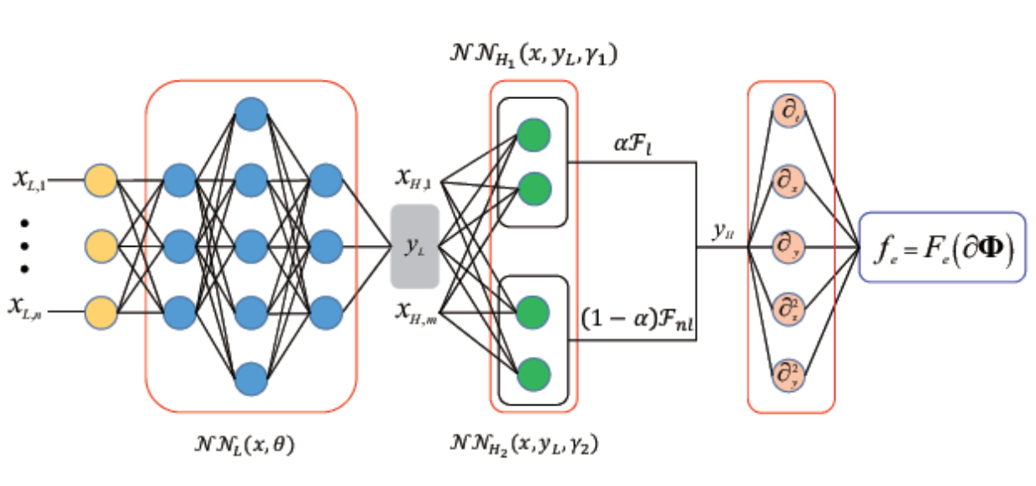
Multifidelity PINNs
Meng et al. [3]
Low-fidelity observation points
Low-fidelity network
Differential operator
Low fidelity approximation and high-fidelity collocation points
Linear and nonlinear correlation networks
Notes:
Physics informed neural networks (PINNs) learn the solution to a differential equation for one set of initial and boundary conditions.

Slide 8
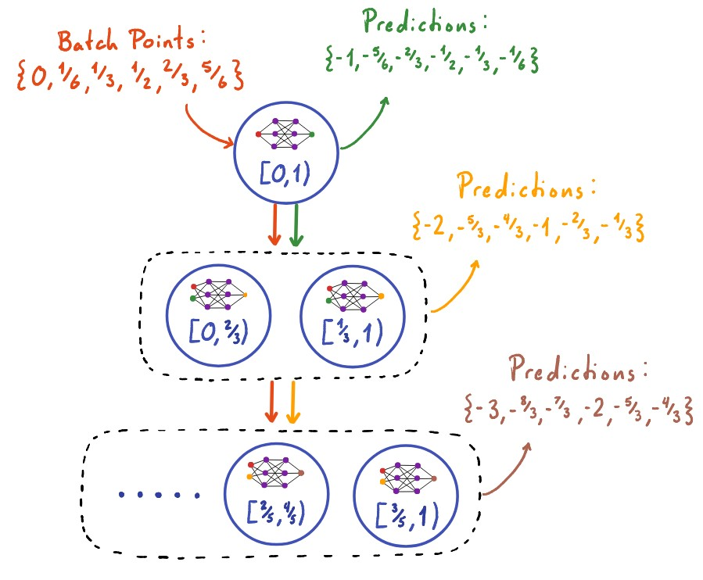
Multifidelity Finite Basis PINNs
Notes:
The more that we know

Slide 9
Results
Notes:
The more that we know

Slide 10
Acknowledgements
I acknowledge and appreciate the support from the National Science Foundation Mathematical Sciences Graduate Internship program. This project was completed with support from the U.S. Department of Energy, Advanced Scientific Computing Research program, under the Scalable, Efficient and Accelerated Causal Reasoning Operators, Graphs and Spikes for Earth and Embedded Systems (SEA-CROGS) project (Project No. 80278), The computational work was performed using PNNL Institutional Computing at Pacific Northwest National Laboratory. Pacific Northwest National Laboratory (PNNL) is a multi-program national laboratory operated for the U.S. Department of Energy (DOE) by Battelle Memorial Institute under Contract No. DE-AC05-76RL01830.
Notes:
The more that we know

Slide 11
References
Rohrhofer, F. M., Posch, S., Gößnitzer, C., & Geiger, B. C. (2022). On the role of fixed points of dynamical systems in training physics-informed neural networks. arXiv preprint arXiv:2203.13648.
Dolean, V., Heinlein, A., Mishra, S., & Moseley, B. (2023). Multilevel domain decomposition-based architectures for physics-informed neural networks. arXiv preprint arXiv:2306.05486.
Xuhui Meng, George Em Karniadakis, A composite neural network that learns from multi-fidelity data: Application to function approximation and inverse PDE problems, Journal of Computational Physics, Volume 401, 2020, 109020, ISSN 0021-9991, https://doi.org/10.1016/j.jcp.2019.109020.
Notes:
The more that we know

Slide 12
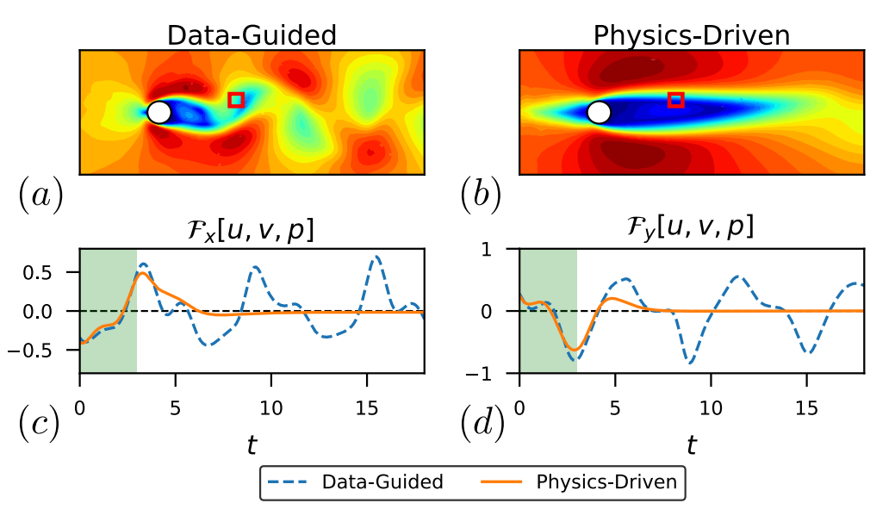
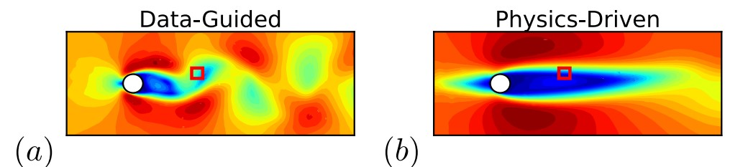

Slide 13
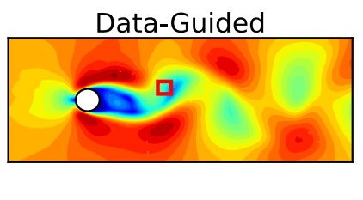
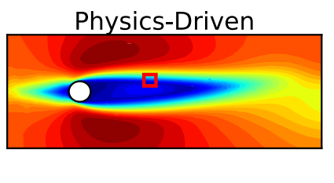
Rohrhofer et al. [1]

