Slide 1



Multifidelity Finite Basis Physics Informed Neural Networks
By Damien Beecroft
Notes:
Hello, my name is Damien Beecroft. I am a third year PhD student in the Applied Mathematics department at the University of Washington. This summer I worked on the development and testing of a new algorithm called multifidelity finite basis physics informed neural networks.
This summer I interned at Pacific Northwest National Lab on a project supervised by Amanda Howard and Panos Stinis in the SEA-CROGS group. In addition, we worked with Alex Heinlein, an Assistant Professor at the Delft Institute of Applied Mathematics. For this project I worked on the development and testing of a new algorithm called multifidelity finite basis physics informed neural networks.

Slide 2



Mentors
Amanda Howard
PNNL
Panos Stinis
PNNL
Alex Heinlein
TU Delft
Notes:
I would like to thank Amanda Howard and Panos Stinis in the SEA-CROGS group at PNNL and Alex Heinlein at the Delft Institute of Applied Mathematics for their guidance throughout the course of this project.

Slide 3

Introduction to Pinns
Suppose we want to solve a physics problem of the form
${u(t,x)}_{t}+N\left[u(t,x)\right]=0$for $x∈Ω,t∈\left[0,T\right]$,
$B[u\left(t,x\right)]=0$ for $x∈∂Ω$,
and $u\left(0,x\right)=u_{0}\left(x\right)$.
Here, $N$ and $B$ are placeholders for two spatial differential operators.
Notes:
I will begin by introducing the concept of a physics informed neural network for those that are unfamiliar with the concept. Suppose we have a differential equation with some following boundary and initial conditions. Note that N and B can be arbitrary spatial differential operators.
Click

Slide 4
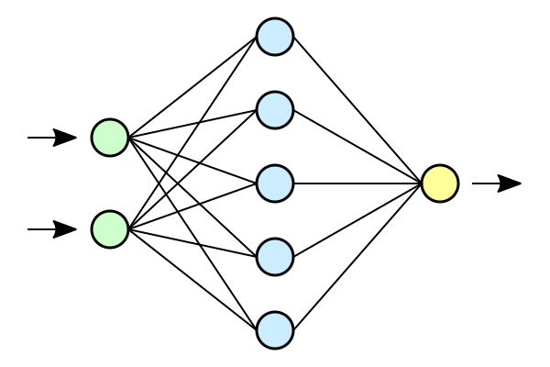


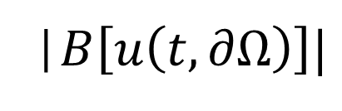






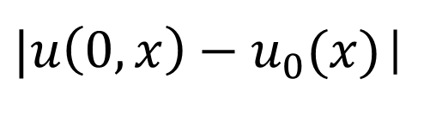
Introduction to Pinns
$$h$$
$$|h|$$
$|u\left(0,x\right)−u_{0}(x)$|
$$x$$
$$u$$
|$B\left[u\left(t,∂Ω\right)\right]|$
$$L$$
$$t$$
$${|u(t,Ω)}_{t}−N[u(t,Ω)]|$$
$$h←h − ε∇_{h}L$$
Notes:
We want to train a neural network to learn this differential equation. We take an untrained network and pass in the spatiotemporal coordinates where we would like to evaluate the differential equation. This gives us our initial approximation, u. Of course, this is not a very good approximation for the solution yet. We need to train.
Click
We compute how well our neural network approximates the true solution. This is a very simple task for the initial conditions. We use automatic differentiation to compute the loss of the boundary conditions and the differential equation. We also penalize the networks weights to avoid overfitting. The losses are all summed to get the total loss, L.
Click
We take the gradient of the total loss and use this to update the weights of the PINN.
Click

Slide 5
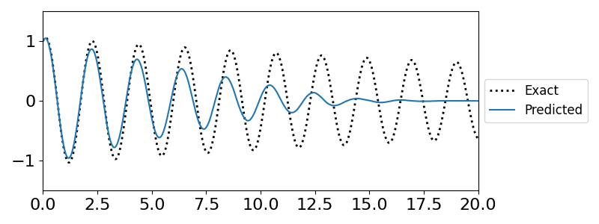
Challenges in training PInns
Difficulty representing high frequency solutions
Erroneous convergence to fixed point solutions
Notes:
This construction is simple. However, convergence behavior is not so straightforward.
Click
If a differential equation has an oscillatory solution, a PINN attempting to learn the dynamics will often struggle to converge. The weights and biases of the network need to change significantly in order to capture the behavior of highly oscillatory solutions.
Click
On the other hand, erroneous fixed point solutions are attractive because they produce a small residual error.
We see an example of this behavior in the figure on the above. We are training a PINN to predict the solution of a slightly damped pendulum. The PINN understands that the solution should be oscillatory, but it converges to the fixed point far too quickly.
Click

Slide 6
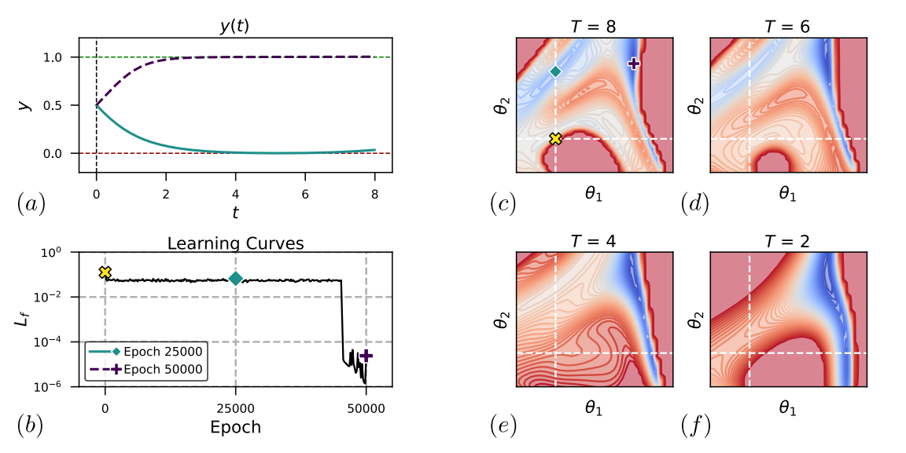
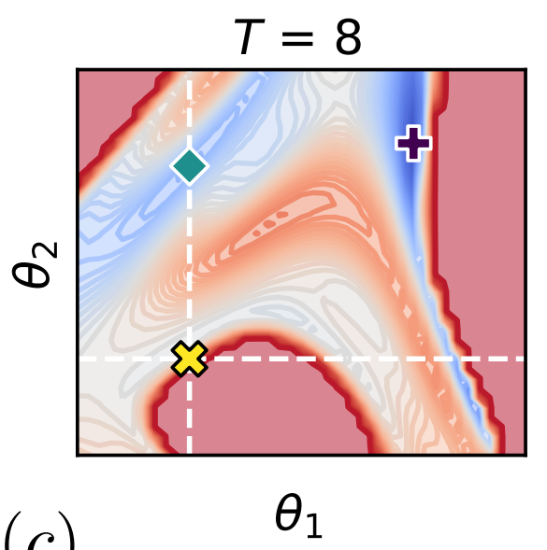
Why does this occur?
Non-physical fixed points can create saddle points in the loss function
Loss Landscape
The main goal of this project is to overcome this convergence issue.
(c)
Rohrhofer et al. [1]
Notes:
One reason for this behavior is that non-physical fixed points can create saddle points in the loss function. This phenomenon is well demonstrated in Rohrhofer et al. I have taken a figure from that paper to illustrate the issue. They train a PINN to learn a differential equation that has an unstable fixed point at 0 and a stable fixed point at 1. After training for 25,000 iterations, the PINN incorrectly converges to the unstable fixed point. This is the blue line in figure (a). After another 25,000 iterations the loss drops sharply and the PINN correctly converges to the stable fixed point solution as it should. We can see why this occurs from the topology of the loss landscape. The non-physical fixed point solution corresponds to a saddle point in the loss landscape which severely slows convergence.
Click
The main goal of this project is to overcome this convergence issue.
Click

Slide 7
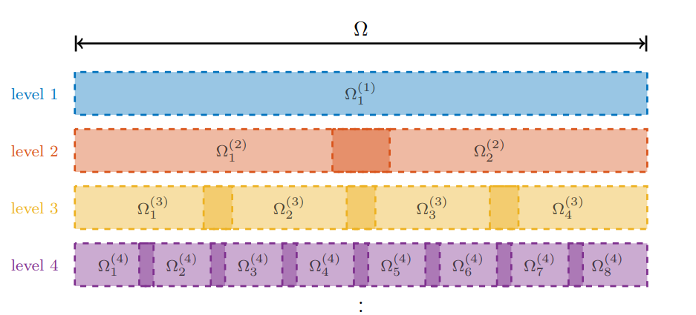
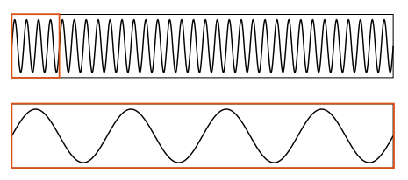
Multilevel Finite Basis PINNs
Iteratively discretize the solution domain
Define a PINN on each subdomain
Define weight functions for each PINN that sum to one globally and have compact support
Dolean et al. [2]
Notes:
Before introducing MFFBPINNs we must introduce multilevel finite basis PINNs and multifidelity PINNs. We discuss the former here.
Click
In Multilevel Finite Basis PINNs create a sequence of levels. Each level contains a set of overlapping subdomains whose union is the entire problem domain. In the top figure we see an example of this where the number of subdomains is doubled each level.
Click
We define a PINN on each subdomain…
Click
And we also define weight functions on each subdomain that ensure a smooth transition between the PINNs defined on those subdomains. The global solution is achieved by averaging the predictions over all the levels. Domain decomposition decreases the length scale of oscillations with respect to the PINN. This can help PINNs overcome the spectral bias that stops them from converging to oscillatory solutions.
Click

Slide 8
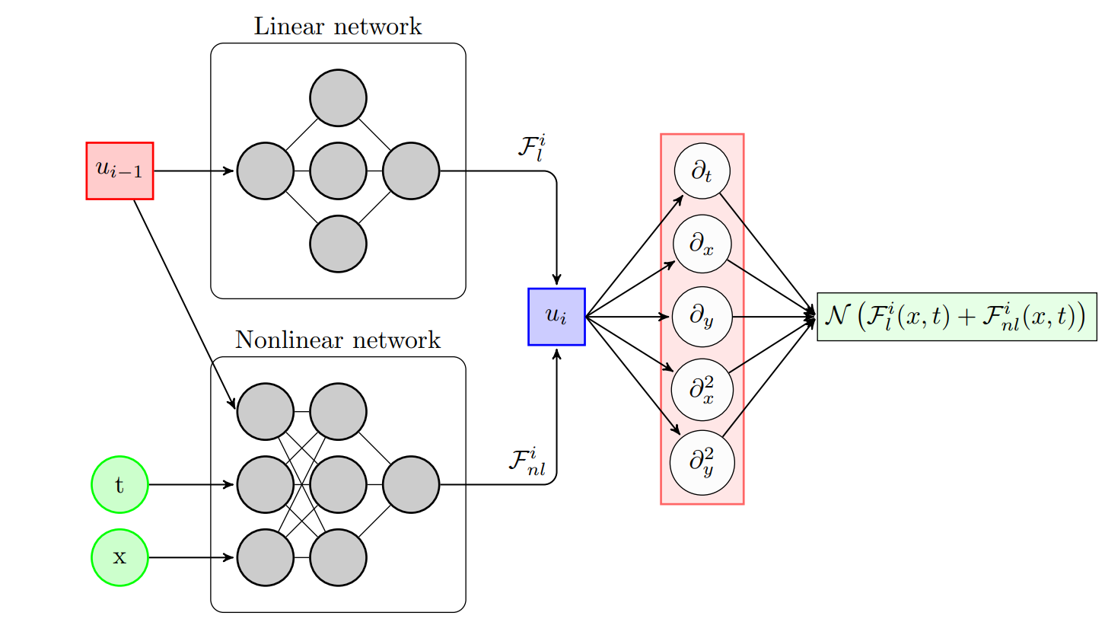
Multifidelity PINNs
Low fidelity predictions at collocation points
Collocation points
High fidelity prediction
Differential operator
Notes:
Now we introduce multifidelity PINNs. Multifidelity PINNs take in not only
Click
the spatiotemporal collocation points (x and t), but also
Click
a low fidelity approximation of the solution to the differential eqation (u_{i-1}).
Click
This information is passed through the network and used to create a high fidelity approximation of the true solution.
Click
The multifidelity PINN can then be differentiated just like a normal PINN to train the network.
Click

Slide 9
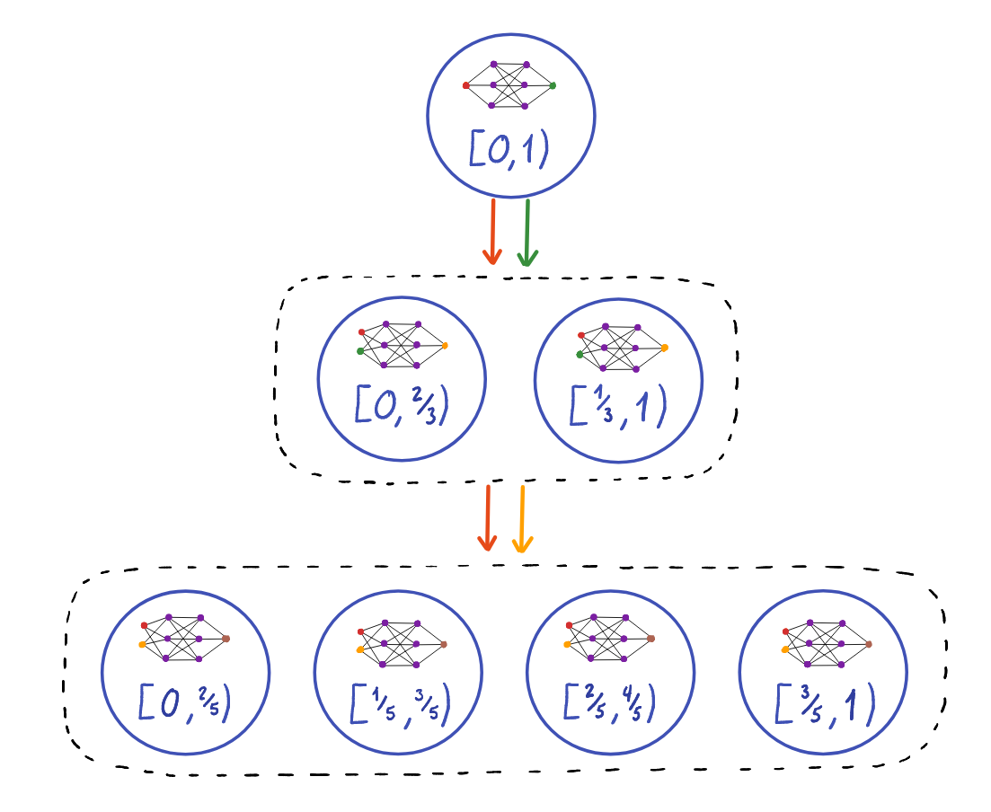
Single fidelity PINN on the zeroth level
Collocation points and the level zero prediction are passed to level one
Multifidelity Finite Basis PINNs
Multifidelity PINNs on the first level
Collocation points and the level one prediction are passed to level two
Multifidelity PINNs on the second level
Notes:
Multifidelity Finite Basis PINNs are a combination of multilevel finite basis PINNs and multifidelity PINNs.
We give a brief illustration of how a MFFBPINN produces predictions.
Click
A set of collocation points (denoted by the red) are given to the single fidelity PINN on the zeroth level to get our single fidelity prediction.
Click
The collocation points and the single fidelity prediction from the zeroth level are passed to the first level.
Click
The multifidelity PINNs on the first level take in the collocation points that lie within their subdomain and the corresponding single fidelity predictions to get predictions from each multifidelity subnetwork. These subnetwork predictions are then weighted to get the final high fidelity prediction of the first level.
Click
The high fidelity prediction from level one is passed to level two as the low fidelity prediction along with the collocation points.
Click
The process on level two is the same as level one.
Click
This process can be repeated until a desired level of accuracy is achieved or convergence stalls.

Slide 10
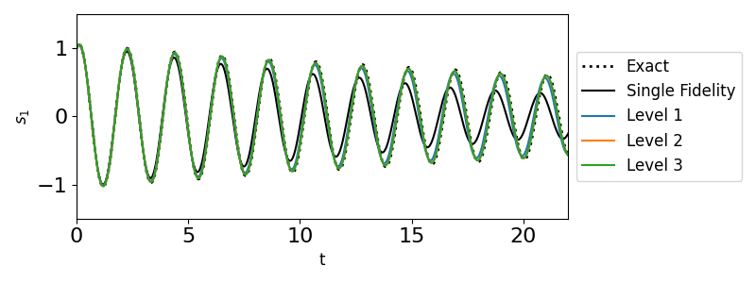
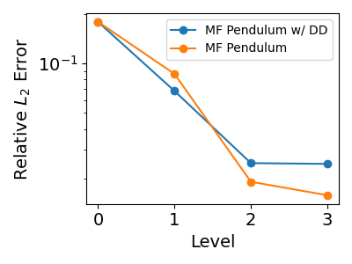
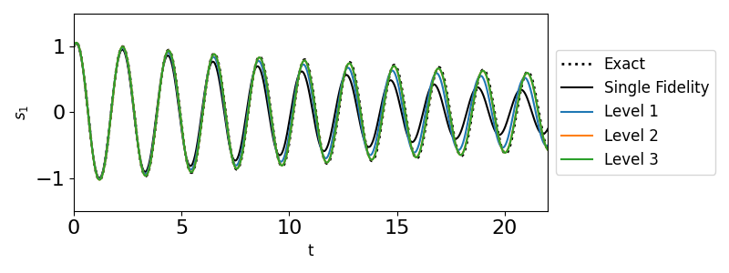

Pendulum Equation
MF Pendulum with DD
$$\frac{ds_{1} }{dt}=s_{2}$$
$$\frac{ds_{2} }{dt}=\frac{1}{20}s_{2}−g\sin{(s_{1})}$$
MF Pendulum
Notes:
Now we will introduce some of the results that we observed when training MFFBPINNs. Note that these results are preliminary and there is still much work to be done. Furthermore, all results were trained without the use of solution data.

Slide 11
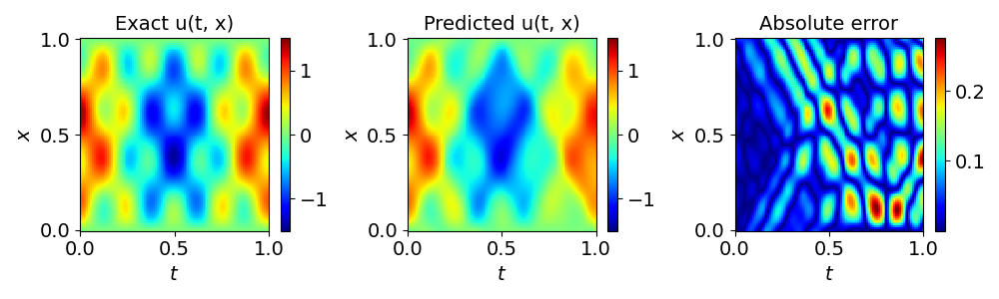
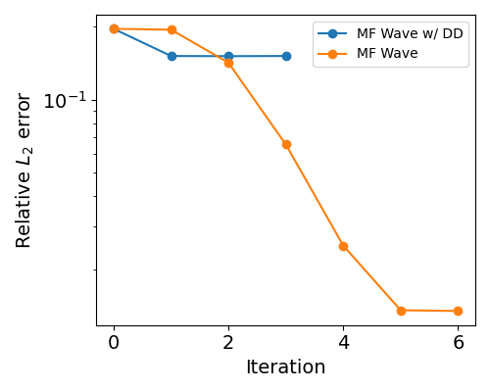
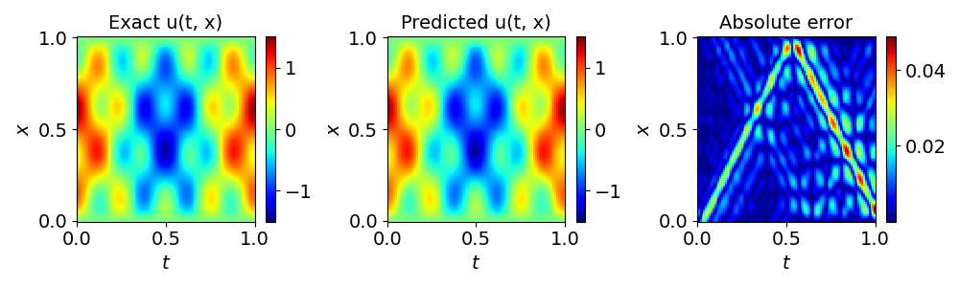

Wave equation
MF Wave with DD
$$u_{tt}=4u_{xx}$$
$$u(0,x)= sin\left(πx\right)+2\sin{(4πx)}$$
$u\left(t,1\right)=0$ $u\left(t,0\right)=0$
MF Wave
Notes:
The more that we know

Slide 12
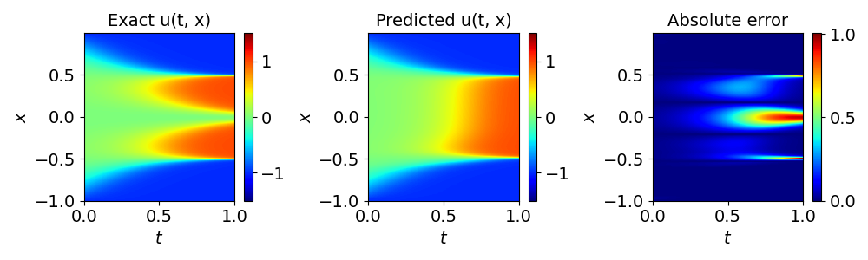
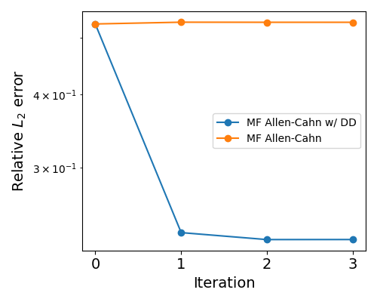
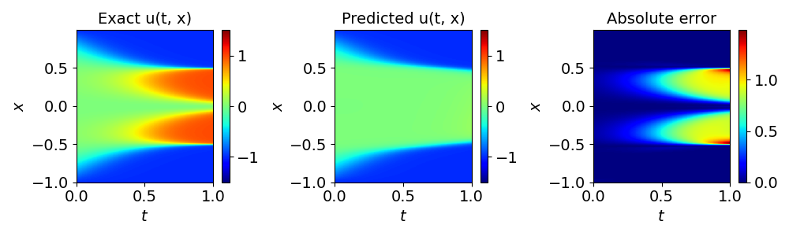

Allen-Cahn equation
MF Allen-Cahn with DD
$$u_{t}=\frac{u_{xx}}{10,000}+5u^{3}−5u$$
$$u\left(0,x\right)=x^{2}\cos{(πx)}$$
$u\left(t,−1\right)=u(t,1)$
$$u_{x}\left(t,−1\right)=u_{x}(t,1)$$
MF Allen-Cahn
Notes:
The more that we know

Slide 13
Comments and Conclusions
The results here are preliminary and more tests need to be run to ascertain the capabilities of MFFBPINNs and how domains should be decomposed for best convergence.
Multifidelity PINNs can improve on the training of single fidelity PINNs to increase accuracy.
One could use a numerical method as the single fidelity solver as opposed to a vanilla PINN. It would be interesting to see if operator learning is viable in this construction and whether MFFBPINNs can outperform classical numerical methods.
The current implementation of MFFBPINNs is not as efficient as it could be. It would be interesting to study the error versus computation time of an optimized MFFBPINN code versus a classical PINN.
Notes:
The more that we know

Slide 14
Acknowledgements
I acknowledge and appreciate the support from the National Science Foundation Mathematical Sciences Graduate Internship program. This project was completed with support from the U.S. Department of Energy, Advanced Scientific Computing Research program, under the Scalable, Efficient and Accelerated Causal Reasoning Operators, Graphs and Spikes for Earth and Embedded Systems (SEA-CROGS) project (Project No. 80278), The computational work was performed using PNNL Institutional Computing at Pacific Northwest National Laboratory. Pacific Northwest National Laboratory (PNNL) is a multi-program national laboratory operated for the U.S. Department of Energy (DOE) by Battelle Memorial Institute under Contract No. DE-AC05-76RL01830.
Notes:
The more that we know

Slide 15
References
Rohrhofer, F. M., Posch, S., Gößnitzer, C., & Geiger, B. C. (2022). On the role of fixed points of dynamical systems in training physics-informed neural networks. arXiv preprint arXiv:2203.13648.
Dolean, V., Heinlein, A., Mishra, S., & Moseley, B. (2023). Multilevel domain decomposition-based architectures for physics-informed neural networks. arXiv preprint arXiv:2306.05486.
Xuhui Meng, George Em Karniadakis, A composite neural network that learns from multi-fidelity data: Application to function approximation and inverse PDE problems, Journal of Computational Physics, Volume 401, 2020, 109020, ISSN 0021-9991, https://doi.org/10.1016/j.jcp.2019.109020.
Howard, A. A., Perego, M., Karniadakis, G. E., & Stinis, P. (2022). Multifidelity deep operator networks. arXiv preprint arXiv:2204.09157.
M. Raissi, P. Perdikaris, G.E. Karniadakis, Physics-informed neural networks: A deep learning framework for solving forward and inverse problems involving nonlinear partial differential equations, Journal of Computational Physics, Volume 378, 2019, Pages 686-707, ISSN 0021-9991, https://doi.org/10.1016/j.jcp.2018.10.045.
Notes:
The more that we know

