Slide 1

EV Car Hire Higher Diploma in Computer Science.
Damien Driver - 20099851

Slide 2
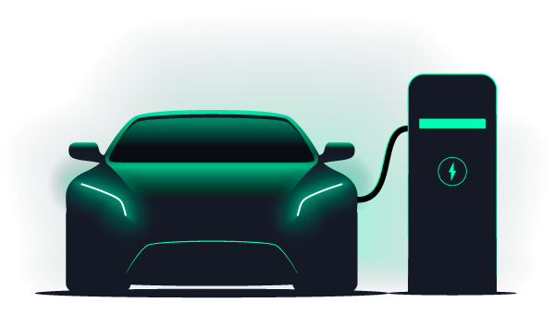
EV Car Hire Reservation Web Application
EV Car Hire Reservation is a user-friendly web application designed to enable users to easily book electric vehicle rentals.

Slide 3
Background
The idea for the project came from observing the difficulty potential customers had with making bookings on traditional car hire platforms.

Slide 4
Technologies
The application is built using the MERN stack of MongoDB, Express.js, React.js and Node.js.
Supporting tech include Nodemailer, Zoho, Cloudinary, Leaflet, Openchargemap, Bootstrap, Ant Design, Stripe & Vercel.

Slide 5
Live Demo
A short demonstration of how a user interacts with the application.

Slide 6
Implementation
Homepage &
Navbar
MongoDB Connection
Display Cars
API
Maps - Opencharge & Locations
User
Authentication
GitHub
Repository

Slide 7
Implementation
Stripe
Payments
Admin
User
Contact
Form
Nodemailer & Zoho
Vercel
Deploy
DNS
Vehicle
Filters

Slide 8
Challenges
Time Management, disappear down rabbit holes.
Filters and state management issues.
JWT Web tokens not set in cookie after deployment.

Slide 9
Use of AI
No AI used for the application design, project report or video.
ChatGPT used mainly for debugging code to find syntax errors.
Useful for research into alternative libraries and tools.
Often for more complex blocks of code suggestions led to errors, example the filters on vehicle display page.

Slide 10
Future Development
Improve map interaction to allow search by current location.
Provide full CRUD on all models to Admin User.
Allow member users to update current reservations.
Document the API in Swagger to improve testing and validation of the data.
Improve pricing system to allow for seasonality.

Slide 11
Learnings
Project Management Skills, now see the importance of good planning and a structured approach to development.
Gained further experience with React and how the backend and database interact with the frontend via HTTP requests and APIs.
Expanded my knowledge of many new technologies and libraries not limited to the MERN stack.

Slide 12
Thank You. Any Questions?

