Slide 1
Using AI emulation to train military personel.
Why was this chosen as the topic?
AI emulation has the potential to revolutionize military training by providing realistic and immersive simulations. It allows military personnel to engage in complex scenarios, learn from their mistakes, and refine their skills in a controlled environment. This can significantly enhance training efficiency and effectiveness, enabling troops to be better prepared for real-world operation. By utilizing AI emulation, the need for physical resources can be significantly reduced, leading to cost savings. Virtual training can be conducted repeatedly without incurring additional expenses, making it a cost-effective solution for training a large number of personnel.
Opportunities
Enhanced Realism: Using AI emulation can create realistic training scenarios that simulate real-world combat situations. These simulations can provide soldiers with a more accurate representation of what they may face in combat, helping them prepare for the challenges ahead.
Cost-effectiveness: Traditional military training can be expensive due to the use of equipment and personnel. However, using AI emulation to create training scenarios can reduce costs significantly since it eliminates the need for expensive equipment and live personnel.
Customizability: AI emulation allows for customizability and flexibility in training scenarios, which can be tailored to meet the specific needs of individual soldiers or units. This can improve training effectiveness by ensuring that soldiers are trained in areas where they need the most improvement.
Safety: Using AI emulation can reduce the risks associated with live training exercises, which can be dangerous and potentially fatal. AI emulation eliminates the need for live ammunition and explosives, making training exercises safer for soldiers.
Autonomous Vehicles and Transportation: AI emulation plays a crucial role in training algorithms and systems that power autonomous vehicles. By using realistic simulations, engineers can refine the behaviour and decision-making capabilities of self-driving cars, trucks, and drones.
Medical Training and Simulation: AI emulation can also be utilized in the medical field for training healthcare professionals. Simulations can provide realistic scenarios for medical students, allowing them to practice procedures, diagnostics, and patient interactions without risk to real patients.

Slide 2
Using AI emulation to train military personel.
RISKS
Lack of Contextual Understanding: AI emulation may fail to provide trainees with a deep understanding of the complex human and social dynamics that occur in real-world military operations. Without this contextual understanding, trainees may struggle to make appropriate decisions in unpredictable or nuanced situations.
Bias and Unfairness: AI emulation relies on data and algorithms, both of which can be influenced by biases. If the training data used to develop the AI emulation is biased or if the algorithms have inherent biases, it can lead to discriminatory decision-making or unfair treatment of certain individuals or groups.
Security Risks: AI emulation requires access to large amounts of sensitive military data, which poses security risks. If these emulation systems are compromised or hacked, it could lead to the exposure of classified information or enable adversaries to manipulate training scenarios for malicious purposes.
.
CHOICES
Training Objectives: Clearly define the training objectives and desired outcomes. Determine the specific skills, knowledge, and decision-making abilities that AI emulation should focus on developing in military personnel.
Data Selection and Bias Mitigation: Carefully select the training data to ensure it is representative, diverse, and free from biases. Implement robust mechanisms to identify and mitigate biases in both the data and the AI algorithms used for emulation.
Adaptability and Dynamic Training: Incorporate mechanisms to continuously update and adapt the AI emulation systems to reflect evolving warfare tactics, emerging threats, and technological advancements. Enable trainees to practice in dynamic and unpredictable scenarios to enhance their adaptability

Slide 3
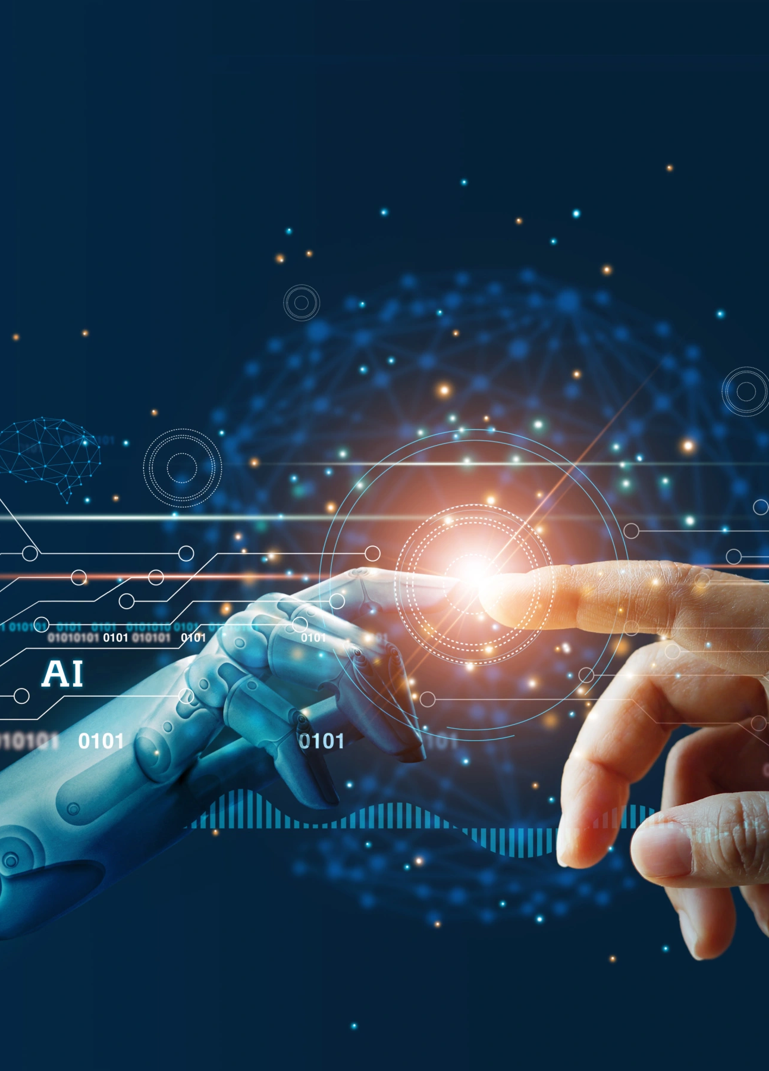
Team roles and responsibilities
Damien – oversaw putting together the presentation and website.
Taj – in charge of researching and helping with presentation.
References-
Dinicu, A. (2022). A New Global Competition is on the Rise. Artificial Intelligence as a Means of Gaining a Competitive Military Advantage. Land Forces Academy Review, 27(4), 368-375.
Fawkes, A. J. (2017, May). Developments in Artificial Intelligence: Opportunities and Challenges for Military Modeling and Simulation. In Proceedings of the 2017 NATO M&S Symposium (pp. 11-1).
Hoadley, D. S., & Lucas, N. J. (2018). Artificial intelligence and national security.
Horowitz, M. C. (2018). Artificial intelligence, international competition, and the balance of power. 2018, 22.
Khan, F., Kumar, R. L., Kadry, S., Nam, Y., & Meqdad, M. N. (2021). Autonomous vehicles: A study of implementation and security. International Journal of Electrical & Computer Engineering (2088-8708), 11(4).
Meerveld, H. W., Lindelauf, R. H. A., Postma, E. O., & Postma, M. (2023). The irresponsibility of not using AI in the military. Ethics and Information Technology, 25(1), 14.
Orlansky, J., & String, J. (1981). Cost-effectiveness of maintenance simulators for military training. Institute for Defense Analyses Alexandria VA Science And Technology Div.
Szabadföldi, I. (2021). Artificial Intelligence in Military Application–Opportunities and Challenges. Land Forces Academy Review, 26(2), 157-165.
Tolsgaard MG, Pusic MV, Sebok-Syer SS, Gin B, Svendsen MB, Syer MD, Brydges R, Cuddy MM, Boscardin CK. The fundamentals of Artificial Intelligence in medical education research: AMEE Guide No. 156. Med Teach. 2023 Jun;45(6):565-573. doi: 10.1080/0142159X.2023.2180340. Epub 2023 Mar 2. PMID: 36862064.

