Slide 1



Automated S3 Blocking with AWS Macie and DataCop
By Damien Burks
Notes:
Introduction – introduce yourself bio – say who you are.
Name – Damien Burks
I’m a Cloud Security Engineer at Citi bank currently, however, this presentation is this tool that I developed based on a noticeable gap within a particular AWS service for incident response purposes. So today, I’m going to talk about automated S3 blocking in AWS.

Slide 2
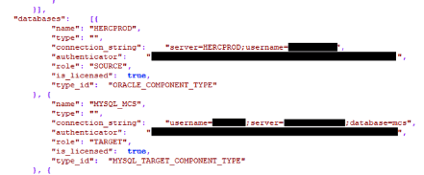
Why should we even block S3 buckets?
Buckets have been exposed quite frequently within the past couple of years.
Data that is commonly exposed:
Personally Identifiable Information (PII)
Credentials & Tokens
The common cause(s) of data exfiltration:
Lack of access control
Lack of monitoring
Misconfiguration
Exposed Netflix DB Credentials
Notes:
Why should we even block S3 buckets?
- Talk about the increase in the number of buckets
Common causes of data exfiltration ():
Lack of AC -> misassignment of roles and permissions that are associated with those buckets
Lack of monitoring -> we don’t necessarily know what data is going in or out, and sometimes we’re writing things through automation.
Misconfiguration -> a combination of them both – hell and heaven (nightmarish)

Slide 3
Scenario: Genericx
An example organization, Genericx, is a mid-size mobile gaming company that caches server and user data within several S3 buckets and on-premise. This company operates out of a single account, utilizing several AWS services such as EC2, Lambda, and CodeCommit/CodeBuild. Within the past year, this organization has sold over 1000+ copies of their hit mobile game – AngryDolphins.
Based on its userbase, Genericx has a data compliance/classification policy that must be enforced to protect the users. Because it’s a small organization, it must ensure that the S3 buckets are not publicly accessible. In addition, their standards prohibit storing internal data and sensitive customer data (PII and PCI) within AWS.
After the influx of the creation of S3 buckets, management has requested the security engineers to execute a Macie scan job against all S3 buckets.
Notes:
Set this up ☺

Slide 4
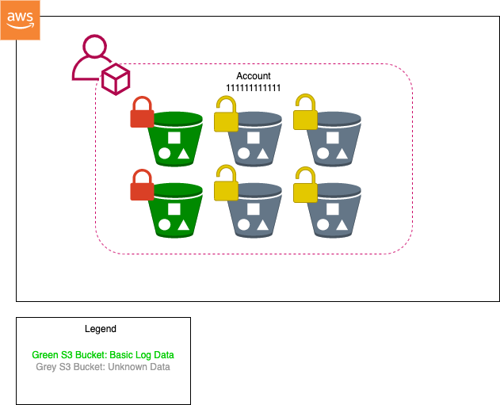
Scenario: Genericx Bucket(s) (cont.)
Notes:
At this point, we are only focused on one thing – that is, generic buckets that are associated with everything.

Slide 5

S3 Monitoring Solution: Macie
Data security/privacy service that leverages machine learning and pattern matching to discover sensitive data in AWS, specifically AWS S3.
Automatically provides an inventory list of S3 buckets and classifies them.
Helps organizations meet data compliance regulations such as GDPR and HIPPA.
Notes:
Read the text book definition for Macie – and this is the symbol/logo

Slide 6
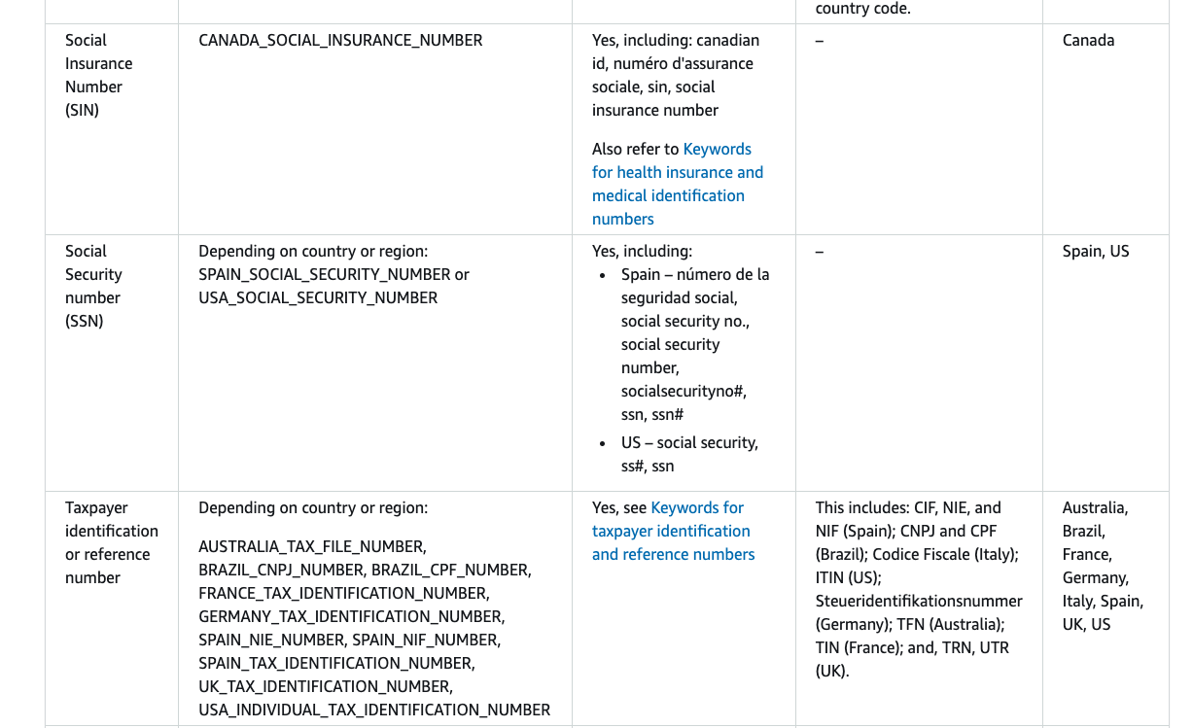
Macie: Pros & Con(s)
Pros
Fully-managed sensitive data types
Seamless integration with several other services such as AWS EventBridge, CloudWatch, and Step Functions.
Customizable data types and fields for data/risk classification
Can create automated sensitive data discovery jobs that run on a specific basis.
Cons
$$$ - Expensive
Returns a bloated JSON file
No feature available for auto-remediation of buckets. ☹
Macie’s Managed Data Types
Notes:
Pros:
Bullet 1: Fully-managed sensitive data types -> refer to the image on the left-hand side. AWS has data types and configurations for you to scan your files. SSNs, SINs, etc etc. It’s not just limited to a specific country – spans internationally
Bullet 2: Integration with other services – very important for the open source tool that I’ll discuss
Bullet 3: Customizable data types and fields for data classification: you can create your own data types and classifications for Macie
Cons:
Note that it is an expensive service due to the machine learning and pattern matching capability for each file within an S3 bucket.
No feature available for auto-rem of buckets ☹: it just tells you that this bucket is a risk (high, medium, low) and doesn’t tell you anything.

Slide 7
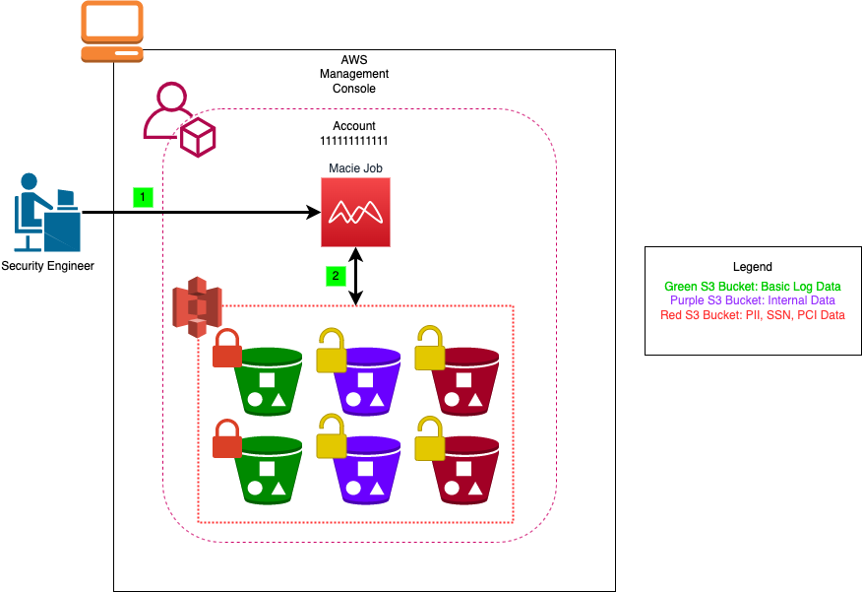
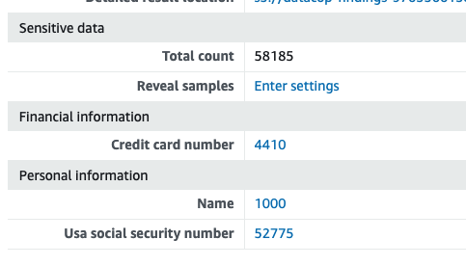
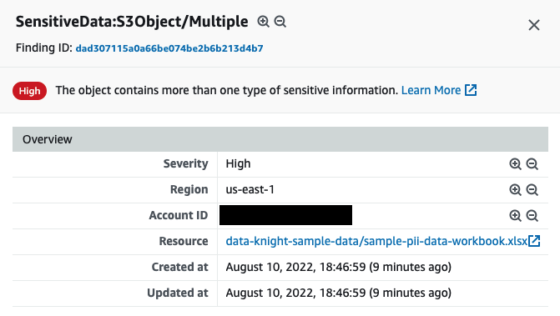
Scenario: Genericx S3 Bucket(s) (cont.)
Notes:
Talk about the next steps
Scenario steps:
Security Engineer creates a Macie job and executes it against the six s3 buckets
Macie begins scanning the S3 buckets – meaning it parses through all the data within the S3 bucket itself and classifies the data accordingly. One thing to mention is that we’ve made a few adjustments to Macie that classifies any internal data as a High risk ☺

Slide 8
What would it look like if we wanted to manually block S3 buckets after a Macie scan?

Slide 9
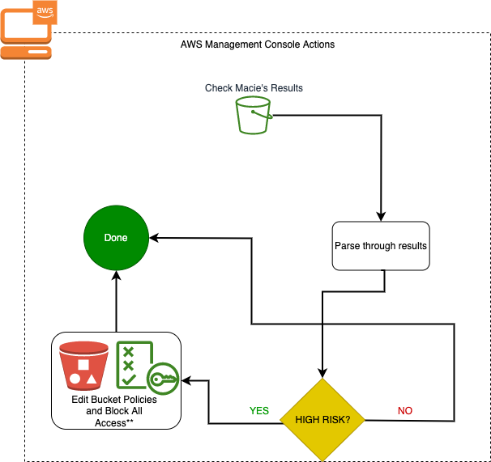
Exploring Manual Blocking
The diagram to the right shows steps for blocking a single S3 bucket classified as a high risk.
Downsides:
Time-consuming
Increased probability of user error
Lack of scalability
Notes:
Per each S3 bucket, we have to iterate through this process:
Check the results from Macie in the S3 bucket
Parse through those results (which is a horribly long JSON file btw)
Check to see if this bucket is a high risk – and if it is, then we’re going to perform blocking actions
Done

Slide 10
DataCop Overview
An open-source AWS framework that mitigates the potential of vulnerable S3 buckets.
Leverages Macie results to automatically block S3 buckets that contain PII or any classified information.
Features:
Automatically provisioned infrastructure to bridge the cap between Macie and S3 with AWS CDK and Python
Configurable settings for bucket blocking
Event-driven S3 bucket blocking
Notes:
AWS Cloud Development Kit (AWS CDK) is an open-source software development framework to define your cloud application resources using familiar programming languages.

Slide 11
“Considerations”
There are quite a few IAM permissions and policies that must be created in order for the following services to be utilized:
EventBridge
Lambda
CloudWatch
SNS
Step Function
DataCop creates the needed roles and permissions for all the above services. However, it will not modify any SCPs that you have defined (intentional).
Notes:
SNS – sending emails to end users
EventBridge – configured rules for detecting events to Macie’s result bucket
Lambda – used for performing blocking actions serverless
Step Function – visual workflow service that relies on the lambda to execute blocking actions in a specific order
IAM – Lots of permissions delegated to the role needed for the execution role.

Slide 12
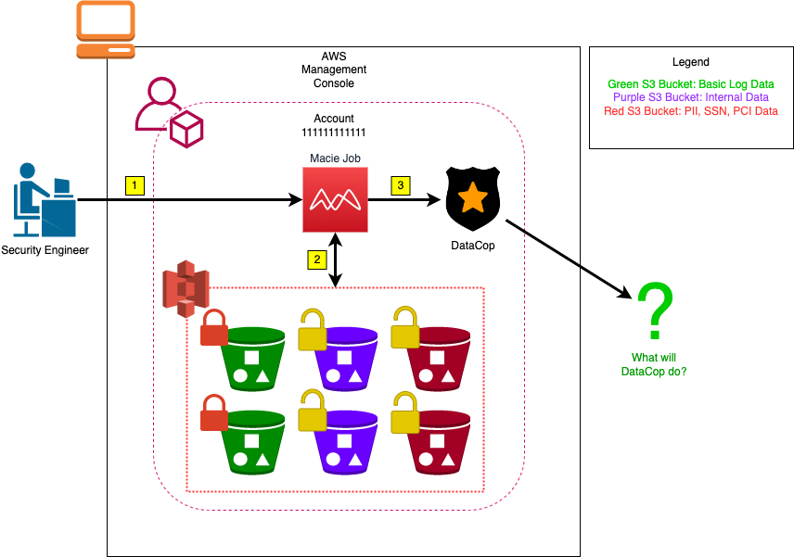
Scenario: Genericx Bucket(s) w/ DataCop
Notes:
Things to mention:
DataCop has been deployed in this account and is configured to block S3 buckets with a severity of HIGH.
Reiterate steps 1 and 2,
Step 3, the Macie’s results have finished and have been published to the DataCop framework. The question is what comes next?

Slide 13
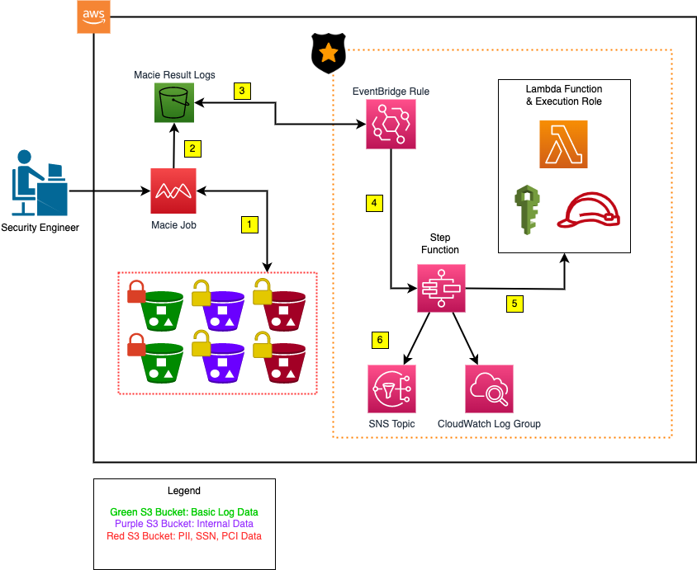
Scenario: Genericx Bucket(s) w/ DataCop (cont.)
Notes:
Let’s talk about the DataCop framework in more detail (lots of moving pieces)
1. Security engineer executes a macie job against the list of buckets
2. When the job is complete, the results from Macie are published. Mention: JSON file that contains a running log of all the violations within each S3 bucket and the findings from the object within the file. The object can be a spreadsheet full of data.
3. Once the results are published, the event bridge service(rule) will detect the actions and take the event payload that comes from it
4. The event data is then sent to the Step Function, which is going to execute a sequence of blocking actions for the S3 bucket.
5. The step function will interact with a lambda function to do the dirty work. The lambda will have the permissions necessary to execute those actions against the buckets themselves
6. Pass or fail: email is sent out to the subscribed users. Once this framework is deployed, the email address that is supplied will be the default user that is subscribed to it.

Slide 14
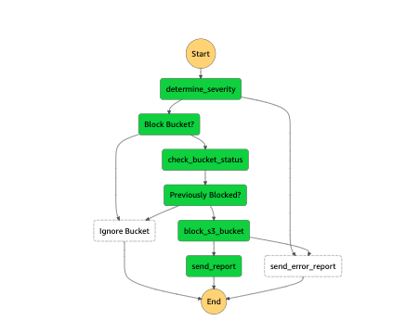
DataCop State Machine
Total of seven states within a step function – or state machine.
Key states:
determine_severity
check_bucket_status
block_s3_bucket
send_error_report
send_report
Notes:
So about those states for the step function – what does it do?
States
determine_severity: Parses the Macie results file in S3 and grab the bucket
Check_bucket_status: Checks the bucket’s status to see if it has already been blocked
Block_s3_bucket_status: If not, then it’ll block the bucket by attaching two things (deny all policy) and revoking public access
Send_error_report: If anything happens at this state, or the determine_severity state, it’ll send an error report to the subscripted user-base
Send_report: Sends a report of the blocked bucket.

Slide 15
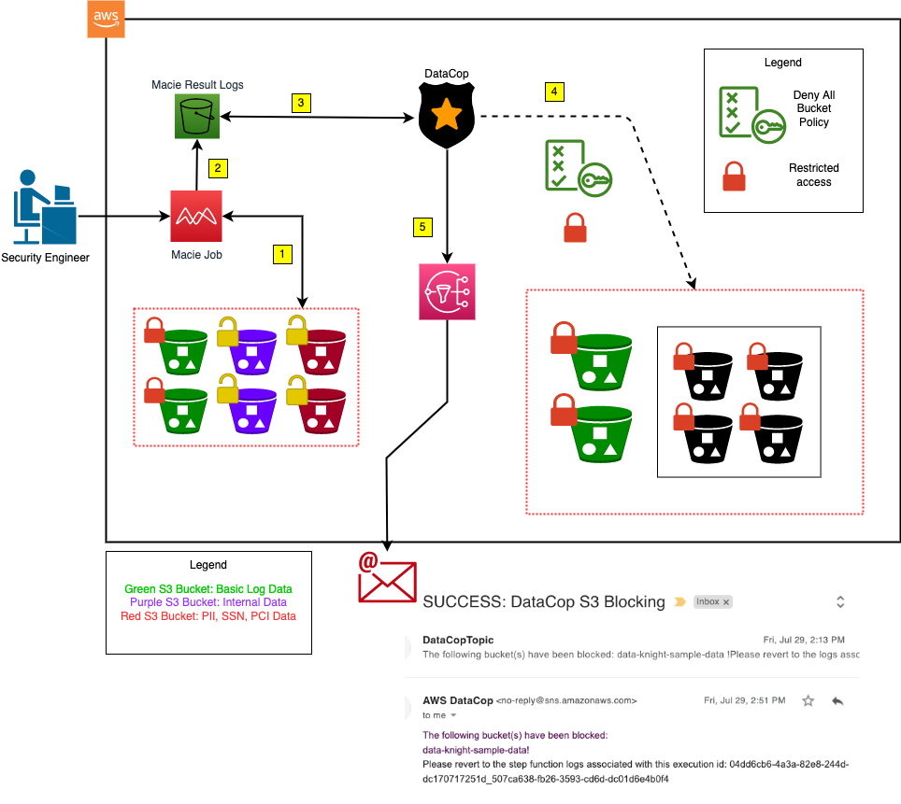
Scenario: Genericx Bucket(s) Solution
Notes:
This is the solution – in what it would look like within the account. We have all of this good stuff here ☺
TODO: Make a few adjustments to the diagram for this slide. Maybe add in the account for AWS.

Slide 16
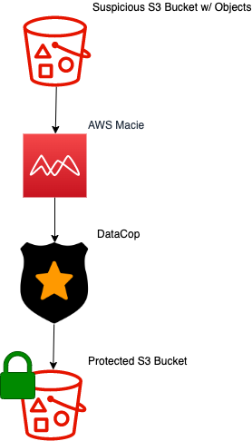
Benefits of DataCop
Eliminates the complexity of repetitive/mundane tasks for blocking S3 buckets.
Eliminates the potential for human error
Reduced response time
Scalable!
Notes:
Bullet Points:
1: Ex. Blocking access to S3 Macie file inspection, etc.
2: Inspecting JSON file = bad.
3 & 4: Because it’s scalable, it will take less time to respond to threats within your environment. Having one person in charge of blocking 100 S3 buckets might just take all week ;)

Slide 17

Thank you!
Thanks for listening! Please scan the QR code for links to DataCop and more!
Shoutout to DevOpsDays – Dallas organizers for a great conference and for allowing me to speak!

