Slide 1
Big O Notation

Slide 2
What We’ll Be Learning
What is Big O Notation and why is it important?
Time Complexity and Space Complexity
Simplifying Big O Expressions
Using Big O Notation to evaluate an algorithm’s time and space complexity
WARNING : We need to learn a few things that involve math and logarithms
BUT : Don’t worry, we’ll try to make this as painless as possible!!!

Slide 3
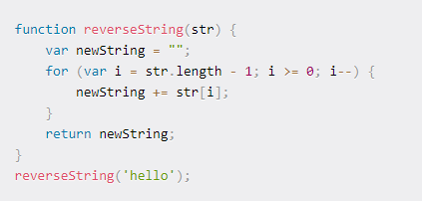
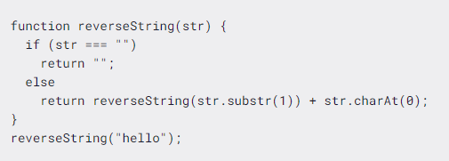
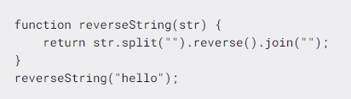
The What and Why
Imagine we are given the task of writing a function that takes in a given string and then returns the reversed copy of that string…
There are tons of ways that we can solve this problem…
…but how do we figure out the best approach to solving this?

Slide 4
A Few Analogies
Earthquakes
To study earthquakes, we start with the richter scale…
Chemistry
To study chemistry, we start with the periodic table…
Working Out
To study weight lifting, we start with form…
Same applies to Algorithms…
To study algorithms, we start with Big O Notation…
This will allow us to talk about algorithms with generalized labels that help us to compare and evaluate the performance of our algorithms

Slide 5
Why Is Big O Important?
We need a vocabulary - a way of talking about how our code is performing
Helps us understand the difference between two or more algorithmic approaches or solutions that can be used to solve the same problem
When applications scale, it’s important that we are able to identify parts of our code that are inefficient so that we can improve the performance of our apps
This is a very common topic in technical interviews

Slide 6
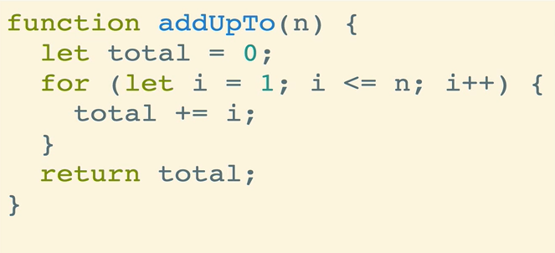
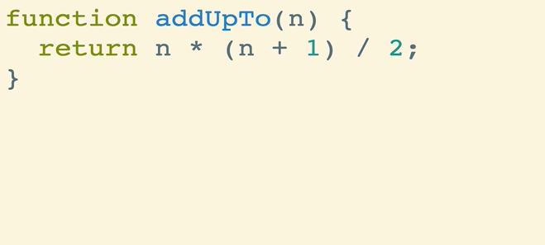
Example
Create a function that sums all numbers from 1 through some number N
Solution #1 Solution #2
Which one is better ???

Slide 7
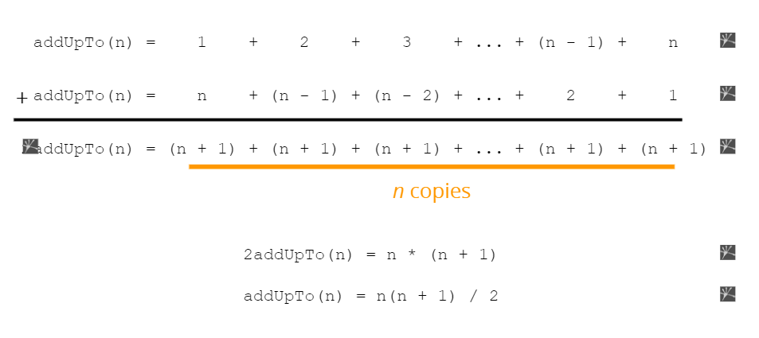
MATHS
(ノಠ益ಠ)ノ彡 ┻━┻
(┛ಸ_ಸ)┛彡 ┻━┻
(•ˋ _ ˊ•)
（┬┬＿┬┬）

Slide 8
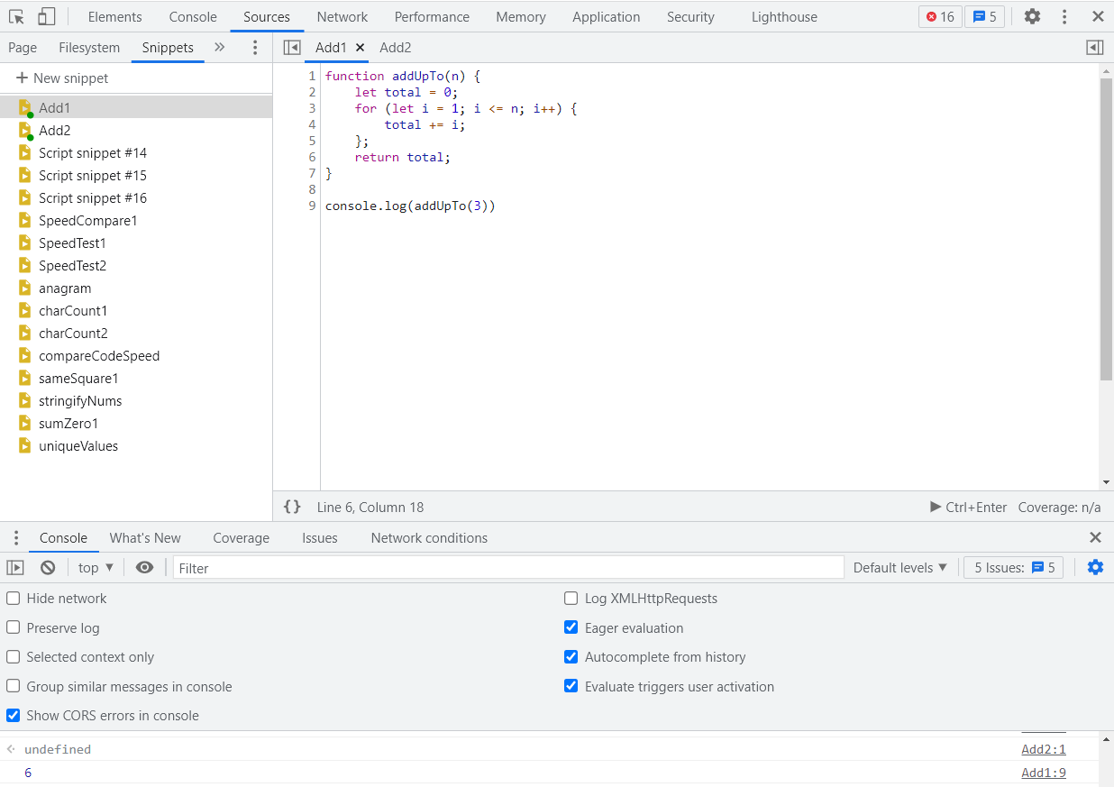
The Snippet Tool
In this course, we’ll make use of something that is built into your browser called the Snippet Tool
Snippets allow us to create functions in the browser using plain old Javascript.
Snippets allow us to run these expressions whenever we want and save them for later use

Slide 9
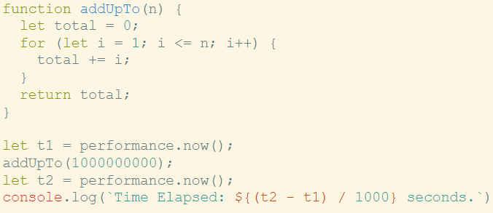
What do we mean by better?
Is it about speed?
Is it about the brevity or readability?
Is it about memory allocation?
All of these are important… but for right now… let’s focus on speed

Slide 10
But this isn’t really what we want to do…
Different computers will evaluate to different times
The same computer will evaluate to different times as well
For fast algorithms, these measurements are not accurate enough
In other words, this is not a reliable way to ACCURATELY compare the performance between different algorithms
Timing your functions can be useful - for sure - but it is not the ideal way to compare algorithmic performance when it comes to “speed”
This is where Big O Notation comes in…

Slide 11
How do we measure performance?
We count the number of operations that the computer has to perform for a given algorithm
Unlike milliseconds or seconds from a javascript timer, the number of operations is going to be constant for a given algorithm
2 assignments
n comparisons
1
2
3
n assignments
n additions

Slide 12
How do we count this?
In the more cluttered approach to this, we had something that could have up to 5n + 2 operations
The low end of this solution would still involve 2n operations
Regardless of the exact numbers of the constants involved, this algorithm’s number of operations grows in proportion to n
As for the first example, what matters is not the number 3 per se, but the fact that the operations are proportional to a constant
This means that regardless of the value of n the algorithm will only perform three total operations - which is constant
For the second example, as n grows, the numbers of total operations needed to evaluate the expression will grow in proportion to n (i.e. if n = 100,000, there will be 100,000+ operations that need to be executed)

Slide 13
VISUALIZING TIME COMPLEXITY

Slide 14
What Exactly Is Big O Notation?
Big O Notation is simply a way for us to formalize an approach to keeping track of the complexity of our algorithms
This allows us to talk about the overall runtime of an algorithm as its inputs grow in size
With Big O, we DO NOT care about the exact details of how the algorithm is running, but instead, it is paying attention to the overall trend
Definition: Big O notation is a mathematical notation that describes the limiting behavior of a function when the argument tends towards a particular value or infinity. - Wikipedia
An algorithm is O(f(n)) if the number of simple operations the computer has to do is eventually less than “a constant times f(n)”, as n increases - CS Person

Slide 15
What can Big O be?
O(1) - Big O can be constant
O(n) - Big O can be linear
O(log n) or O(n log n) - Big O can be logarithmic
O(n^2) - Big O can be quadratic
O(2^n) - Big O can be exponential
O(n!) - Big O can be, but rarely is, proportional to a factorial (um, what?)
Important : When we are talking about Big O, we are talking about the worst-case scenario or upper bound for an algorithm’s runtime
Note : runtime will always vary in the real world, but with Big O notation, we are only worried about the general overall trend

Slide 16
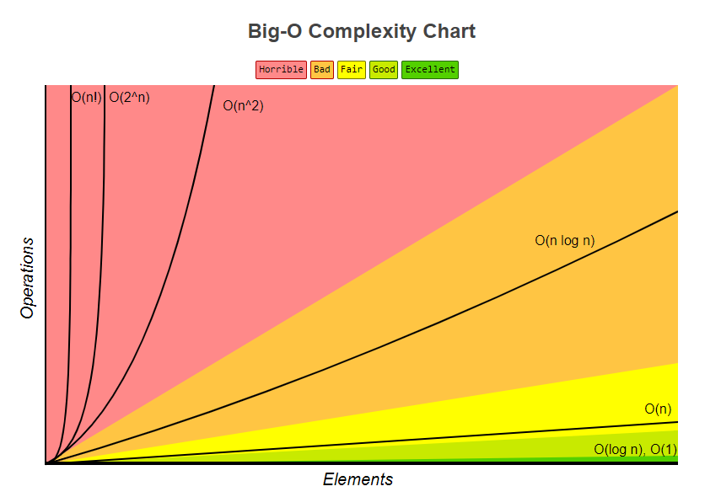
https://www.bigocheatsheet.com/

Slide 17
Example #1
O(1)
O(n)

Slide 18
Example #2
function oneAfterAnother (n) {
console.log(“the one”); for ( let i = 0; i < n; i++ ) { console.log(i); }
console.log(“one after”); for ( let j = 1; i < n; i++ ) { console.log(i); }
console.log(“done”)
}
The number of operations is bounded by a multiple of n, so we say that this algorithm scales in a linear fashion.
The Big O is:
O(n)

Slide 19
Example #3
function printPairs (n) { for ( let i = 0; i < n; i++ ) { for ( let j = 1; i < n; i++ ) { console.log(i,j); }
}
The number of operations is bounded by a multiple of n squared because of the nested loops, so we say that this algorithm scales quadratically
The Big O is:
O(n^2)

Slide 20
Rules For Evaluating Big O Expressions
Constants and Smaller Trends DO NOT matter
O(4n) → O(n)
O(167) → O(1)
O(9n^2) → O(n^2)
O(5n^2 + 10n + 7) → O(n^2)
O(16n + 1300) → O(n)
Basic Rules Of Thumb (For Time Complexity Only)
Arithmetic operations and variable assignments → Constant
Accessing elements in an array but index → Constant
Accessing objects by key → Constant
Complexity of loops is the length of loop times complexity of what is inside the loop itself

Slide 21
Space Complexity
We can also use Big O notation to analyze the Space Complexity of our algorithms - i.e. How much memory the computer needs to allocate to successfully run our code.
Space complexity refers to the space required by the algorithm itself, not the space required of our given inputs
Booleans, numbers, null, and undefined values are constant in space O(1)
Strings depend on the length (n) of the string, so they are O(n)
Arrays and objects are proportional to their respective length and number of key value pairs, so they too are O(n) in space complexity
A good example: consider the running total algorithm. It has O(1) space

Slide 22
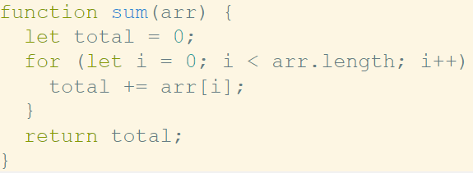
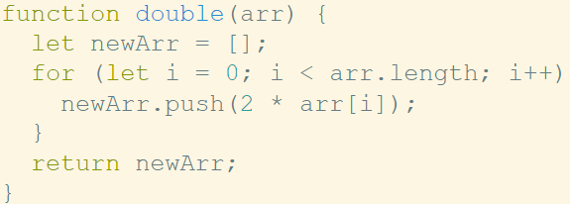
Examples
O(1)
O(n)

Slide 23


The Mathy Part :(
Sometimes Big O expressions are more complex… and one that will appear often is the logarithm… O(log n) and O(n log n)
What does log do?
Which is the same thing as saying:
In general:
log base number (value) = exponent ⇒ (base number) ^ exponent = value

Slide 24
More Log Stuff
Logarithmic time complexity is awesome!
O(log n) is nearly as good as Constant time
O(n log n) is better than quadratic time complexity but worse than linear time
A lot of algorithms that you’ll see have logarithmic time complexity
This includes some of the more efficient sorting algorithms
Recursive algorithms actually have logarithmic space complexity (!)

Slide 25
Conclusion
We use Big O Notation to analyze the overall performance of algorithms
Gives us a high-level understanding about the time and space complexity of a given algorithm
Big O Notation is not precise - we only care about the generalized trends of an algorithm’s performance as the input scales in size
These measurements of complexity only depend on the algorithm itself… we do not care about the hardware (just remember that PC > Mac)
Big O Notation WILL come up in your technical interviews so be sure to practice this concept a lot
As this course progresses, we will refer to Big O ALL THE TIME
You may have to memorize some of the Big O trends that belong to certain algorithms but by the end of this course, you will!

