Slide 1
Sorting
Algorithms
Part 1
Getting Things In Order

Slide 2
What We’ll Be Learning & Why
Why learning simple sorting algorithms is important
We’ll learn about Bubble Sort, Selection Sort, and Insertion Sort
Why Learn Sorting Algorithms?
Sorting is a very common task, so in general, it is important to know how it works
There are a plethora of approaches and techniques to sorting, all of which have their respective ups and downs when executing them in various situations
There are a lot nuances and quiks involved with learning sorting algorithms, even the basic ones that we’ll be learning about today, so it’s important to understand them so you can deal with them in an interview situation
What exactly is sorting?
Sorting is simply the process of moving around and rearranging items in a collection/array so that they can have a specified order to them
Examples: we can sort things alphabetically, by size, by date, or whatever we are interested in
Sorting is a fundamental aspect in coding and you’ll see it in your interviews

Slide 3
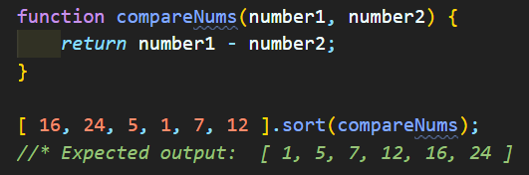
The Built-In Array.sort( ) Method
Javascript comes with a built-in sorting method that we can use on any array of values, but it doesn’t always sort the way you want it to.
Under the hood, the sort method looks at each pair of elements (x and y) and determines their order based on the what the comparison returns
If it’s negative, x will come before y; If it’s positive, y comes before x
If it’s zero, that means that x and y are the same value
We can pass in and optional parameter called a “comparator”, which is a function that we can create to indicate to Javascript how exactly we want to the data to be sorted
Example:
If we wanted to sort in the opposite order, we would simply sway number1 with number2 in our function
When running this in the browser, Chrome uses something called Timsort while Firefox actually uses Merge Sort

Slide 4
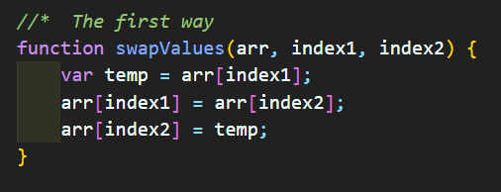
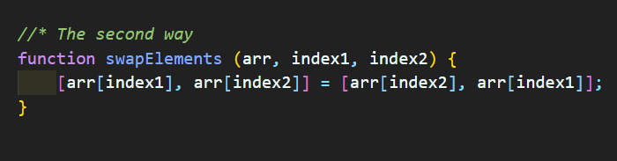
The Approach To Basic Sorting
Most sorting algorithms, as we will see shortly, involve functionality that will “swap” elements in order to sort things accordingly
This involves doing something very similar to what we saw on Day 2 when we were counting unique values in an array. If you recall, we created a temporary variable that held the value of something so that we could “swap” it’s value with its neighbor as it aligned unique values to the beginning end of the array
Two Ways Of Swapping:

Slide 5
Bubble Sort
The first sorting algorithm that we’ll be learning is called the Bubble Sort
Bubble sort does exact what its name implies, it “bubbles” up the values to the end of the array depending or your sorting criteria
A Simple Example:
[ 33, 3, 9, 11 ]
[ 3, 33, 9, 11 ]
[ 3, 9, 33, 11 ]
[ 3, 9, 11, 33 ]
[ 3, 9, 11, 33 ]
Using the “swapping” functions that we just introduced, we can easily “bubble” higher values to the end of the array
Let’s go through the pseudo-code for this sorting algorithm and give it go!

Slide 6
Bubble Sort Pseudo Code
First, we start by defining a function that accepts an array
Next, we want to create an outer loop that loops from the end of the array to the beginning of the array
Then we’ll create a next inner loop that loops from the beginning of the array until it reaches ( i - 1 )
Inside of the inner loop, we’ll check to see how arr[j] compares to arr[j+1] (the neighboring element ahead) and we’ll swap those values if the former value is greater than the latter value
After the loops, we’ll return the sorted array.
It helps to think of the outer loop as a “bounding” filter that decements each iteration through b/c the inner array can only loop up until ( i - 1)
Now it’s your turn to implement it!

Slide 7
Insertion Sort
With the insertion sorting algorithm, we essentially mimic the way we did the unique values algorithm – we build up our sorted array on the left side of the array as a sub-array (more or less)
We complete this by starting at the left-most index and evaluate, one by one, the next element to the right of the sub array we are constructing
It looks at each value and inserts that value into the subarray where it belongs
A simple example:
[ 11, 3, 33, 9 ]
[ 11, 3, 33, 9 ]
[ 3, 11, 33, 9 ]
[ 3, 11, 33, 9 ]
[ 3, 9, 11, 33 ]

Slide 8
Insertion Sort Pseudo Code
First, we need to create a function that accepts an array
Next, we need to access the first and second element of the array so that we can compare the two values with one another
If the second element is less than the first, then we need to swap them
We then continue on to the next element, one by one
If they are not in the correct order, then we start looping through the already sorted portion at the beginning of the array and “insert” the element into the correct spot as to keep the left side of our array sorted
We will repeat this process over and over until the entire array is sorted
Now that we understand what insertion does, it’s your turn to code it!

Slide 9
Selection Sort
Selection sorting is very similar to both the previous sorting algorithms that we’ve seen thus far. It does something similar to bubble sort but with smaller values - like we do with insertion sort - instead of larger values.
It will look at the first item in an array and then check the value of each of the remaining items in the array, and then it will swap the first item with the item that corresponds to the lowest value in the array
It continues this process for each index of the array until the array is sorted
Here’s a quick example:
[ 9, 3, 33, 11 ]
[ 9, 3, 33, 11 ]
[ 3, 9, 33, 11 ]
[ 3, 9, 33, 11 ]
[ 3, 9, 33, 11 ]
[ 3, 9, 33, 11 ]
[ 3, 9, 11, 33 ]

Slide 10
Selection Sort Pseudo Code
As always, we start by defining a function that accepts and array of values
We start by labeling the first element as the smallest in the array (so far)
Then we compare the item with the value of the item to the right, and then to the right of that, all the way to the end of the array, labeling the smallest value each time (if there is a smaller value)
When we hit the end of the array, the value labeled as the smallest should be selected and swapped with the item at the beginning of the array (unless the first item - of course - is the smallest already)
We increment the first pointer to the next indexed item in the array and repeat this process over and over until our array is finally sorted
Now that you’ve seen the pseudo code, it’s your turn to code it again.

Slide 11
Basic Sorting Recap
Sorting algorithms are super important in the professional coding world and will be essential for you to know going into your first coding interviews
Bubble Sort, Insertion Sort, and Selection Sort are very elementary and essentially do the same thing in slightly different ways - they all do swapping!
There are MUCH BETTER algorithms that we can use to sort collections
Remember: For these basic sorting algorithms, we often use swapping logic that can help us to swap values in a collection of data as needed
When To Use These Algorithms:
When your array is nearly sorted already → Bubble Sort, Insertion Sort
When you have data coming in “live” in your application → Insertion Sort
You’ll probably never find a reason to use Selection Sort

Slide 12
Conclusion
The sorting algorithms that we just learned have terrible Big-O performance with time complexity that are quadratic in nature
Even with these simple sorting algorithms, there are always ways to improve their overall performance
Become an expert with these and the harder ones will be way easier to pick up
Besides the few edge cases mentioned in the previous slide, there will hardly be a time when you’ll actually want to use these primitive sorting algorithms instead of the preferred and more efficient ones that you’ll see soon
That’s it for now! Tomorrow we’ll see more sorting algorithms that are much more complex but far more efficient than the basic ones your learned today.

