Slide 1


STATS 141XP: Cry Detection Classification
Ananya Garg, Carly Jeung, Damien Ha, Janice Chung, Jiaruo Ding, Ken Deng

Slide 2
Table of Contents
Introduction + Abstract
2. Literature Review
3. Methodology & EDA
4. Good Statistics: Modelling
5. Bad Statistics
6. Conclusions + Recommendations

Slide 3
1
Introduction & Abstract

Slide 4
Background & Problem Statement
Background
Can human babies’ cries give information about their underlying cause?
Understanding the emotions of a baby–tiredness, hunger, discomfort, or pain is importance in communication and intervention, especially because babies are unable to convey their needs and emotions through spoken language
Aim
By analysing data about the acoustic features of baby cries, we aim to understand whether or not we can extract information about the cause of a baby cry.
We train and test different models (including Logistic, KNN, Random Forest, and SVM) on our data to check classification accuracy

Slide 5
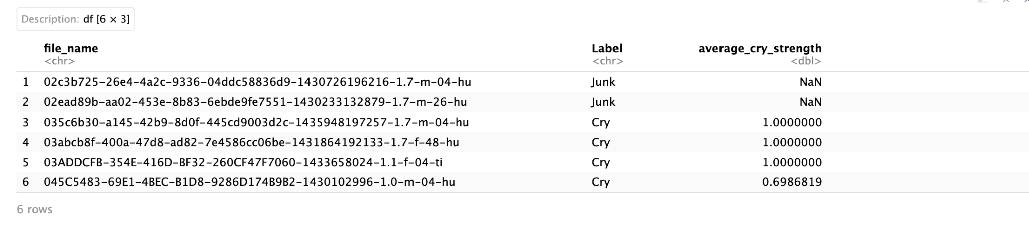
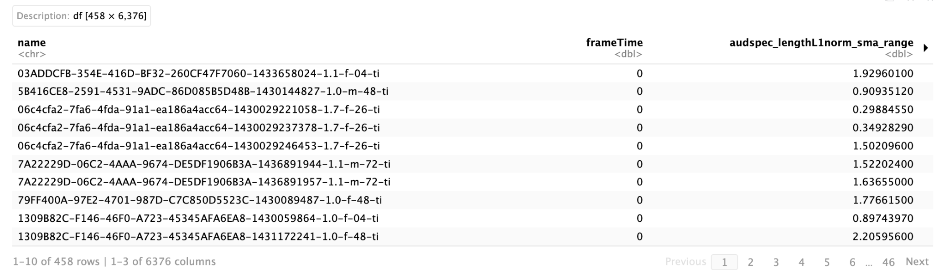
Introduction to the Data
Cry Detection Classifications
2. Acoustic Features Data
458 observations
Predicts whether cry is actually a cry vs. junk noise
458 observations, 6373 acoustic features
Gives information about acoustic features of audios of baby cries

Slide 6
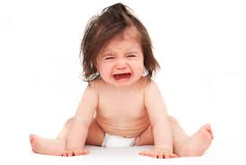
Abstract
In this project, our research is focused on conducting a thorough review of existing literature by meticulously reviewing scholarly articles to identify the advantageous and disadvantageous aspects of various models, while simultaneously constructing both reliable and intentionally flawed models using the Baby Cry dataset, in other words, being separately good statisticians and bad statisticians . Among the effective statistical models, we employed techniques such as Logistic Regression, KNN, Random Forest, and SVM. All the methods were conducted twice as both using all classes and only two classes due to the domination of one type of cry. Notably, the Random Forest model recorded the highest test accuracy, achieving 85.71%. Conversely, being bad statisticians, we used the unfiltered data to conduct the same four models as mentioned above again. When modelling parameters on entire data (including test set), the Random Forest Method got the surprisingly high accuracy (100%). The following slides will discuss the details of model algorithms and challenges we faced during our project.

Slide 7
2
Literature Review

Slide 8
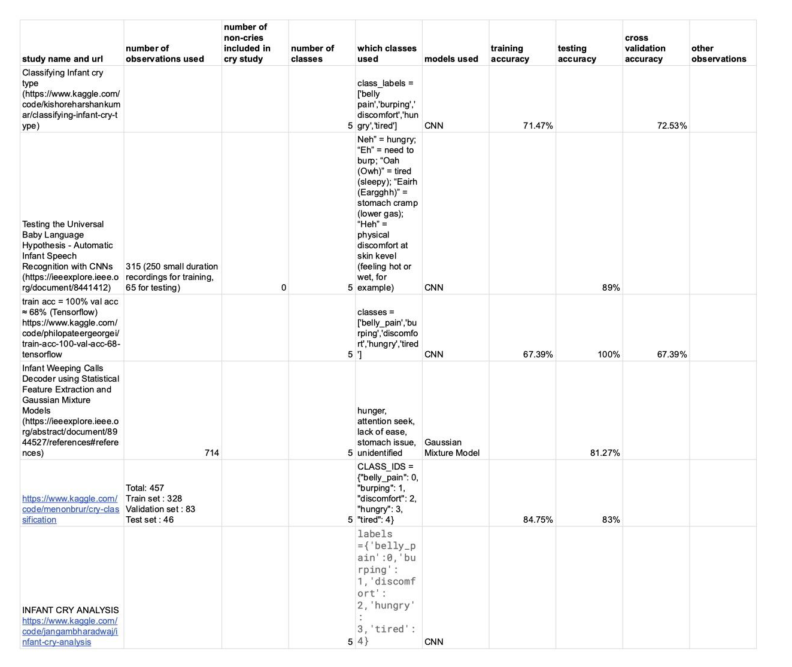
Literature Review
Looked at a total of 7 research studies
Majority use CNN models for classification
Testing accuracy ranges from 81% - 100%%
Very little acknowledgement of skewness of data:
Some studies don’t report cross-validation

Slide 9
3
EDA & Methodology

Slide 10
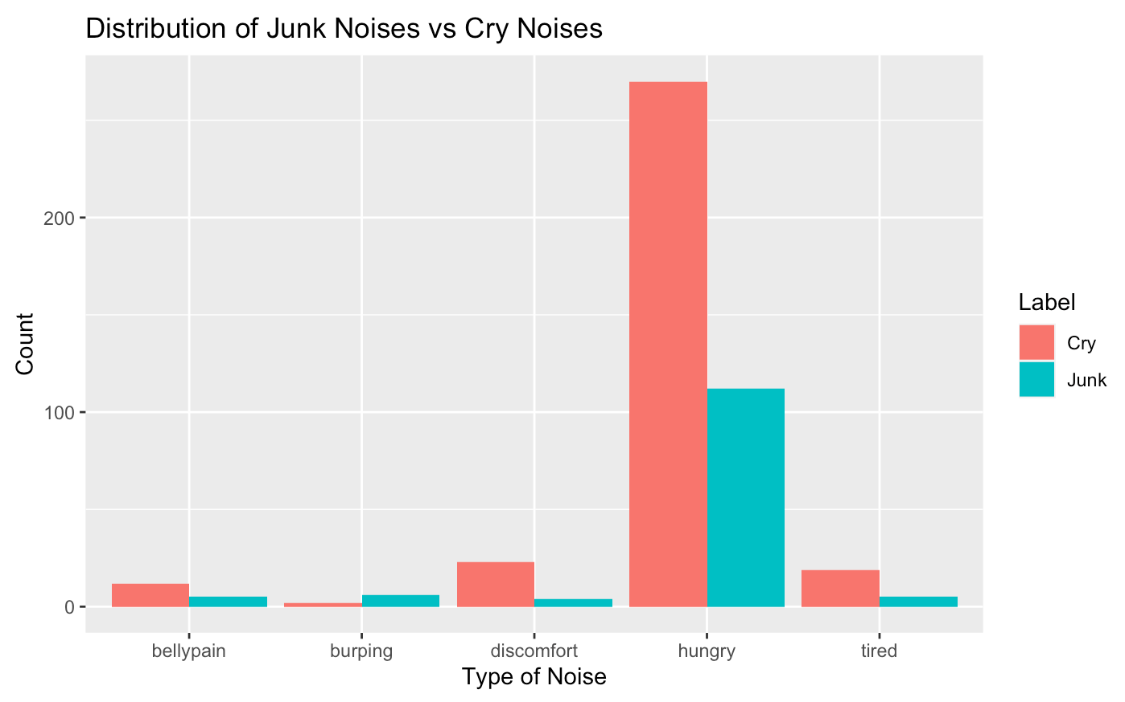
Exploratory Data Analysis
Outcome variable: prediction of cry noise with 5 classes
Out of 458 observations:
  83% are classified as ‘hungry’ - 382 obs.
  326 classified as cry noises vs. 132 classified as junk noises

Slide 11
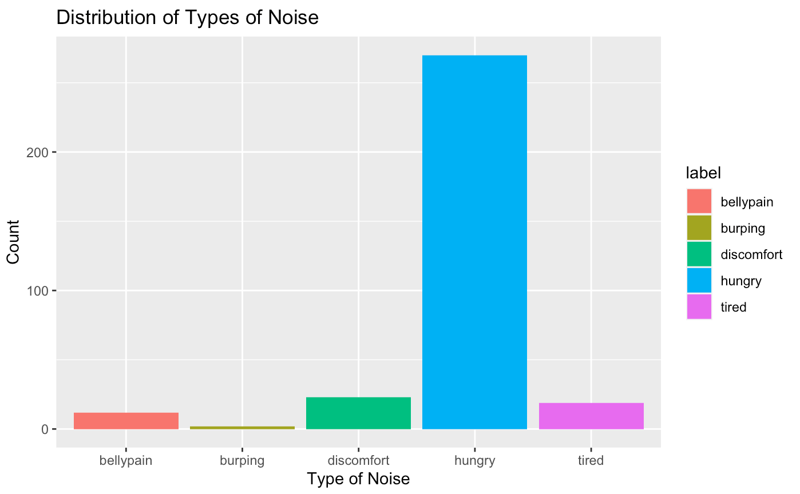
Exploratory Data Analysis - Filtering out Junk Noises
Type of Cry | Count
Belly | 12
Discomfort | 23
Hungry | 270
Tired | 19
Burping | 2
  326 observations - majority are classified as hungry

Slide 12
Methodology
Conduct PCA analysis on filtered data to find variables that contribute most to predicting the outcome variable
Train and test 4 different models: Logistic Regression, K Nearest Neighbours, Random Forest, and Support Vector Machines (SVM)
First train models to classify all 5 classes of types of cry & see prediction accuracy
Next, since ‘hungry’ has the most number of observations, split data into 2 classes: ‘hungry’ & ‘other’, and train + test models again to check if prediction accuracy increases

Slide 13
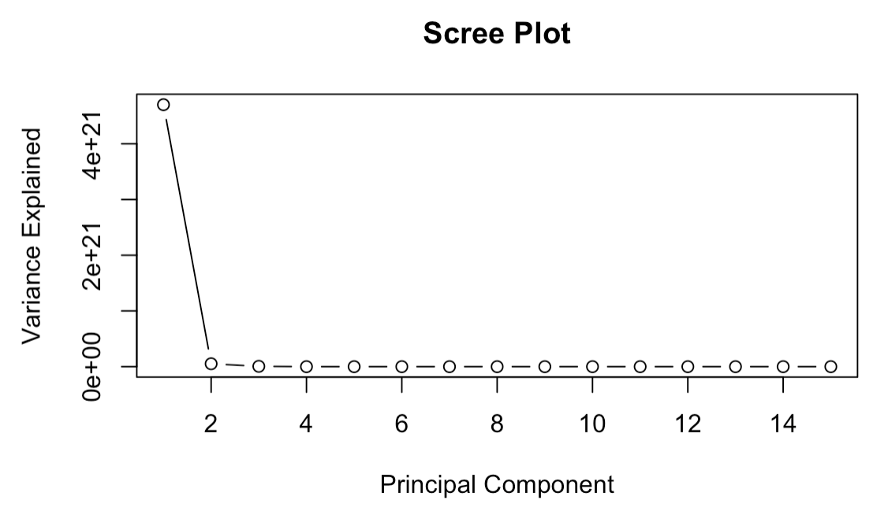
Principal Component Analysis
3 components that contributed the most to predicting the response variable

Slide 14
4
Good Statistics: Models

Slide 15
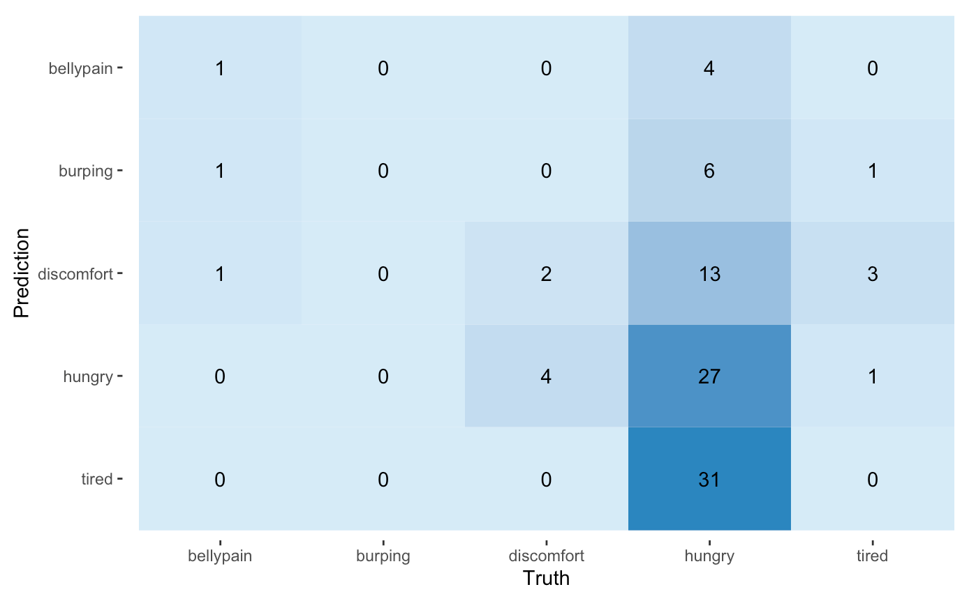
Logistic Regression - All Classes
 | Sensitivity | Specificity | Precision | Misclassification
Belly | 20% | 97.78% | 33.33% | 6.32%
Burping | 0% | 100% | NaN | 8.42%
Discomfort | 10.53% | 94.74% | 33.33% | 22.11%
Hungry | 84.38% | 14.29% | 33.33% | 62.11%
Tired | 0% | 92.19% | 0% | 37.89%
Testing Accuracy: 31.58%
Kappa: -0.0042

Slide 16
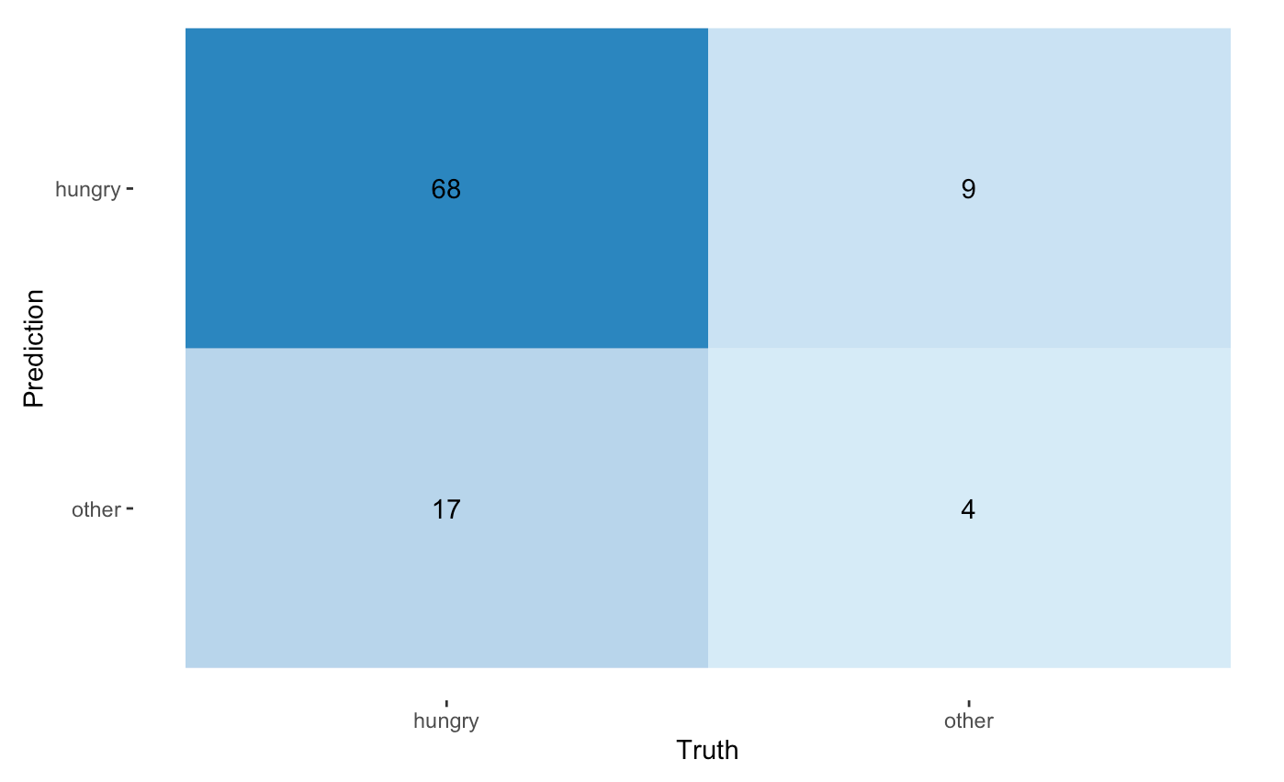
Logistic Regression - 2 Classes
Sensitivity | Specificity | Precision | Misclassification
88.31% | 19.05% | 80.00% | 26.53%
Testing Accuracy: 73.47%
Kappa: 0.0854

Slide 17
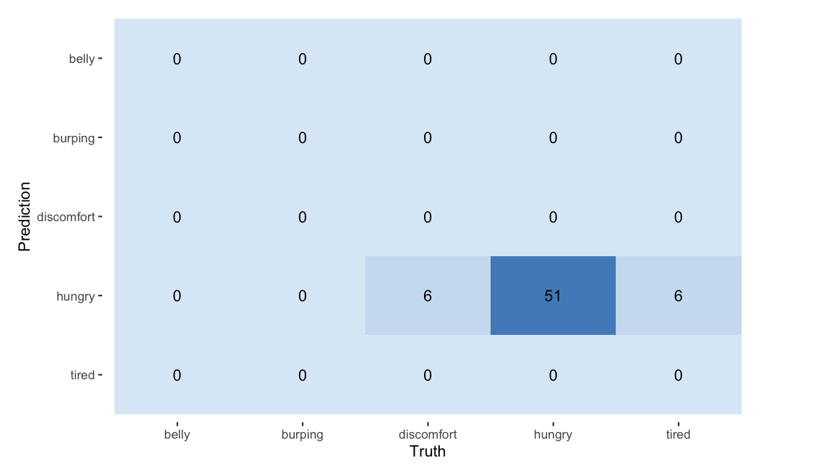
2. K Nearest Neighbours (KNN) - All Classes
 | Sensitivity | Specificity | Precision | Misclassification
Belly | NaN | 100% | NaN | 0%
Burping | NaN | 100% | NaN | 0%
Discomfort | 0% | 100% | NaN | 9.52%
Hungry | 100% | 0% | 80.95% | 19.04
Tired | 0% | 100% | NaN | 0.95%
Testing Accuracy: 80.95%
Kappa: 0

Slide 18
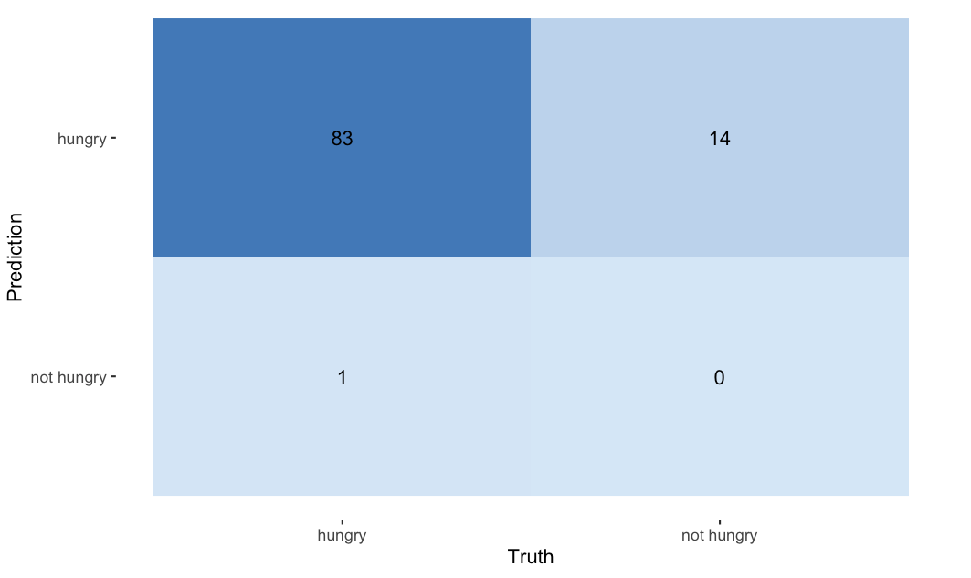
2. K Nearest Neighbours (KNN) - 2 Classes
Sensitivity | Specificity | Precision | Misclassification
98.81 | 0% | 85.57% | 15.31%
Testing Accuracy: 84.69%
Kappa: -0.0194

Slide 19
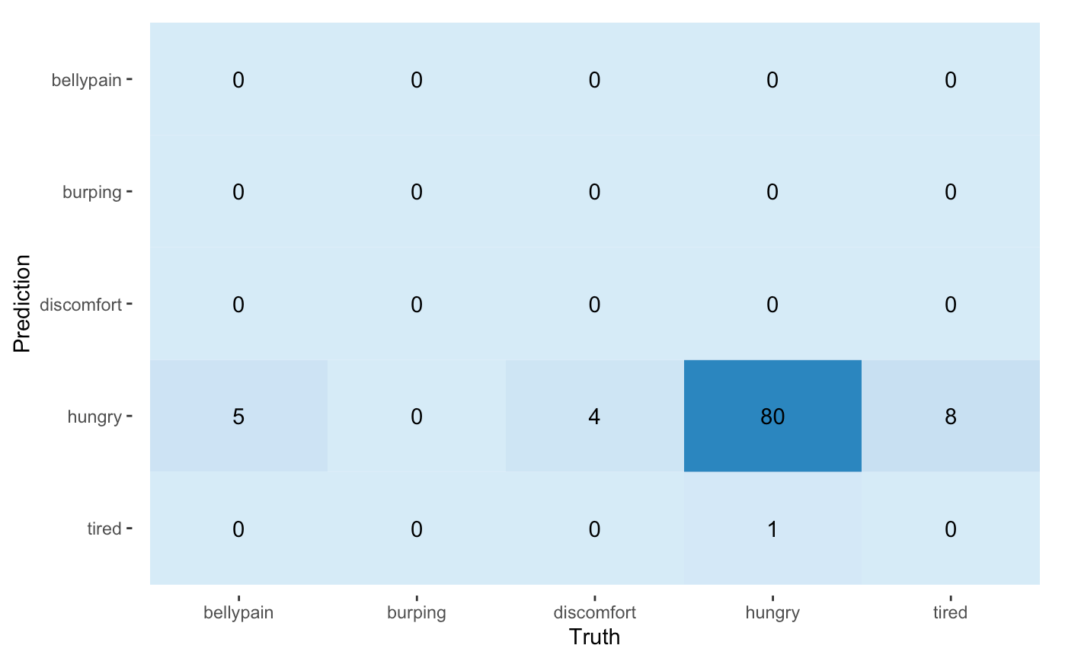
3. Random Forest - All Classes
 | Sensitivity | Specificity | Precision | Misclassification
Belly | NaN | 94.90% | 0% | 5.10%
Burping | NaN | 100% | NaN | 0%
Discomfort | NaN | 95.92% | 0% | 4.08%
Hungry | 82.47% | 0% | 98.77% | 18.37%
Tired | 0% | 91.75% | 0% | 9.18%
Accuracy: Train: 100%, Test: 81.63%
Kappa: -0.0144

Slide 20
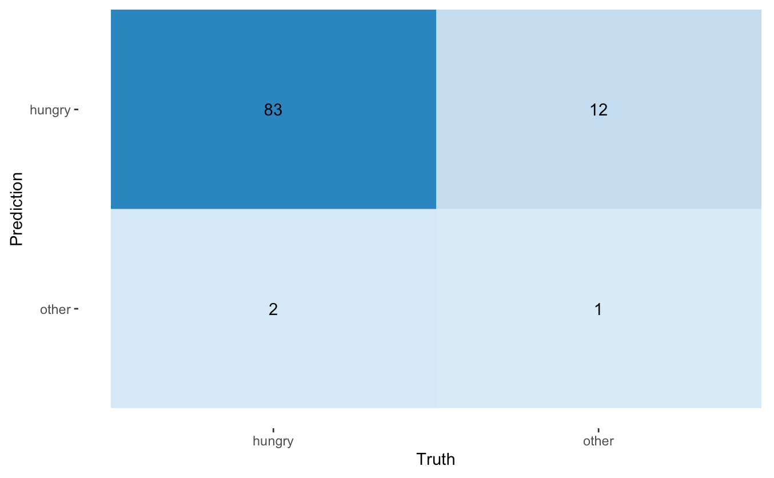
3. Random Forest - 2 Classes
Sensitivity | Specificity | Precision | Misclassification
87.37% | 33.33% | 97.65% | 14.29%
Accuracy: Train: 100%, Test: 85.71%
Kappa: 0.0792

Slide 21

4. Support Vector Machines (SVM) - All Classes
 | Sensitivity | Specificity | Precision | Misclassification
Belly | 0% | 100% | NaN | 93.88%
Burping | 0% | 100% | NaN | 98.98%
Discomfort | 0% | 100% | NaN | 91.84%
Hungry | 100% | 0% | 79.49% | NaN
Tired | 0% | 100% | NaN | 89.80%
Testing Accuracy: 74.49%
Kappa: 0

Slide 22
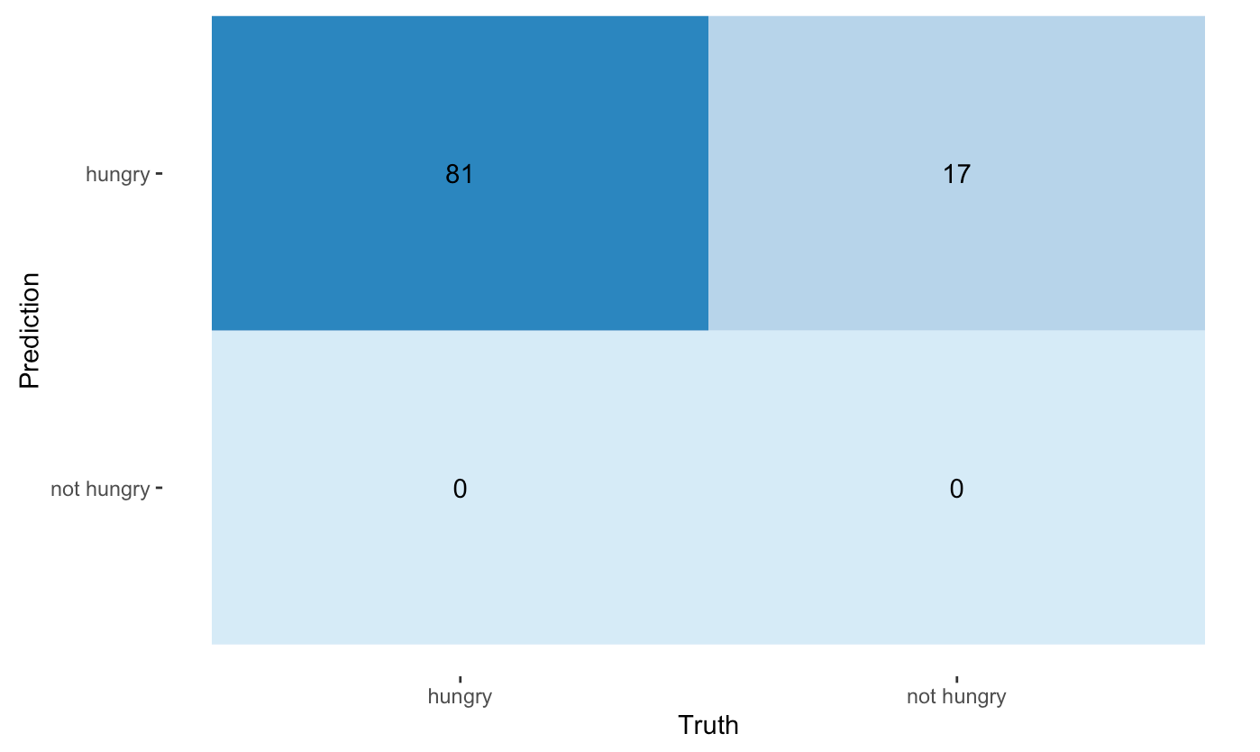
4. Support Vector Machines (SVM) - 2 Classes
Sensitivity | Specificity | Precision | Misclassification
100% | 0% | 82.65% | NaN
Testing Accuracy: 82.65%
Kappa: 0

Slide 23
Summary
Model | Testing Accuracy - All Classes | Testing Accuracy - 2 Classes
Logistic | 31.58% | 73.47%
KNN | 80.95% | 84.69%
Random Forest | 81.63% | 85.71%
SVM | 74.49% | 82.65%

Slide 24
5
Bad Statistics

Slide 25
Including junk cries in models
Model | Testing Accuracy
Logistic Regression | 83.82%
KNN | 84.78%
Random Forest | 81.02%
SVM | 39.86%

Slide 26
Modelling parameters on entire data (including test set)
Model | Testing Accuracy
Logistic Regression | 85.26%
KNN | 84.25%
Random Forest | 100%
SVM | 89.34%

Slide 27
Feature Selection Cherry Picking
Model | Testing Accuracy
Logistic Regression | 83.16%
KNN | 83.61%
Random Forest | 74.45%
SVM | 86.23%

Slide 28
5
Conclusions

Slide 29
Conclusions
Recommendations
It is important to acknowledge that the dataset is skewed heavily
‘hungry’ cries are in a dominate place over all other types of cries which led to bias and hard for the models to accurately classify the data
KNN generally works better in less noisy data and a smaller dataset. Maybe downsampling the data would improve the accuracy of these models, and also including more data of different types of cries.
Random Forest seems to be the best model from the good statisticians’ perspective as it archives the accuracy of 85.71%.
Overall, it is incredibly hard to tell whether the models we ran were accurate or not due to the skewness of the data. This meant that even reducing the number of variables or number of classes to be predicted did not improve testing accuracy for some of the models.
Include more observations to make a larger dataset and improve balance of data to properly train models into predicting classes other than hungry cries
Make sure to reduce dimensionality of the data since PCA is important in choosing the factors that account for most of the variance in the data, especially in this kind of data where the number of predictor variables are massive and makes the data incredibly noisy. It is good to understand which variables are useless to reduce the runtime for models
Deeper understanding of the meaning of all various variables of acoustics features in the dataset and try to make more interactions in between.
Though using the unfiltered data as we did from the bad statistician's’ perspective, we achieved the highest accuracy ever (100%), we still have to be honest with clients and our own research goal by cleaning the dataset thoroughly.

