Slide 1
SMB Brute Forcer (Simple Version)

Slide 2

Who am i
Damien Nair
Script Kiddie
Still a Noob
First Time Speaker @SensePost

Slide 3

What is SMB
Super Mario Brothers

Slide 4
What it really stands for
Server Message Block
Runs on PORT 139 and 445
Originally ran on 139 but after Win 2000 it ran on 445 which allowed it to use TCP and could run over the internet
Is a protocol used for sharing access to files, printers and other resources on a network.

Slide 5
Extra Info
Though SMB was originally developed for Windows, it can also be used by other platforms, including Unix and Mac OS X, using a software implementation called Samba

Slide 6
More Information
Originally designed by IBM
There is 3 versions of SMB
It allows computers connected to the same network to easily assess files from local computers

Slide 7
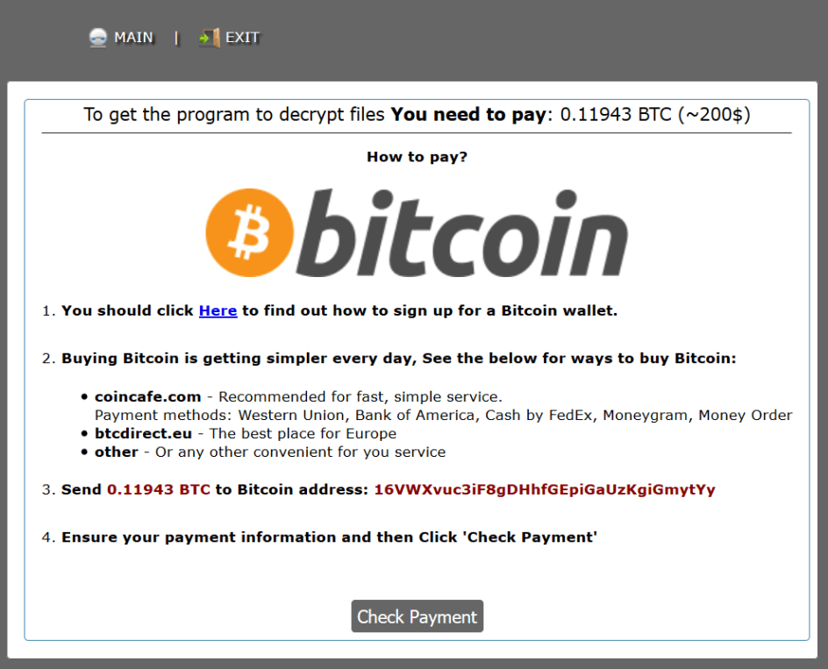
Some Cool SMB Exploits
EternalBlue is an exploit of Windows SMB protocol released by The Shadow Brokers
Within a day the code was reported to have infected more than 230,000 computers in over 150 countries
Aftermath at around $94 million related to IT support and restoring data and systems.

Slide 8


Other Similair tools
Hydra (OverKill)
Crackmap
SMB Brute
All these tools are more complicated versions of mine
Has more features but is more complicated to use

Slide 9
My Tool
Bruteforce tool for SMB
Takes a specific username and password
Takes username file
Takes password file
Standard output
Option for Verbose

Slide 10

ENDGAME!

Slide 11
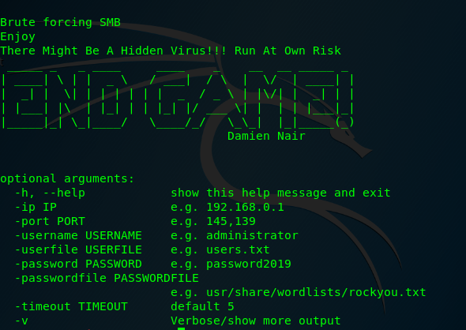
Its all you need!

Slide 12
Commands
./endgame.py -userfile users.txt -passwordfile password.txt -ip 10.2.15.35 -port 139 -v > output.json
./endgame.py -username Admin -passwordfile password -ip 10.2.15.35 -port 445 -v > damien.json

Slide 13
Github
https://github.com/damiennair/SMB-BRUTE.git
Link to program

