Slide 1
Starting with Log Analytics from scratch
VAN ROBAEYS Damien
@syst_and_deploy

Slide 2
What you will learn ?
1
2
What it Log Analytics
KQL fundamentals
4
3
Creating your
own lab
Sending custom data
5
Creating cool workbook

Slide 3

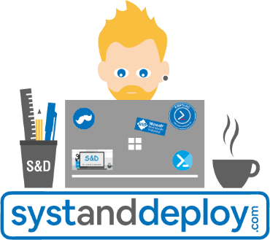


Van Robaeys Damien
Modern Workplace consultant, MVP Microsoft (6 years). Working with PowerShell, Intune, MS Graph, MECM, Log Analytics…
systanddeploy.com
@syst_and_deploy

Slide 4
A question ?
Time is limited, ask me at the end of the session

Slide 5
Log Analytics, what is it ?
What is it ?
Log Analytics Workspace
Data structure
Data retention

Slide 6
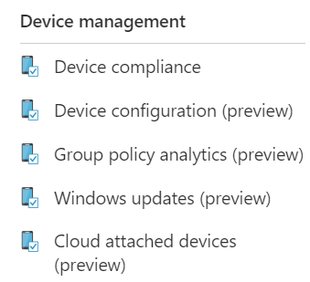
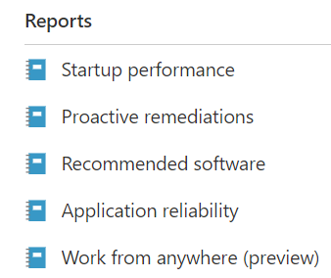
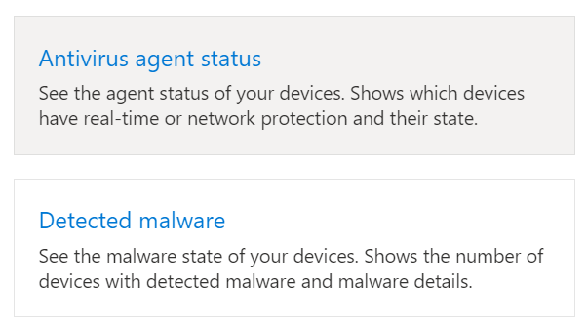
Existing reports in Intune
Lot of reports available in the Report part
Monitor part (Devices, Apps)

Slide 7
What is Log Analytics ?
Part of Azure available from Azure & Intune portals
Run queries and play with data from your tenant, devices…
Data are located into Logs
Can be used to find things on Azure, Intune…
Hey, show me details about this device
Hey, show me details about this IMEI
Hey, show me audit logs of my Intune tenant
By default, Log Analytics is empty you need to configure it

Slide 8
Prerequisites for Log Analytics
Azure subscription (of course)
Resource group (container that holds all your resources) *
Log Analytics workspace (we will see this later)
* More info about resource group
https://learn.microsoft.com/en-us/azure/azure-resource-manager/management/manage-resource-groups-portal

Slide 9
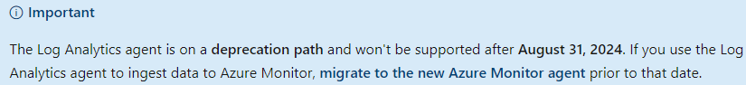
Log Analytics agent
You can use an agent on your devices to collect logs, but…
https://learn.microsoft.com/en-us/azure/azure-monitor/agents/log-analytics-agent

Slide 10
Log Analytics Workspace
A workspace has a unique ID* and resource ID
When you collect logs, all data are stored in a workspace
* We will use the Workspace ID to send custom data later in the session
Contains all things relative to your logs and data:
Azure Monitor, Custom log
Microsoft Sentinel, Microsoft Defender portal

Slide 11
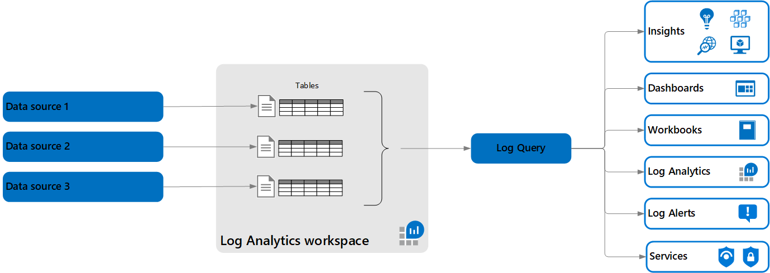
Data structure
Data are located/sent in Tables in a Workspace

Slide 12
Data structure
Tables organized in columns containing rows of data

Slide 13
Data structure
A table corresponds to a Log

Slide 14
Data structure
You can then query log to play with data

Slide 15
Data retention
Retention ? When data will be removed/archived from your workspace
Archiving allows you to keep older or less used data at a reduced cost

Slide 16
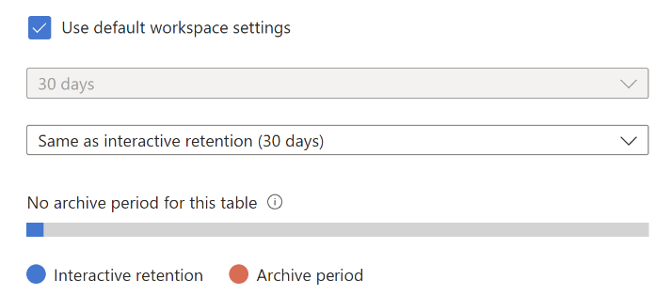
Data retention
Default retention period is 30 days, but you can create a new policy
You can customize data retention period by managing tables

Slide 17
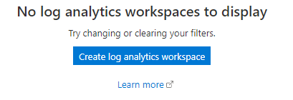
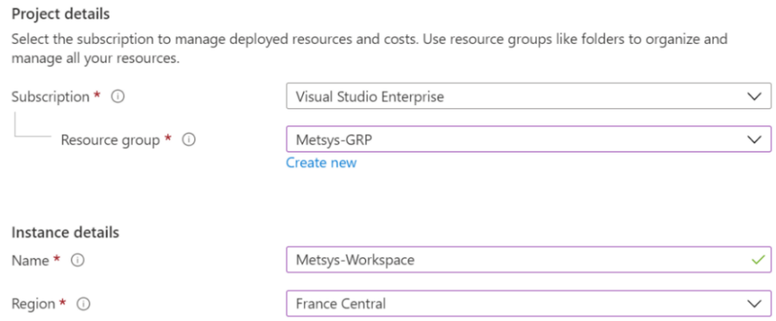
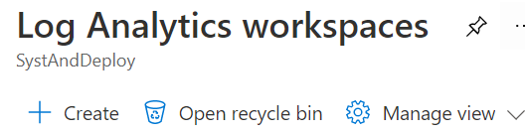
Creating a workspace
Manually
Go to Log Analytics workspaces > Create
Fill information

Slide 18

Creating a workspace
With PowerShell
Install module Az: Install-Module -Name Az –Force
Connect-AzAccount
New-AzOperationnalInsightsWorkspace

Slide 19
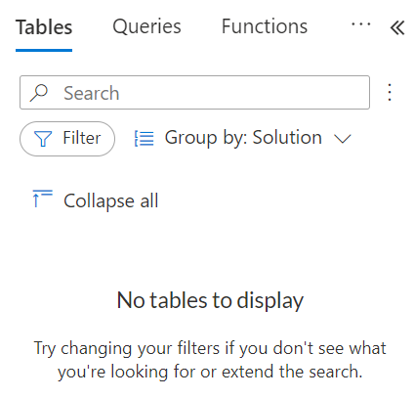
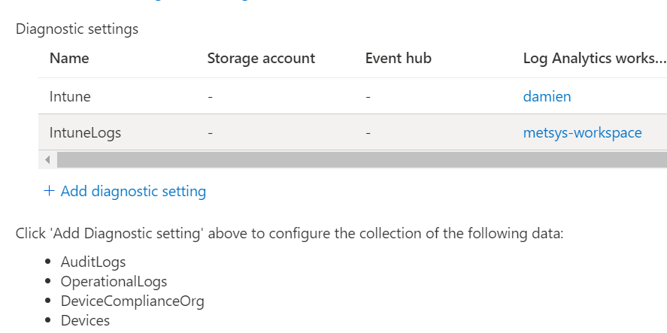
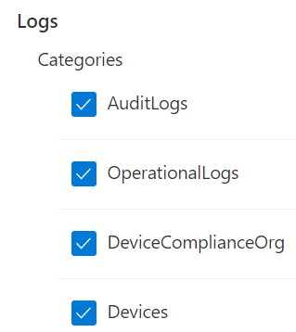
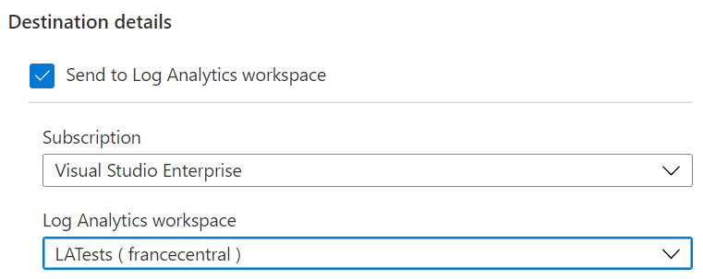
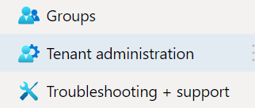
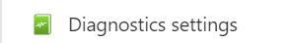
Adding Intune datas
By default Logs part is empty (no tables)
First step: add Intune datas to Log Analytics workspace
Go to Intune > Tenant administration > Diagnostic settings
Click on Add diagnostic setting
Select logs to add and your workspace
Then Intune datas will be available

Slide 20
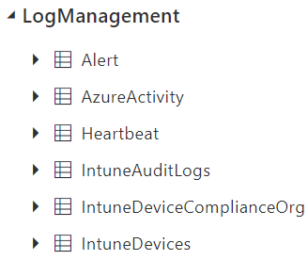
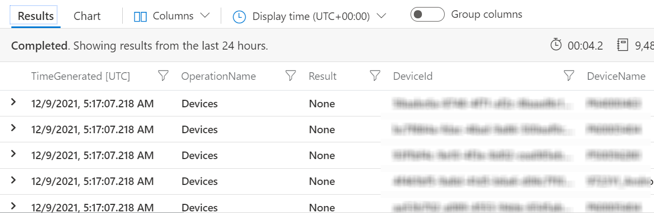
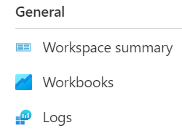
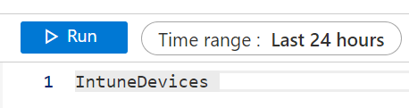
Log Analytics and Intune
Go to Logs
You have now Intune logs
Example IntuneDevices (list enrolled devices)
You can now run query on your Intune datas
Language for query is KQL (Kusto Query Language)

Slide 21

Demo: first overview
What will we see ?
Workspace overview
Data structure, logs, custom logs…
Data retention
Ingesting Intune data
Playing with Intune table

Slide 22
KQL (Kusto Query Language)
What is it ?
Starting with KQL
Export or save queries

Slide 23
KQL, the heart of your analysis
KQL for Kusto Query Language
Language to request and explore data from Logs
Same language than in CMPivot
Structure is similar than in SQL: tables, columns…
Used in Log Analytics, Sentinel, M365 Defender…

Slide 24
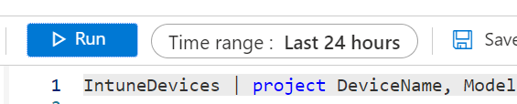
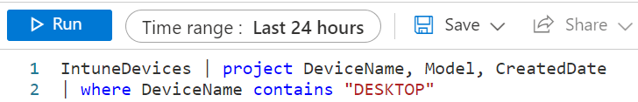
Starting with KQL
Select a log like IntuneDevices
Select a time range
Use pipe « | » with operators : | and where are essentials
| where : allows you to filter on a field (contains, !contains, ==, startswith…)
| project operator : allow you to select fields (columns) to display

Slide 25
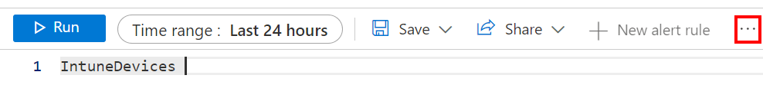
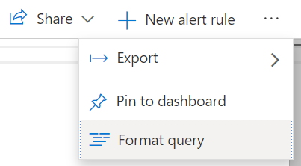
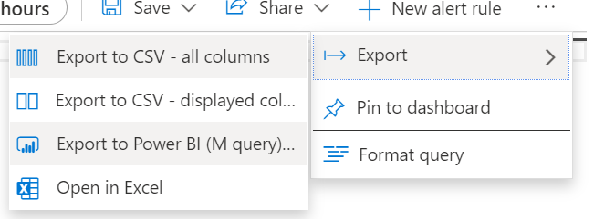
Log Analytics from Power BI ?
You can create a query in LA and use it in Power BI
Go to … > Export > Export to PBI (M query)

Slide 26
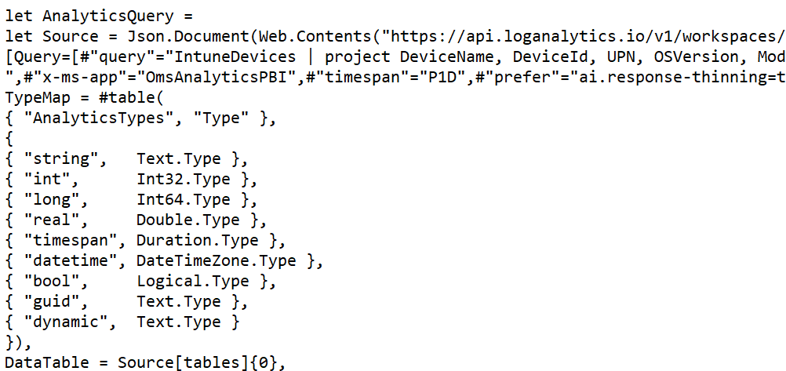
Log Analytics from Power BI ?
Copy file content

Slide 27

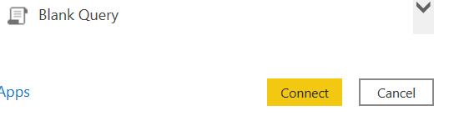
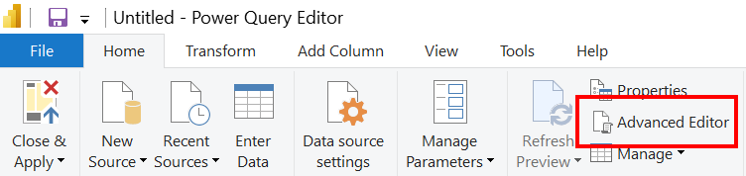
Log Analytics from Power BI ?
In PBI go to Get data > Blank query > Connect > Advanced editor

Slide 28
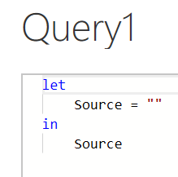
Log Analytics from Power BI ?
Replace content from Query1 with file content

Slide 29
Demo: let’s start with KQL
What will we see ?
Understanding KQL
Quick start with basic queries

Slide 30
Custom reporting
How does it work ?
Required information for sending data
How to send data with PowerShell ?
Examples of custom report

Slide 31
How does it work ?
Getting data you want
Sending data to Log Analytics
Script to get data you want from devices or tenant
The script will send them into a Custom Log in Log Analytics
Sending
data in
Log Analytics
Creating the script to get data
Gather data in a report
Once datas are in the Custom Log, we can create a workbook with them
Create & schedule a script

Slide 32
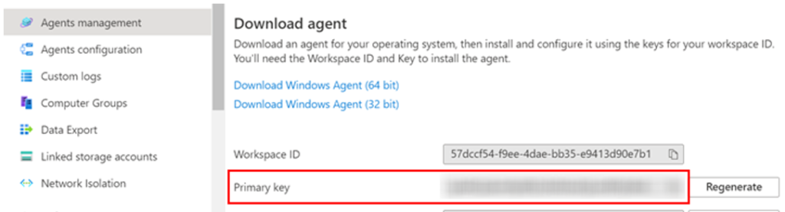
Required information (for sending data)
Some info required to import data through a script into Log Analytics:
$CustomerId: Log Analytics Workspace ID
SharedKey: Primary Key
$LogType: Name of the Custom Log to create or update
Used as credentials

Slide 33
Sending data with PowerShell
Functions Build-Signature and Post-LogAnalyticsData
Build-Signature: getting token
Post-LogAnalyticsData: sending data to LA
* MS functions, more info here

Slide 34
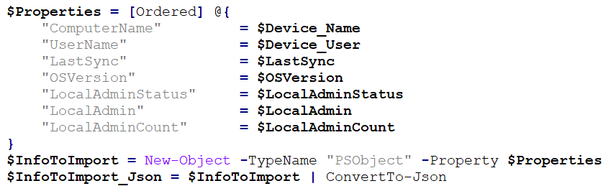
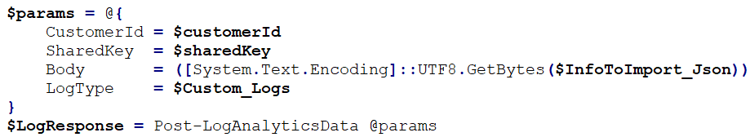
Sending data with PowerShell
Creating an object with information
Converting object to JSON
Sending data to Log Analytics

Slide 35


Sending data ? From where ?
Use Proactive Remediation script to import data from devices
Local admin report
BIOS versions report
Disk size report
Use Azure Automation runbook to send data from your environment
BSOD report
Endpoint Analytics report

Slide 36
Local admin report
What it does ?
Get all local admin account(s) added on devices
If a local admin account has been found and is not authorized: ALERT
+ info ?
Power BI: link here
Log Analytics : link here

Slide 37
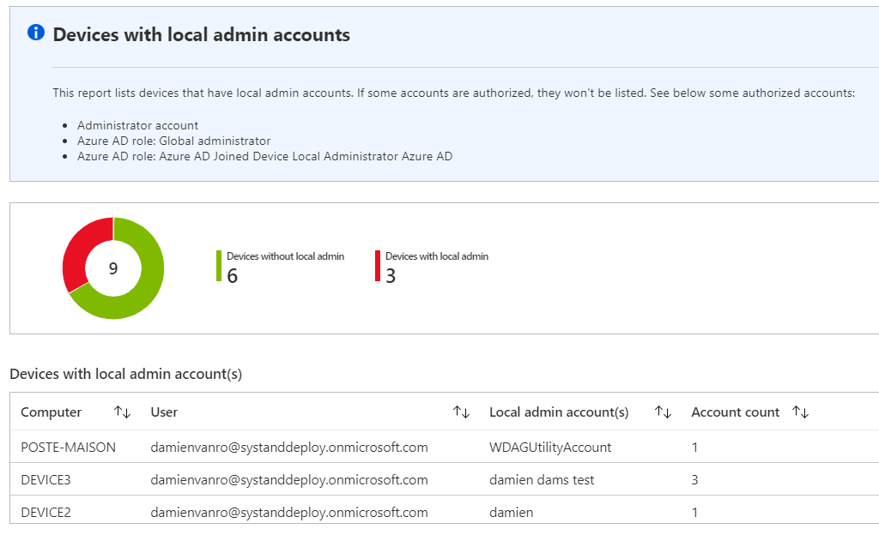
Displays device name, user, admin account, when account has been added and by who

Slide 38
BIOS update version
What it does ?
Displays devices with BIOS uptodate and not uptodate
Displays details about devices
+ info ?
Lenovo : link here
Dell : link here

Slide 39
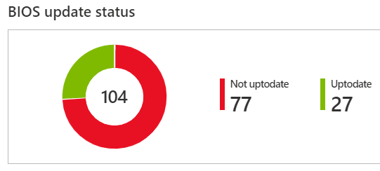
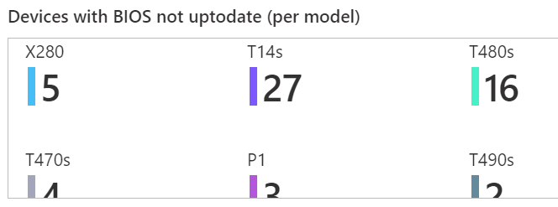
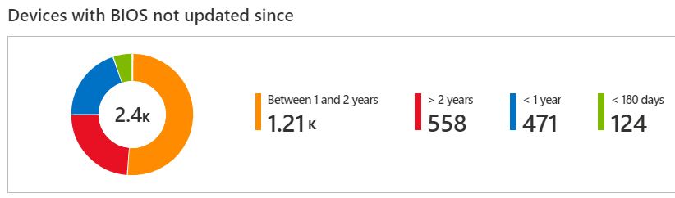

Slide 40
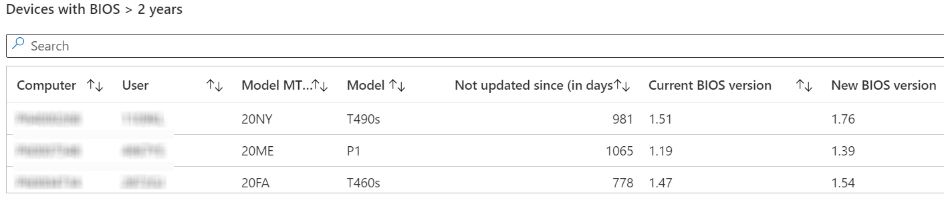
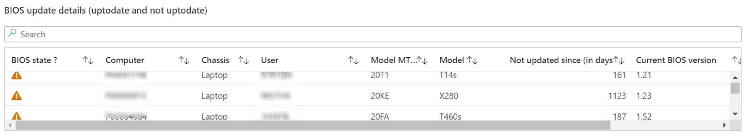

Slide 41
Monitor BSOD on devices
What it does ?
Get all BSOD on your devices from Intune
Get BSOD count, details and direct access to logs
+ info ?
Log Analytics : link here
Automatically send BSOD logs : link here

Slide 42
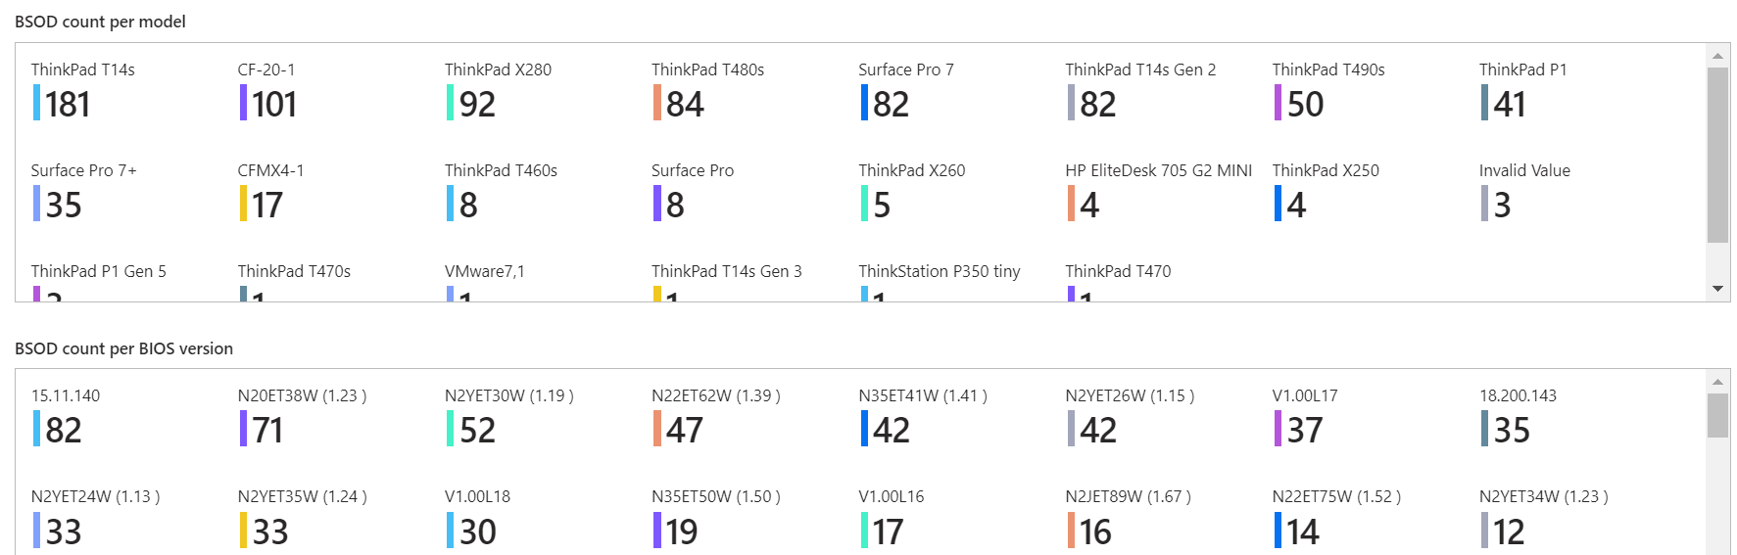
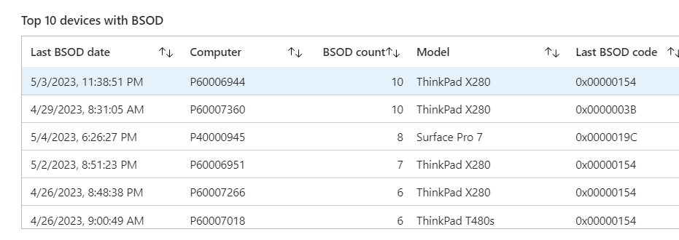
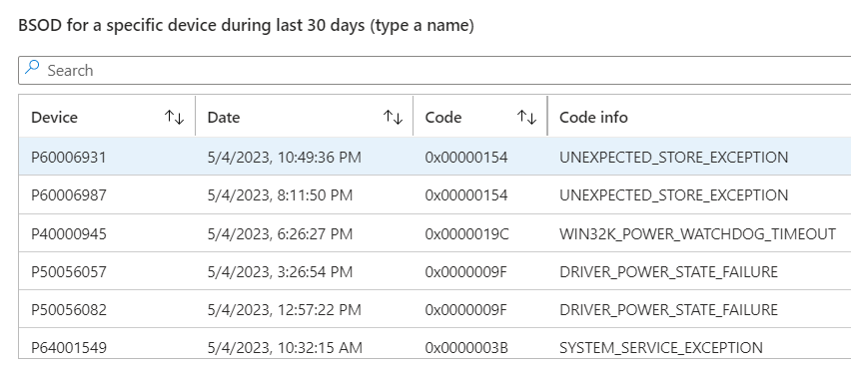
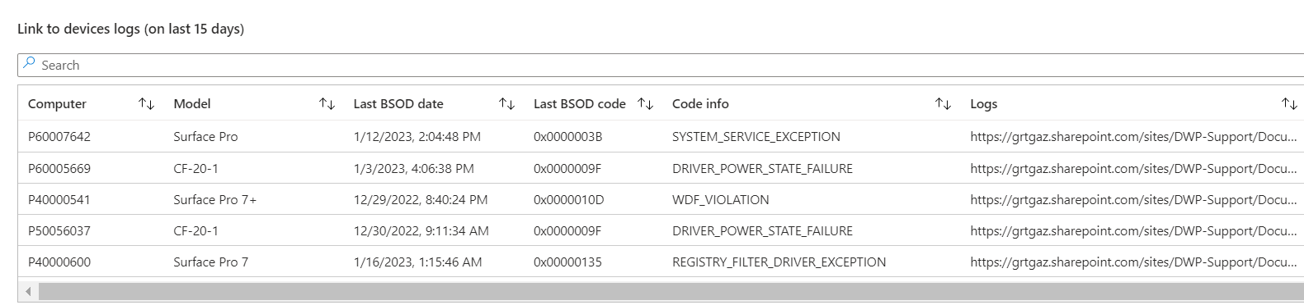
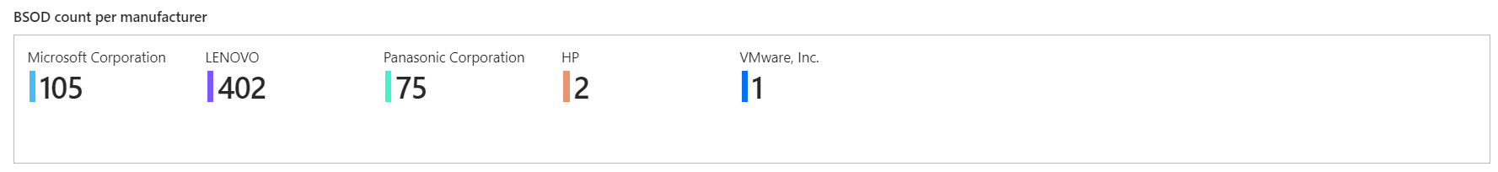

Slide 43
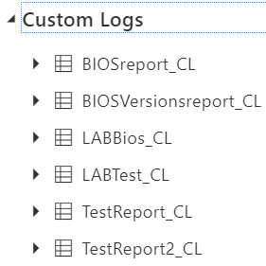
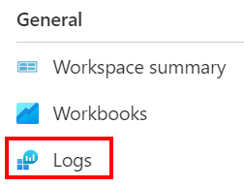
Imported data in Log Analytics
After the import, data are available in a Custom Log
Custom Log is named like: YourCustomLog _CL
Run queries on the table from Logs > Custom Logs

Slide 44
Demo: custom reporting
What will we see ?
Creating quick lab from CSV
Creating a workbook in live

Slide 45

Rate my session
Please rate my session in the Yellenge app!

Slide 46
Going further
Log Analytics demo env
KQL cheat sheets
KQL Threat Hunting
KQL Search
Must Learn KQL

Slide 47
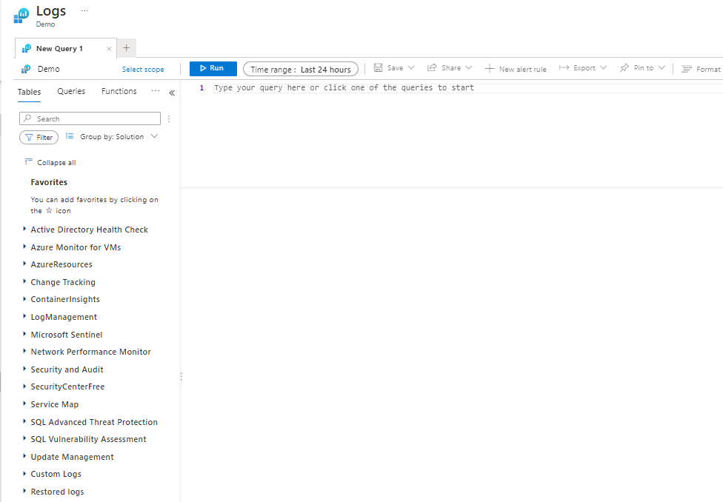
Log Analytics Demos env
https://portal.azure.com/#blade/Microsoft_Azure_Monitoring_Logs/DemoLogsBlade
Allows you to play with an environment containing a lot of Logs and data

Slide 48
KQL cheat sheets
An easy way to start with KQL
https://techcommunity.microsoft.com/t5/azure-data-explorer-blog/azure-data-explorer-kql-cheat-sheets/ba-p/1057404

Slide 49
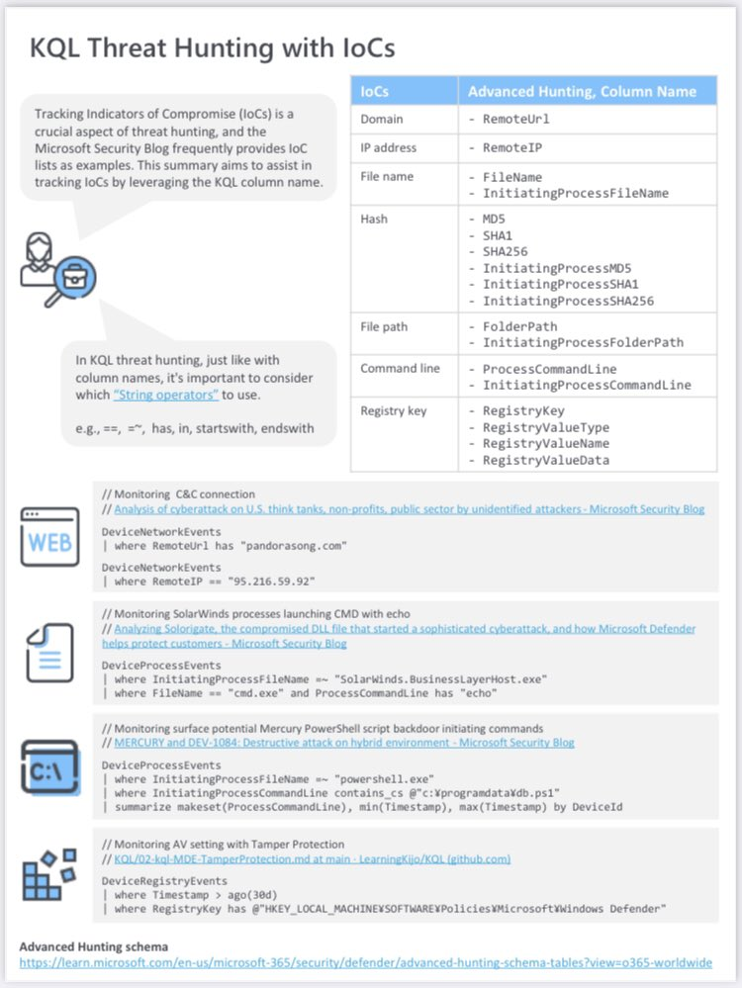
KQL Threat Hunting
Using KQL for threat hunting by Kijo Niimura
https://github.com/LearningKijo/KQL/blob/main/KQL-Effective-Use/10-kql-ThreatHunting-IoCs-tips-v1.pdf.pdf

Slide 50
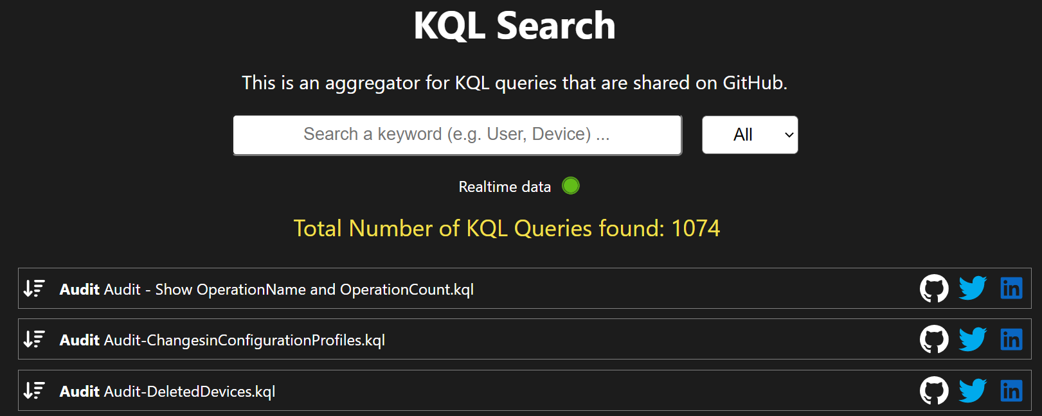
KQL Search
Created by Ugur Koc (@UgurKocDe)
https://www.kqlsearch.com

Slide 51
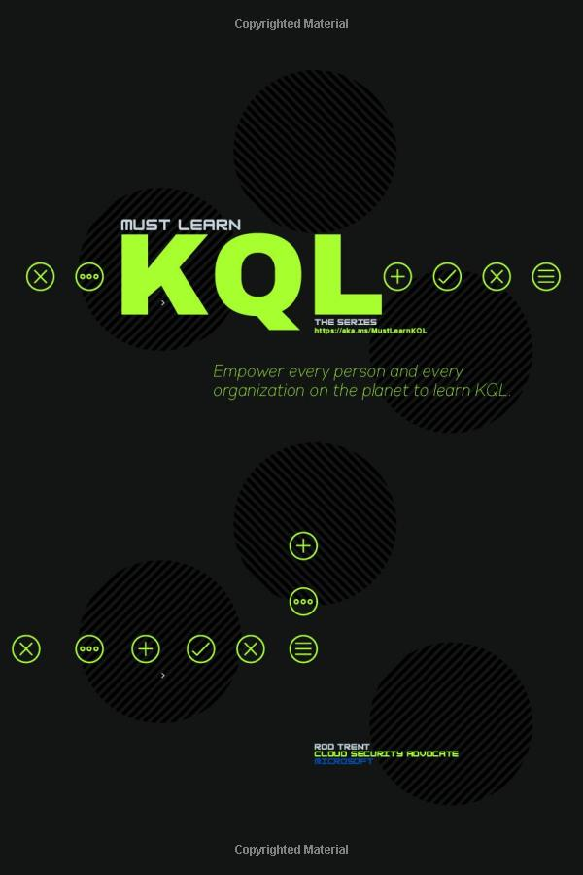
Must Learn KQL
Blog post series about KQL by Rod Trent
https://github.com/rod-trent/MustLearnKQL
Book available: https://a.co/d/fINFGnw

