Slide 1

Workshop
SLUsa-TE
Master in Computer Science
Implementing a Syntax Directed Editor for LISS.
Damien Vaz
June 2016
Supervisors:
Pedro Rangel Henriques
Daniela Carneiro da Cruz

Slide 2
Workshop
SLUsa-TE
Master in Computer Science
Goals:
- Implementing LISS with Antlr as an Attribute Grammar.
Generating the Mips Assembly Code.
Creating the SDE.

Slide 3
LISS
SLUsa-TE
Master in Computer Science
LISS language:
Language for Integers, Sequences and Sets
Imperative language:
- Constants/Variables:
- Atomics and structured types:
- Dynamic sequences, arrays or sets.

Slide 4
LISS
SLUsa-TE
Master in Computer Science
Example:
PROGRAM exemplo1{
DECLARATIONS
v1=10, v2=20, v3 -> INTEGER;
flag1, flag2 = TRUE -> BOOLEAN;
nums = [2,3,4] -> ARRAY SIZE 4;
notas -> SEQ; limites-> SET;
STATEMENTS
v1 = 1+2;
nums[1] = v1 + nums[v1];
flag2 = !flag1;
notas = <10,12>+v2;
limites = {x | x > 10 && x < 50};
}

Slide 5
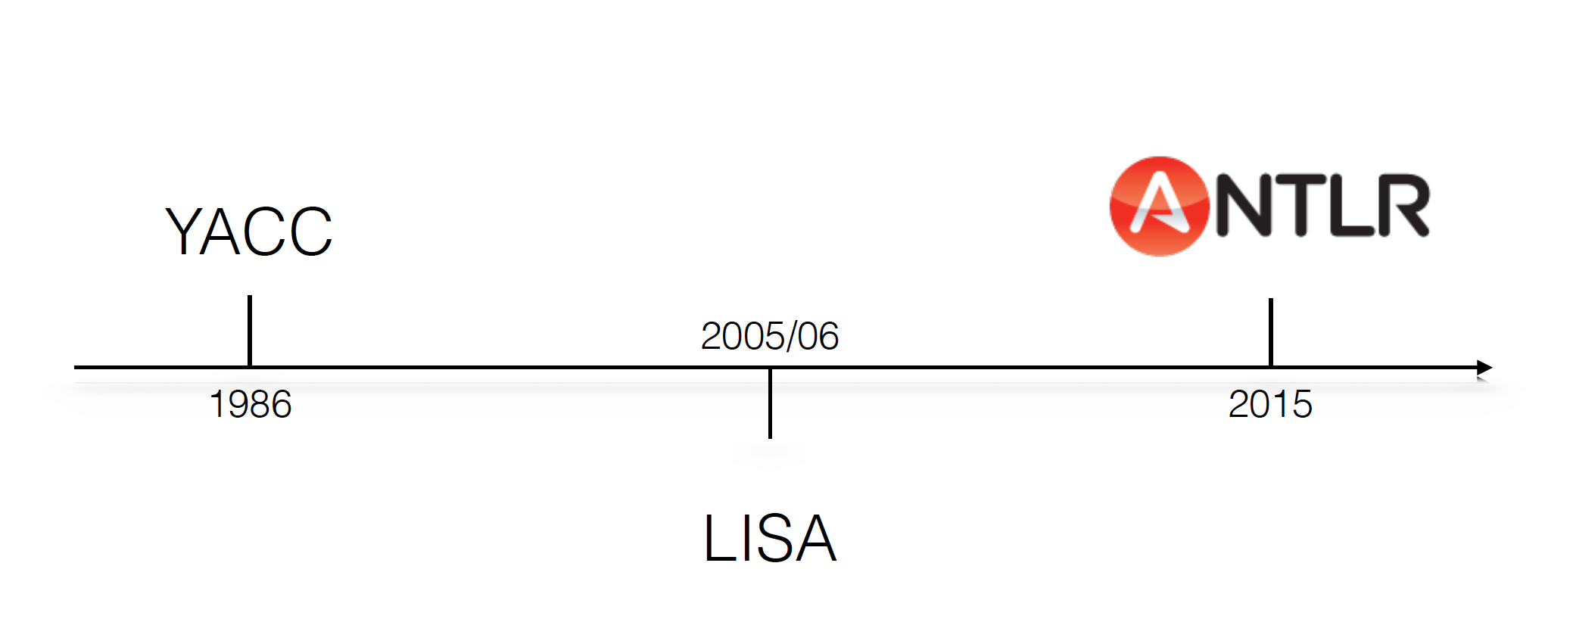
LISS
SLUsa-TE
Master in Computer Science
Compilers used during LISS life:

Slide 6
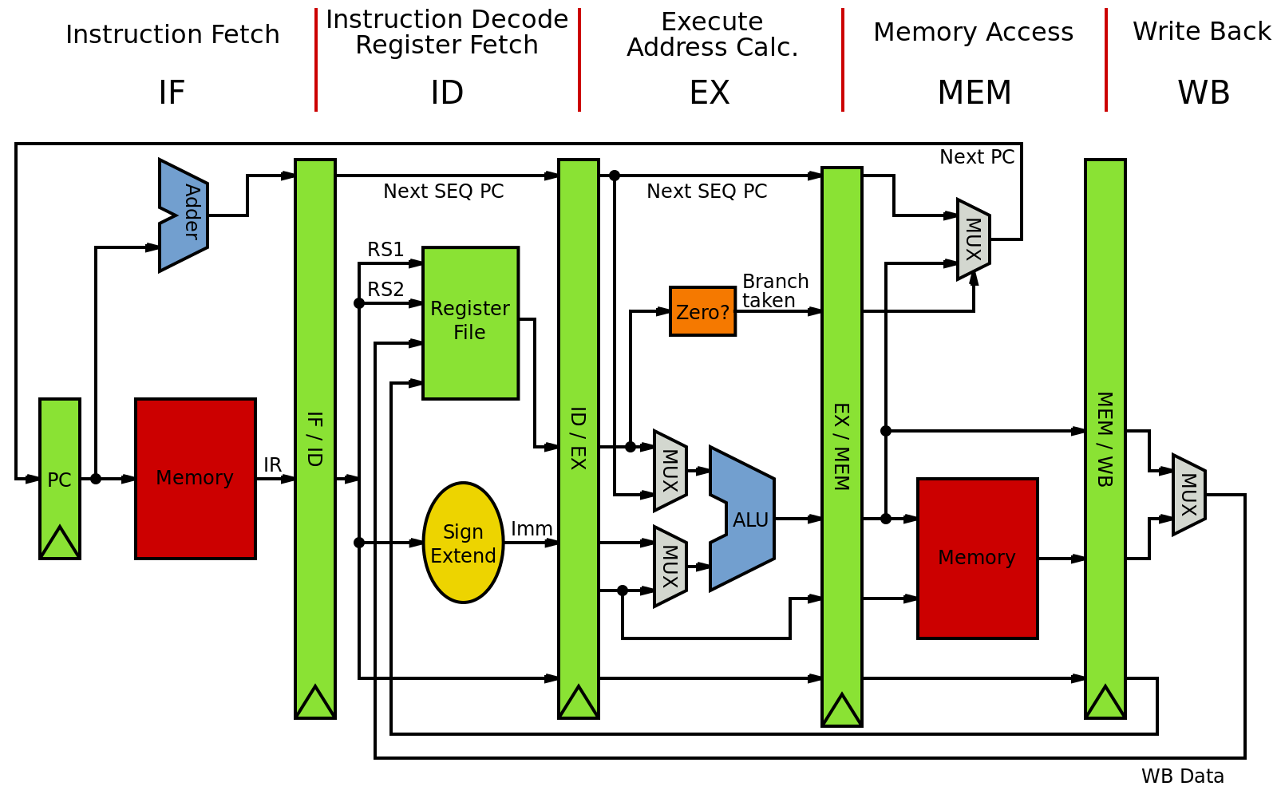
MIPS
SLUsa-TE
Master in Computer Science
MIPS
Microprocessor without Interlocked Pipeline Stages
RISC architecture
32 registers
6 groups of instructions:
Arithmetic (Integer, Floating Point)
Data transfer (Integer, Floating Point)
Logical (Integer, Floating Point)
Bitwise Shift (Integer)
Conditional Branch (Integer, Floating Point)
Unconditional Branch (Integer)

Slide 7
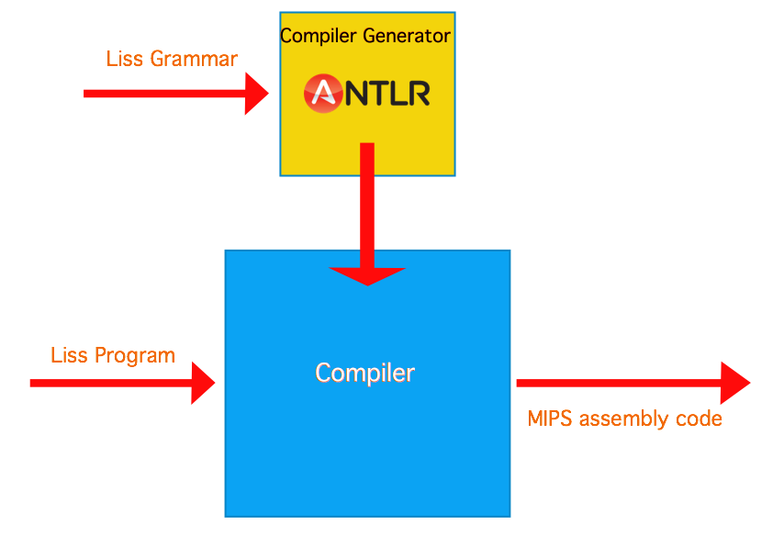
MIPS
SLUsa-TE
Master in Computer Science

Slide 8
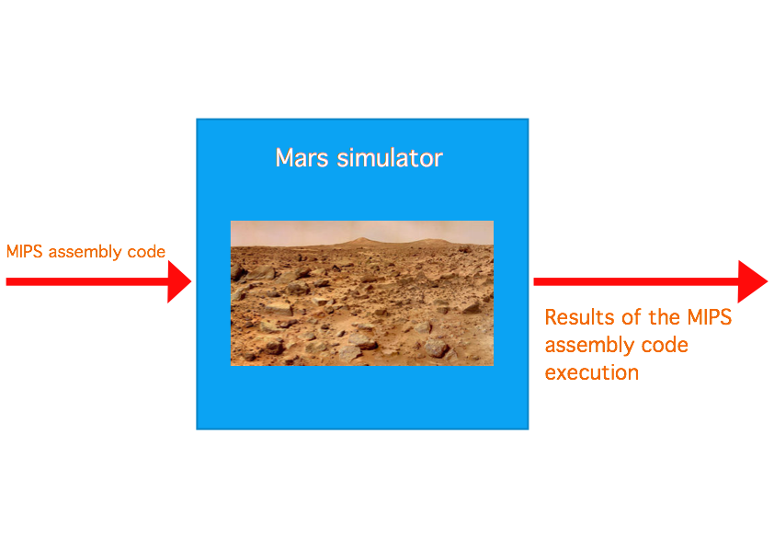
MIPS
SLUsa-TE
Master in Computer Science

Slide 9
Tools/Technologies
SLUsa-TE
Master in Computer Science
Which tools and technologies were used?
Compiler:
- AnTLR (ANother Tool for Language Recognition)
- MIPS (Assembly Code)
- Java
SDE:
- HTML5
- JS
- Java
- IntelliJ (IDE)
- JavaFX ( set of graphics and media packages )
- RichTextFX (Java plugin for creating a code editors with syntax highlighting)
- Mars simulator ( IDE simulator for MIPS assembly code)

Slide 10

LISS|SDE
SLUsa-TE
Master in Computer Science

Slide 11
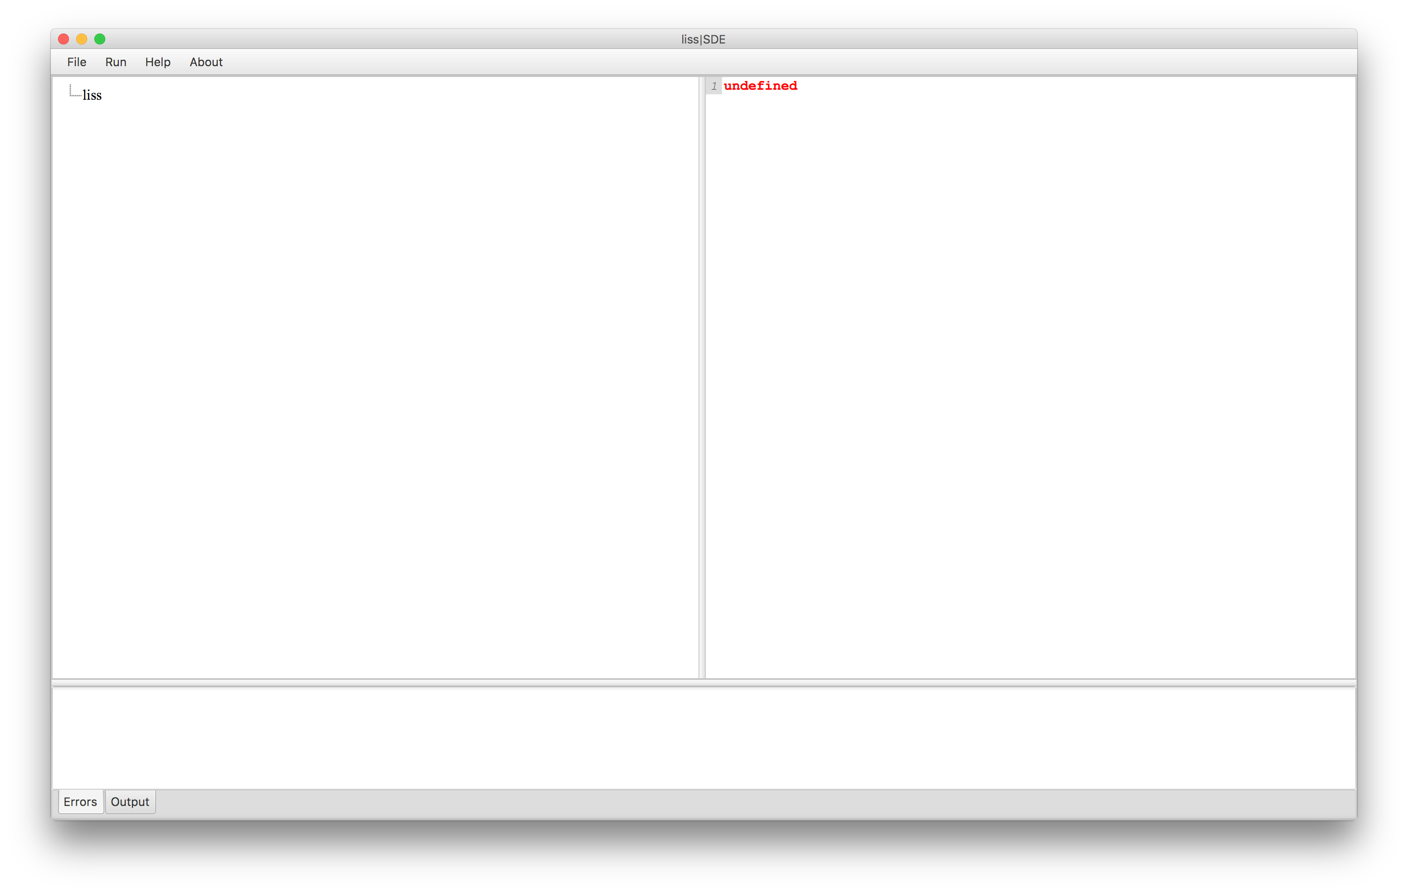
LISS|SDE
SLUsa-TE
Master in Computer Science
User interface

Slide 12
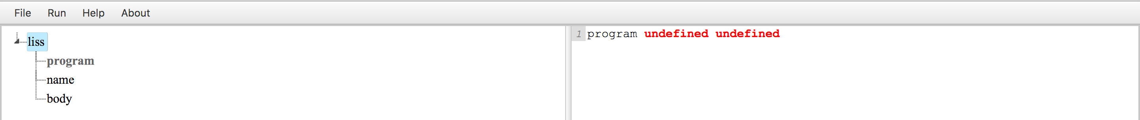
LISS|SDE
SLUsa-TE
Master in Computer Science
How does it work?

Slide 13
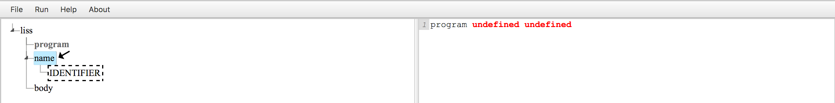
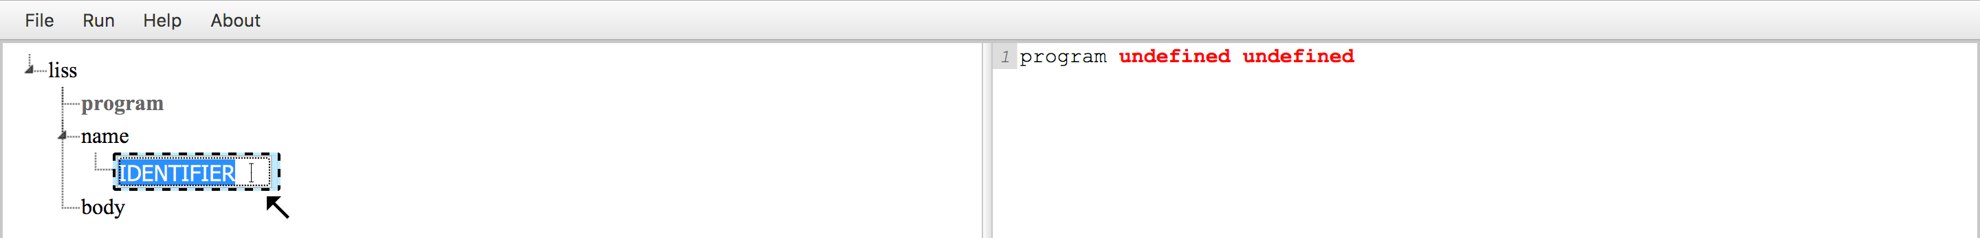
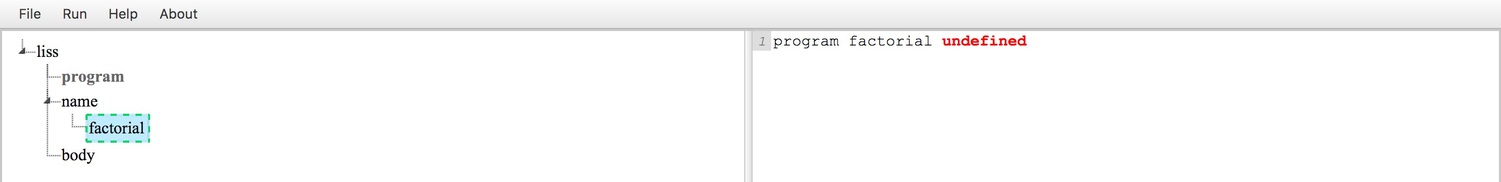
LISS|SDE
SLUsa-TE
Master in Computer Science

Slide 14
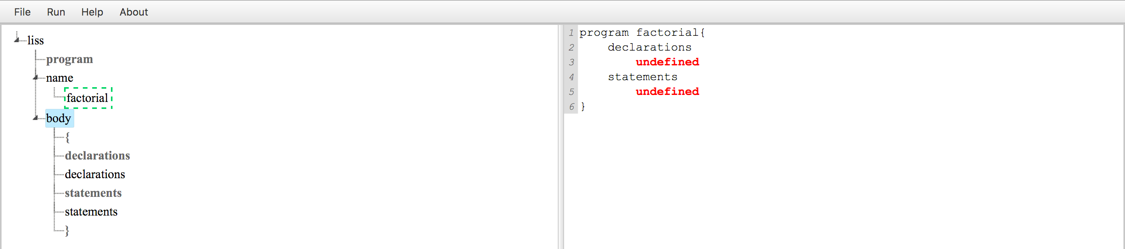
LISS|SDE
SLUsa-TE
Master in Computer Science

Slide 15
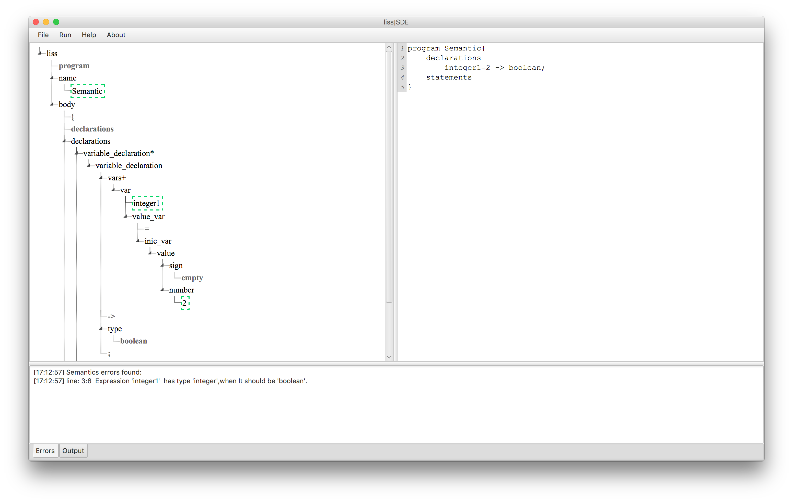
LISS|SDE
SLUsa-TE
Master in Computer Science
Semantic system

Slide 16
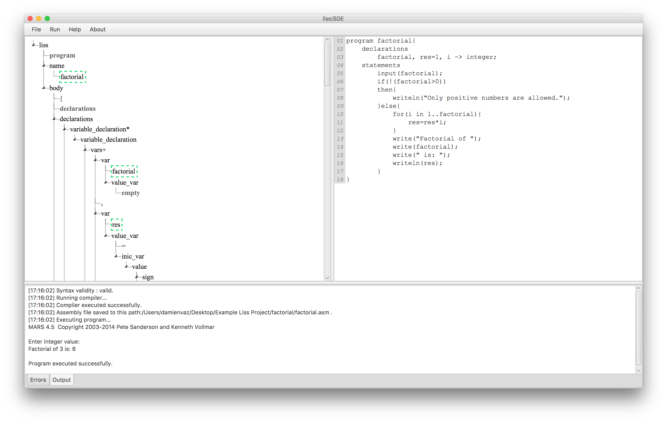
LISS|SDE
SLUsa-TE
Master in Computer Science

Slide 17
Conclusion
SLUsa-TE
Master in Computer Science
Conclusion:
- Attribute grammar completed
- Incompleted code generator (75% - Sets type missing)
- Semantic system completed
- SDE User Interface completed

Slide 18
Workshop
SLUsa-TE
Master in Computer Science
Thank you for your attention!
:D

