Slide 1
rfswarm setup
We will cover:
What machines you will need and their roles
How to install on Windows
How to install on MacOS
How to install on Linux

Slide 2
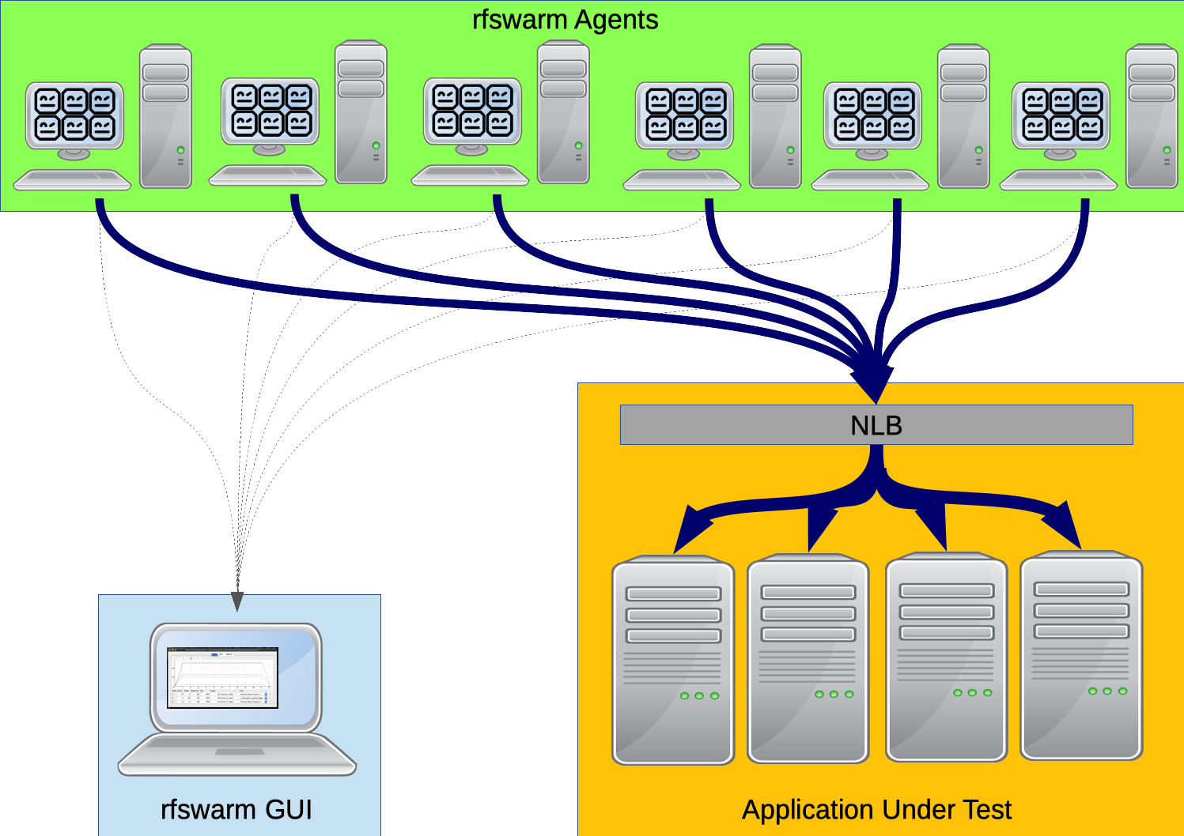

Machines you will need and their roles
GUI Machine
  Doesn’t need to be high spec
Agents
  These host the swarm or robots, generally the higher spec the better
TestDataTable Server (optional)
TestDataTable

Slide 3
Installation
Install GUI on Windows
Install Agents on Windows
Install GUI on MacOS
Install Agents on MacOS
Install GUI on Linux
Install Agents on Linux

