Slide 1

ARCTIC NUCLEAR
NECESSITY
A Data-Driven Case for Micro-Reactors in Northern Canada
Damil Randhawa
March 2026
DATA: NASA POWER API · Statistics Canada 2021 · NRCan Arctic Energy
ARCTIC NUCLEAR NECESSITY · DAMIL RANDHAWA · MARCH 2026
01

Slide 2



THE PROBLEM
Five remote Northern communities are trapped on diesel — expensive, dirty, and fragile.
ELECTRICITY COSTS
CARBON INTENSITY
SUBSIDY BURDEN
SUPPLY CHAIN RISK
4–6×
780 g
$60M+
1 route
more expensive
CO₂e per kWh
per year
per year
Nunavut pays $0.62–0.68/kWh versus ~$0.13 in the south. Families and businesses bear the cost.
Among the highest electricity carbon intensity in Canada. Diesel generators run around the clock.
Federal and territorial diesel subsidies for Nunavut alone. Canadian taxpayers fund the gap.
Diesel arrives by summer barge or winter road. A single disruption means total power loss.
ARCTIC NUCLEAR NECESSITY · DAMIL RANDHAWA · MARCH 2026
02

Slide 3
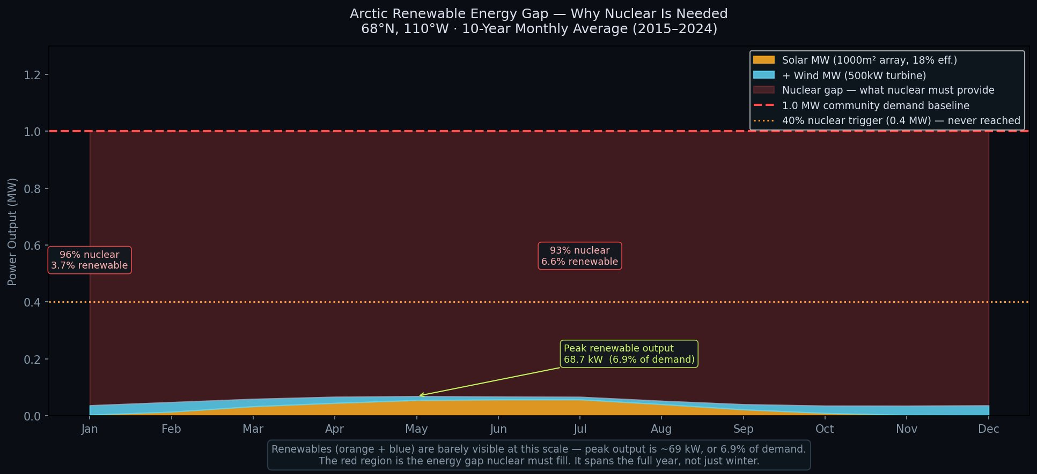
RENEWABLES CAN'T CLOSE THE GAP
Not in winter. Not in summer. Not ever.
WHAT THIS MEANS: Solar and wind together never supply more than 6.9% of what these communities need — in any month, across 10 years of data. The red zone is 93–97% of demand that only nuclear can fill.
ARCTIC NUCLEAR NECESSITY · DAMIL RANDHAWA · MARCH 2026
03

Slide 4
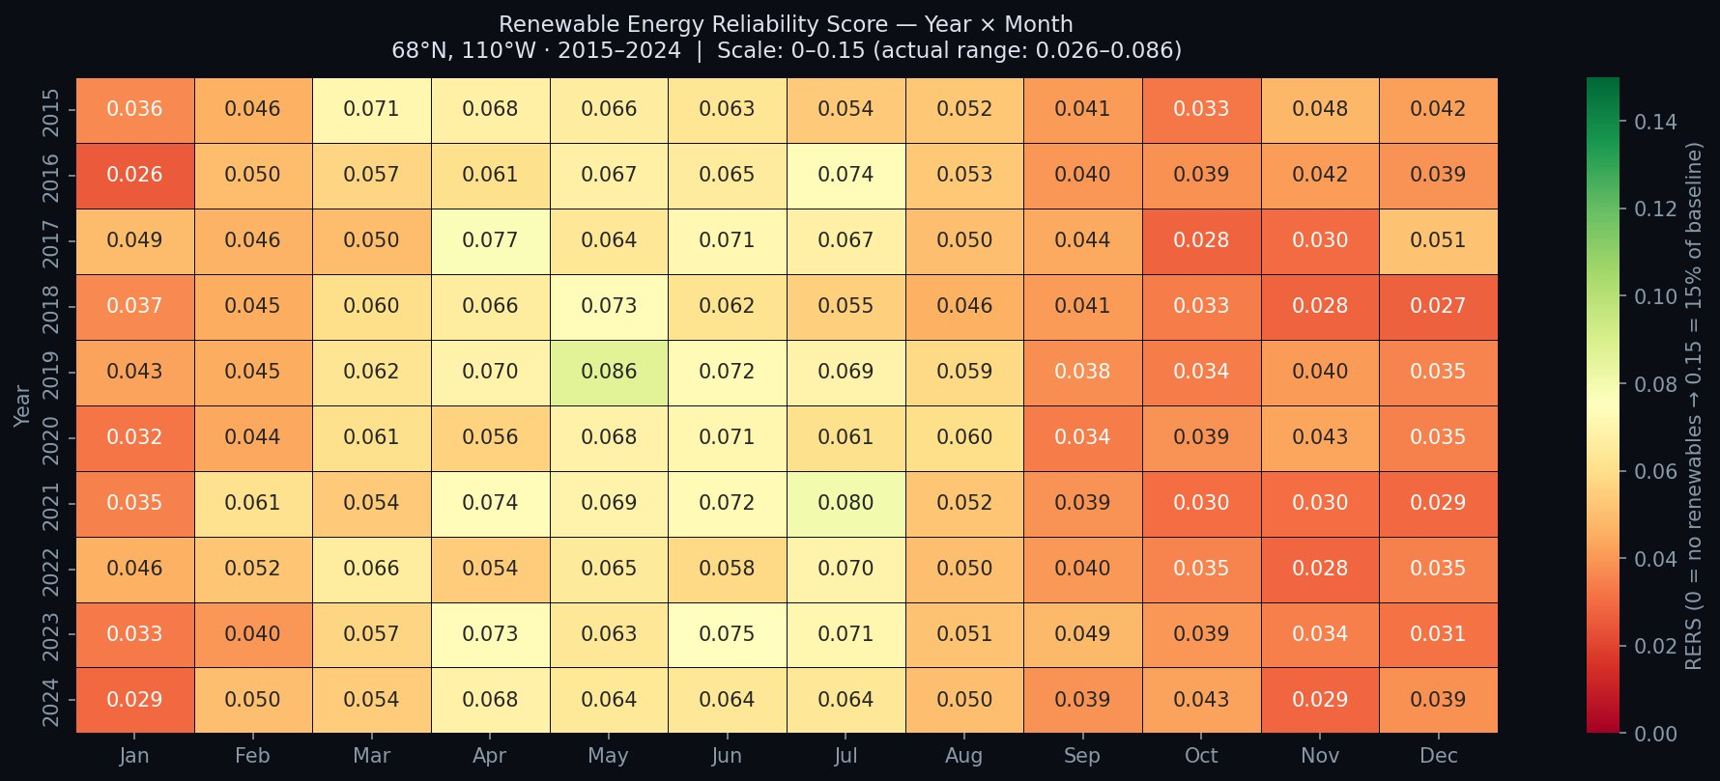
THIS ISN'T A BAD YEAR — IT'S EVERY YEAR
10 years of satellite data confirm the gap is permanent, not seasonal bad luck.
Scale: 0 = no power, 0.15 = 15%
Every cell is orange or red
This is latitude, not weather
The highest value ever recorded is 0.086 — less than 9%.
No month in any year comes close to the 0.40 viability threshold.
The sun angle and polar night are fixed physics. More panels won't help.
ARCTIC NUCLEAR NECESSITY · DAMIL RANDHAWA · MARCH 2026
04

Slide 5
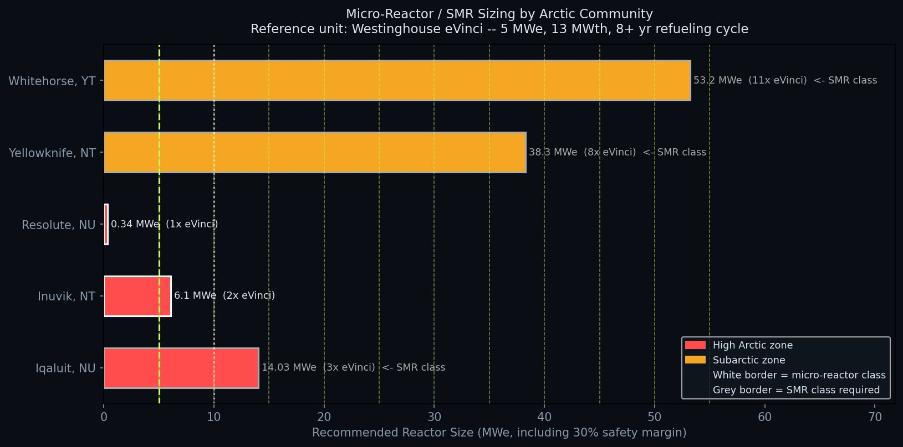
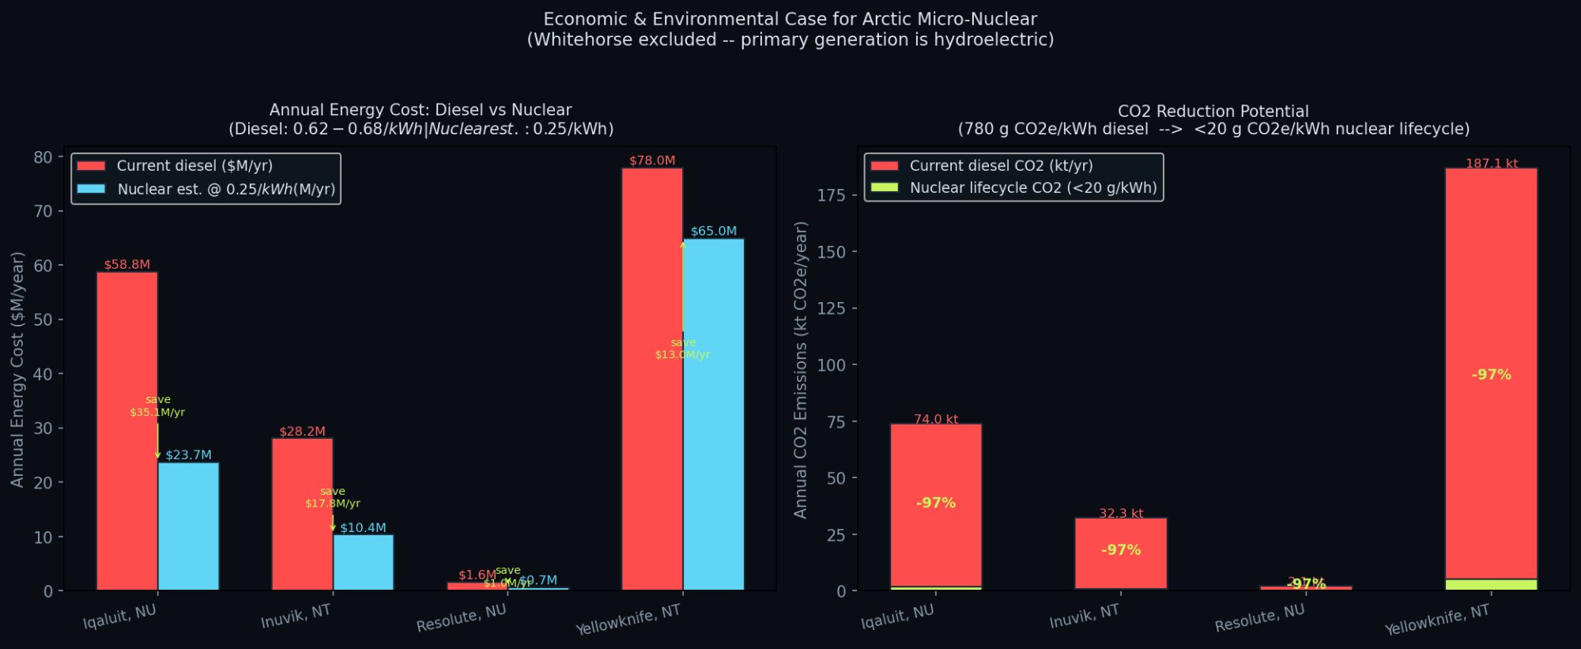
THE SOLUTION — AND THE SAVINGS
Right-sized micro-reactors for each community. The economics speak for themselves.
$66.9M
295.5 kt
97%
1–3
saved per year
across 4 communities
CO₂ avoided
per year
emissions cut
versus diesel
eVinci units per
priority community
ARCTIC NUCLEAR NECESSITY · DAMIL RANDHAWA · MARCH 2026
05

Slide 6
PATH FORWARD
01
Resolute, NU
Smallest community, lowest complexity. Ideal pilot site — lessons learned transfer to every subsequent deployment.
208 people · 0.34 MWe · 1 eVinci unit
02
Inuvik, NT
Mid-size proof of concept. Partial gas infrastructure exists, reducing transition risk. Strong regional signal.
3,243 people · 6.10 MWe · 2 eVinci units
03
Iqaluit, NU
Nunavut's capital and largest electricity market. Saves $35M/year alone — more than the entire territorial diesel subsidy.
7,429 people · 14.03 MWe · 3 eVinci units
BOTTOM LINE: Replacing diesel with nuclear saves $66.9M/year, cuts 295.5 kt of CO₂, and eliminates the single greatest risk to Arctic power supply — the annual fuel shipment that can fail.
ARCTIC NUCLEAR NECESSITY · DAMIL RANDHAWA · MARCH 2026
06

