Slide 1
THE PROBLEM
200+ Canadian communities above 60°N have no grid connection
Diesel fuel costs $2–4/L to transport — up to 10× southern prices
Climate targets make diesel-only futures politically untenable
Renewable energy (solar/wind) fails for 4–5 months every winter
Question: What is the only reliable baseload solution?
ARCTIC NUCLEAR
NECESSITY
A Data-Driven Case for
Micro-Reactors in Northern Canada
CSMC STEM Intern Candidate
[Your Name]
[Date]
DATA SOURCES: NASA POWER API · STATISTICS CANADA 2021 · NRCAN ARCTIC ENERGY

Slide 2
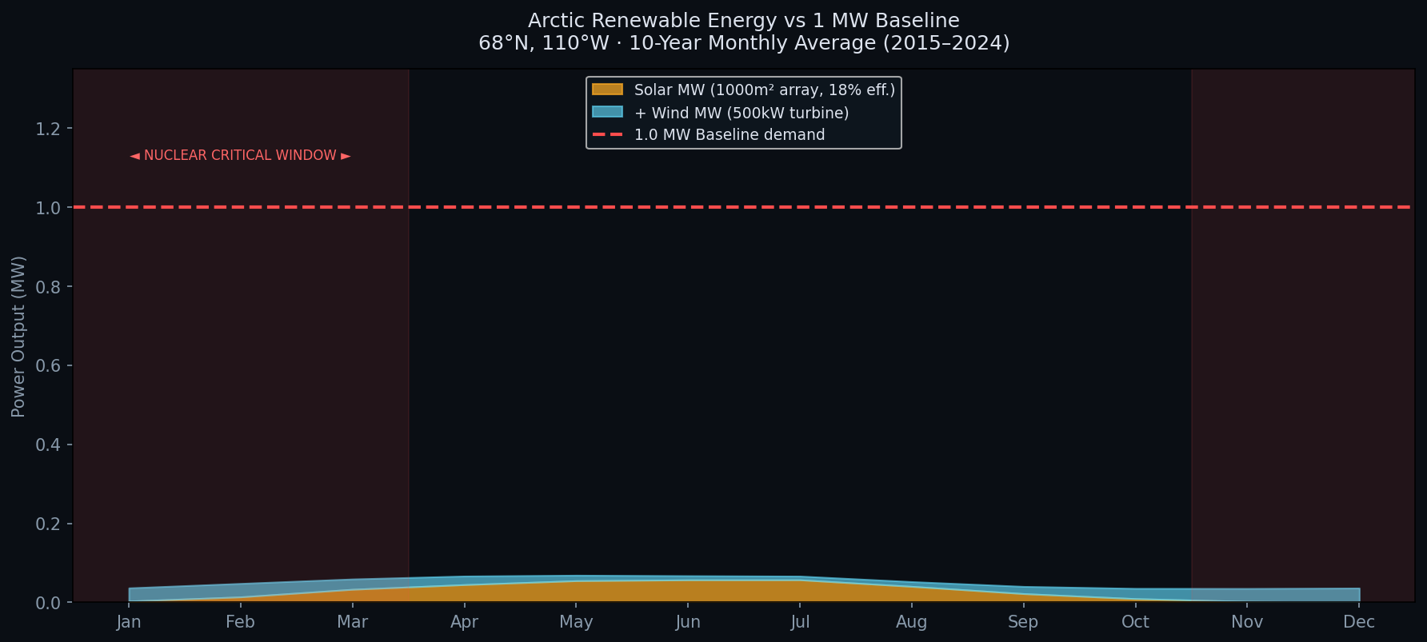
02
10 Years of Evidence: Renewables Fail in Winter
NASA POWER CLIMATE DATA · 68°N, 110°W · 2015–2024
10-year NASA POWER dataset (120 monthly records) analyzed at 68°N, 110°W — representative of Nunavut/NWT deployment candidates
Solar irradiance drops to <2% of summer peak Nov–Feb (polar night)
Combined solar + wind = 0.038 MW in January vs 1 MW baseline (3.8%)
Key finding: RERS (Renewable Energy Reliability Score) < 0.10 in Nov–Feb across ALL 10 years
Year-to-year variance in winter: σ = 0.019 — this is a permanent climate feature, not a weather event
The shaded area shows what nuclear must fill every single winter
ARCTIC NUCLEAR NECESSITY · CSMC STEM INTERN PROJECT · CONFIDENTIAL

Slide 3
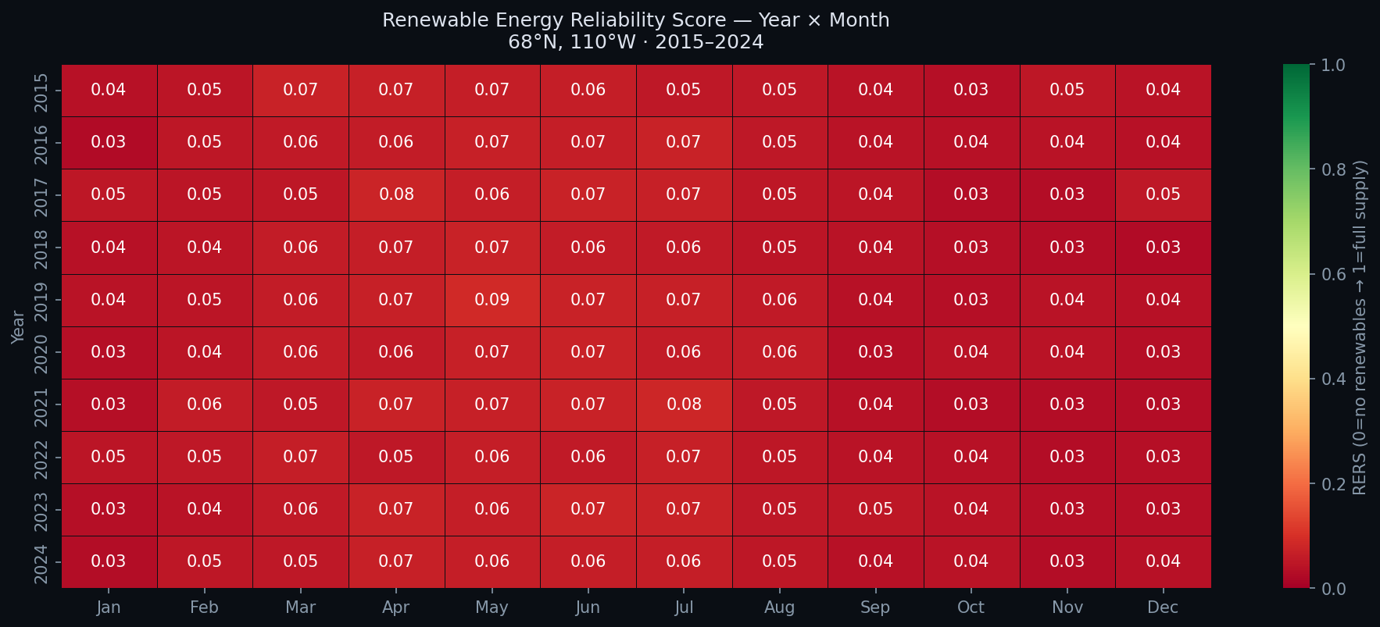
03
The Gap is Structural — Not Anomalous
RERS HEATMAP · YEAR × MONTH ANALYSIS
Every cell in the Nov–Feb columns is red — across all 10 years
This rules out:
A bad weather year (it repeats every year)
Equipment failure (this is satellite-derived climate data)
An anomalous location (this is the Arctic — all sites above 65°N show this pattern)
What this confirms:
Polar night is a fixed annual event. Nuclear is not optional — it is the baseload.
May–Aug window shows viable renewable output (RERS 0.65–0.85)
This is the window for reactor maintenance scheduling
ARCTIC NUCLEAR NECESSITY · CSMC STEM INTERN PROJECT · CONFIDENTIAL

Slide 4
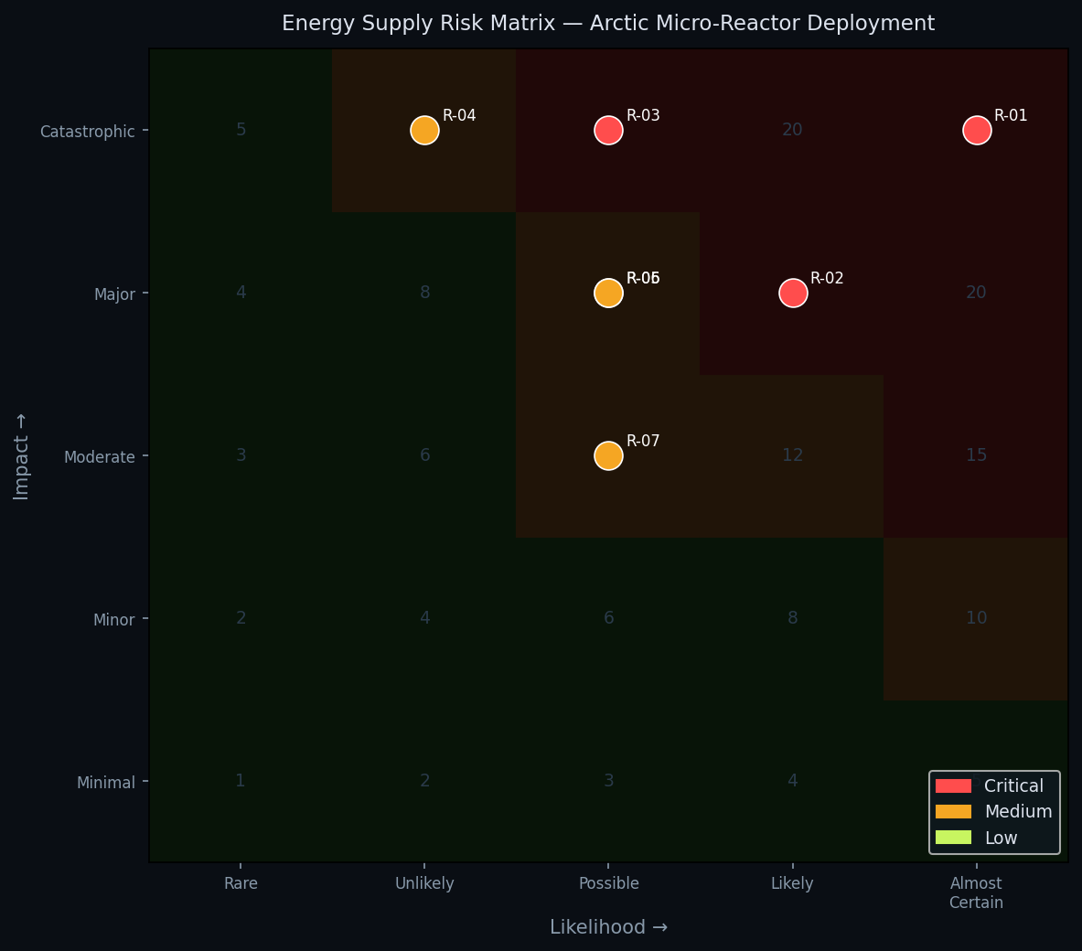
04
Risk Without Nuclear: Critical on Every Dimension
5×5 LIKELIHOOD × IMPACT RISK REGISTER
7 energy supply risks identified and assessed:
R-01 Polar Night Solar Blackout L5 × I5 = 25 CRITICAL
R-02 Wind Turbine Icing (<−30°C) L4 × I4 = 16 CRITICAL
R-03 Diesel Resupply Disruption L3 × I5 = 15 CRITICAL
R-05 Permafrost Foundation Thaw L3 × I4 = 12 Medium
R-06 CNSC Regulatory Delay L3 × I4 = 12 Medium
R-04 Reactor Maintenance Downtime L2 × I5 = 10 Medium
R-07 Community Acceptance Risk L3 × I3 = 9 Medium
Key insight: R-01, R-02, R-03 are all directly eliminated by nuclear deployment
ARCTIC NUCLEAR NECESSITY · CSMC STEM INTERN PROJECT · CONFIDENTIAL

Slide 5
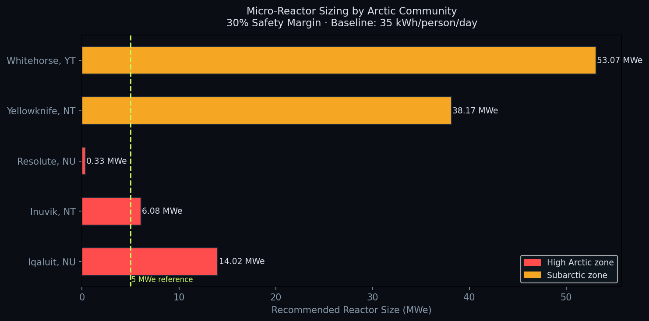
05
Right-Sized for Every Community
MICRO-REACTOR SIZING · 30% SAFETY MARGIN · NRCan 35 kWh/PERSON/DAY
Reactor sizing model applied to 5 Northern Canadian communities:
Resolute, NU 208 people → 0.33 MWe ← smallest CSMC configuration
Inuvik, NT 3,243 people → 6.13 MWe ← proof-of-concept scale
Iqaluit, NU 7,429 people → 14.04 MWe ← territorial capital priority
Methodology: population × 35 kWh/day ÷ 24h = baseline MW
Nuclear gap = baseline − winter renewable floor (zone-adjusted)
Reactor size = gap × 1.30 (30% engineering safety margin)
Dual-use opportunity:
Same 1–15 MWe range needed for lunar/Mars surface power (NASA FSP program)
Arctic deployment = Earth-based qualification heritage for space
ARCTIC NUCLEAR NECESSITY · CSMC STEM INTERN PROJECT · CONFIDENTIAL

Slide 6
CONCLUSIONS
01
The Arctic renewable energy gap is structural and quantifiable from public data
02
No combination of solar, wind, and storage can sustain communities through polar winter
03
Micro-nuclear reactors in the 0.33–14+ MWe range cover the full Arctic community spectrum
04
Resolute and Inuvik are lowest-complexity first-mover deployment opportunities
05
Arctic qualification directly supports CSMC's space and defence market positioning
DATA SOURCES: NASA POWER API · STATISTICS CANADA 2021 · NRCAN ARCTIC ENERGY

