Slide 1
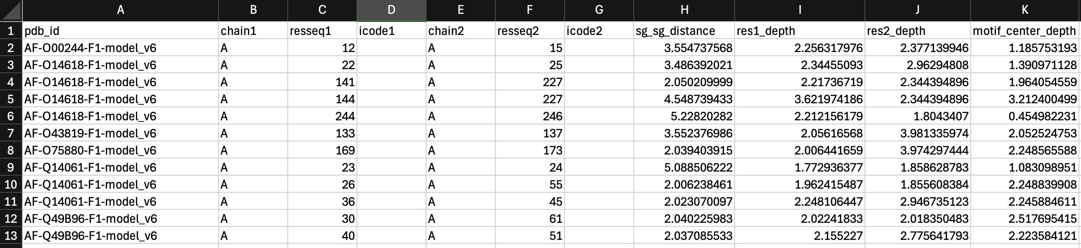
Human Copper chaperones

Slide 2
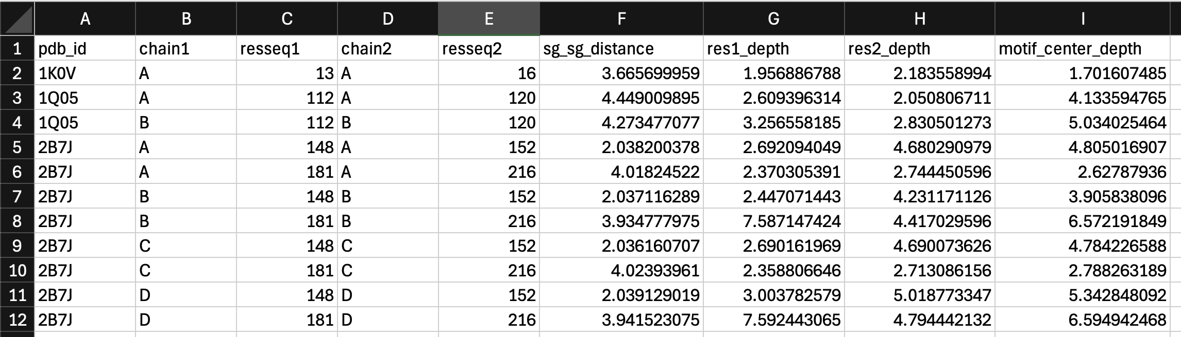
Bacteria Copper chaperones

Slide 3
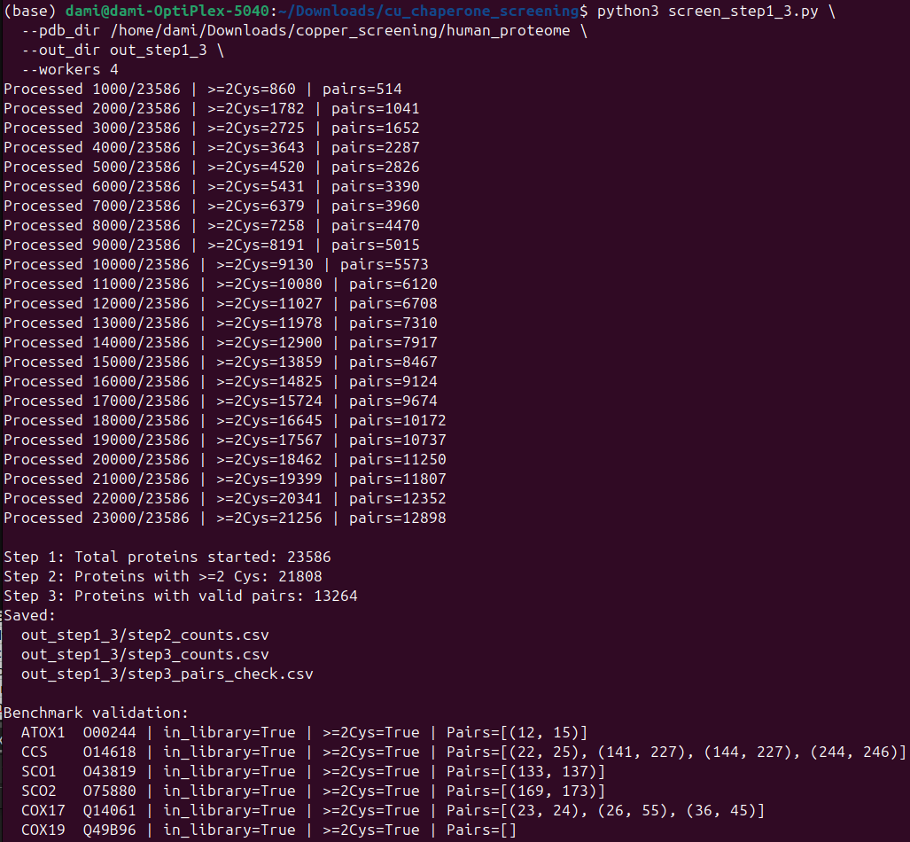
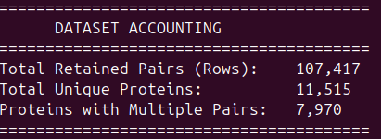

Slide 4
A: kept proteins with ≥2/3 valid in APEX_Label
B: kept proteins with ≥2/3 valid in both Ctrl and APEX_Label; no imputation.
Counts
A: tested 5924 proteins; significant (q ≤ 0.05) = 2056
B: tested 1228 proteins; significant (q ≤ 0.05) = 583
C (overlap A&B): 305 proteins
Match to step4_depths_FIXED_dedup.csv (by UniProt in pdb_id)
A matched: 4440 rows (structural pairs), 595 unique UniProt
B matched: 555 rows, 150 unique UniProt
C matched: 328 rows, 87 unique UniProt

Slide 5
BLACKLIST
KERATIN (KRT): classic human handling contaminant in MS datasets.
ALBUMIN (ALB): dominant serum/plasma protein; often indicates serum carryover/contamination rather than a specific interactor.
IMMUNOGLOBULIN / ANTIBODY (IGH/IGK/IGL): usually irrelevant unless your sample is immune/B-cell–rich; frequently treated as background in proteomics contaminant repositories.
METALLOTHIONEIN (MT*): genuine metal-binding “buffer/sink” proteins, typically not trafficking chaperones
HISTONE (HIST1/2/3/4): abundant nuclear proteins; can be true hits only if experiment involves nuclei/chromatin.
COLLAGEN (COL*): extracellular matrix; exclude unless explicitly profiling ECM/secretome.
FIBRINOGEN (FGA/FGB/FGG): plasma protein; exclude unless working with plasma/serum proteomics.
INSULIN (INS/IAPP): secreted disulfide proteins; typically irrelevant unless system is pancreatic/secretory-focused.
RPL / RPS: ribosomal protein large-subunit / small-subunit genes.

