Slide 1
Docker
containerized applications

Slide 2
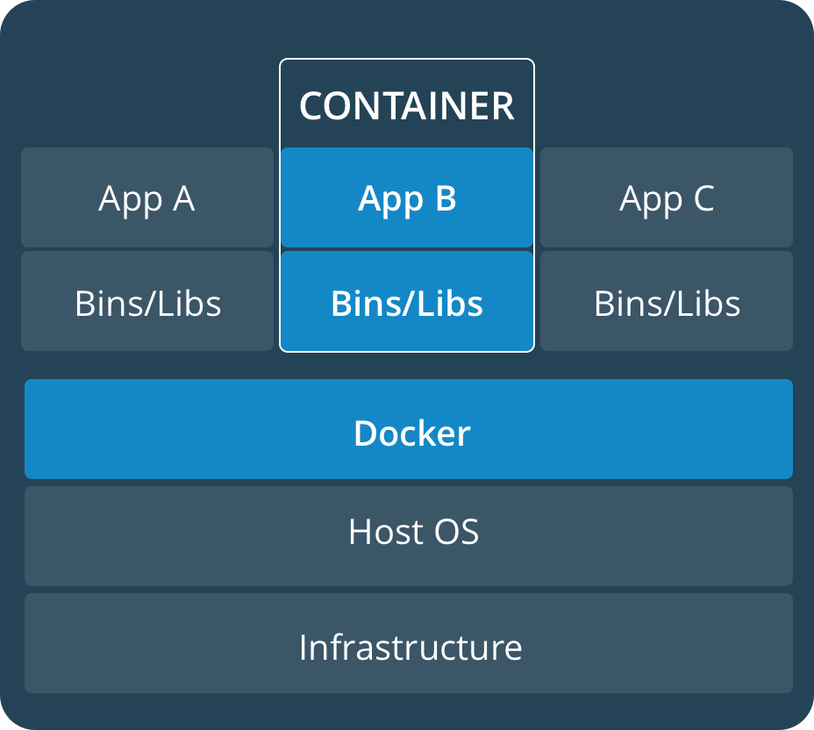
Container
“the image is the recipe, the container is the cake ;-) you can make as many cakes as you like with a given recipe” (https://stackoverflow.com/questions/23735149/what-is-the-difference-between-a-docker-image-and-a-container#comment79144517_23736802)

Slide 3
Container
standalone, executable package of software that includes everything to run an application
immutable, static file that includes executable code to run an isolated process on IT infrastructure
container images become containers at runtime
image shares OS kernel of host system
stored in a registry (public or private repository)
pushed by creator, pulled by user

Slide 4
Container
generally consume less system resources than a virtual machine
rely on open standards
pros
operate across different infrastructure (physical/virtual machine, cloud-hosted instances)
cons
authenticity: IT must monitor for fraudulent images
container image sprawl (different containers with same apps)
container images are isolated from each other

Slide 5
Docker
platform to manage container images (create, store, run, supervise)
Docker Hub: repository for storing and managing images
Docker Store: repository to pull images from (if not found locally)
Docker Engine: run and supervise containers
runs on various Linux and Windows Server OS
built on containerd (industry-standard container runtime by CNCF)
Docker Desktop: built and deliver container applications
available for Windows 10 Pro, Windows Server 2016 and MacOS only
for Google Kubernetes or Docker Swarm
Docker Content Trust (Enterprise only): FIPS 140-2 encryption
Docker Trusted Registry (Enterprise only): store, share and manage images
image signing, image scanning, image lifecycle, access control
Docker Compose: tool for defining and running multi-container Docker applications

Slide 6
Use Cases
traditional applications: containerize legacy applications (i.e. Java or .NET)
microservices
continuous integration / delivery / deployment

Slide 7
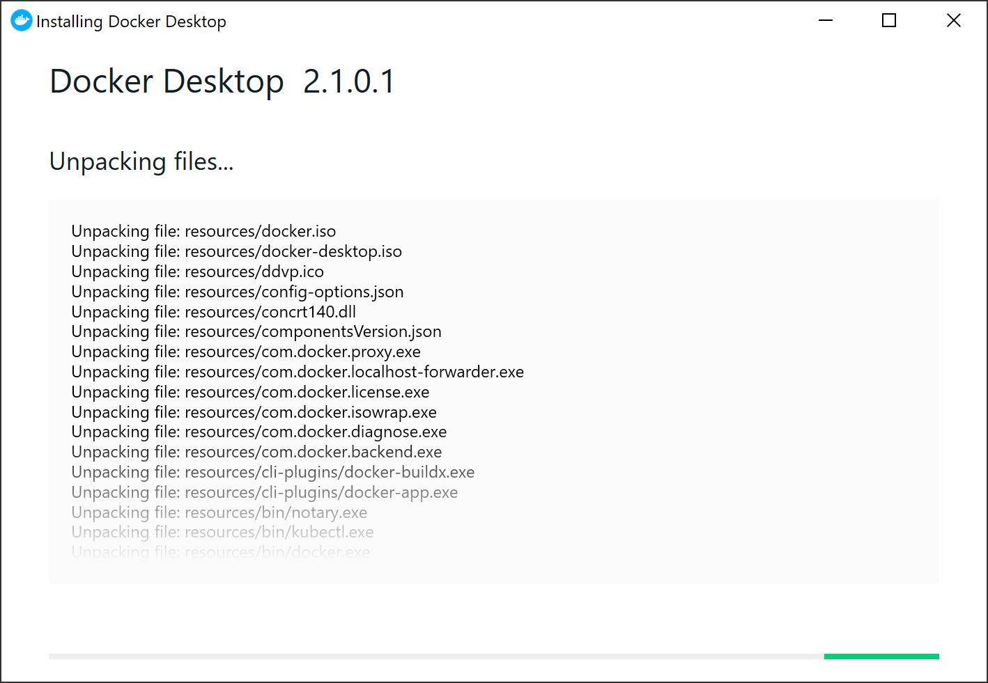
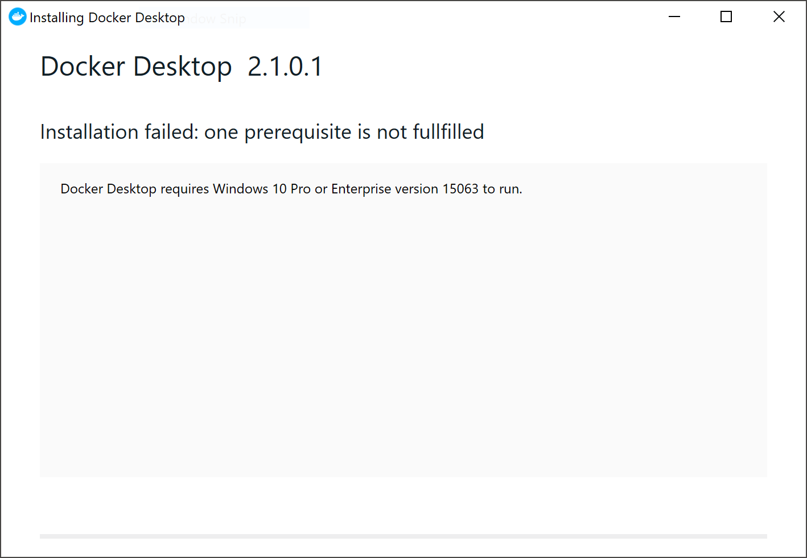
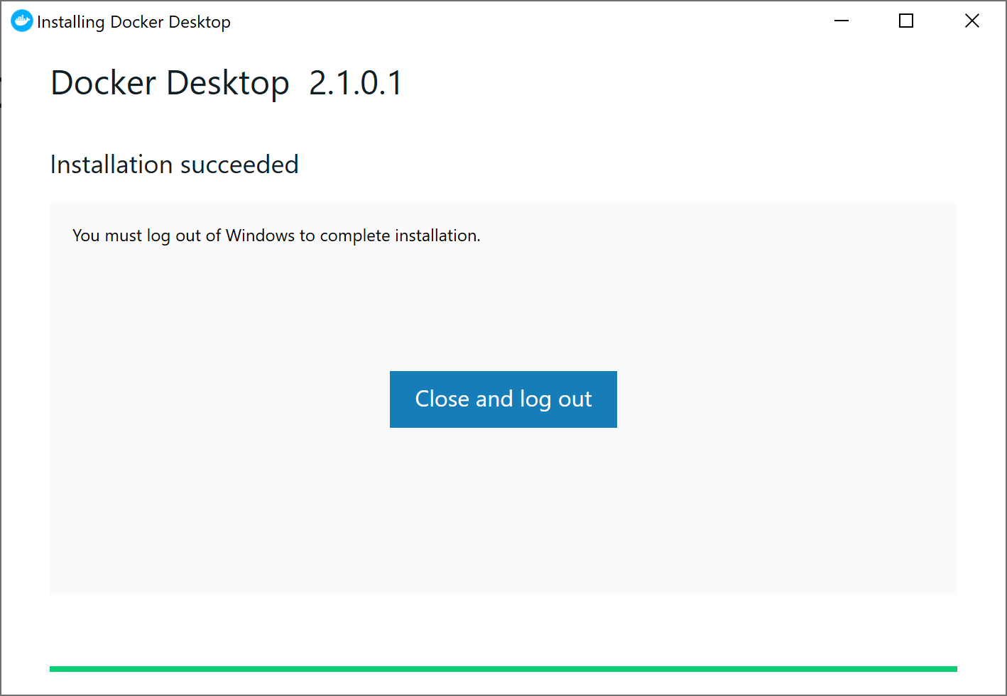
Docker Engine - Community
Windows 10 Pro required

Slide 8
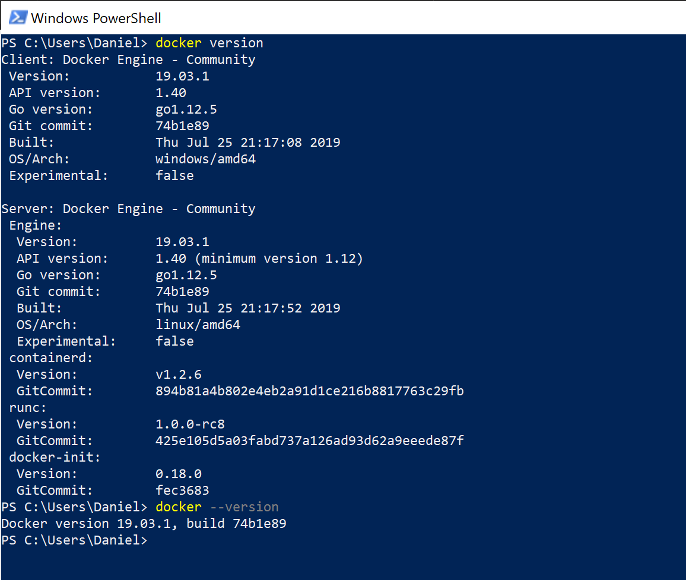
CMD version
docker version
docker --version

Slide 9
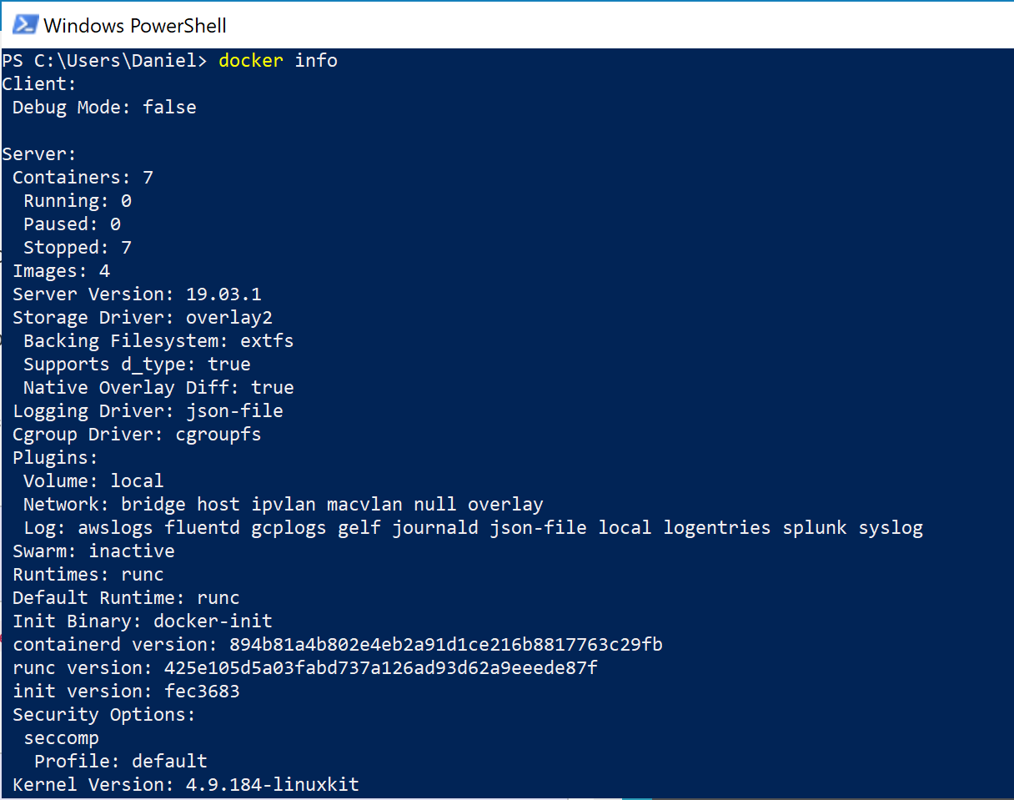
CMD info
docker info

Slide 10
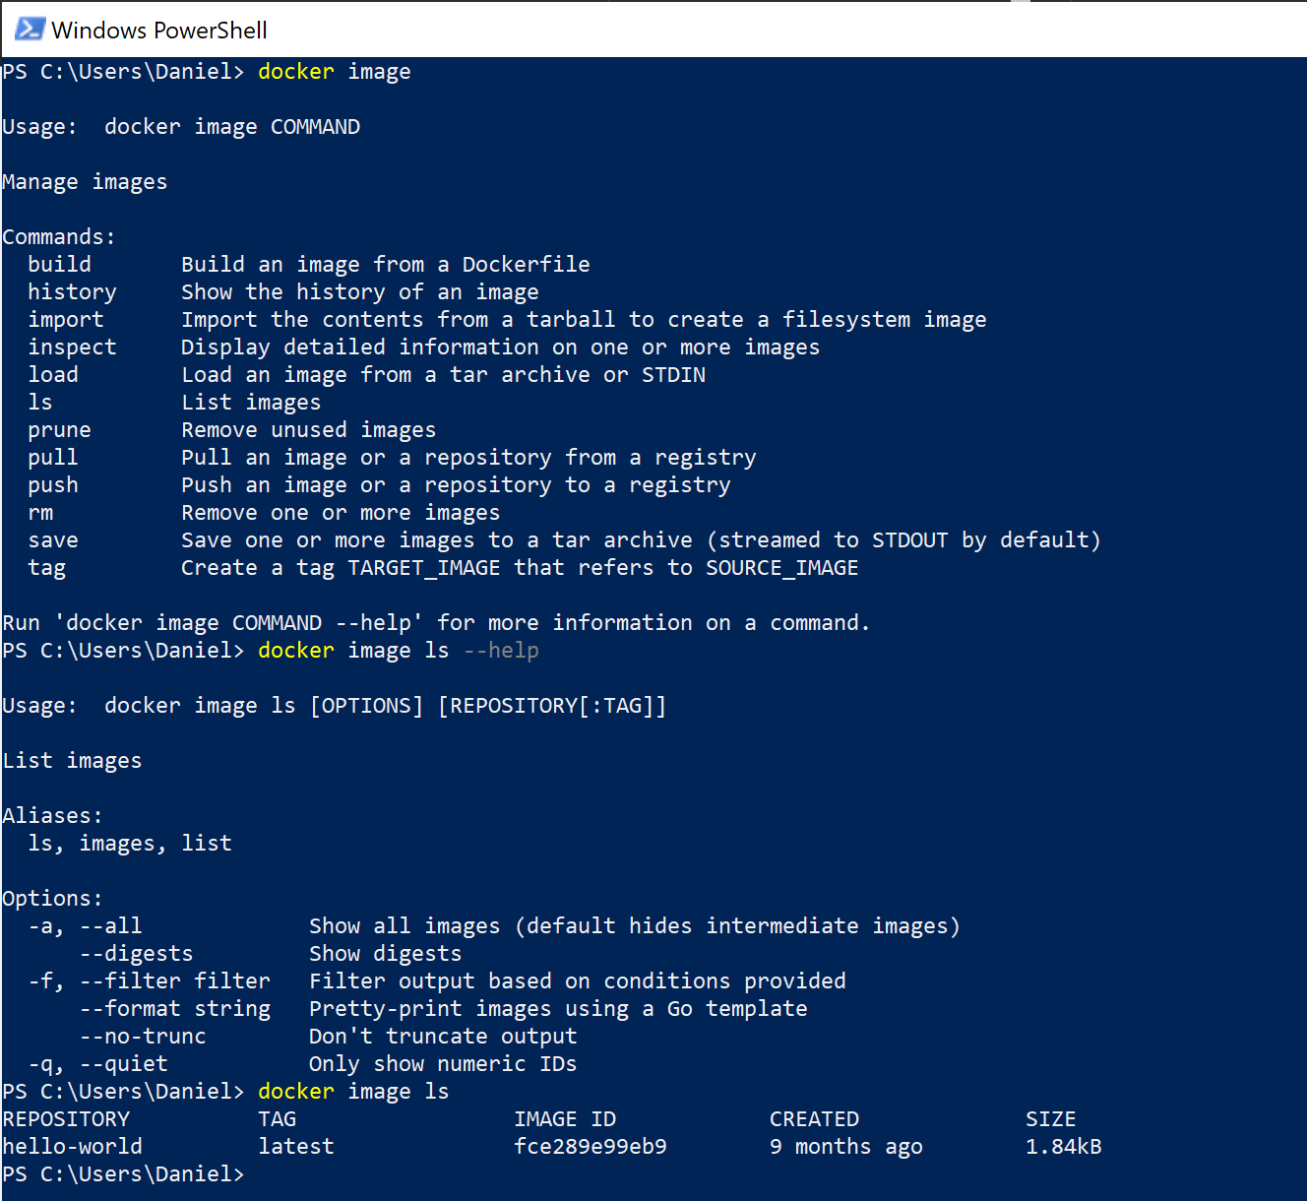
CMD image: help
docker image

Slide 11
CMD image: commit container as image
quick start example:
docker image pull ubuntu
docker container run --interactive ubuntu bash
<do some changes> (i.e. install figlet)
exit
docker container ls -a
docker container diff <container id>
docker container commit <container id>
list all containers (started and exited):
docker image ls –a
tag container:
docker image tag <image id> <tagname>
run existing container:
docker container run <tagname> figlet hello

Slide 12
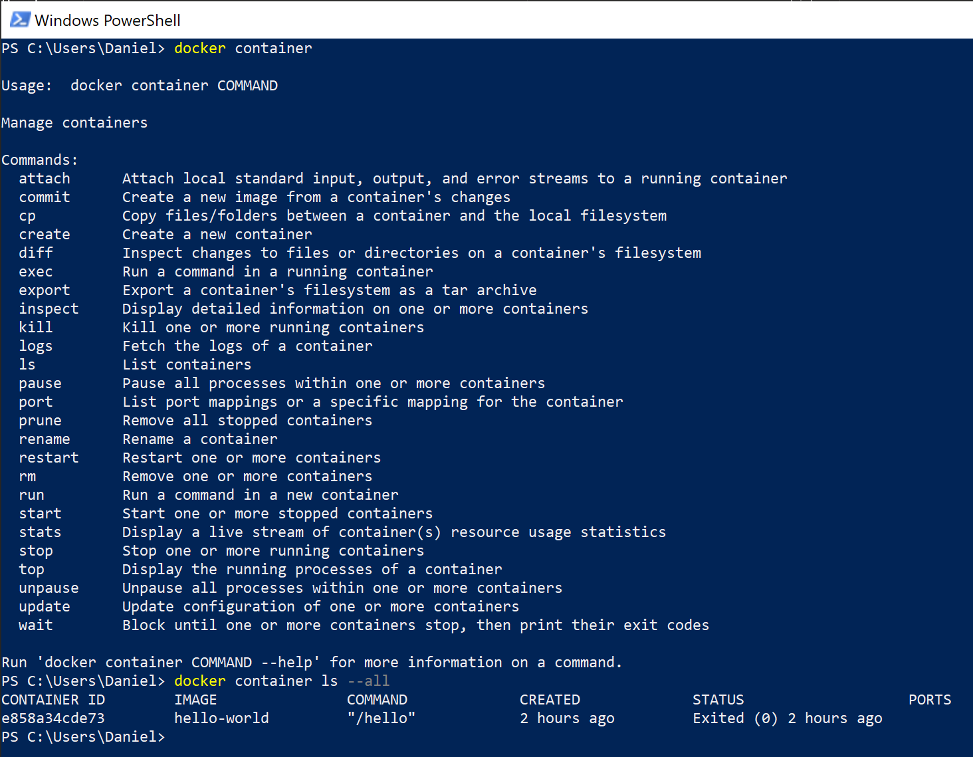
CMD container: help
docker container

Slide 13
CMD container
run container – single command:
(after docker image pull alpine and docker image ls)
docker container run alpine ls –l
(or docker run alpine ls –l)
run container - interactive terminal:
docker container run --interactive alpine
(or docker run –-interactive alpine)
exit
run container - background:
docker container run –-detach <container id or name>
(or docker run –-detach <container id>)
list all containers (started and exited):
docker container ls –a
start container:
[q] What is the difference to docker container run?
docker container start <container id or name>
execute command:
[q] What is the difference to docker container run?
docker container exec <container id or name> <cmd>
remove existing container:
docker container rm <name>

Slide 14
Dockerfile
https://docs.docker.com/engine/reference/builder/
text document to assemble and build an image automatically
contains a step-by-step recipe how to build the image
first step to containerizing an application
[i] build is run by Docker daemon
‘.dockerignore’ file

Slide 15
Dockerfile: usage to build image
docker build .
docker build --file <DockerfilePath> --tag <name> .

Slide 16
Dockerfile: instructions
FROM <image>[:<tag>] [AS <name>]
RUN <command> or ["executable", "param1", "param2"]
WORKDIR
CMD ["executable", "param1", "param2"] or command param1 param2
[i] there can only be one CMD instruction per Dockerfile
- main purpose of CMD: provide defaults for an executing container
COPY
VOLUME
EXPOSE
USER
# (comment)

Slide 17
Volumes

Slide 18
Docker Compose
Docker Compose: tool for defining and running multi-container Docker applications
commands for managing the whole lifecycle of your application:
start, stop, and rebuild services
view the status of running services
stream the log output of running services
run a one-off command on a service
YAML file is used to configure your application’s services
3 steps:
define app’s environment with a Dockerfile (for reproduction purposes)
define services of your app in a docker-compose.yml (isolation)
run docker-compose up

Slide 19
Docker Compose: docker-compose.yml
https://docs.docker.com/compose/compose-file/

Slide 20
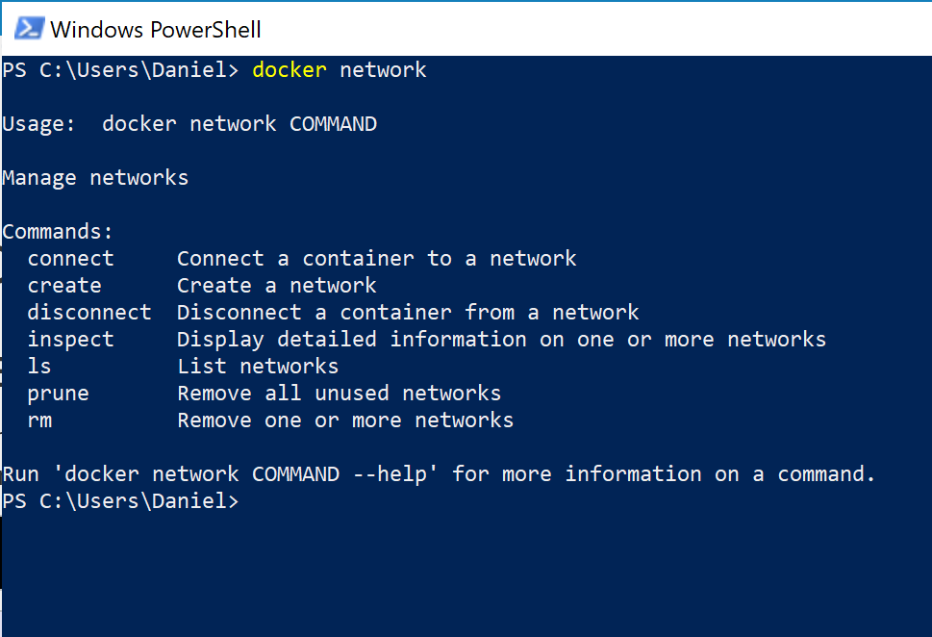
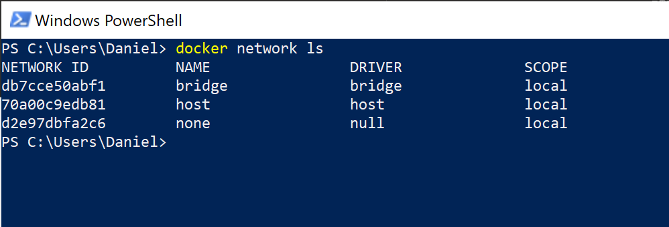
Networking
docker network
allows to create new networks or list, inspect and remove existing network
docker run -dt ubuntu sleep infinity
docker ps
docker network inspect bridge

Slide 21
Networking
using ‘docker run’ only → container is added to bridge network

Slide 22
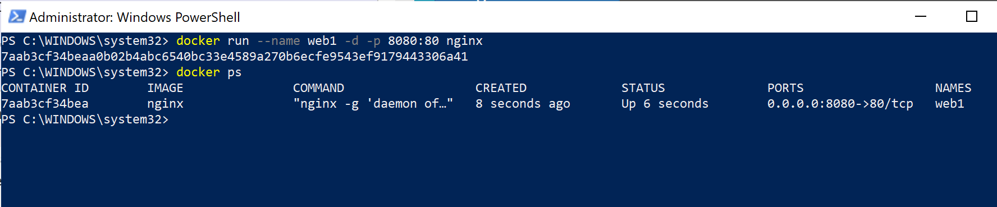
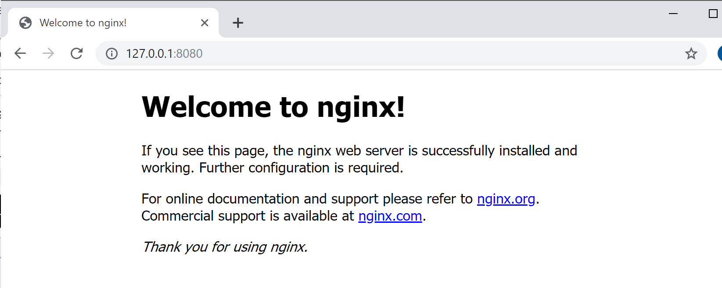
Networking | configure NAT for ext com
docker image pull nginx docker container run --publish 8080:80 –-detach --name web1 nginx docker ps curl <ip:port> (from docker inspect bridge) docker stop web1

Slide 23
Networking
[q] How to create own networks?
[q] What types of networks are available? (bridge, overlay, host, null)

Slide 24
Quickstart Example

Slide 25
Docker ML Python Env
Docker image: https://hub.docker.com/_/python
best practices: https://pythonspeed.com/
build image:
docker build . --tag pyml
make drive C shareable (Docker settings), create dir C:/dockerShare
run image (as container):
docker container run --rm --detach --publish 9999:9999 --volume C:/dockerShare:/home/mluser/share pyml
open browser, navigate to localhost:9999[/lab]

Slide 26
Learning Resources
https://training.play-with-docker.com/
https://docs.docker.com/

Slide 27
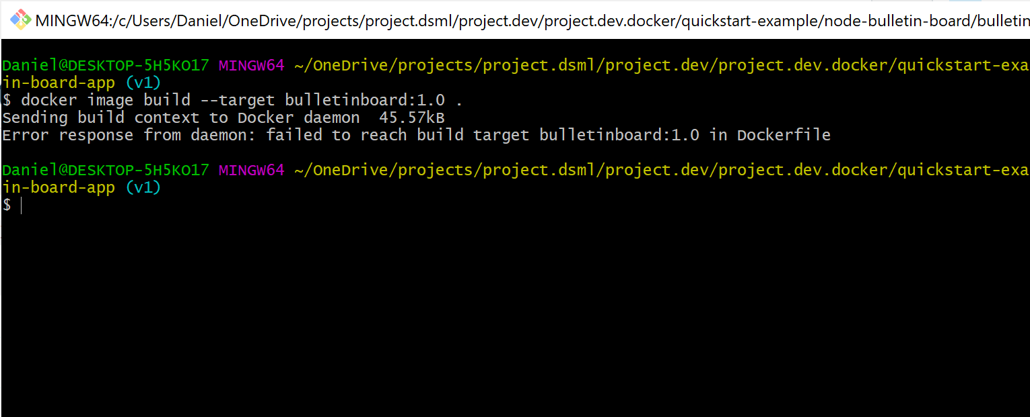
Issues: docker image build […]
‘failed to reach build target […]’

Slide 28
Other vendors
Kata Containers
balenaEngine
embedded and IoT use cases
Firecracker

Slide 29
Docker
Docker, Inc.
San Francisco, CA
USA

