Slide 1
Classification & Localization of Objects in Images
Project Type: Machine Learning
Daniel Hellwig / Dominik Hillmann

Slide 2
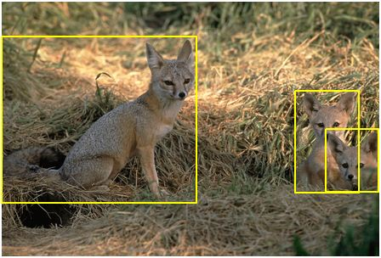
Task
Classify and localize an object of a given image
Resources
https://www.kaggle.com/c/imagenet-object-localization-challenge
http://www.image-net.org/
https://www.youtube.com/watch?v=_GfPYLNQank

Slide 3
Task
1. Classification
use Transfer Learning to train a Neural Network
2. Localization

Slide 4
Dataset
Original Dataset is ImageNet
Here: use Tiny ImageNet
https://tiny-imagenet.herokuapp.com/

