Slide 1
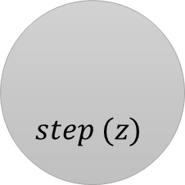
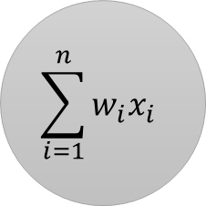

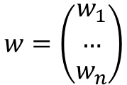
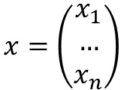
inputs
mathematical operations
outputs
$$w=\left(\begin{aligned}w_{1} \\ … \\ w_{n}\end{aligned}\right)$$
$$\sum_{i=1}^{n}{w_{i}x_{i}}$$
$$step (z)$$
$$y\left(x\right)$$
$$x=\left(\begin{aligned}x_{1} \\ … \\ x_{n}\end{aligned}\right)$$

Slide 2

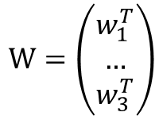

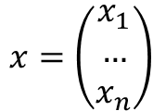



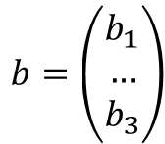

inputs
LTU layer
outputs
$$W=\left(\begin{aligned}w_{1}^{T} \\ … \\ w_{3}^{T}\end{aligned}\right)$$
$$∑$$
$$y_{1}$$
$$x=\left(\begin{aligned}x_{1} \\ … \\ x_{n}\end{aligned}\right)$$
$$∑$$
$$y_{2}$$
$$b=\left(\begin{aligned}b_{1} \\ … \\ b_{3}\end{aligned}\right)$$
$$∑$$
$$y_{3}$$

Slide 3

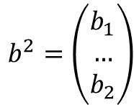
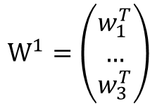

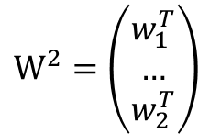
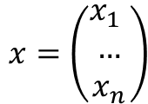

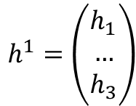


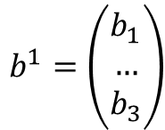


input layer
hidden layer
output layer
(inputs
of hidden layer)
(inputs
of output layer)
$$W^{1}=\left(\begin{aligned}w_{1}^{T} \\ … \\ w_{3}^{T}\end{aligned}\right)$$
$$W^{2}=\left(\begin{aligned}w_{1}^{T} \\ … \\ w_{2}^{T}\end{aligned}\right)$$
$$∑$$
$$∑$$
$$y_{1}$$
$$x=\left(\begin{aligned}x_{1} \\ … \\ x_{n}\end{aligned}\right)$$
$$h^{1}=\left(\begin{aligned}h_{1} \\ … \\ h_{3}\end{aligned}\right)$$
$$∑$$
$$∑$$
$$y_{2}$$
$$b^{1}=\left(\begin{aligned}b_{1} \\ … \\ b_{3}\end{aligned}\right)$$
$$b^{2}=\left(\begin{aligned}b_{1} \\ … \\ b_{2}\end{aligned}\right)$$
$$∑$$

Slide 4
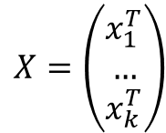
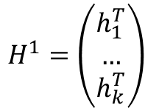
input layer
hidden layer
output layer
(inputs
of hidden layer)
(inputs
of output layer)
$$W^{1}=\left(\begin{aligned}w_{1}^{T} \\ … \\ w_{3}^{T}\end{aligned}\right)$$
$$W^{2}=\left(\begin{aligned}w_{1}^{T} \\ … \\ w_{2}^{T}\end{aligned}\right)$$
$$∑$$
$$∑$$
$$y_{1}$$
$$X=\left(\begin{aligned}x_{1}^{T} \\ … \\ x_{k}^{T}\end{aligned}\right)$$
$$H^{1}=\left(\begin{aligned}h_{1}^{T} \\ … \\ h_{k}^{T}\end{aligned}\right)$$
$$∑$$
$$∑$$
$$y_{2}$$
$$b^{1}=\left(\begin{aligned}b_{1} \\ … \\ b_{3}\end{aligned}\right)$$
$$b^{2}=\left(\begin{aligned}b_{1} \\ … \\ b_{2}\end{aligned}\right)$$
$$∑$$

Slide 5
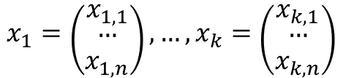
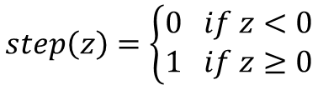
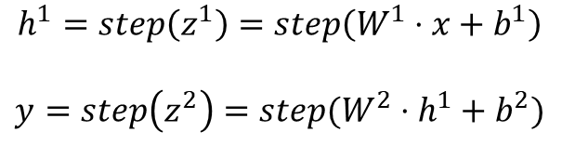
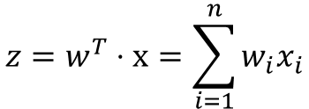
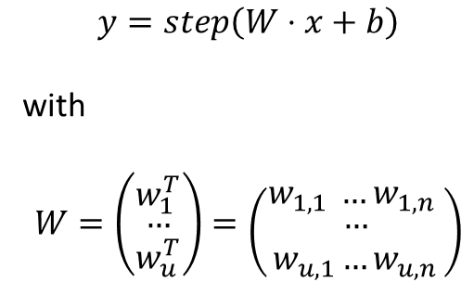
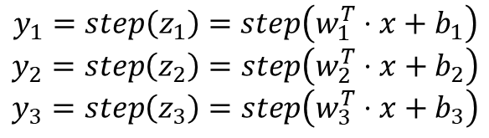


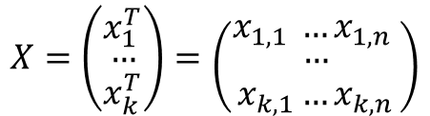
$$z=w^{T}⋅x=\sum_{i=1}^{n}{w_{i}x_{i}}$$
$$y_{1}=step\left(z_{1}\right)=step\left(w_{1}^{T}⋅x+b_{1}\right)$$
$$y_{2}=step\left(z_{2}\right)=step\left(w_{2}^{T}⋅x+b_{2}\right)$$
$$y_{3}=step\left(z_{3}\right)=step\left(w_{3}^{T}⋅x+b_{3}\right)$$
$$h^{1}=step\left(z^{1}\right)=step\left(W^{1}⋅x+b^{1}\right)$$
$$y=step\left(z^{2}\right)=step(W^{2}⋅h^{1}+b^{2})$$
$$step\left(z\right)=\left\{\begin{aligned}0 if z<0 \\ 1 if z≥0\end{aligned}\right.$$
$$y=step\left(W⋅x+b\right)$$
with
$$W=\left({w_{1}^{T} \atop \begin{aligned}… \\ w_{u}^{T}\end{aligned}}\right)=\left({w_{1,1} …w_{1,n} \atop \begin{aligned}… \\ w_{u,1}…w_{u,n}\end{aligned}}\right)$$
$$x_{1}=\left({x_{1,1} \atop \begin{aligned}… \\ x_{1,n}\end{aligned}}\right),…,x_{k}=\left({x_{k,1} \atop \begin{aligned}… \\ x_{k,n}\end{aligned}}\right)$$
$$y=step\left(z\right)=step(w^{T}⋅x)$$
$$X=\left({x_{1}^{T} \atop \begin{aligned}… \\ x_{k}^{T}\end{aligned}}\right)=\left({x_{1,1} …x_{1,n} \atop \begin{aligned}… \\ x_{k,1}…x_{k,n}\end{aligned}}\right)$$
$$y=step\left(Z\right)=step(X⋅W+b)$$

