Slide 1

CouchDB Overview and Architecture
Ruth Okoilu

Slide 2
Overview
Quintessential JSON- and REST-based document-oriented nosql database
An acronym for cluster of unreliable commodity hardware
written in Erlang
First released in 2005
Later became an Apache Software Foundation project in 2008
Open source and designed with the Web in mind
[3]
Notes:
CouchDB is the quintessential JSON- and REST-based document-oriented database. First released in 2005, CouchDB was designed with the Web in mind and all the innumerable flaws, faults, failures, and glitches that come with it.
An acronym for cluster of unreliable commodity hardware
Couch is part of the "NoSQL" movement, where your data, rather than living in one massive relational database on a single server,
may be distributed on many machines across the web. Or it might be sitting in a DesktopCouch database on your local desktop machine.
Because your data can sit comfortably on virtual or remote servers rather than a rdbms server

Slide 3
Overview
CouchDB is a Distributed Architecture with Replication
It is able to scale down as well as up, CouchDB fits problem spaces of varying size and complexity with ease.
It offers a robustness unmatched by most other databases. Whereas other systems tolerate occasional network drops, CouchDB thrives even when connectivity is only rarely available.
Notes:
Distributed Architecture with Replication
This means that CouchDB was designed with bi-direction replication (or synchronization) and off-line operation in mind.
Mulitple replicas can have their own copies of the same data, modify it, and then sync those changes at a later time.
Unlike relational, does not require a schema, data is stored as key value format in json objects
CouchDB is able to scale down as well as up, this just means to make it is capable of doing more work.
CouchDB fits problem spaces of varying size and complexity with ease.
It offers a robustness unmatched by most other databases. Whereas other systems tolerate occasional network drops, CouchDB thrives even when connectivity is only rarely available.

Slide 4
Features
Does not store data and relationships in tables
Each database is a collection of independent document
Can run on Android phone, MacBook, and in the datacenter
Uses JSON as its storage and communication language
Calls to CouchDB happens over a REST interface
Fauxton, formerly called FUTON - CouchDB GUI
Notes:
Unlike a relational database, a CouchDB database does not store data and relationships in tables. Instead, each database is a collection of independent documents.
Each document maintains its own data and self-contained schema.
Replication and synchronization capabilities of CouchDB make it ideal for using it in mobile devices, where network connection is not guaranteed, and the application must keep on working offline.
CouchDB is well suited for applications such as (CRM, CMS systems, by example).
In version 2 they introduced Fauxton which is more intuitive, formerly called FUTON - CouchDB GUI

Slide 5
Couch?
Relax!
No JDBC!!
Ready made APIs
Extremely, ridiculously reliable
Fault Tolerant
Notes:
If there’s one word to describe CouchDB, it is relax.
CouchDB’s design borrows heavily from web architecture and the concepts of resources and methods.
Whether it’s MongoDB or MySQL or Oracle, you will need your JDBC connector for Java and perhaps an ORM layer or maybe you just give up on Hibernate and write all the database objects yourself, so half of your code is getters and setters, but that’s OK, because that’s how we abstract the database. But with Couch,
No SELECT query etc just map reduce functions
You do not have to fear random behavior and untraceable errors. If anything should go wrong, you can easily find out what the problem is—but these situations are rare.
Its internal architecture is fault-tolerant, and failures occur in a controlled environment and are dealt with gracefully. Single problems do not cascade through an entire server system but stay isolated in single requests.

Slide 6
Definition
Document - a document consists of a JSON object containing key- value pairs called fields. All documents in CouchDB have an _id field, which must be unique and can never be changed.
Views - In CouchDB, a view is a window into the documents contained in a database
Views are the principal way that documents are accessed in all but trivial cases
Notes:
Documents consists of json objects have have an _id field.
You can specify an _id explicitly, but if you don’t, CouchDB will generate one for you. In our case, the default is fine, so click Save Document to finish.
Immediately after saving the document, CouchDB will assign it an additional field called _rev. The _rev field will get a new value every time the document changes.
To update or delete an existing document, you must provide both an _id and the matching _rev. If either of these do not match, CouchDB will reject the operation. This is how it prevents conflicts—by ensuring only the most recent document revisions are modified.
Creating Views is like the Querying using select statement but in couch we use map reduce

Slide 7
Document Modeling
Schema free model
Models are basically around use cases
Models evolve
Notes:
CouchDB’s schema-free design unburdens you with a powerful way to aggregate your data after the fact, just like we do with real-world documents.
Models are basically around use cases
Models can and do change
This is the best database for document oriented data
E.g.
See next page

Slide 8
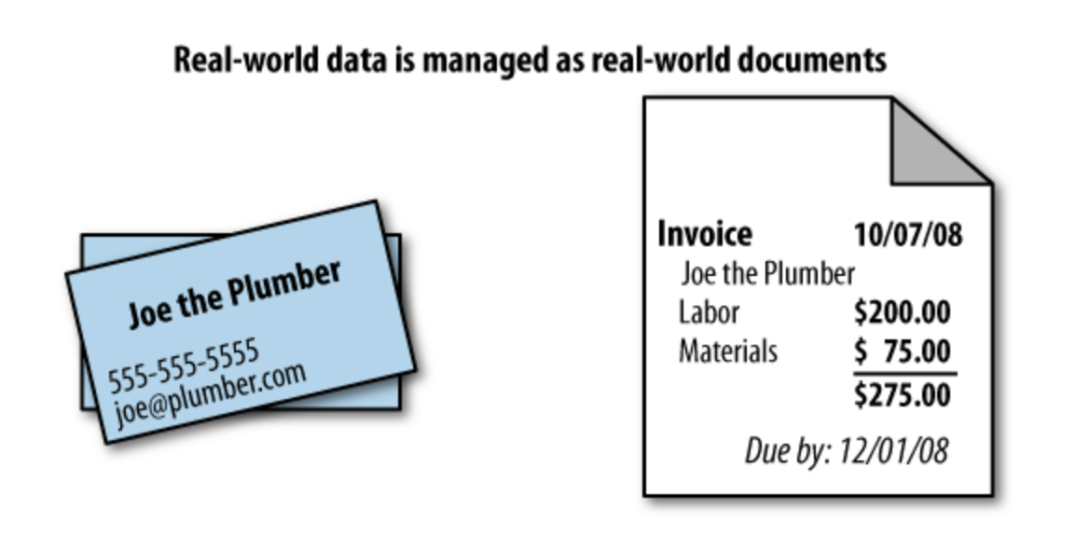
Notes:
E.g :
An invoice contains all the pertinent information about a single transaction—the seller, the buyer, the date, and a list of the items or services sold.
Contacts
Profiles
Business cards
Blog Posts

Slide 9
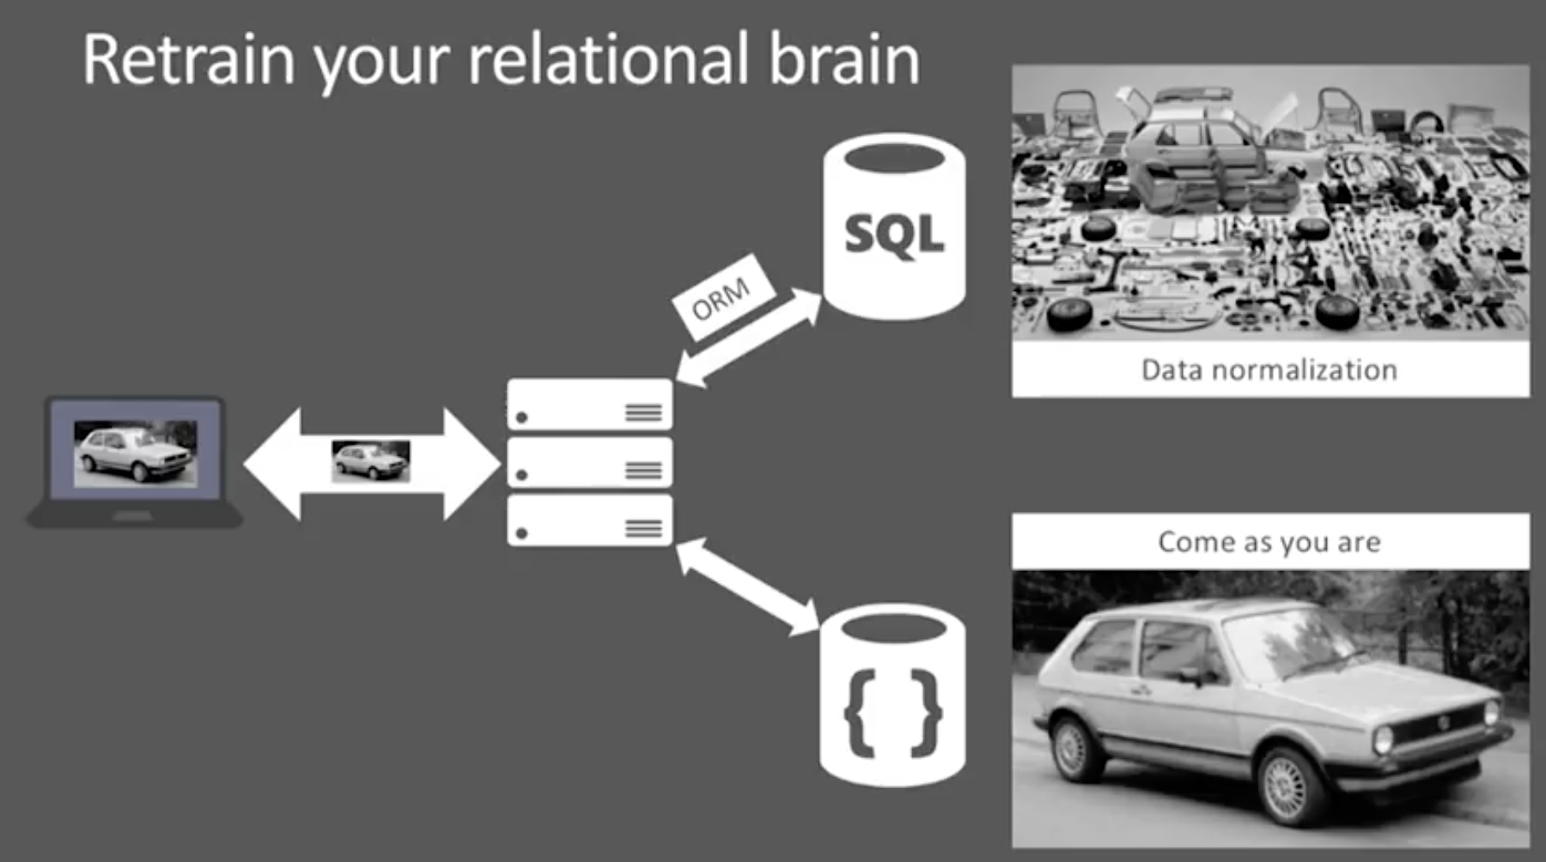
[1]
Notes:
To set the scene and context of what we are talking about. I’m going to paint two extreme scenarios which will give an idea of how different rdbms and nosql approaches are.
Let’s say I’m building an applicaiton that deals with motor vehicles or selling them.
And I want to display motor vehicle on the screen,
In RDBMS, I might quickly use some ORM or mapping tool and change the format and store each component part in different tables. Put wheels in one place, and seats in another.
And when you want to display the motor vehicle again on the page, you write a code in the DB or in application to take all these part and assemble it back again and then present the motor vehicle on the page
In a document databases on the other hand, it’s simply come as you are, you have the motor vehicle,
And you send that over the wire as it is and you persist that whole motor vehicle as a motor vehcicle object in the database.
when you want to display that motor vehicle on the page you do a query bring it down over the wire just like come as you are.

Slide 10
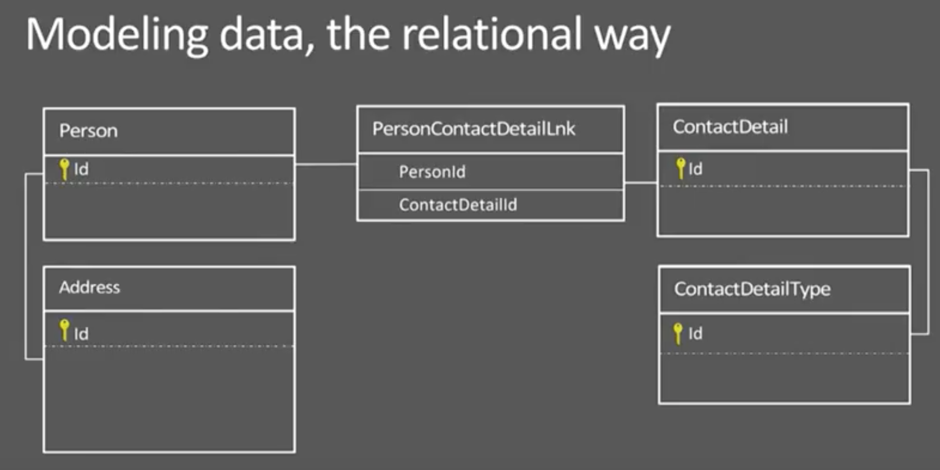
[1]
Notes:
We’ve all seen the kind of data model that is up on the screen. Where a person has an address, contact details which has a type and we split these up into separate tables.
We use foreign keys to break these up and reassemble the object.
Reassembling is basically by referencing

Slide 11
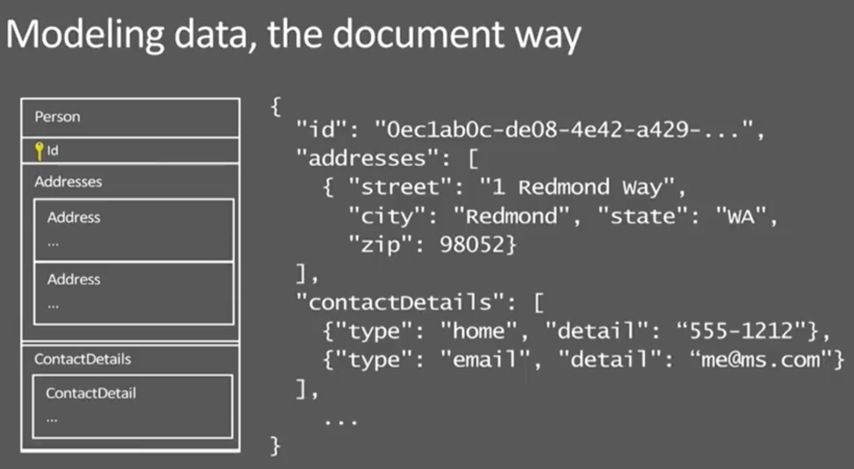
[1]
Notes:
But in a document world, a document called person has attribute and we embed the contact details of the person in a single document

Slide 12
CouchDB Architecture
CouchDB servers operate as individual nodes
Application servers can then read from and write to any of the CouchDB servers.
Changes are then asynchronously replicated between each server, on a server-to-server basis.
Master - Master replication
Notes:
CouchDB servers operate as individual nodes that each contain a full copy of the data to be stored. Application servers can then read from and write to any of the CouchDB servers. Changes are then asynchronously replicated between each server, on a server-to-server basis.
CouchDB’s solution uses replication to propagate application changes across participating nodes.
No consensus algorithm !!!
4.1.2. Replication Procedure
During replication, CouchDB will compare the source and the destination database to determine which documents differ between the source and the destination database. It does so by following the Changes Feeds on the source and comparing the documents to the destination. Changes are submitted to the destination in batches where they can introduce conflicts. Documents that already exist on the destination in the same revision are not transferred. As the deletion of documents is represented by a new revision, a document deleted on the source will also be deleted on the target.
A replication task will finish once it reaches the end of the changes feed. If its continuousproperty is set to true, it will wait for new changes to appear until the task is cancelled. Replication tasks also create checkpoint documents on the destination to ensure that a restarted task can continue from where it stopped, for example after it has crashed.
When a replication task is initiated on the sending node, it is called push replication, if it is initiated by the receiving node, it is called pull replication.
4.1.3. Master - Master replication
One replication task will only transfer changes in one direction. To achieve master-master replication, it is possible to set up two replication tasks in opposite direction. When a change is replicated from database A to B by the first task, the second task from B to A will discover that the new change on B already exists in A and will wait for further changes.

Slide 13
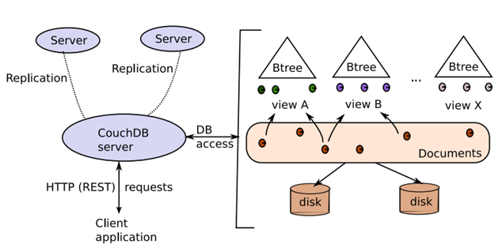
CouchDB Architecture
[8]
Notes:
At the heart of CouchDB is a powerful B-tree storage engine.
A B-tree is a sorted data structure that allows for searches, insertions, and deletions in logarithmic time.
uses this B-tree storage engine for all internal data, documents, and views.
B-tree to index its documents and views.
A B-tree is an excellent data structure for storing huge amounts of data for fast retrieval.
B-trees are usually a shallow but wide data structure. While other trees can grow very high, a typical B-tree has a single-digit height, even with millions of entries.
This is particularly interesting for CouchDB, where the leaves of the tree are stored on a slow medium such as a hard drive. Accessing any part of the tree for reading or writing requires visiting only a few nodes, which translates to a few head seeks
STOP here
CouchDB’s B-tree implementation is a bit different from the original. While it maintains all of the important properties, it adds Multi-Version Concurrency Control (MVCC) and an append-only design. B-trees are used to store the main database file as well as view indexes. One database is one B-tree, and one view index is one B-tree.
In a B-tree, data is kept only in leaf nodes. CouchDB B-trees append data only to the database file that keeps the B-tree on disk and grows only at the end.
Add Note from REF:
http://www.myassignmenthelp.net/couchdb-assignment-help
Drawbacks
This architecture has two main consequences:
●the master is a single point of failure for accepting reads
●data read from the slaves is eventually consistent; there is a lag between a write happening on the master and that being replicated to all slaves.
CouchDB differs from others by accepting eventual consistency, as opposed to putting absolute consistency ahead of raw availability, like RDBMS or Paxos
Alternatively, a CouchDB cluster could accept writes to any node and then replicate between each. This would improve write availability but increase the scope for write conflicts, which CouchDB helps you detect, and the time it would take for all copies of the data to be in sync.

Slide 14
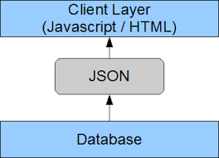
CouchDB Architecture
[8]
Notes:
Add note ref:
http://www.myassignmenthelp.net/couchdb-assignment-help
Querying:
It uses Java Script to query data using map reduce.
As a pure document store, Apache CouchDB allows you to retrieve data based on the contents of documents. It does this through a system of views. You can also pull out a full document using its key.
You can think of CouchDB’s views as indexes that you generate by writing JavaScript MapReduce queries. For example, if you want to retrieve a user profile based on that user’s email address you could:
1.Create a view that provides all the documents that contain an email address and have a type of ‘userProfile’.
2.Query that view for the email address of the user whose profile you want to retrieve.

Slide 15
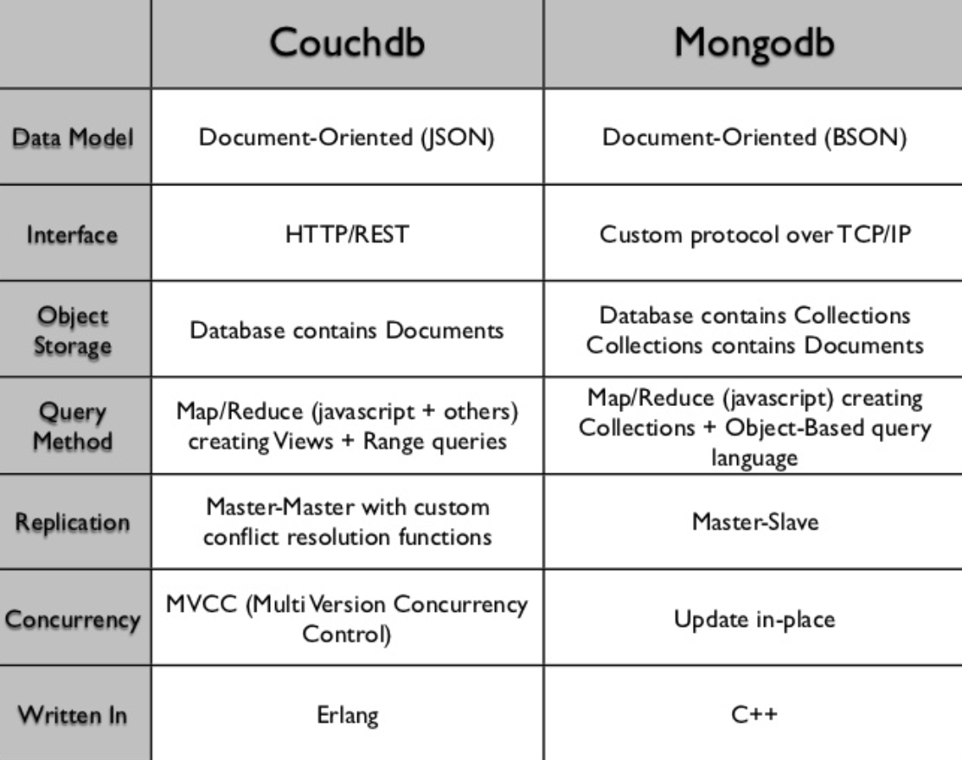
CouchDB vs MongoDB
[7]
Notes:
Other Document-Oriented Data Stores
MongoDB
CouchDB Uses JavaScript as a query language for Map/Reduce indexes Ø HTTP for its API Ø RESTful interface
Generate views for querying – Mongo uses Collections which are like tables so sql queries can be used.
●MongoDB: If you need dynamic queries. If you prefer to define indexes, not map/reduce functions. If you need good performance on a big DB. If you wanted CouchDB, but your data changes too much, filling up disks.
●CouchDB : For accumulating, occasionally changing data, on which pre-defined queries are to be run. Places where versioning is important.
●A recent (Feb 2012) and more comprehensive comparison by Riyad Kalla,
●MongoDB : Master-Slave Replication ONLY
●CouchDB : Master-Master Replication
●
●n practice the deciding factor for most people will be the fact that MongoDb allows ad-hoc querying with a SQL like syntax while CouchDb doesn't (you've got to create map/reduce views which turns some people off even though creating these views is Rapid Application Development friendly - they have nothing to do with stored procedures).
●To address points raised in the accepted answer : CouchDb has a great versionning system, but it doesn't mean that it is only suited (or more suited) for places where versionning is important. Also, couchdb is heavy-write friendly thanks to its append-only nature (writes operations return in no time while guaranteeing that no data will ever be lost).
●One very important thing that is not mentioned by anyone is the fact that CouchDb relies on b-tree indexes. This means that whether you have 1 "row" or 20 billions, the querying time will always remain below 10ms. This is a game changer which makes CouchDb a low-latency and read-friendly database, and this really shouldn't be overlooked.
●To be fair and exhaustive the advantage MongoDb has over CouchDb is tooling and marketing. They have first-class citizen tools for all major languages and platforms making the on-boarding easy and this added to their adhoc querying makes the transition from SQL even easier.
●CouchDb doesn't have this level of tooling - even though there are many libraries available today - but CouchDb is exposed as an HTTP API and it is therefore quite easy to create a wrapper in your favorite language to talk with it. I personally like this approach as it avoids bloat and allows you to only take what you want (interface segregation principle).
●
●From:
●https://stackoverflow.com/questions/12437790/when-to-use-couchdb-over-mongodb-and-vice-versa
Add note: from ref
http://blog.scottlogic.com/2014/08/04/mongodb-vs-couchdb.html
Other Document-Oriented Data Stores
MongoDB
CouchDB Uses JavaScript as a query language for Map/Reduce indexes Ø HTTP for its API Ø RESTful interface
Generate views for querying – Mongo uses Collections which are like tables so sql queries can be used.
●MongoDB: If you need dynamic queries. If you prefer to define indexes, not map/reduce functions. If you need good performance on a big DB. If you wanted CouchDB, but your data changes too much, filling up disks.
●CouchDB : For accumulating, occasionally changing data, on which pre-defined queries are to be run. Places where versioning is important.
●A recent (Feb 2012) and more comprehensive comparison by Riyad Kalla,
●MongoDB : Master-Slave Replication ONLY
You let only certain database servers write data and let others handle the reads.
●CouchDB : Master-Master Replication
Each node in a system should be able to make decisions purely based on local state. If you need to do something under high load with failures occurring and you need to reach agreement, you’re lost. If you’re concerned about scalability, any algorithm that forces you to run agreement will eventually become your bottleneck. Take that as a given.
—Werner Vogels, Amazon CTO and Vice President
●
●in practice the deciding factor for most people will be the fact that MongoDb allows ad-hoc querying with a SQL like syntax while CouchDb doesn't (you've got to create map/reduce views which turns some people off even though creating these views is Rapid Application Development friendly - they have nothing to do with stored procedures).
●To address points raised in the accepted answer : CouchDb has a great versionning system, but it doesn't mean that it is only suited (or more suited) for places where versionning is important. Also, couchdb is heavy-write friendly thanks to its append-only nature (writes operations return in no time while guaranteeing that no data will ever be lost).
●One very important thing that is not mentioned by anyone is the fact that CouchDb relies on b-tree indexes. This means that whether you have 1 "row" or 20 billions, the querying time will always remain below 10ms. This is a game changer which makes CouchDb a low-latency and read-friendly database, and this really shouldn't be overlooked.
●To be fair and exhaustive the advantage MongoDb has over CouchDb is tooling and marketing. They have first-class citizen tools for all major languages and platforms making the on-boarding easy and this added to their adhoc querying makes the transition from SQL even easier.
●CouchDb doesn't have this level of tooling - even though there are many libraries available today - but CouchDb is exposed as an HTTP API and it is therefore quite easy to create a wrapper in your favorite language to talk with it. I personally like this approach as it avoids bloat and allows you to only take what you want (interface segregation principle).
●
●From:
●https://stackoverflow.com/questions/12437790/when-to-use-couchdb-over-mongodb-and-vice-versa
Add note: from ref
http://blog.scottlogic.com/2014/08/04/mongodb-vs-couchdb.html

Slide 16
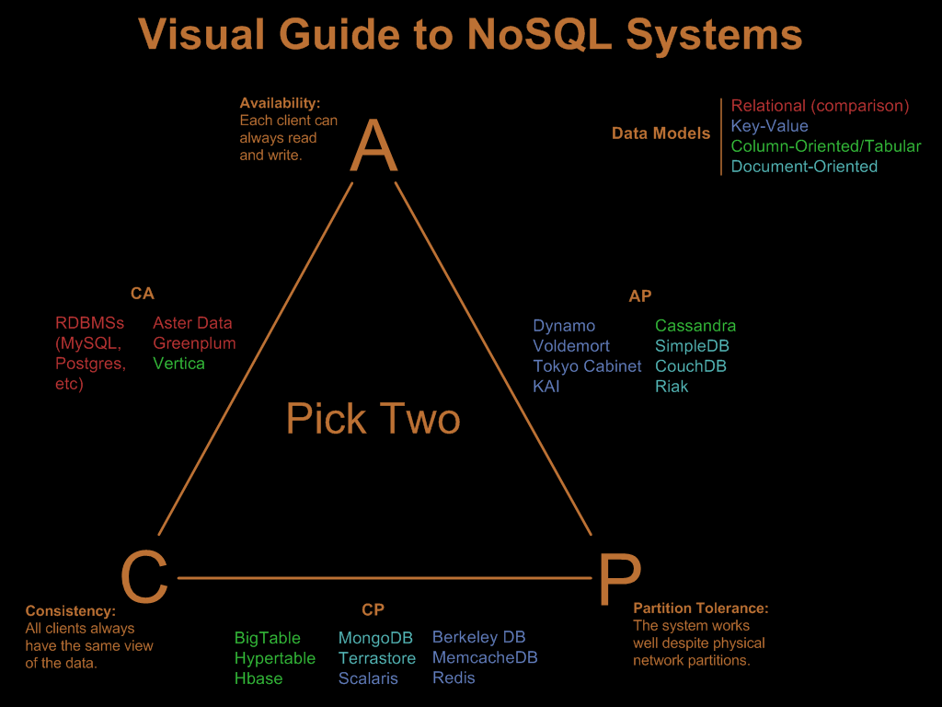
[7]
[9]
Notes:
Apart from these differences
As you can see in the diagram, MongoDB and CouchDB are built with a slightly different focus. Both scale across multiple nodes easily, but MongoDB favours consistency while CouchDB favours availability.
So you use mongoDB when considering immediate consistency
dont say: In the MongoDB replication model, a group of database nodes host the same data set and are defined as a replica set.
USe Mongo when considering immediate consistency.
So you use mongoDB when considering immediate consistency
Add note: from ref
http://blog.scottlogic.com/2014/08/04/mongodb-vs-couchdb.html

Slide 17
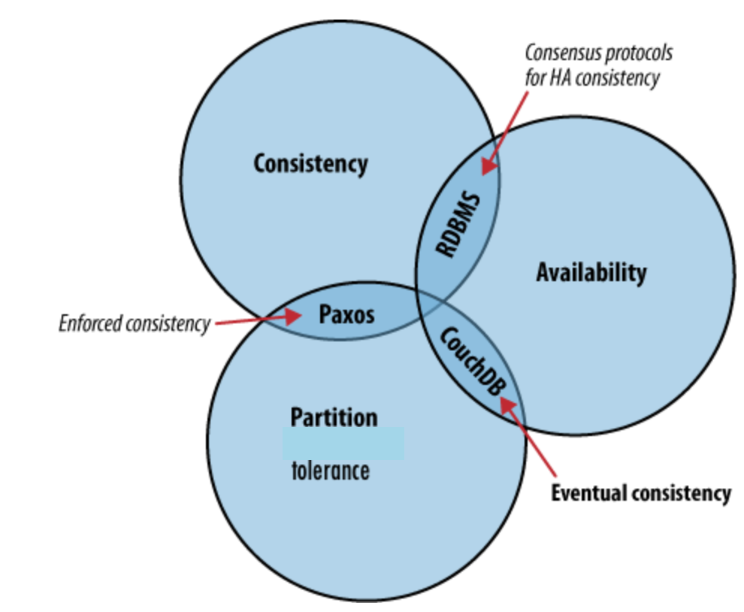
CouchDB & Cap Theorem
[2]
Notes:
The CAP theorem describes a few different strategies for distributing application logic across networks. CouchDB’s solution uses replication to propagate application changes across participating nodes.
This is a fundamentally different approach from consensus algorithms and relational databases, which operate at different intersections of consistency, availability, and partition tolerance

Slide 18
CouchDB & Cap Theorem
Consistency - All database clients see the same data, even with concurrent updates.
Availability - All database clients are able to access some version of the data.
Partition tolerance - The database can be split over multiple servers.
Notes:
.
The CAP theorem, shown in Figure 1, “The CAP theorem”, identifies three distinct concerns:
Consistency
All database clients see the same data, even with concurrent updates.
Availability
All database clients are able to access some version of the data.
Partition tolerance
The database can be split over multiple servers.
If availability is a priority, we can let clients write data to one node of the database without waiting for other nodes to come into agreement. If the database knows how to take care of reconciling these operations between nodes, we achieve a sort of “eventual consistency” in exchange for high availability. This is a surprisingly applicable trade-off for many applications.
CouchDB makes it really simple to build applications that sacrifice immediate consistency for the huge performance improvements that come with simple distribution.
The aim of the replication is that at the end of the process, all active documents on the source database are also in the destination database and all documents that were deleted in the source databases are also deleted on the destination database (if they even existed).
STOp
4.1.3. Master - Master replication
One replication task will only transfer changes in one direction. To achieve master-master replication, it is possible to set up two replication tasks in opposite direction. When a change is replicated from database A to B by the first task, the second task from B to A will discover that the new change on B already exists in A and will wait for further changes.

Slide 19
No Locking
No transactions or locking in CouchDB
To modify an existing record,
Read it out, taking note of the _id and _rev.
Request an update by providing the full document, including the _id and _rev.
All operations are first come, first served.
Matching _rev ensures consistency.
Resolving a conflict generally involves first merging data into one of the documents, then deleting the stale one
Notes:
CouchDB implements a form of multiversion concurrency control (MVCC) so it does not lock the database file during writes.
Instead of locks, CouchDB uses Multi-Version Concurrency Control (MVCC) to manage concurrent access to the database.
No transactions or locking in CouchDB
To modify an existing record,
first read it out, taking note of the _id and _rev.
Then, you request an update by providing the full document, including the _id and _rev. All operations are first come, first served.
By requiring a matching _rev,
CouchDB ensures that the document you think you’re modifying hasn’t been altered behind your back while you weren’t looking.

Slide 20
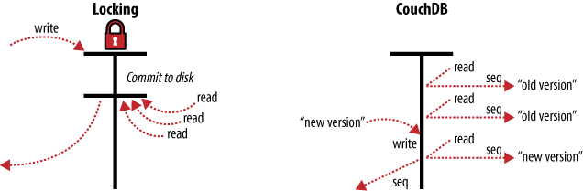
Multi-Version Concurrency Control
[2]
Notes:
MVCC means that CouchDB can run at full speed, all the time, even under high load. Requests are run in parallel, making excellent use of every last drop of processing power your server has to offer.
Documents in CouchDB are versioned, much like they would be in a regular version control system such as Subversion or Git. If you want to change a value in a document, you create an entire new version of that document and save it over the old one. After doing this, you end up with two versions of the same document, one old and one new.
How does this offer an improvement over locks? Consider a set of requests wanting to access a document. The first request reads the document. While this is being processed, a second request changes the document. Since the second request includes a completely new version of the document, CouchDB can simply append it to the database without having to wait for the read request to finish.
When a third request wants to read the same document, CouchDB will point it to the new version that has just been written. During this whole process, the first request could still be reading the original version.
A read request will always see the most recent snapshot of your database at the time of the beginning of the request.
MVCC allows concurrent reads and writes without using a locking system. Writes are serialized, allowing only one write operation at any point in time for any single database. Write operations do not block reads, and there can be any number of read operations at any time. Each read operation is guaranteed a consistent view of the database. How this is accomplished is at the core of CouchDB’s storage model.
CouchDB’s replication system comes with automatic conflict detection and resolution. When CouchDB detects that a document has been changed in both databases, it flags this document as being in conflict, much like they would be in a regular version control system.

Slide 21
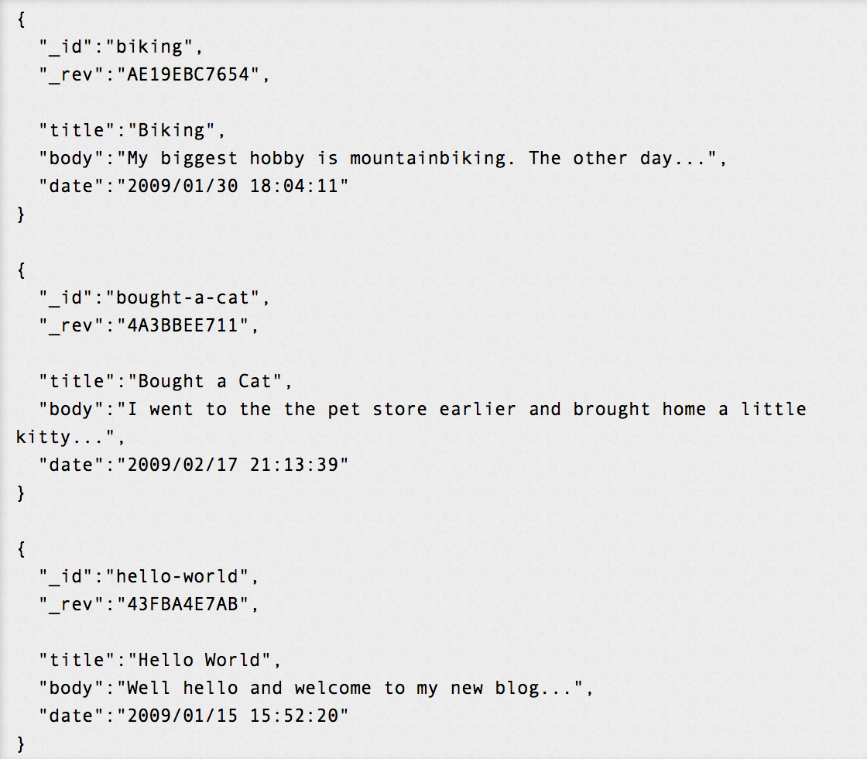
[2]
Notes:
Anatomy of a view request
CouchDB uses MapReduce to compute the results of a view. MapReduce makes use of two functions, “map” and “reduce,” which are applied to each document in isolation. Being able to isolate these operations means that view computation lends itself to parallel and incremental computation.
More important, because these functions produce key/value pairs, CouchDB is able to insert them into the B-tree storage engine, sorted by key. Lookups by key, or key range, are extremely efficient operations with a B-tree, described in big O notation as O(log N) and O(log N + K), respectively.
Lets consider the use case in the document shown. First is extracting data that you might need for a special purpose in a specific order. For a front page, we want a list of blog post titles sorted by date.
Note that the documents are sorted by "_id", which is how they are stored in the database. We’ll create a view in the hands-on section.
When you query your view, CouchDB takes the source code and runs it for you on every document in the database your view was defined in using a map function.
In CouchDB, we access documents and view results by key or key range. This is a direct mapping to the underlying operations performed on CouchDB’s B-tree storage engine. Along with document inserts and updates, this direct mapping is the reason we describe CouchDB’s API as being a thin wrapper around the database core.
Being able to access results by key alone is a very important restriction because it allows us to make huge performance gains.

Slide 22
Fauxton - The GUI
Notes:
Fauxton is a native web-based interface built into CouchDB. It provides a basic interface to the majority of the functionality, including the ability to create, update, delete and view documents and design documents. It provides access to the configuration parameters, and an interface for initiating replication.

Slide 23
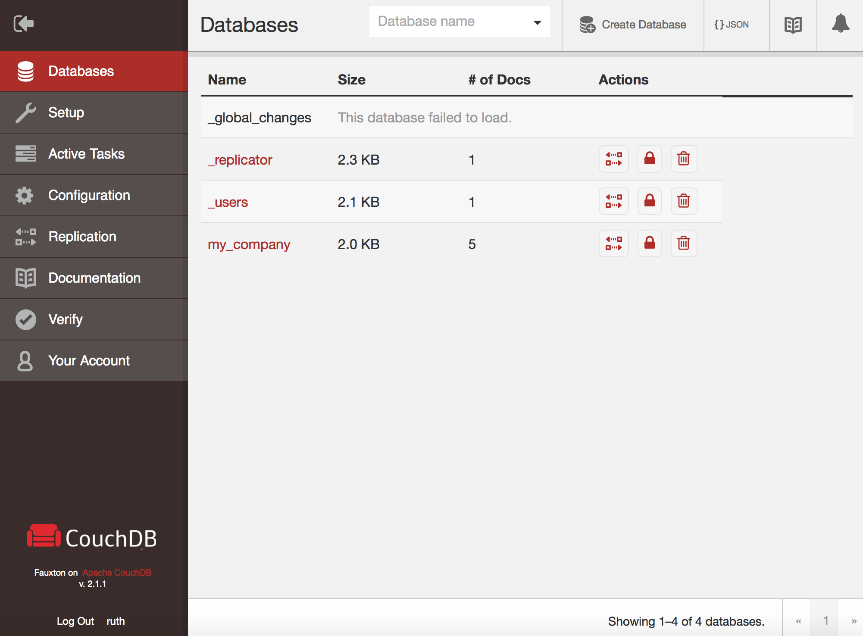
Notes:
FAUXTON previously known as FUTON
Has a beautiful interface
You can Create Database
Configure replications
Shortly we’ll see how to create a one node cluster

Slide 24
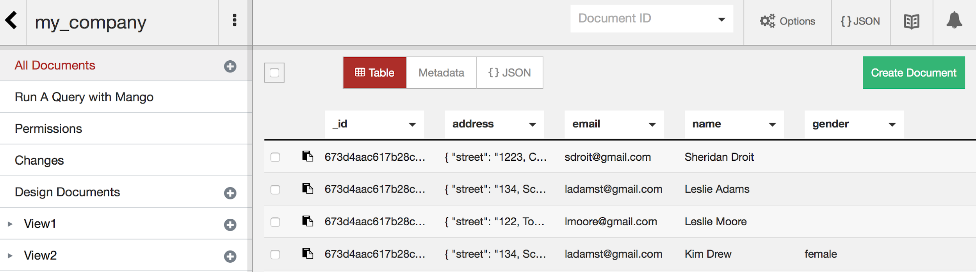
Notes:
We can see four documents shown as table
that each document is entered at once
Notice that the first three entries don't have gender value
CouchDB allows for this

Slide 25
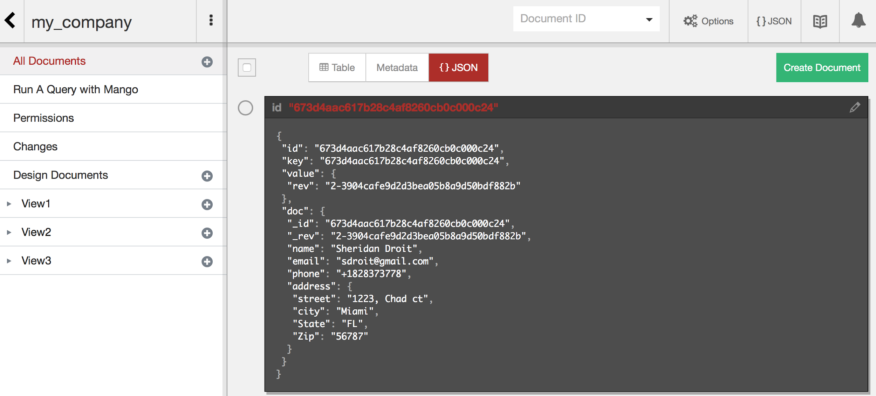
Notes:
You also have an option of viewing the data as JSOn,
The id is automatically generated.
We’ll play around with Fauxton during the hands on session.

Slide 26
Applications of CouchDB
User settings for an app
For mobile apps like To-Do, reminders or list of items
Comments and replies from blogs
Service logs from field equipments
Data from instruments and/or GPS
Live Sports/Game/Racing Stats
[6]
Notes:
Because High velocity log writes and High performance caching
You want to store User settings for an app.
.
2) The all important To-do app or list of items.
3) Comments & Replies to a Quora Question.
4) Service logs from field techs.
5) Data from instruments and/or GPS.
6) Live Sports/Game/Racing Stats

Slide 27








Notes:
The following companies use CouchDB
for ...
Akamai ultimately selected Cloudant's NoSQL DBaaS, which is built upon Apache CouchDB. It has been supporting Akamai's internal API management application for many years
Inovalon uses COuchDB to manage their health care data
Applied Memetrics uses couchdb for their message-oriented integration solutions
Talend has what they call Talend Flow which has couchsb as its backend
https://help.talend.com/reader/hCrOzogIwKfuR3mPf~LydA/Hpa62f54bSyJ8ToCpygbmA
Honeywell makes use of NoSQL solutions including couchdb for their data storage
Grubhub uses couchdb as backend for their real-time data sources and services.
Hothead Games Big Win Soccer had been built on Apache CouchDB. They recently moved to Cloudant which is IBM’s big data support version of CouchDB
Comcast use big data NoSQL solutions including CouchDB for their data storage
There a so mnay companies not listed here that have embraced couchdb or a variant of couchdb as their data engine

Slide 28
References
[1] Conference Videos. (2016, April 15). Modeling Data for NoSQL Document Databases. Retrieved February 16, 2018, from https://www.youtube.com/watch?v=-o_VGpJP-Q0
[2] C. Anderson, Lehnardt, J., & Slater, N. (n.d.). CouchDB The Definitive Guide. Retrieved February 16, 2018, from http://guide.couchdb.org/draft/consistency.html
[3] Couchbase Server. (2018, February 13). Retrieved February 16, 2018, from https://en.wikipedia.org/wiki/Couchbase_Server
[4] Seamless multi-master sync, that. (n.d.). Retrieved February 16, 2018, from http://couchdb.apache.org/
[5] P. (2012, March 11). Learn NoSQL From The Comfort of CouchDB | Pluralsight. Retrieved February 16, 2018, from https://www.youtube.com/watch?v=TvRDOLiadtg
[6] Quora. “What is the essence of CouchDB?” What is the essence of CouchDB? - Quora, www.quora.com/What-is-the-essence-of-CouchDB.
[7] handsonERP. “What is Apache CouchDB?” YouTube, YouTube, 1 Mar. 2014, www.youtube.com/watch?v=axmItMFT6Og
[8]“Hadoop Tool: CouchDB Assignment Help.” Assignment help, www.myassignmenthelp.net/couchdb-assignment-help.
[9] Gorst, Dan. “MongoDB vs CouchDB.” Scott Logic, 4 Aug. 2014, blog.scottlogic.com/2014/08/04/mongodb-vs-couchdb.html.

Slide 29
Thanks for Listening!
Q&A

