Slide 1
Bloom
A cycle-aware, evidence-based health coach
All my health data in one place · an AI coach that knows my data, my cycle and the research
Final project · LLM Engineering · Demo Day, 25 September 2026 · Damilya
Notes:
One sentence: Bloom brings my scale, gym, watch and food data into one place and adds a coach that answers from my data and from research it can cite, and knows when to send me to a doctor.

Slide 2
5 apps, 0 answers
My health data is scattered, and the advice I get is generic and male-default
Withings
weight, body fat, muscle
Kinetix · Tanita
gym sessions, 1RM tests, scans
Apple Watch
workouts, cycle, sleep, HR
Foodvisor
calories & macros (no API)
Weather
can I run outside?
None of them talk to each other
Weight trends live in one app, training in two others, food in a fourth. No app sees the menstrual cycle next to training and nutrition, so no one can say whether a bad week is the cycle, sleep or under-eating.
Advice ignores women and PCOS
“Train fasted in the morning to burn fat”, “sync your training to your cycle”: popular claims, often from male-only studies or weak evidence. With PCOS, wrong advice (under-fuelling, crash diets) has real costs.
Notes:
Pain: 5 apps, manual screenshots and spreadsheets, and advice that isn't graded for evidence or adapted to female physiology.

Slide 3
Who it's for
Built for one real user first: me
“A woman with PCOS who strength-trains and runs in Brussels, and wants advice that fits her body, her data and the evidence.”
1
Today
Screenshots, spreadsheets and 5 app dashboards; mental math to connect them.
2
Pain
Advice that isn't evidence-graded, ignores the cycle, and never says “see a doctor”.
3
Bloom
One timeline + a coach that cites research, uses my numbers and escalates red flags.
Notes:
Business value: a personal tool first; later the same product for women with PCOS who train (irregular cycles break every 'cycle syncing' app).

Slide 4
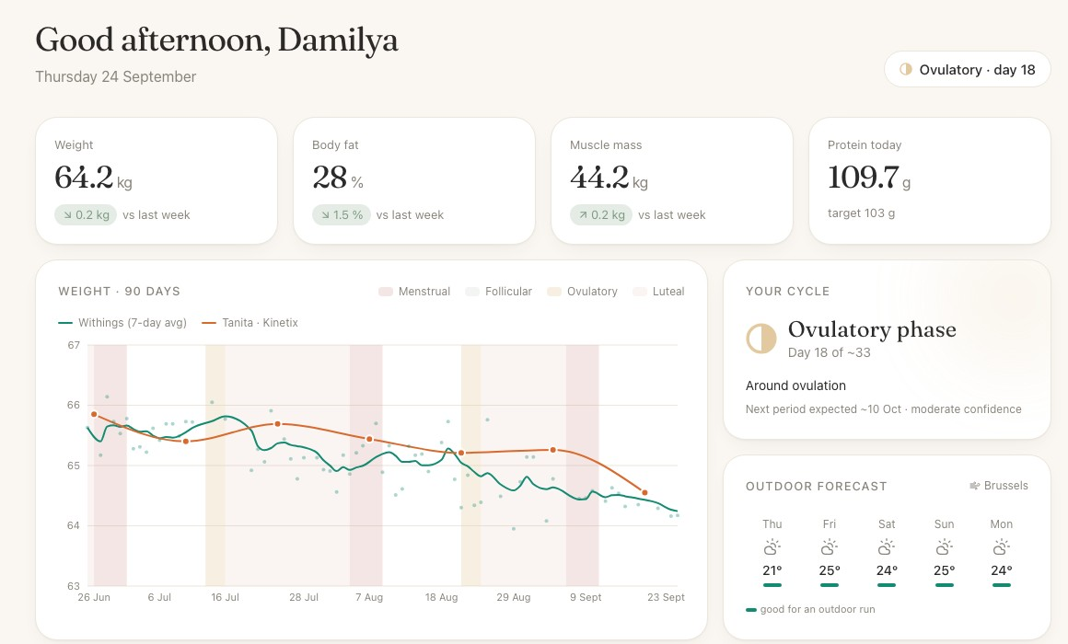
The solution: one calm dashboard + a coach
Next.js app · three personas: Fitness Coach, Nutritionist, Integrative Medicine
One timeline
Withings, Tanita, Apple Watch, Kinetix and Foodvisor on one chart, shaded by cycle phase
Cited answers
every research claim links to the passage, page and DOI it came from
Safety first
red-flag symptoms → doctor referral, never coaching
Goals you approve
the coach proposes, you approve or edit before anything is saved
Screenshot: demo data

Slide 5
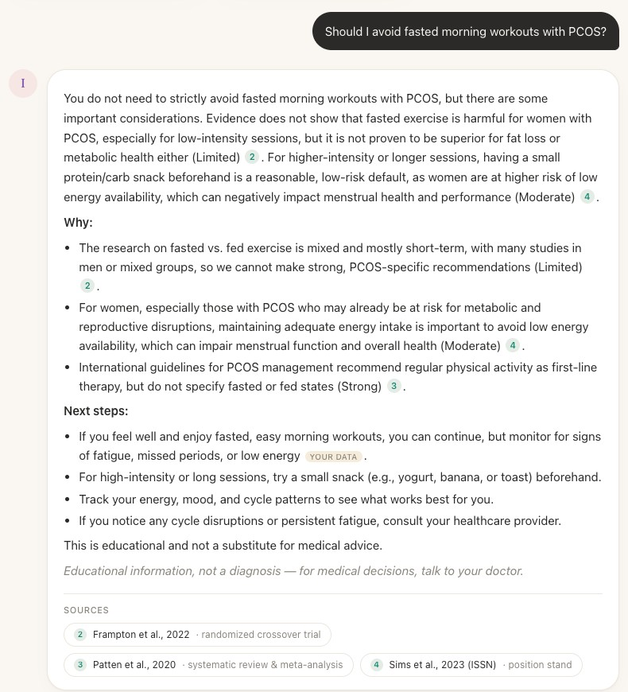
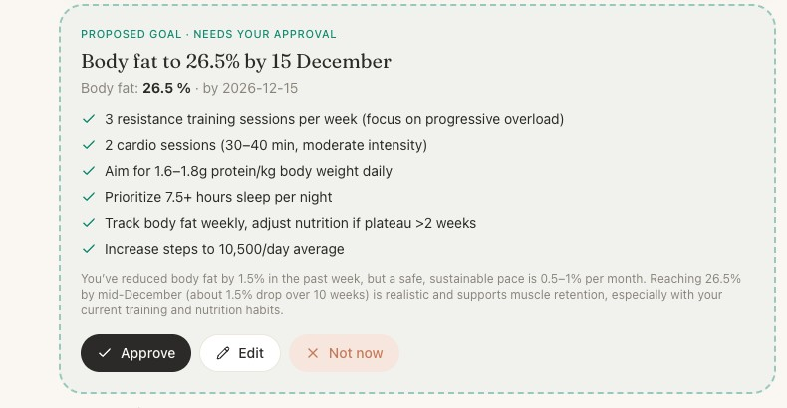
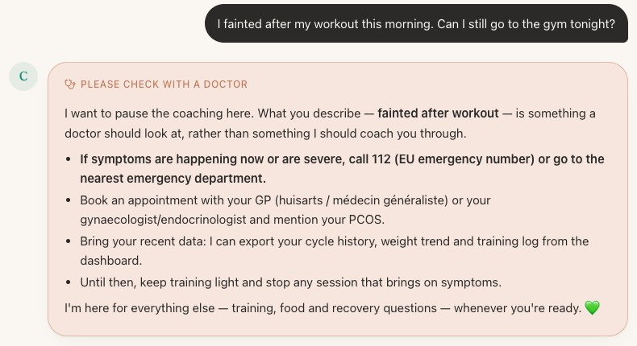
Demo
Live walkthrough: the same three flows as below
2 · Goal proposal, human approval
“Set me a realistic body-fat goal for December”
3 · Red flag → doctor referral
“I fainted after my workout this morning…”
Also in the demo
Data page: Withings OAuth sync · Apple Health ZIP · Mywellness ZIP · Foodvisor screenshot → vision extraction with consistency checks → confirm
1 · Cited, evidence-graded answer
“Should I avoid fasted morning workouts with PCOS?”
Notes:
Demo order (3 min): Today dashboard → Integrative Medicine: fasted cardio question, open a citation chip → Coach: body-fat goal, approve → Goals page → 'I fainted…' → Data page: Foodvisor screenshot. Show 'How I got here' under an answer and the matching LangSmith trace.

Slide 6
Architecture
Every box is replaceable by config; the data layer is deliberately shared
Next.js frontend
FastAPI · SSE
health-data MCP server
9 tools
SQLite
health data
Sources
Withings OAuth
Apple Health ZIP
Mywellness ZIP
Foodvisor screenshot
Open-Meteo
LangGraph agent
14 nodes
guards · triage · Skill
cache · generate
citation loop · HITL
RAG: Qdrant +
FlashRank rerank
14 research
papers (PMC)
OpenAI
gpt-4.1 / 4.1-mini
+ fallback, budget
LangSmith
traces · evals
Coupling by choice: the dashboard and the MCP tools call the same queries.py, so the coach quotes exactly the numbers on the charts. Claude Desktop/Code can use the same MCP server.
Notes:
Walk one request: SSE chat → input guard → triage (mini) → Skill → cache → MCP tools → multi-query retrieval + rerank → gpt-4.1 → per-claim citation check (loop) → output guard → final/interrupt.

Slide 7
The agent: branches, a loop and a human in it
LangGraph StateGraph · checkpointed so an approval can resume in a later HTTP request
Input guard
Triage
Skill router
Cache
MCP data
Retrieve
Generate
Citation check
Output guard
Branch: safety triage
Red flags (chest pain, fainting, no period > 3 months, eating < 1,000 kcal, medication changes) → doctor referral with 112 for emergencies. Off-topic → polite decline.
Loop: citation verification
Every cited sentence is checked against its passage; unsupported → targeted feedback → rewrite (max 2), then a visible “unverified” note.
Human-in-the-loop
Goal requests → structured SMART goal → interrupt() → Approve / Edit / Not now → saved through the MCP save_goal tool.
Why LangGraph: explicit, testable control flow (bounded loop + durable interrupt), tested with fake LLMs. CrewAI hides the flow behind roles; Parlant is policy-centric rather than pipeline-centric.

Slide 8
Own MCP server + own Skill
Why not just functions and a longer prompt?
health-data MCP server · 9 tools
body-composition trend · latest metrics · strength progress (1RM) · cycle status · nutrition summary · workouts · weather · goals · save goal
Why MCP: the same tools serve the in-app agent and Claude Desktop/Code with zero glue; the tool schema is the contract the planner LLM reads. If the server is down the agent falls back to in-process tools.
womens-health-evidence Skill (SKILL.md)
Evidence grading (Strong / Moderate / Limited / Expert opinion), cycle and PCOS nuances, fasted-training honesty, red flags, citation rules.
Why a Skill: versioned domain policy in one file, loaded only when the question triggers it (keywords + triage flag), so ~1.5k tokens aren't paid on unrelated questions. Works in Claude Code too.

Slide 9
RAG over research + vision for food logs
Answers are only as good as what's retrieved, and what's read from a screenshot
14 papers
PCOS guideline 2023, ISSN, WHO, meta-analyses
Parse
PDF glyph-gap fix + JATS XML
455 chunks
section-aware, 450 tok, page kept
Embed + Qdrant
text-embedding-3-small
Multi-query
triage writes 1–3 sub-queries
Rerank
FlashRank per query → top 5
Found by measuring
6 of 12 PDFs lost their spaces (15–43 % glued words) → rebuilt words from glyph positions. Compound questions (“fasted cardio + women + PCOS”) retrieved only PCOS papers → multi-query with per-facet round-robin.
Multimodal: Foodvisor has no API
The screenshot is the only data channel → vision model with a strict schema → Atwater check (kcal ≈ 4C + 4P + 9F) → user confirms. Caught a real misread: “122 Cal over” (vs goal) read as intake; now computed from macros (1,589 kcal).

Slide 10
Evaluation: 43 golden examples, 7 metrics
Safety, groundedness and personal accuracy: the three ways a health coach fails
metric | type | catches
route_correct | deterministic | red flags, near-misses, injections
retrieval_hit | deterministic | expected paper in top-5
numeric_accuracy | deterministic | true personal number in answer
goal_proposed | deterministic | HITL reached (or correctly not)
faithfulness | LLM judge | claims supported by evidence/data
citation_precision | LLM judge · custom | cited passage supports its sentence
key_point_recall | LLM judge | says what the literature says
Plus latency p50/p95, cost/query, rewrite rate · evals run on a seeded demo DB, cache off · A/B arms = config options, no code changes

Slide 11
What the experiments decided
Citation precision by configuration (LLM judge: gpt-4.1) · single runs unless noted
100%
safety routing
(red flags, injections)
78% → 94%
citation precision (mean of 3 runs;
run-to-run noise ≈ ±5 pts)
$0.0088
mean cost per query
(red flags ≈ $0.0003)
Notes:
Decisions: keep gpt-4.1 as writer (mini is -0.04 precision at half the cost → it's the fallback). Keep the reranker (largest drop without it). Keep multi-query (fixes compound questions). Adopt the per-claim judge (+0.15). T=0.3 kept; hyperparameters matter less than architecture. Caveat: n=14–23 per metric, one example ≈ 0.05.

Slide 12
What broke on real data, and what I learned
Demo data passed every test; my own exports didn't
Timezones
Apple Health stamped everything +05:00 (the phone's zone at export) → workouts 4 h off, dedupe failed. Now one HOME_TZ for all sources.
Same event, 3 apps
Mywellness mirrors the Watch (66 walks) and Withings (220 readings); the Watch re-records gym visits (55). Cross-source dedupe after every import.
Format drift
Newer iOS writes VaginalBleeding* instead of MenstrualFlow*: 0 of 202 cycle records imported until fixed.
Lenient self-check
The in-graph citation judge passed 95 % of answers; the offline eval found 22 % unsupported citations → per-claim judge.
Over-eager goals
“How should I adjust training this week?” triggered goal approval → stricter triage + a negative golden example.
Evidence ≠ popular belief
“Fasted training is bad for women” is not settled in the literature; the Skill makes the coach say so.

Slide 13
Conclusions
What works
Safety routing 100 % on the golden set · cited, evidence-graded answers · real data from 4 sources in one timeline · goals only with approval
Trade-offs I chose
Quality over latency (citation loop, gpt-4.1 writer) · calendar-based cycle phases flagged low-confidence instead of guessing · local SQLite for privacy
Next
Harder red-flag cases (indirect, multilingual) · real users with PCOS · wearable temperature/LH for ovulation · auth + deployment
Thank you · Questions?

