Slide 1
MAGENTO
Prepared By:
Chaitali Patel(C0697976)
Damini Dholakiya(C0705705)
Himanshu Singhal(C0710799)

Slide 2
WHY MAGENTO?
Magento is an open source E-commerce software.
Magento is scalable and offers small organizations to build business.
Magento enables searching and sorting of products in several ways.
Magento easily integrates with many of the third-party sites which are needed to run effective E-commerce website.

Slide 3
WHAT IS MAGENTO?
Magento is an open source E-commerce software, created by Varien Inc., which is useful for online business.
It is scalable and it has many control options that helps the user to build both user-friendly and search engine friendly websites.
Magento uses E-commerce platform which offers companies the ultimate E-commerce solutions and extensive support network.
Magento allows user to update E-commerce website automatically.
It is simple, quick and versatile to use and it has a flexible modular architecture.
Magento was developed by Varien Inc., and it was first released on March 31, 2008.

Slide 4
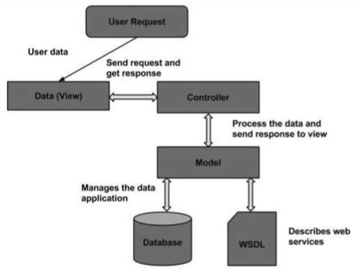
ARCHITECHTURE:

Slide 5
The Magento architecture comes with Models, Views and Controllers.
User Request − The user sends a request to a server in the form of request message where web browsers, search engines, etc. act like clients.
View − View represents the data in particular format. It is the user interface which is responsible for displaying the response for user request. It specifies an idea behind the presentation of the model's data to the user. Views are used to reflect "how your data should look like".
Controller − The controller is responsible for responding to user input and perform interactions on the data model objects. It uses models to process the data and send responses back to the view.
Model − The model is responsible for managing the data of the application. It contains logic of the data and represents basic data object in the framework. It responds to request from the view and to the instructions from the controller to update itself.

Slide 6
Database − Database contains the information which is requested from the user. When the user requests data, view sends requests to the controller, the controller requests from the model and the model fetches the required information from the database and responds to the user.
WSDL − WSDL stands for Web Services Description Language. It is used for describing web services and how to access them.

Slide 7
MAGENTO PRODUCTS:
Magento provides 6 different types of products.
Appropriate selection of product type is essential for accessing the appropriate set of features required to sell the product.
Following are the product types available in Magento.
Simple Products,
Grouped Products,
Configurable Products,
Virtual Products,
Bundled Products,
Downloadable Products.

Slide 8
Details of Products:
Simple Products
These are general product type, which are the most used products. In this section, there are no options for selecting size or color of the product.
Example − Coffee cup, DVD's, Camera lens, etc.
Grouped Products
This is a group of simple products. In this type, you cannot specify a specific price for a product; you can just specify the discount.
Example − Cell phone + Memory card + Ear phone
Configurable Products
In this type, customer can select products according to their color and size before purchasing.

Slide 9
Example − Cell phones obtained in different colors and sizes.
Virtual Products
Virtual products are those which do not have physical counterpart, i.e. these are used for virtual items. These products cannot be shipped or stocked.
Example − Online training course
Bundled Products
Bundled products are those products which cannot be sold separately and doesn't give any choice to the end user.
Example − Consider you want to buy a cell phone which includes earphone, memory card, battery, charging cable, etc. These are together called bundled products. These products cannot be sold individually but can be sold within the bundle product.

Slide 10
Downloadable Products
Products which are available for download are known as downloadable products.
Example − MP3 file, e-book, documents, etc.

Slide 11
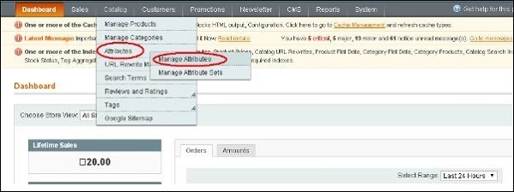
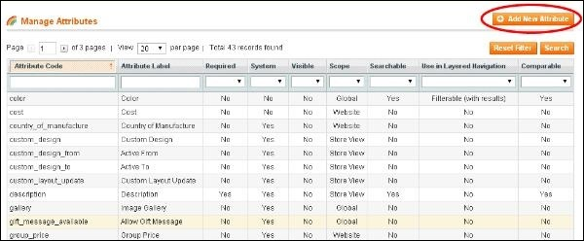
Product Attributes:
Attribute describes the property of the product. Product attributes helps to set product properties such as color, size width, height, etc. and makes the product unique. You can add as many attributes to your product as required.
The following steps describe, how to set up the attributes for products in Magento −
Step (1) − Login to your Magento Admin Panel.
Step (2) − Go to Catalog and select Attributes from the dropdown menu and click on the Manage Attributes option.

Slide 12
Step (3) − Under Manage Attributes section, you will find different attributes used in the system. For adding new attribute, click on Add New Attribute seen on the top right corner of the screen.

Slide 13
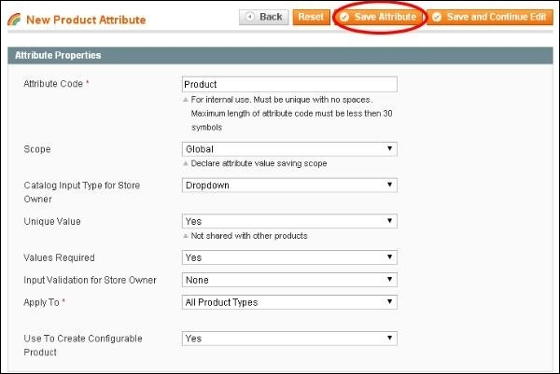
Step (4) − Now you need to set the attribute properties for your product. After setting up all the required attribute properties, click on Save Attribute button to store the product information.

Slide 14
FEATURES:
Magento provides different payment methods such as credit cards, PayPal, cheque, money order, Google checkouts, etc.
Magento enables shipping of products in one order to multiple addresses.
Magento helps to manage the orders easily by using the admin panel.
Magento provides order of product status and history of product. It also supports e-mail and RSS feeds.
Magento supports multiple languages, different currencies and tax rates.
Magento filters the products and displays in grid or list format.
Magento makes it easy to browse the products. 4It has features such as image zoom-in and checking of stock availability.

Slide 15
ADVANTAGES:
Magento is user friendly E-commerce software.
Magento is compatible with smartphones, tablets and other mobile devices.
Magento provides multiple payment options, so every visitor can make payment based on their preferred payment gateway.
Magento has many extensions which support the development of an online store.

Slide 16
DISADVANTAGES:
Magento uses larger disk space and memory.
Magento takes longer time to build the customized functionality.
Magento is very slow compared to other E-commerce sites.
Magento needs proper hosting environment.
If the hosting environment is improper, the user can face many problems.

Slide 17
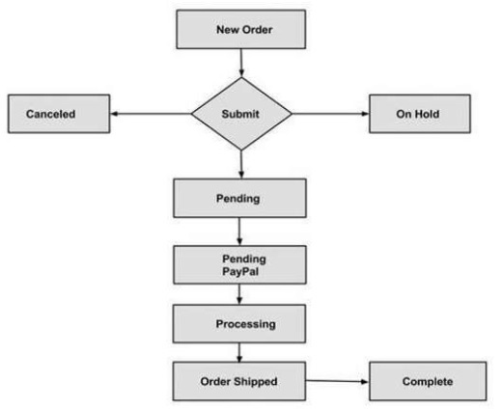
MAGENTO ORDER PROCESSING

Slide 18
New Order − Customer places an order into the Magento store.
Pending − Pending orders are brand new orders that have not been processed. These orders need to be invoiced and shipped.
Pending PayPal − These are the brand new orders that have been not cleared by PayPal.
Processing − When you invoice the order, Magento will change the state to 'processing'.
Cancelled − This status is called when the customer visits the store and cancels an order or else if the order has been not paid for.
Order Shipped − Order shipment is generated when an order status changes from pending to complete.
On Hold − Order is put on hold when more information from the user is required before the purchase is processed.
Complete − When order is marked as complete, it has been both invoiced and shipped.

Slide 19





Some of the Top Brands Using Magento:

Slide 20

EXAMPLES OF MAGENTO WEBSITES
Helly Hansen

Slide 21
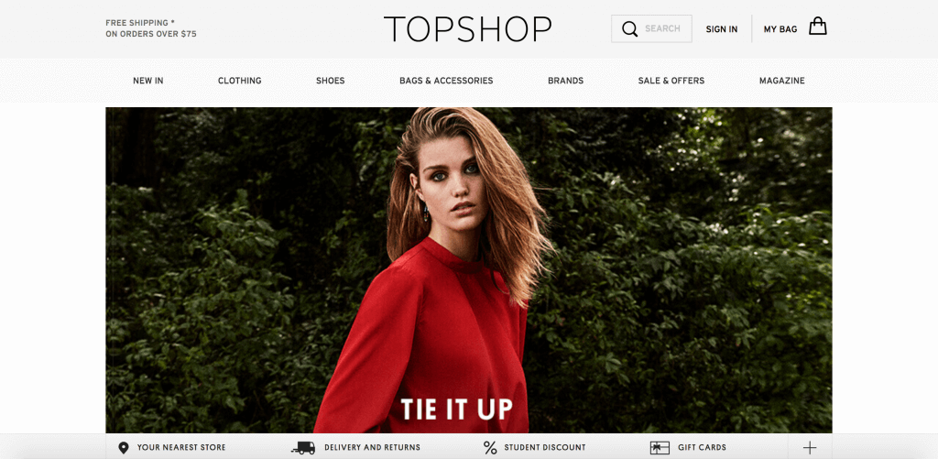
Topshop Australia

Slide 22
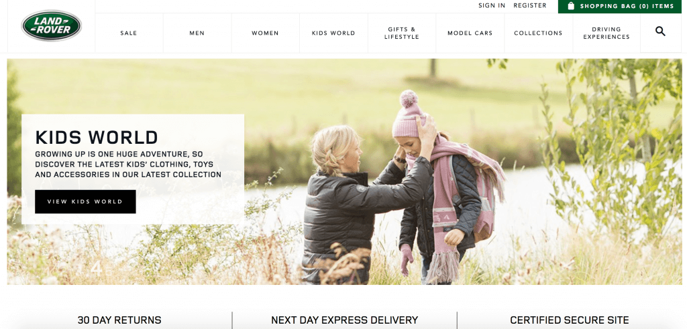
Land Rover

Slide 23
Follow these steps to install Magento manually:
Download the Magento installation packageStep
Upload the Magento files to your serverStep
Create a MySQL Database for Magento to useStep
Go through the Magento installation process

Slide 24
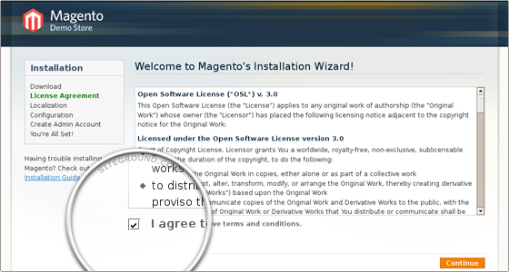
Download the Magento installation packageStep
The first thing you need to do to install Magento manually is to download the latest installation package from the official Magento website.

Slide 25
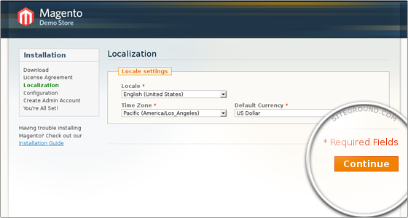
Upload the Magento files to your serverStep
Next, you must upload the installation package on your hosting account through your cPanel -> File Manager or using an FTP client.

Slide 26
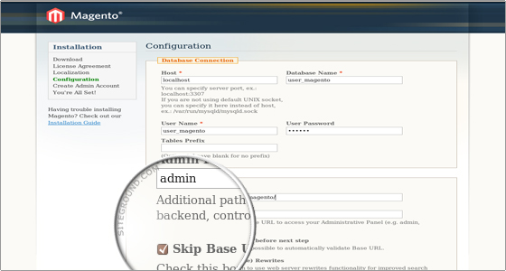
Create a MySQL Database for Magento to useStep
Create a MySQL database and assign a user to it through cPanel -> MySQL Databases. Remember the database details, since you will need them during the script installation.

Slide 27
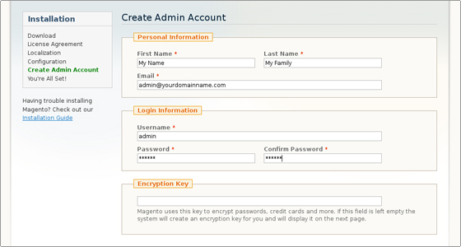
Go through the Magento installation process
Once the package is uploaded and extracted and you have a MySQL database, navigate to http://yoursite.com/store:

Slide 28
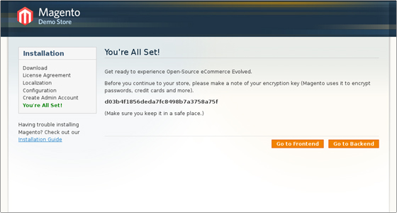
CONGRATULATIONS!!!!!

Slide 29
REFERENCES:
https://www.tutorialspoint.com/magento/magento_database_performance.htm
THIS IS THE LINK WHERE YOU CAN FIND ALL PRESENTATION POINTS.
START FROM ORDER PROCESSING STEP BY STEP IF YOU WANT TO.

Slide 30
THANK YOU!!!!!

