Slide 1
Document Processing POC — Findings
• Confirm Excel, Word & PDF automation on an owned server + web app (not Matterway-only).
• Validate hosting path: API, logging, Windows/IIS deployment.

Slide 2
Objective & Scope
• Prove server-side Excel read/write and PDF/Word validation at scale.
• In scope: upload, server path, downloads, auto-download, in-place Excel, logs.
• Out of scope: full Matterway SCR scrub & CAL allocation products (port in next phase).

Slide 3
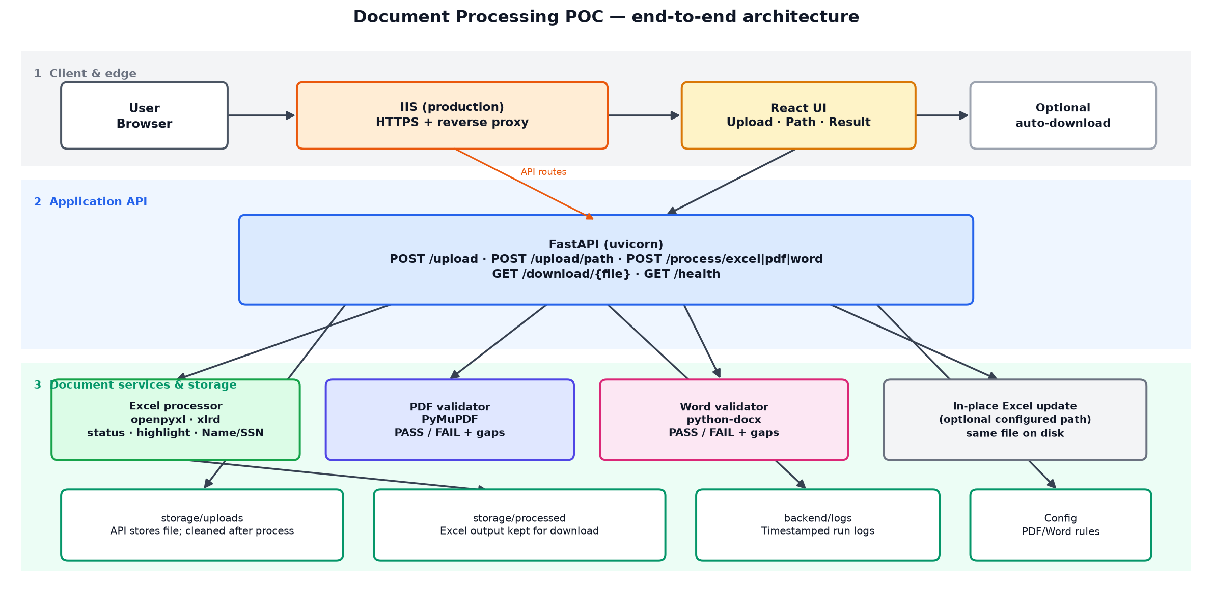
Solution Architecture
Production: browser → IIS (HTTPS) → React UI + FastAPI. Each document type is handled by a dedicated service; Excel outputs stay available for download.

Slide 4
Capabilities & Deliverables
• Excel: POC Status, FALSE/NA highlights, Name/SSN tab; .xlsx/.xls; processed file kept for download.
• PDF/Word: PASS/FAIL and missing required phrases; metrics on result screen.
• Large files tested on server; upload copy removed after process; optional in-place workbook update.

Slide 5
Challenges & Learning
Excel formatting preservation
Named ranges
Formula handling
OneDrive file locks
Performance optimization

Slide 6
Business Outputs
✔ Excel automation without disturbing actual format, formula etc
✔ PDF validation
✔ Word validation
✔ Server path processing
✔ Large file (15 to 20k records) support
✔ Auto Download
✔ Single/multi file upload
✔ Generating & saving logs file

Slide 7
Future Extensions
Excel & Document Automation
Bulk Processing
Version Comparison
Template Automation
Advanced Validation
PDF/Word Data Extraction
Workflow & Integration
Unified Dashboard
Configurable Rule Packs
Exception Management
Scheduled Processing
API Integration
Enterprise Readiness
Authentication & RBAC
Audit & Compliance
Notifications
Antivirus & Security
Retention Policies
Monitoring & Analytics

Slide 8
Conclusion & Next Steps
• POC confirms document automation is feasible on our platform.
• Pilot one production workflow with auth, monitoring, and environment-based config.
• Migrate priority SCR/CAL logic onto this stack.

