Slide 1
Introduction
Discuss the subjective and objective difference between R and Python
Discuss the strengths and weaknesses of each language
Analyze a dataset in Python and R
Show what code is needed in both languages to achieve the same result.
The dataset used for this analysis is obtained from the performance of NBA players in the 2013-2014 season
Without further ado, let’s get started with Python vs R challenge.

Slide 2
Overview
Python follows an object-oriented paradigm while R is more functional.
Everything in python is an object, and almost everything has attributes and methods.
For example in Python, the head method is a method on the data frame object.
In R, there is a separate head function.
This is a common theme we’ll see as we start to do analysis with using both languages.

Slide 3
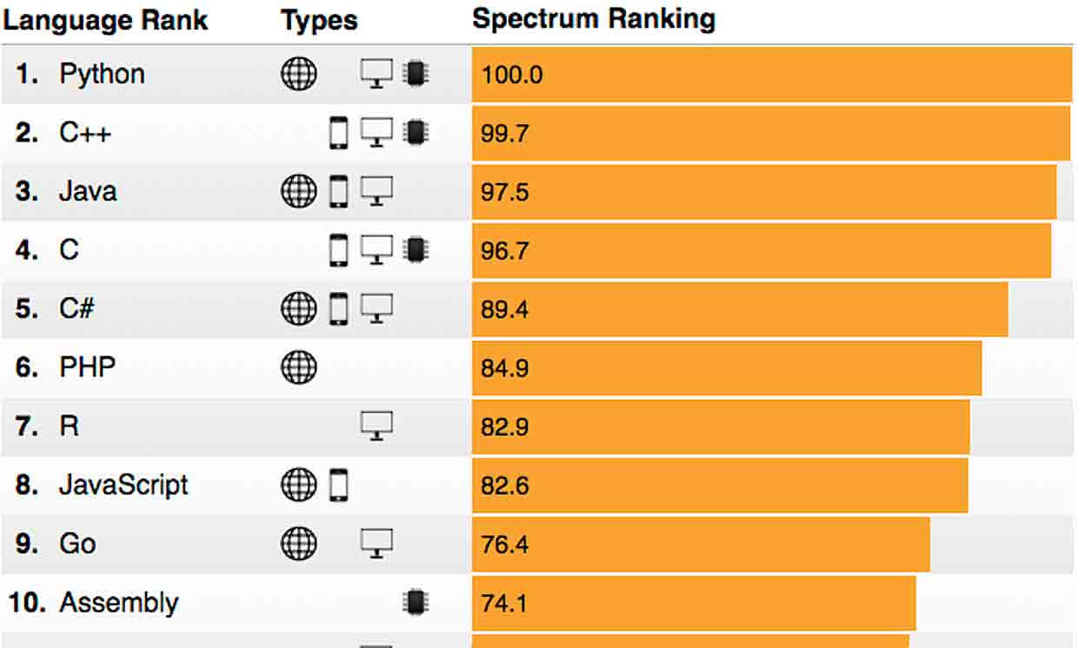
Overview: Popularity index (2018)
Source: The Institute of Electrical and Electronics Engineers (IEEE).
Spectrum ranking is a metrics that quantify the popularity of a programming language.

Slide 4
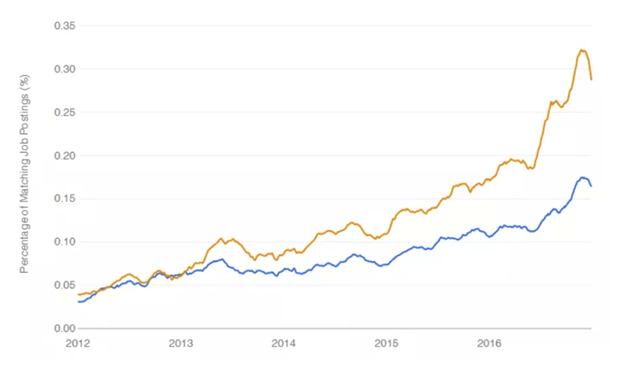
Overview: Popularity index (2016)
Source: IEEE

Slide 5
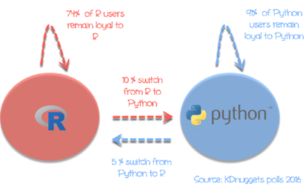
Overview: People switching (2016)
Source: IEEE

Slide 6
Data frames: Importing a CSV
Data frames are two-dimensional arrays and is available in both R and Python.
In Python, we need to import the pandas library to get access to Dataframes.
In R, while we can import the data using the base R function read.csv(), using the readr library function read_csv() has the advantage of greater speed.

Slide 7
Statistics
In both R and Python, we apply a function across a data frame columns to find the a statistic (e.g., mean).
In Python, by applying the mean method on a data frame will find the mean of the numeric columns by default.
In R, we may have to use two packages to perform this task. First, we select the numeric and used the %>% operator, referred to as “the pipe”, to pass the output of one function as input to the next. Then, we calculate the mean of all selected numeric columns.

Slide 8
Plots / Visualization
Plots/visualization are similar in R and Python.
R has many more packages to perform visualization. Such as ggplot2, Lattice, highcharter, GGally - a helper package for ggplot2.
In Python, matplotlib is the primary plotting package, and seaborn is a widely used layer over matplotlib.
With visualization in Python, there is usually one main way to do something, whereas in R, there are many packages supporting different methods of doing things (there are at least a half dozen packages to make pair plots, for instance).

Slide 9
Machine Learning
Split data into train and test sets
- R has many more data-analysis builtin functions, like setting seeds (set.seed), whereas in Python these are called via packages (random.seed).
Models
Python Scikit-learn package has many ML models, such as linear regression and random forest model that we can fit and generate predictions from.
R relies on the built-in lm and predict functions. The predict function will behave differently depending on the kind of fitted model that is passed into it — it can be used with a variety of fitted models.

Slide 10
Machine Learning
In python, the Scikit-learn library has a unified interface for working with many different machine learning algorithms, and there’s usually only one main implementation of each algorithm in Python.
With R, there are many smaller packages containing individual algorithms, often with inconsistent ways to access them. This results in a greater diversity of algorithms (many have several implementations, and many are fresh out of research labs), but with a bit of a usability hit.
For example, to implement the RandomForest model in R, we used a randomforest library, whereas it was built into scikit-learn in Python.

Slide 11
Machine Learning
Model summary statistics
If we want to get summary statistics about the fit of a model, like r-squared value, we’ll need to do a bit more in Python than in R.
With R, we can use the built-in summary function to get information on the model.
With Python, we need to use the statsmodels package, which enables many statistical methods to be used in Python. We get similar results, although generally it’s a bit harder to do statistical analysis in Python than R.

