Slide 1
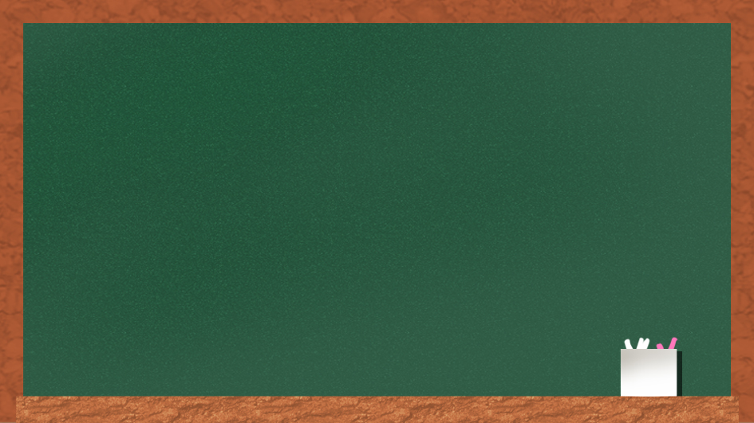
USER EXPERIENCE
(UX)
IN GAMES
Reporter: Damir Pendak
Department: Unity

Slide 2
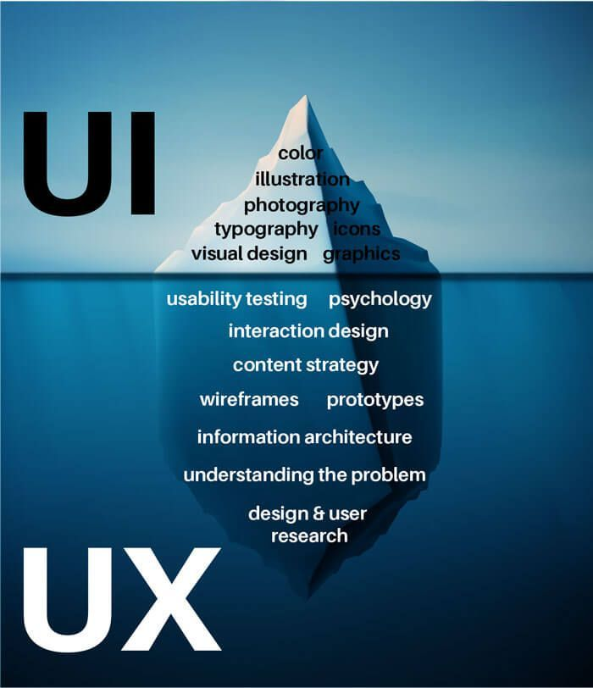
UI vs UX
UX design is process of enhancing user satisfaction with a product by improving usabilitiy, accessibility and pleasure provided in interaction with the product.
UI design is the design of user interfaces for machines and software. The goal od UI design is to make user's interaction as simple and efficient as possible through aesthetic means.

Slide 3
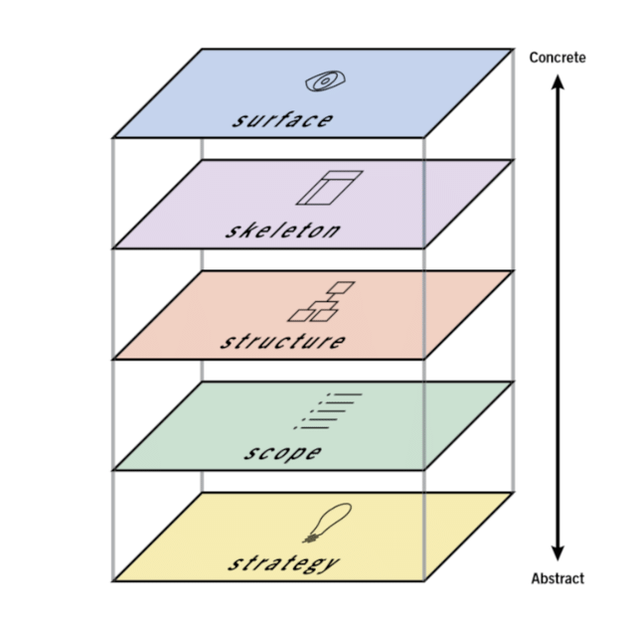
5 planes/elements of UX design (5S)
1. SURFACE - Visual design. What will the finished game look like?
2. SKELETON - Interface & navigation design. Information design. Makes structure concrete. What components will enable people to play the game?
3. STRUCTURE - Information architecture. UX design. Gives shape to scope. How will the pieces of the game & UI elements fit together & behave?
4. SCOPE - Content & feature requirements. Transforms strategy into requirements. What features will the game need to include?
5. STRATEGY - Game objectives. Player's needs. Where it all begins. What do we want to get out of the game? What do players want?

Slide 4

5
STRATEGY
TOP 5 REASONS (USER SURVEY):
- Immersion - seeking new worlds
- Diverse gameplay with multiple mechanics
- Reliving history
- Freedom in environment
- Achieve exploits

Slide 5

4
SCOPE
- FUNCTIONAL REQUIREMENTS : How feature work with each other & how they interrelate. Used to reach final goal. (In games, the goal is functional requirement dictating how items interrelate & setting up a potential final outcome)
- CONTENT REQUIREMENTS - Information we need to gather the value. (In many games, the main character is the content, providing the POV, stories, and other elements needed to create a narrative)

Slide 6


3
STRUCTURE
- INTERACTION DESIGN : How the user interacts and how the product behaves in response.
- INFORMATION ARCHITECTURE - Arrangemnet of content elements & how are they organized to facilitate human understanding.
DEFINES :
- How the user got the where they are
- The navigational elements
- What exists in UI
- How it fits together
In games, the structure is often a narrative.

Slide 7
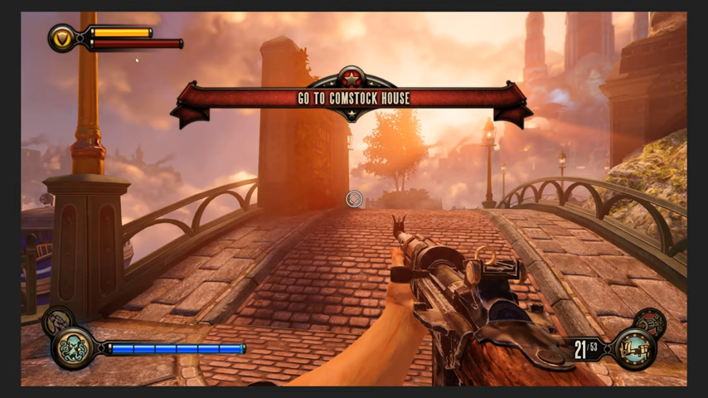

Slide 8


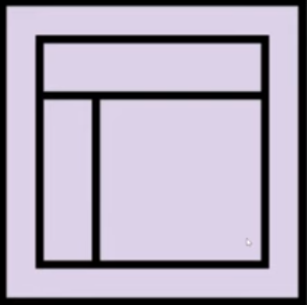
2
SKELETON
- Optimizes arrangement for max effect and efficiency !
- Dictates what visual elements are on the screen.
- Dictates how those interactions are presented and arranged !
- Suggests a way to move around the space.
- How the content is presented.

Slide 9
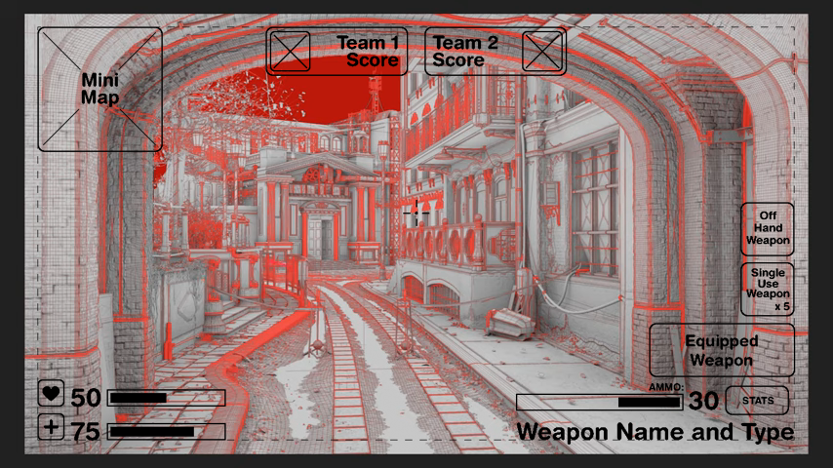

Slide 10

1
SURFACE

Slide 11
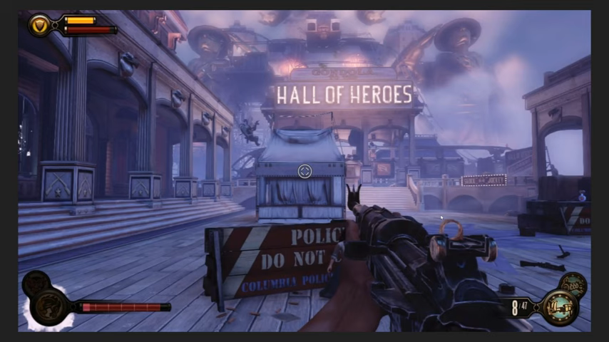

Slide 12
THE END

