Slide 1


Slide 2
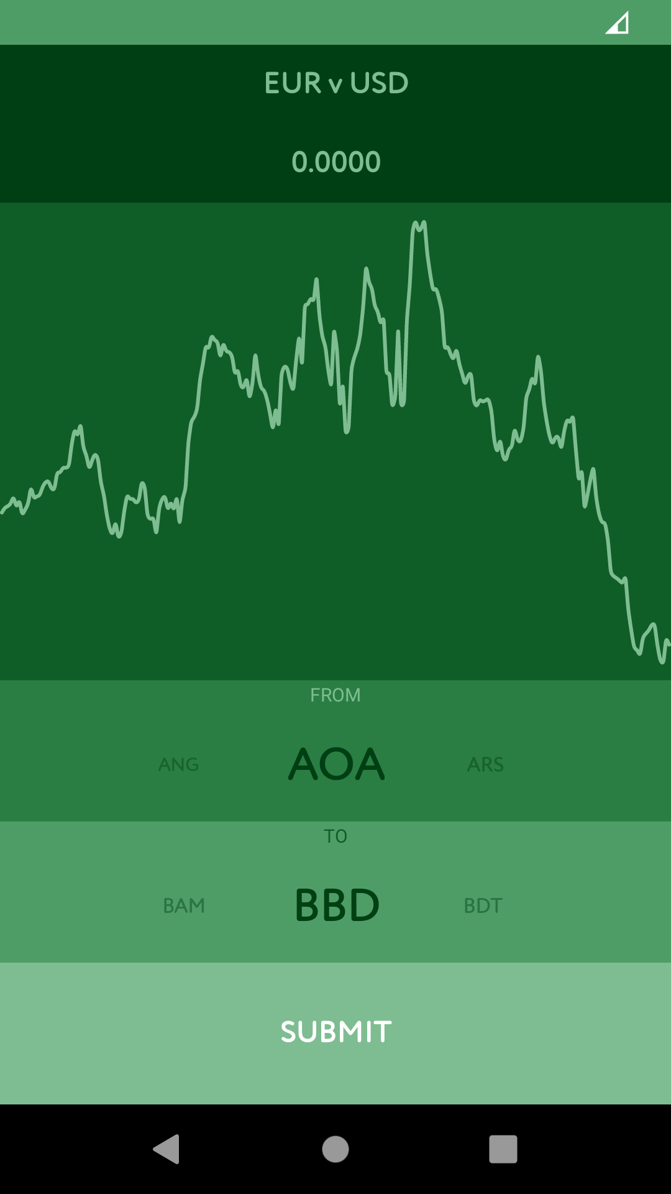
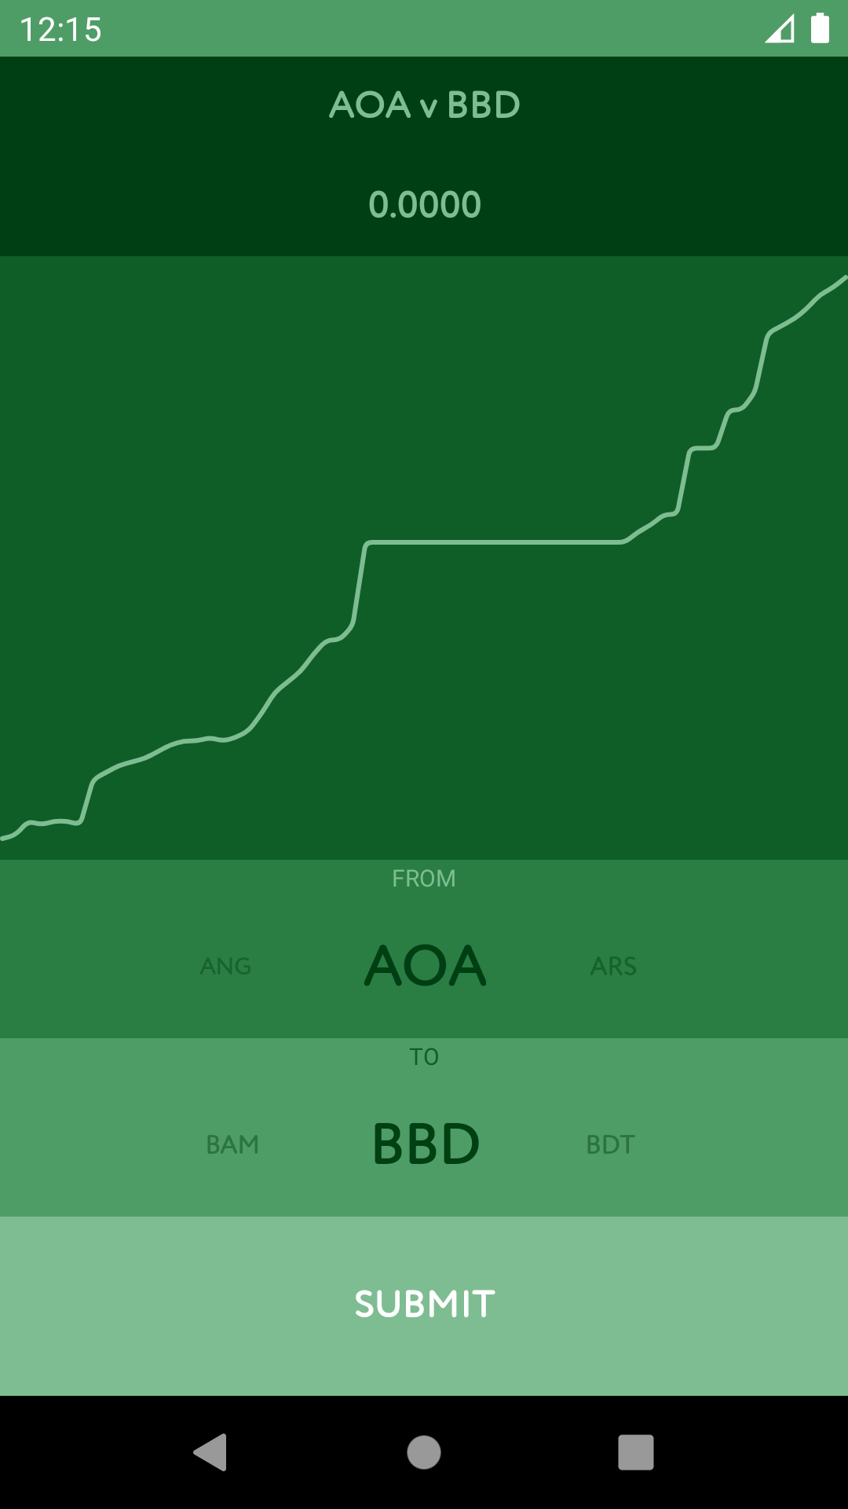
Simple to use
Scroll to pick currency pair
Hit submit
Scrub the graph for more info

Slide 3
Challenges faced
Using the API was especially challenging due to it’s unusual, object based design.
Some of the frontend libraries were hard to integrate as layouts. I had to generate them programmatically to work around that issue.
Not all currency pairs on the API work. This was not clear in the documentation, which led to many unforeseen and vague exception cases.

Slide 4
Libraries Used
Spark : It is a great graphing library for android.
Ticker : A simple aesthetic boost to a very simple UI.
Fuel : It is a joy to use over other HTTP libraries as it handles all the asynchronous routines under the hood.
HorizontalPicker : I was dead set on using the recycler view as a custom picker but styling it was a pain. This is where this library came in.

Slide 5
Things to remember in the future
Take backups regularly, preferably remote.
Don’t overthink a simple UI.

Slide 6
Thank You

