Slide 1
A Global Geometric Framework for Nonlinear Dimensionality Reduction
Joshua B. Tenenbaum, Vin de Silva, John C. Langford
Presented by
Napat Triroj

Slide 2
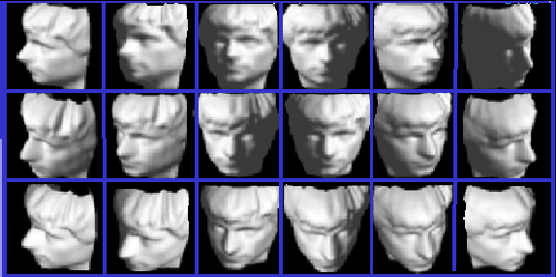
Dimensionality Reduction
Objective: to find a small number of features that represent a large number of observed dimensions.
For each image: there are 64x64 = 4096 pixels (observed dimensions)

Slide 3
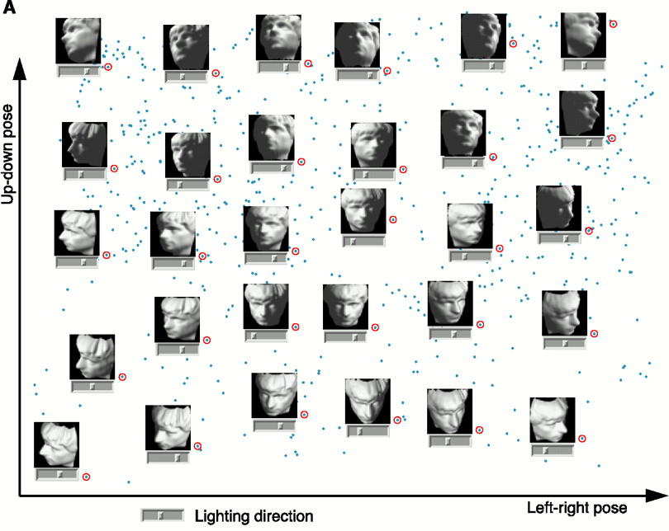

Dimensionality Reduction
Reduced to 3-dimensional manifold: two pose variables + azimuthal lighting angle

Slide 4
Isometric Feature Mapping (Isomap)
A nonlinear method for dimensionality reduction
Finds the map that preserves the global, nonlinear geometry of the data by preserving the geodesic manifold interpoint distances
Geodesic: Shortest curve along the manifold connecting two points
First approximates the geodesic interpoint distances, then runs MDS to find the projection that preserves these distances
2 components:
- How do we measure the geodesic distances on the manifold?
- How to map points on the Euclidean space in lower dimensional
space?

Slide 5
Multidimensional Scaling (MDS)
The algorithm detects meaningful underlying dimensions that explain
observed similarities or dissimilarities (distances) between the
investigated objects.
Given:
n x n matrix of dissimilarities between n objects
(∆^{T} = ∆; δ_{ij} ≥ 0; δ_{ii} = 0)
OR n x n matrix of similarities between n objects
(Θ^{T} = Θ; θ_{ij} ≤ θ_{ii})
convert to dissimilarities → δ_{ij}² = θ_{ii} + θ_{jj} - 2θ_{ij}
Goal: Find a configuration in a low-dimensional Euclidean space R^{k}
whose interpoint distances d(x_{i},x_{j}) closely match dissimilarities.

Slide 6
Measure of goodness-of-fit: Stress
Let the new configuration be obtained by projecting x₁,…,x_{n} onto a k-D subspace.
Minimizing “lack of fit” between the two configurations (dissimilarities and distances)
Stress of the configuration: Φ(∆ , D) = Σ (δ_{ij}² – d_{ij}²)
Then, the subspace is spanned by the k largest principal components.

Slide 7
Classical Solution: Metric method
Given: nxn ∆ dissimilarities matrix of n points in m-D space
Questions:
- Is ∆ an interpoint distance matrix in Euclidean space?
- If yes, what is the dimension?
→ What are the coordinates?
First, check whether ∆ is Euclidean:
define
A_{nxn} with elements a_{ij} = -(1/2)δ_{ij}²
B = HAH = UΛU^{T} “centered inner product matrix”
H_{nxn} = I – n⁻¹1 1^{T} “centering matrix”
→ ∆ is Euclidean if and only if B is positive semidefinite
i.e. λ(B) ≥ 0, with rank ≤ m

Slide 8
Classical Solution: Metric method
If ∆ is Euclidean:
- Construct the matrix A
- Obtain the matrix B with elements b_{ij} = a_{ij} - a_{i·} - a_{·j} + a··
- Find the k largest eigenvalues λ₁ > … > λ_{k} of B, with corresponding
eigenvectors X = (x₁,…, x_{k}) which are normalized by x_{i}^{T} x_{i} = λ_{i} , i =
1,…,k (k< m, is whatever we pick)
- Then, the required coordinates of the reconstruction points P_{i} are
x_{i} = (x_{i1},…, x_{in})^{T}

Slide 9
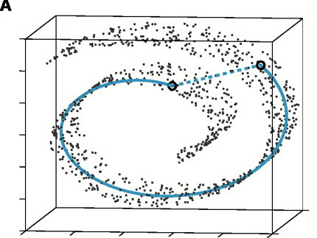
The “Swiss roll” data set
Unlike the geodesic distance, the Euclidean distance cannot
reflect the geometric structure of the data points

Slide 10
Approximating Geodesic Distances
Neighboring points: input-space distance
Faraway points: a sequence of “short hops” between neighboring points
Method: Finding shortest paths in a graph with edges connecting neighboring data points

Slide 11
Isomap Algorithm
Step | Name | Description
1 O(DN²) | Construct neighborhood graph, G | Compute matrix D_{G}={d_{X}(i,j)} d_{x}(i,j) = Euclidean distance between neighbors
2 O(DN²) | Compute shortest paths between all pairs | Compute matrix D_{G}={d_{G}(i,j)} d_{G}(i,j) = sequence of hops = approx geodesic dist.
3 O(dN²) | Construct k-dimensional coordinate vectors | Apply MDS to D_{G} instead of D_{X}

Slide 12
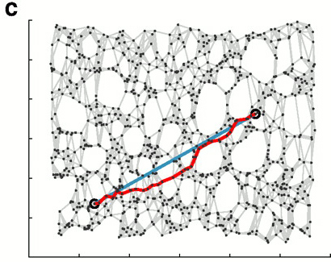
Isomap Output
The 2-D embedding recovered by Isomap

Slide 13
Summary on Isomap Algorithm
Advantages:
Nonlinear
Non-iterative
Globally optimal
Parameters: k or ε (chosen fixed radius)
Disadvantages:
Graph discreteness overestimates the geodesic distance
k must be high to avoid “linear shortcuts” near regions of high surface curvature

