Slide 1
INVESTORSCOPE
Hi-Fi Prototype

Slide 2
Overview
INVESTORSCOPE is an intuitive way for beginning investors to discover new investment opportunities.
Heuristic Eval Results
Progress on Task Implementation
Tools Used
Plan for Completion
Demo

Slide 3
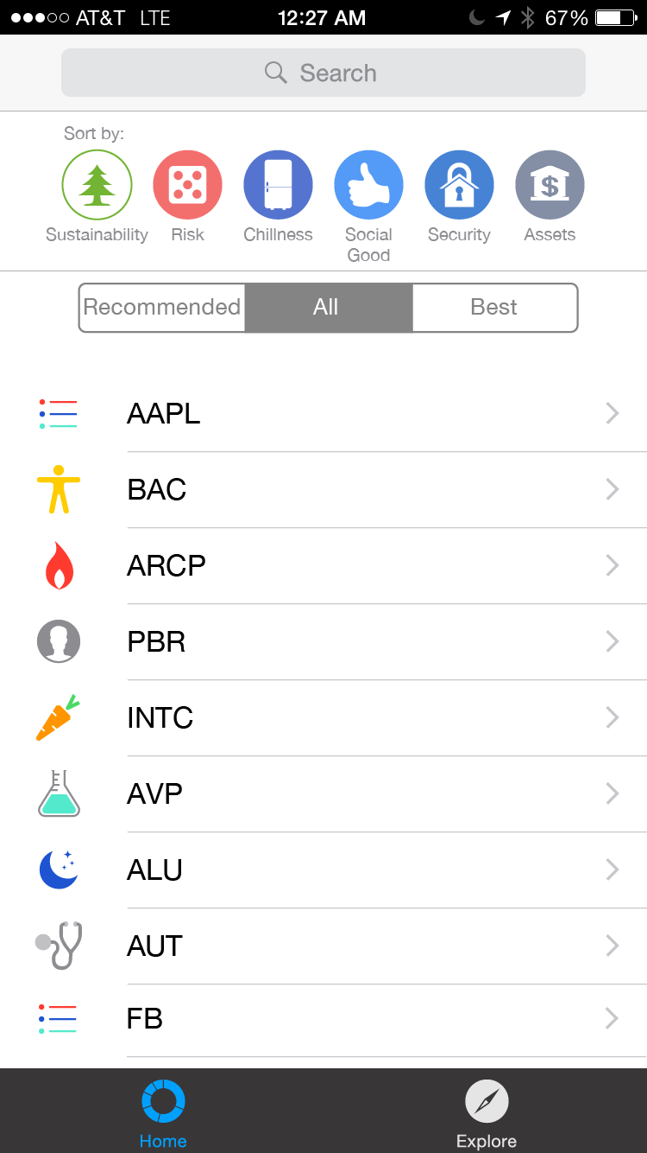
Heuristic Eval Results
[H2-4: Consistency and standards] The two sorting mechanisms are redundant/confusing. Maybe use the categories like filters.
[H2-4 Consistency and Standards] The difference between “Recommended” and “Best” is not clear.
[H2-1 Visibility of system status] There is no connection between the “explore” button and the “Recommended” tabs. The “Explore” tab is used so that the “Recommended” tab works but there is no indication.
Solutions (Implemented):
Removed “Best” sorting
Solutions (Planned):
Potentially change name from “Explore” to “Find Recommendations”
Clarify sorting

Slide 4
Heuristic Eval Results
[H2-2 Match between system and real world] The number of foreign stock abbreviations disorients users in a way that may discourage discovery and the actionable task of clicking on the company.
Solutions (Not Implemented):
Display names and icons

Slide 5
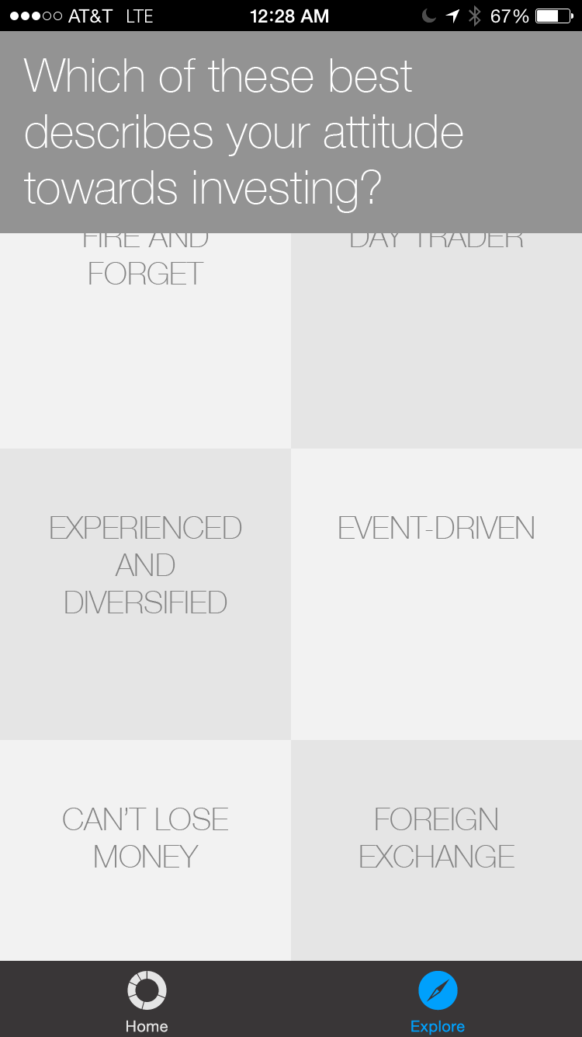
Heuristic Eval Results
[H2-4: Consistency and standards] The UI experience while in the Explore stage seems to be different and unexpected when entering explore. The inconsistent UI flow makes it hard to see how exactly the explore module is tied to the rest of the application.
[H2-3 User control and freedom] Some answer responses in the explore module may not necessarily be the user’s answers to that particular question. This is a slight violation of the freedom heuristic where the user should be given the option to freely answer in the manner that they wish.
Solutions (Implemented):
New question page currently in development
Solutions (Planned):
Change UI to work better with overall UI
OR, allow user to freely answer

Slide 6
IMPLEMENTED
Task #1: Search
A user wants to view relevant information for a specific company.

Slide 7
NOT IMPLEMENTED YET
Task #2: Stock Recommendation
Task #3: Sorting
A user answers a series of questions and receives automatically generated stock recommendations.
A user filters down a large list of potential investments to a small number of candidates, sorting by qualitative and financial metrics.

Slide 8
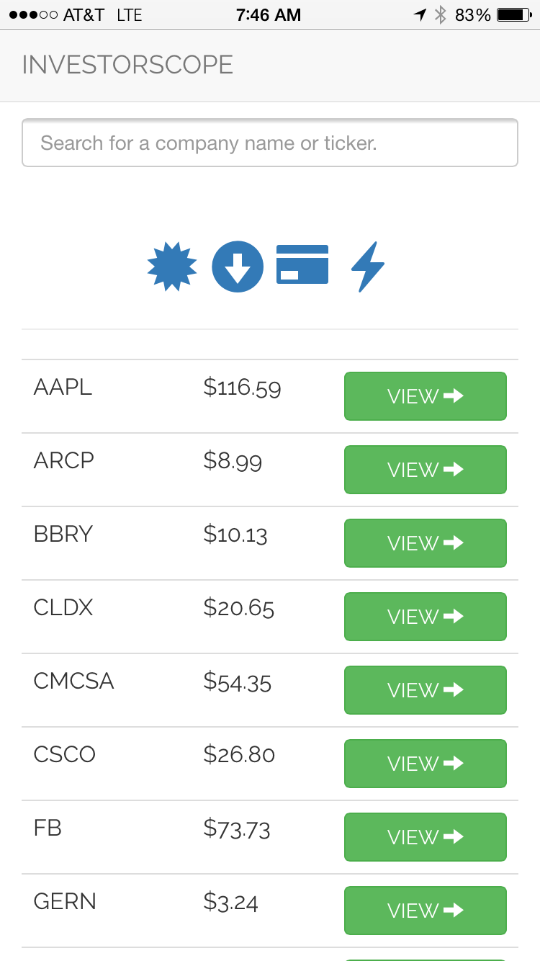

Slide 9
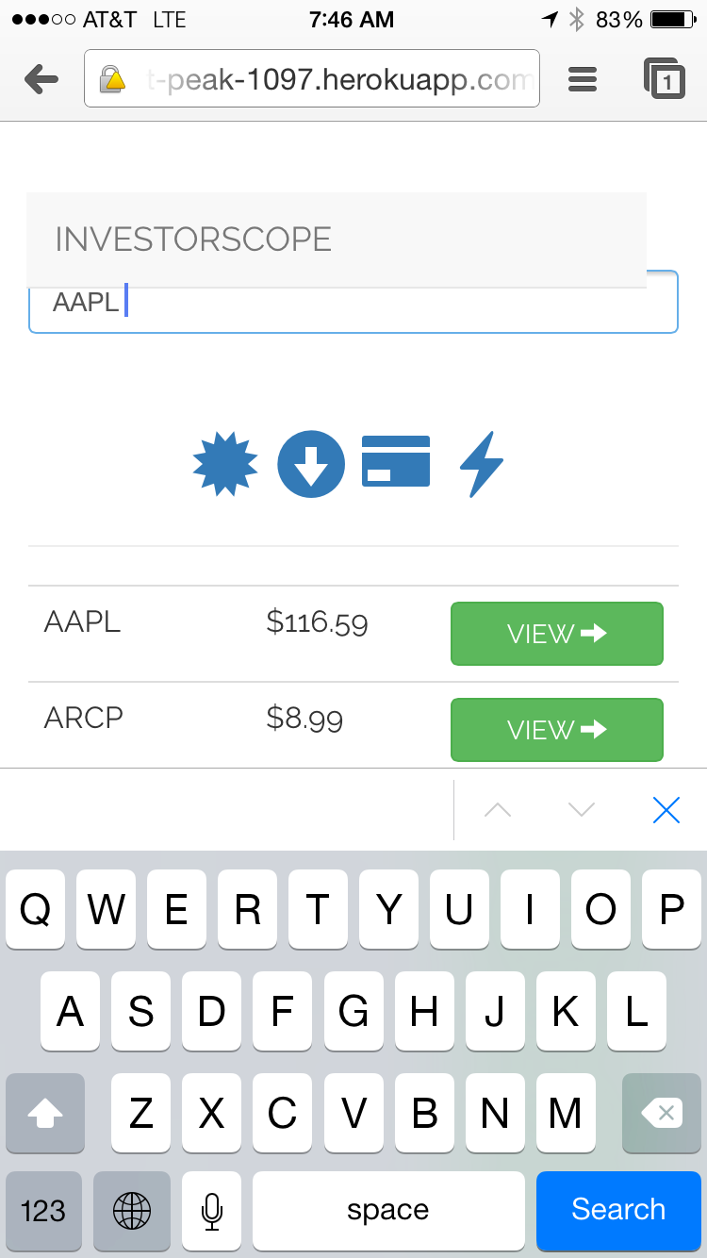

Slide 10
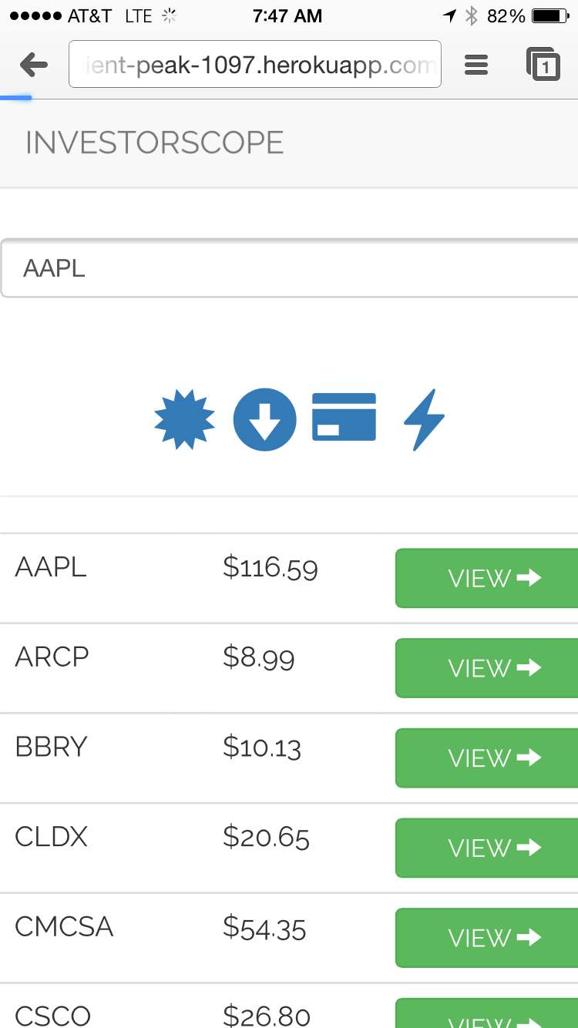

Slide 11
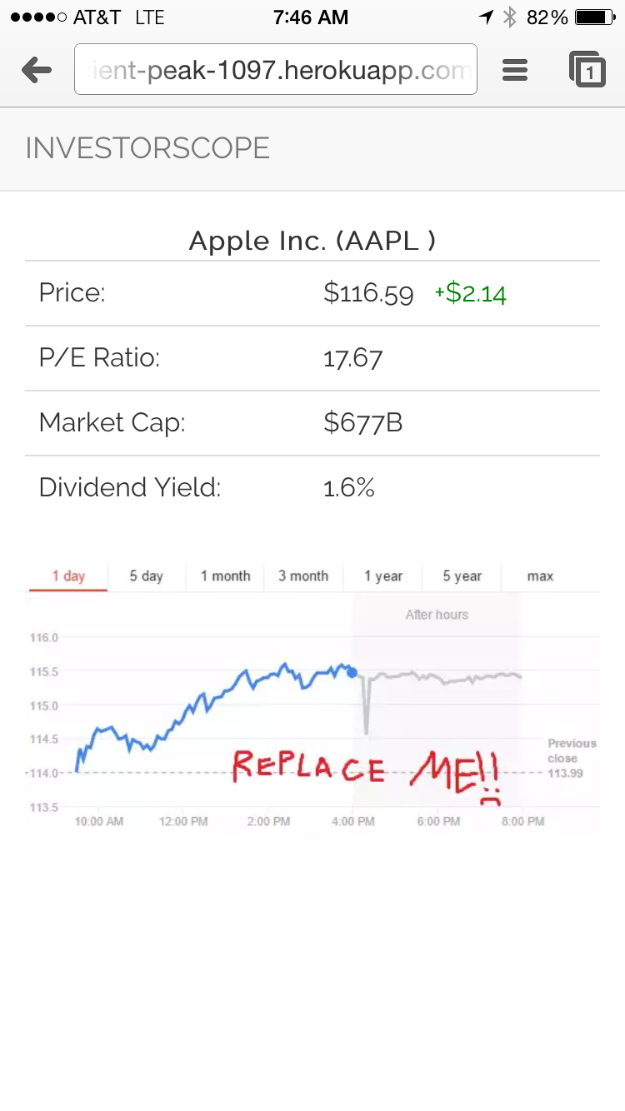

Slide 12
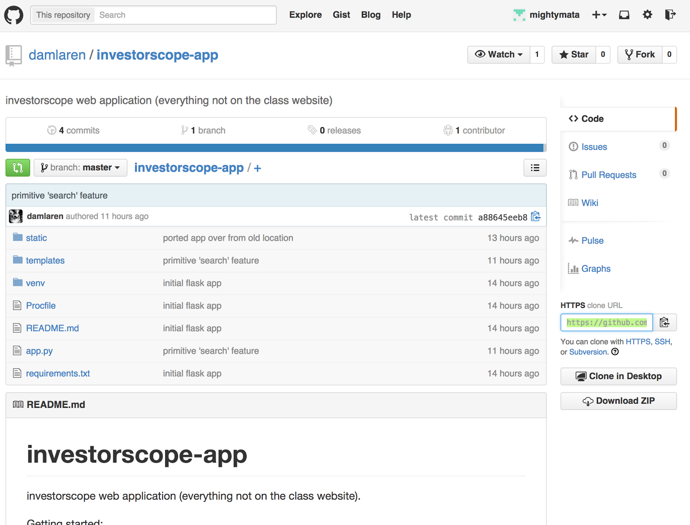
Tools
Github repo

Slide 13
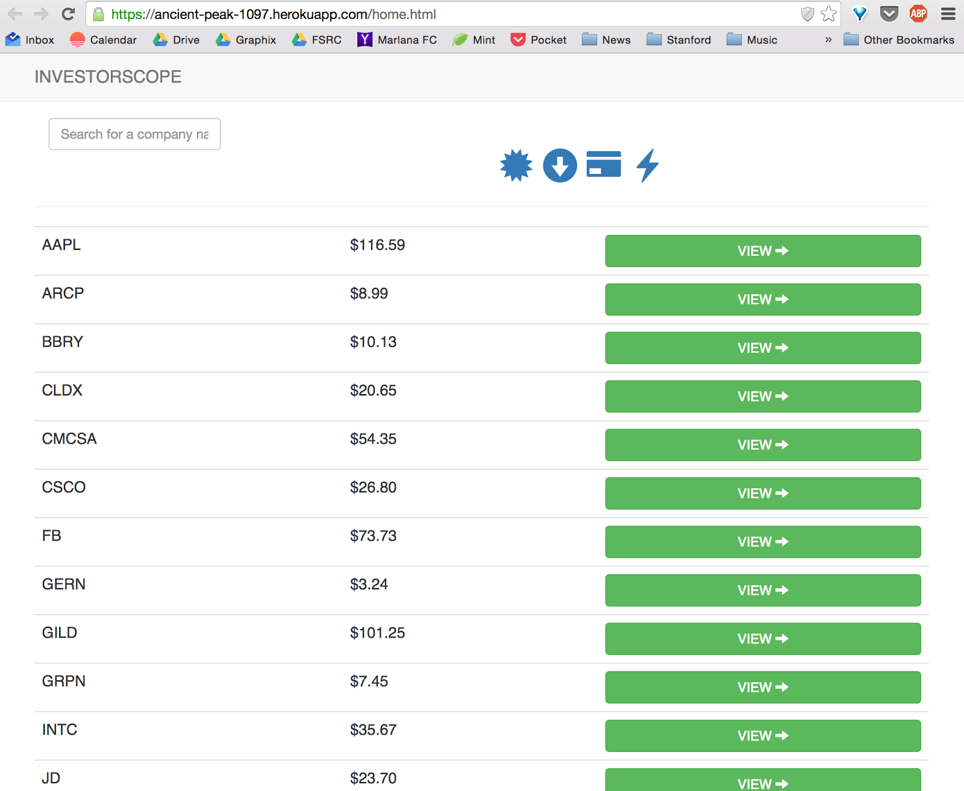
Tools
Web-app running on heroku

Slide 14

Plan
THANKSGIVING BREAK!!
Build Task 2 (Recommendations)
Hard Code OR Wizard of Oz the recommendations
Add more questions
Build Task 3 (Sorting)
clarify sorting options
make sorting metrics for stocks
Build more “filled in” Stock Page

Slide 15
Demo
and now for an underwhelming

