Slide 1
InvestorScope
Interactive Medium-Fi Prototype
David Khavari
Aaron Sekhri
Matt Appleby
David McLaren
Notes:
we are investorscope

Slide 2

Looking Ahead
A seamless, intuitive way for amateur investors to discover new investment opportunities.
A task-by-task review of flaws found during evaluation of the lo-fi prototype, and the corresponding revisions in the medium-fi prototype.
Notes:
Image credit: http://www.mainlesson.com/books/ober/magellan/zpage116.gif

Slide 3
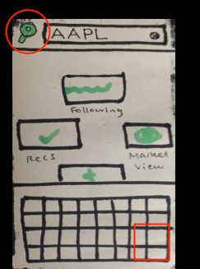
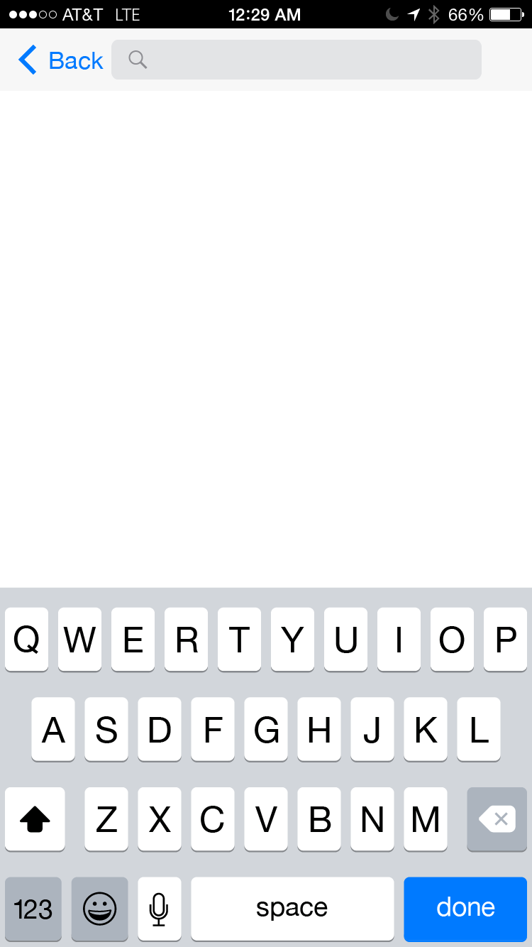
Task #1: Stock Lookup
A user wants to view relevant information for a specific company.
Some users didn’t know how to do a search after typing query.
Some found magnifying glass button distracting or counter-intuitive.
Notes:
Mag glass: one good reason this is counter-intuitive is that different platforms seem to have different expectations of where a magnifying glass button will be placed (left vs. right), if there is one at all. In our paper UI it’s also not clearly marked as a button.

Slide 4
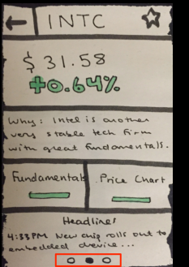
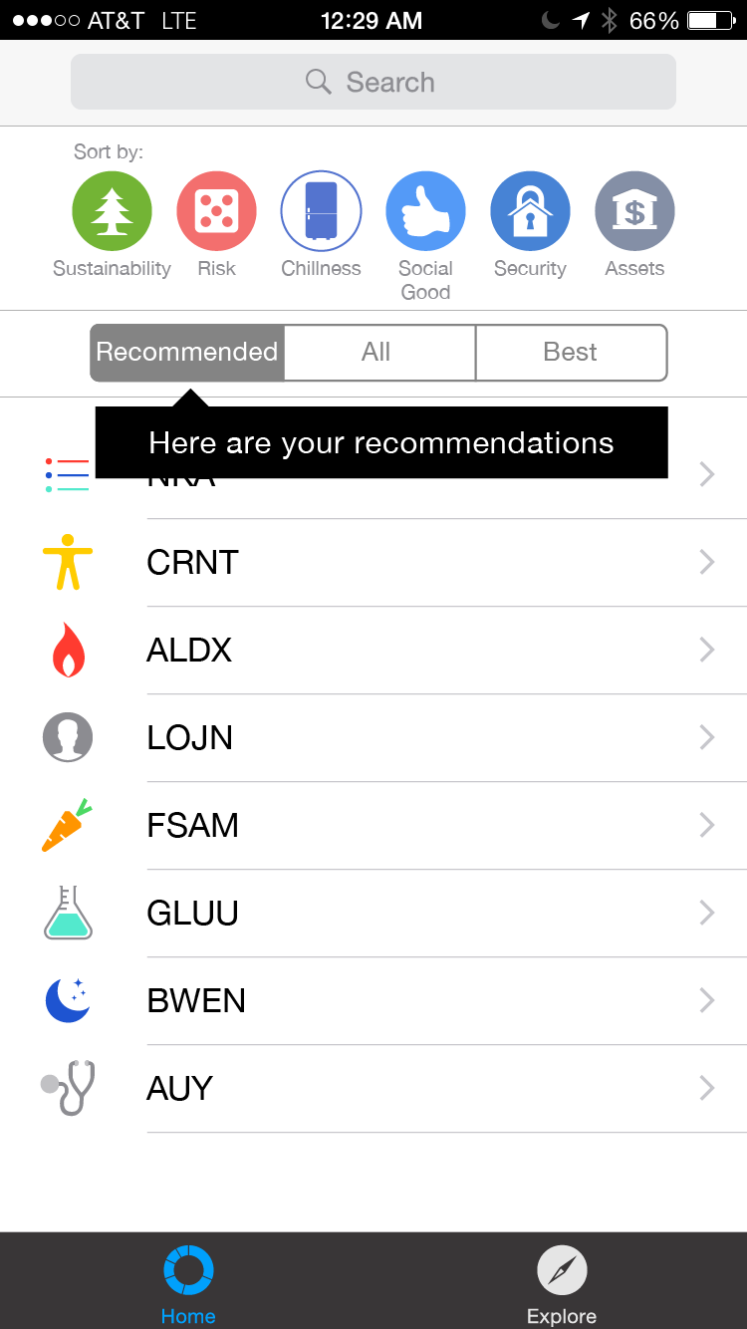
Task #2: Stock Recommendation
A user answers a series of questions and receives automatically generated stock recommendations.
Users loved Q&A.
“Bread crumbs” at bottom of result page unintuitive; we made it a list instead.

Slide 5
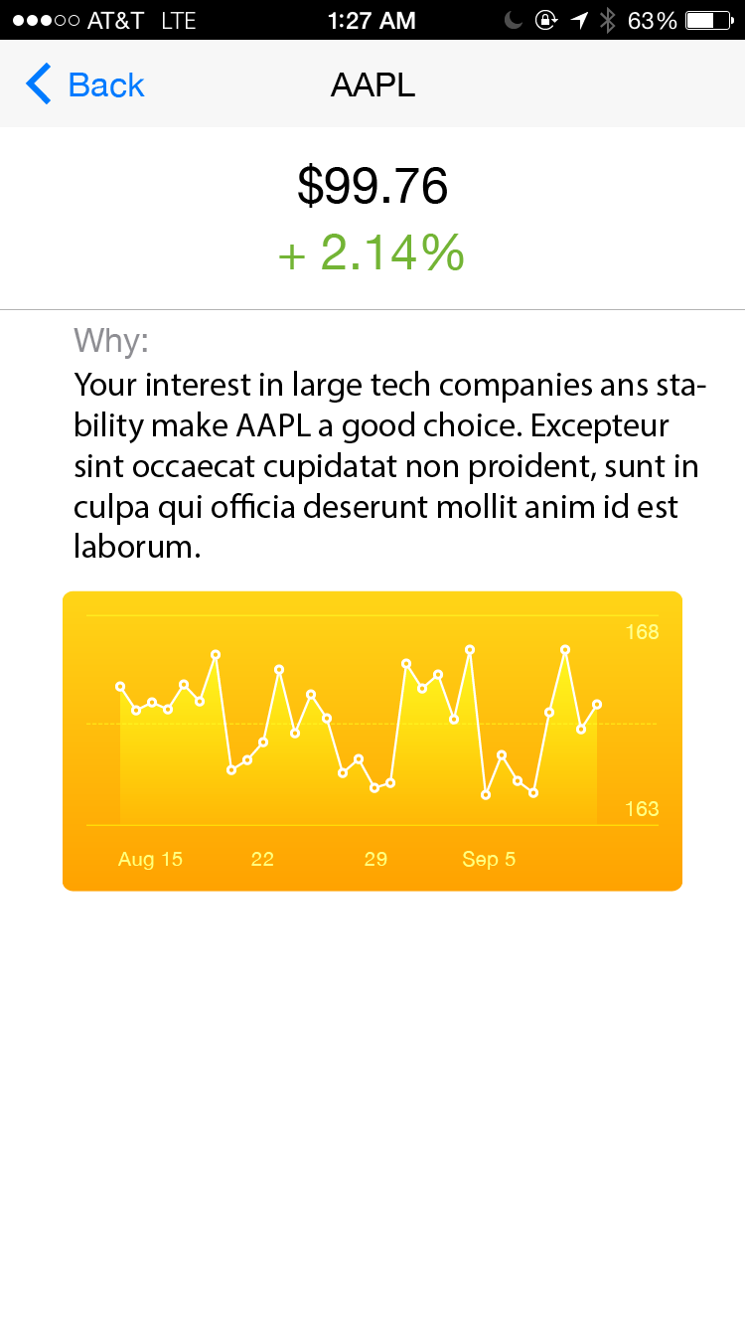
Task #2: Stock Recommendation
A user answers a series of questions and receives automatically generated stock recommendations.
Some users wanted more content on stock page, or more context for why stock picked.

Slide 6
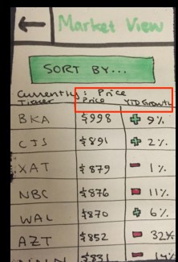
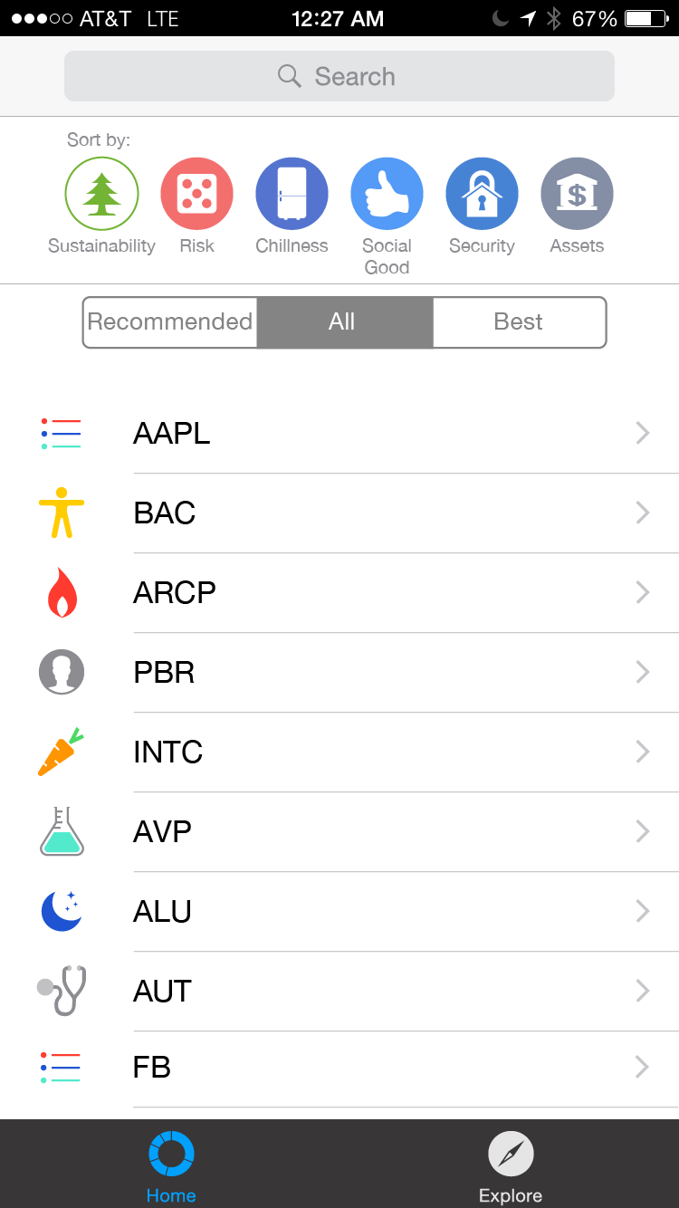
Task #3: Stock Sorting
A user filters down a large list of potential investments to a small number of candidates, sorting by qualitative and financial metrics.
Users wished to sort by qualitative metrics (like sustainability).
Notes:
Note a key change: qualitative metrics were added based on user feedback, and should be emphasized. Users thought this was more understandable or useful.

Slide 7
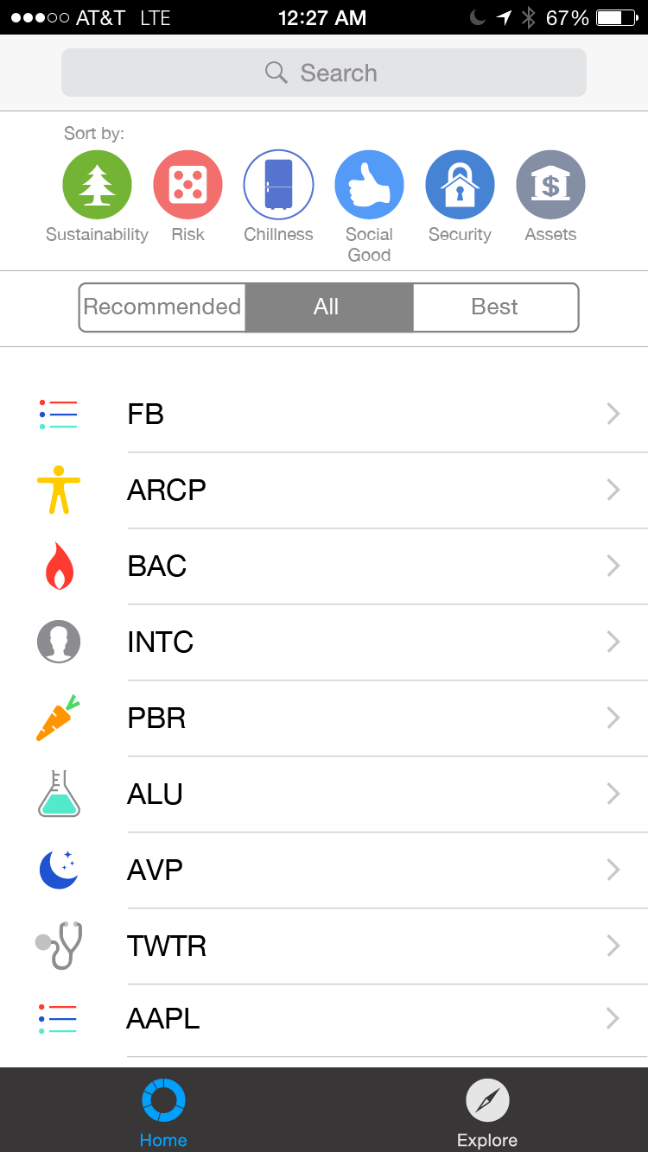
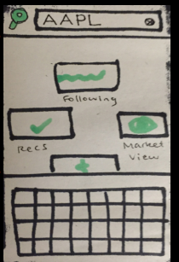
Home Page Redesign
Users expressed that it didn’t feel like a home page. Confused if they had returned to the right place.
Same tasks are accessible, but the homepage now contains information.
Notes:
Not a specific task, but a sore spot with users.

Slide 8
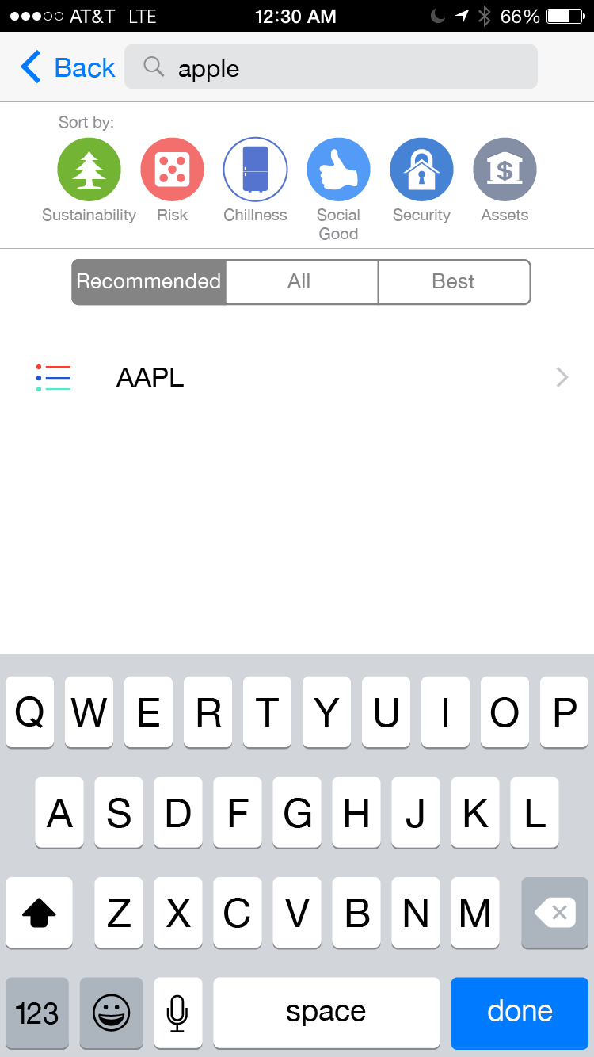
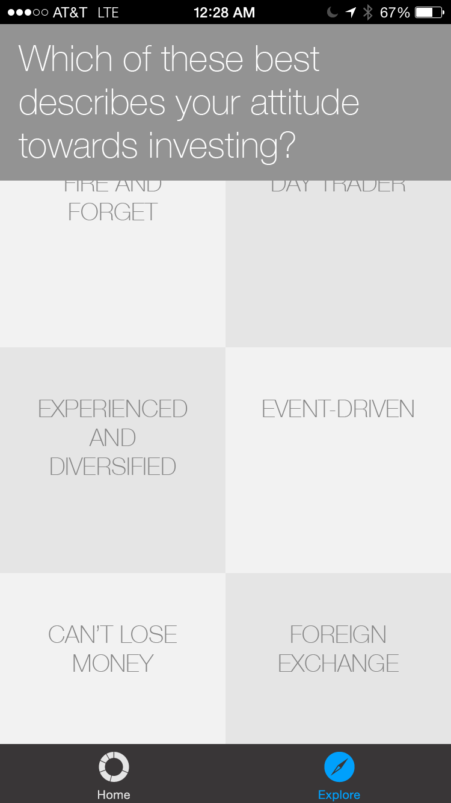
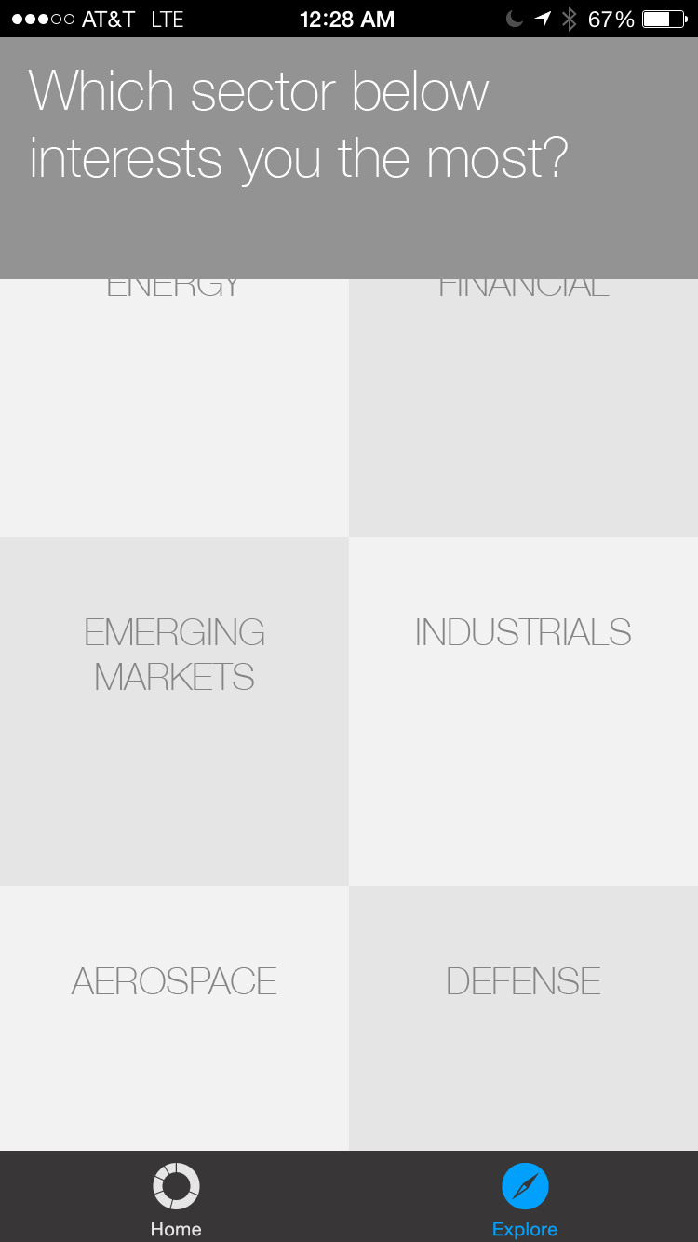
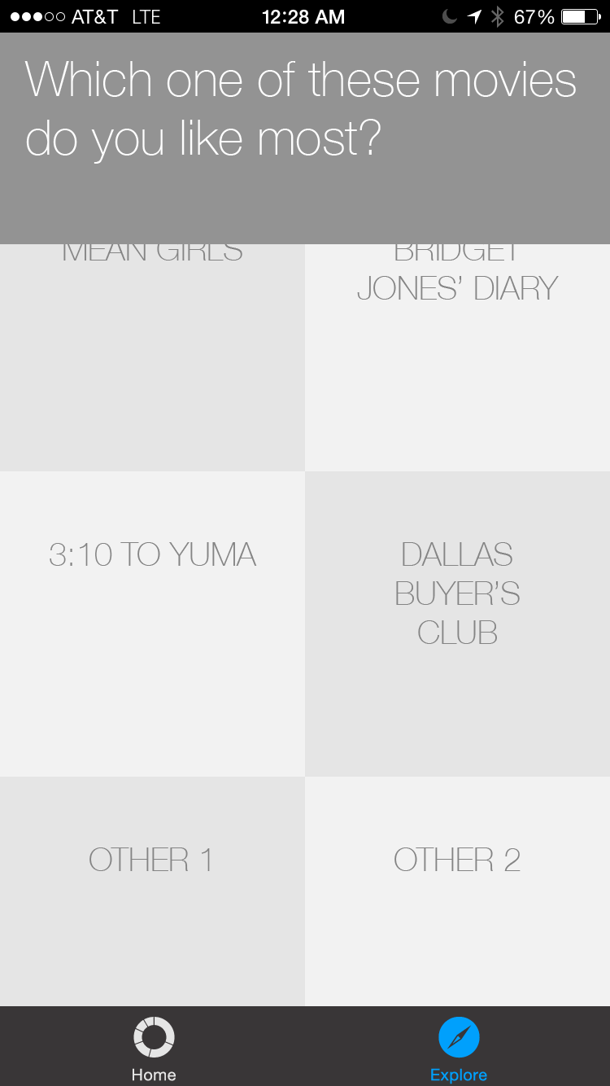
Storyboard
Task 1: Stock Search
Task 2: Stock Recommendations
Task 3: Sort lists by different subjective and objective measures. (here: Sustainability -> Chillness)

Slide 9
Demonstration
https://projects.invisionapp.com/share/7H1M2O2W5#/screens

Slide 10

Tools
InVision: to build the prototype
Adobe Illustrator: screen mockups
The Noun Project: icons
iOS 8 Illustrator Vector UI Kit: buttons, search, tab bar, font
Notes:
image from: http://thenounproject.com/

Slide 11
Tools
What worked:
Team member had lots of experience using Adobe Illustrator and InVision to build prototypes.
InVision syncs with Dropbox. When a file is committed there, it automatically gets synced with the prototype.
What could be better:
Could have been more interactive, with more real data, if we used Proto.io, but this would have taken longer to learn and implement.

Slide 12

Summary
Medium-fi prototype addresses flaws found in lo-fi prototype evaluation while preserving its best features.
Redesigned around a new list view using native UI elements.
Shows the way towards production of the hi-fi prototype.
Notes:
image credit: http://chalkdot.files.wordpress.com/2009/07/compass1.jpg

