Slide 1



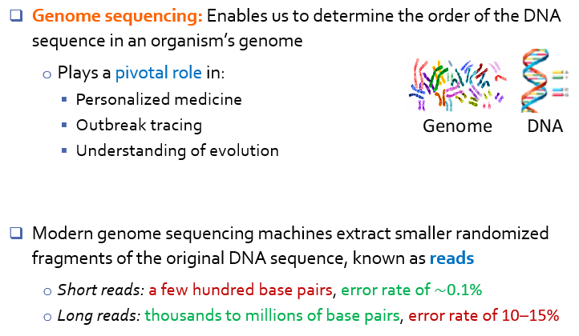
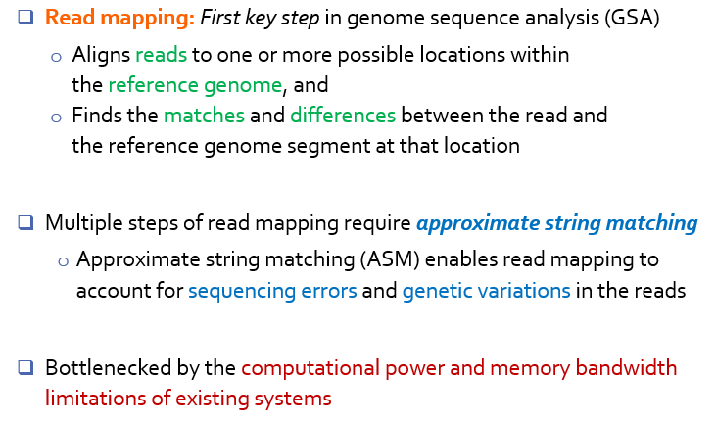
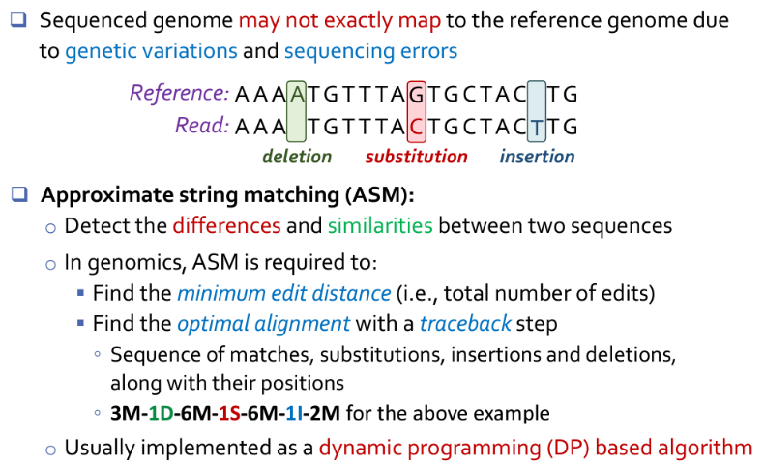
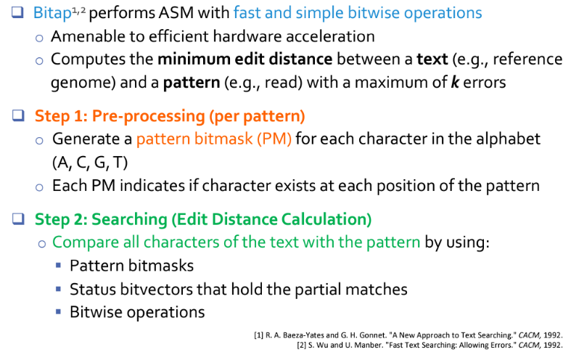
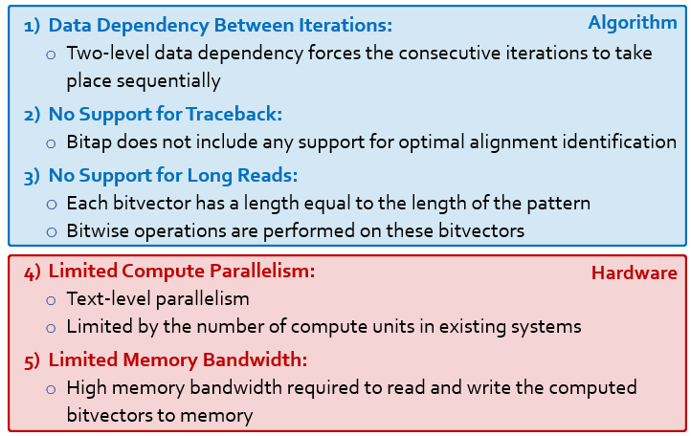
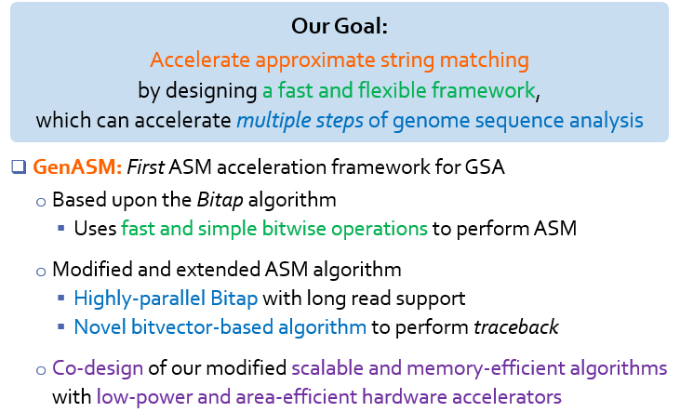
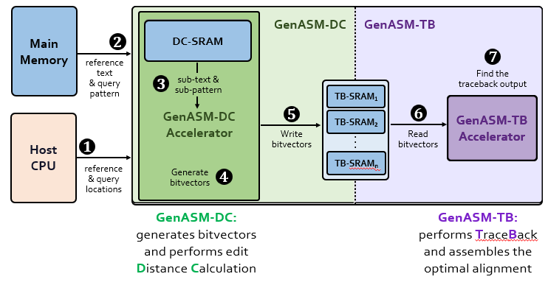
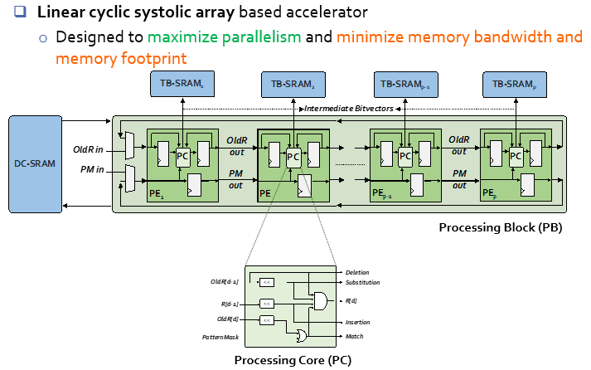
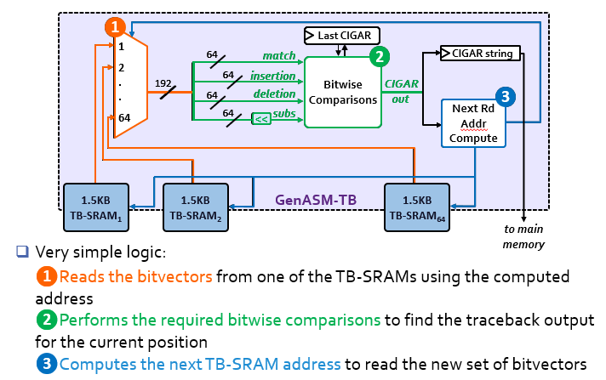
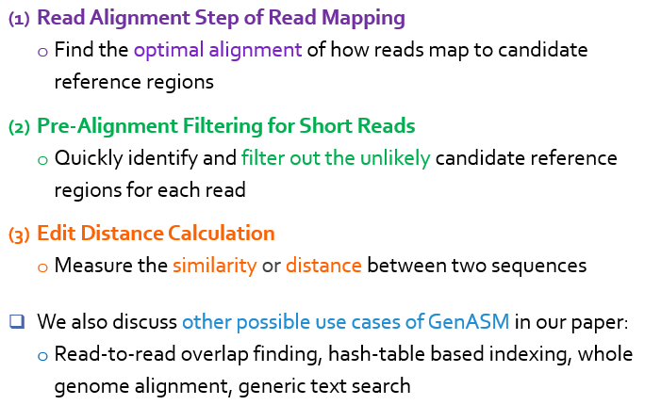
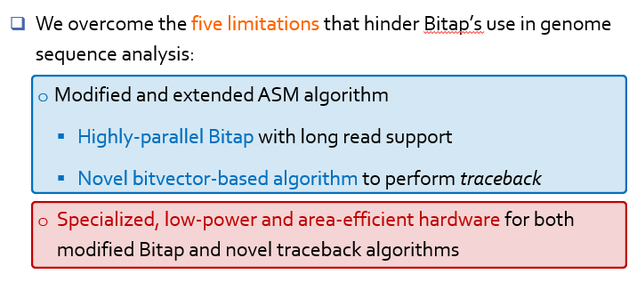
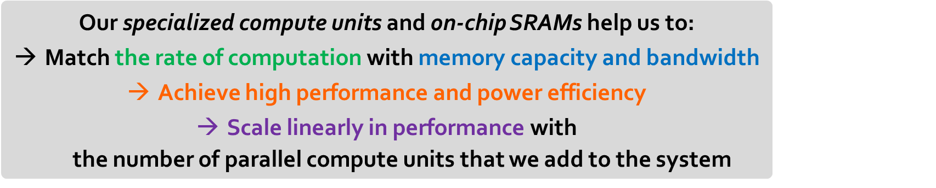
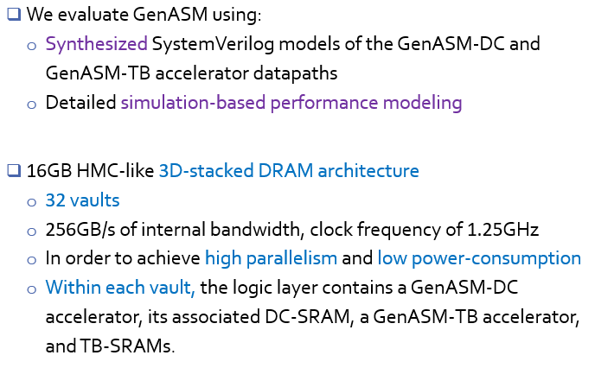
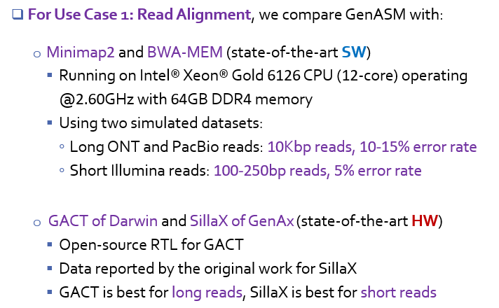
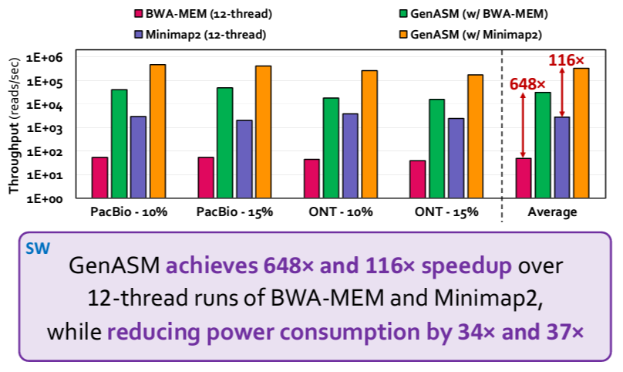
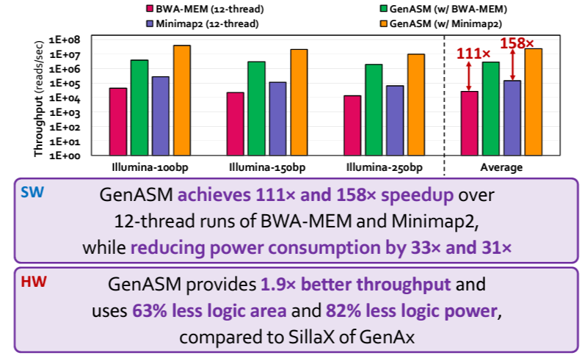
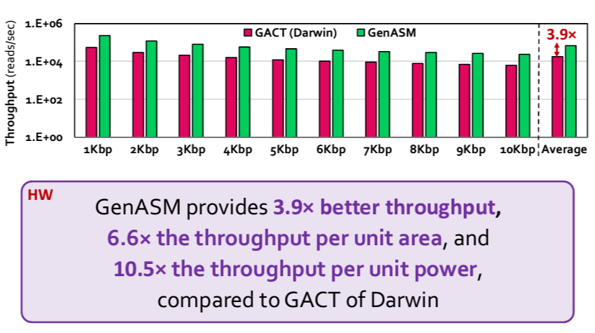
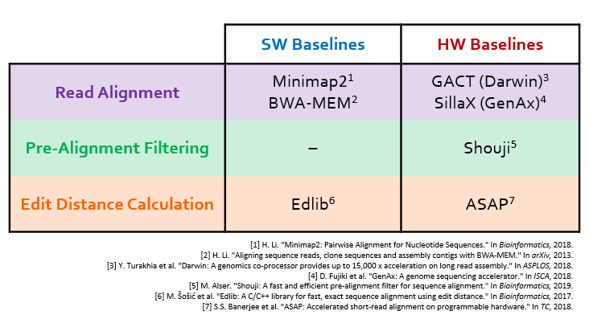
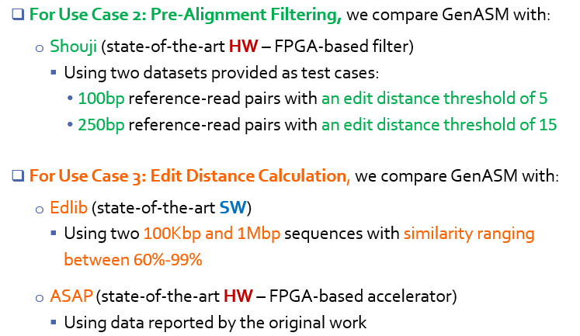
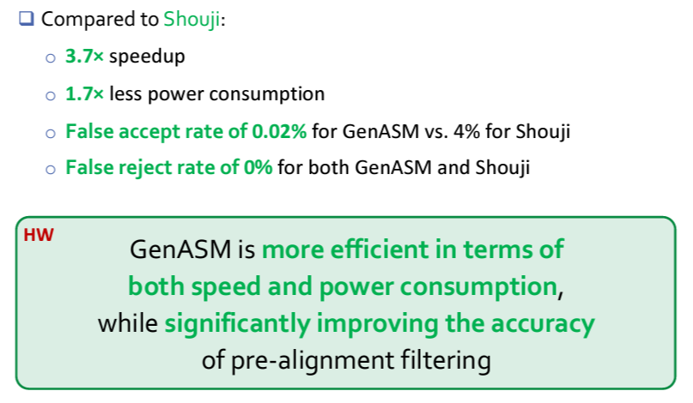
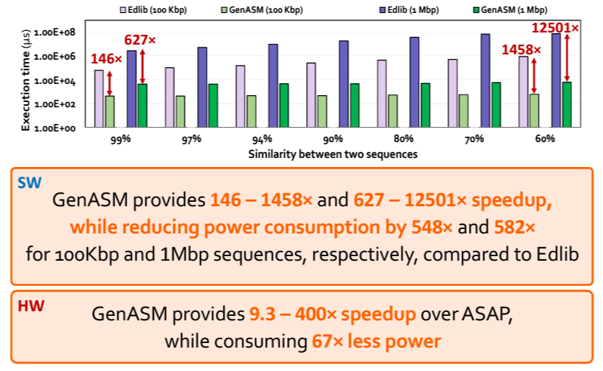
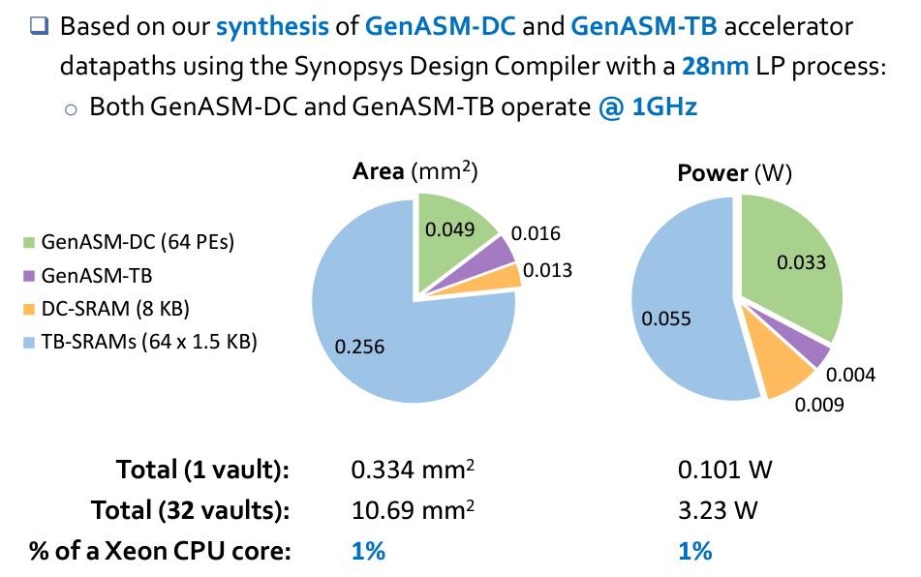
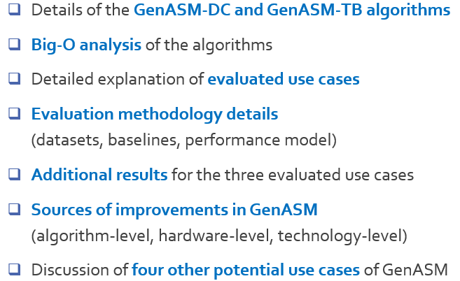




GenASM: A High-Performance, Low-Power Approximate String Matching Acceleration Framework for Genome Sequence Analysis
Damla Senol Cali (damlasenolcali@gmail.com), Gurpreet S. Kalsi, Zulal Bingol, Can Firtina, Lavanya Subramanian, Jeremie S. Kim, Rachata Ausavarungnirun,
Mohammed Alser, Juan Gomez-Luna, Amirali Boroumand, Anant Nori, Allison Scibisz, Sreenivas Subramoney, Can Alkan, Saugata Ghose, and Onur Mutlu
Genome Sequencing
Genome Sequence Analysis (GSA)
Approximate String Matching (ASM)
Bitap Algorithm
Limitations of Bitap
GenASM: ASM Framework for GSA
GenASM Hardware Design
GenASM-DC: Hardware Design
GenASM-TB: Hardware Design
Use Cases of GenASM
Results – Use Case 1
Evaluation Methodology
Long Reads
Short Reads
Results – Use Case 2
Results – Use Case 3
Results – Area & Power
Additional Details in the Paper
Related Links
Paper (PDF)
MICRO’20 Talk
Source Code

