Slide 1


Protectnetic CE359: Software Group Project - IV

Slide 2
Background Theory & Problem Statement
Child Abuse is a major concern in the society today. Many people on the dark web or even the surface web host child abusive content on the internet. Since it’s not feasible for humans to identify 100s of 1000s of links everyday; we made a website which can identify child abusive content with just a click of a button.
To make a website for scraping the dark web website, analyse the content in it and generate a report for the content within it & throw an alert if child abusive content is found on the provided dark web website.

Slide 3
Project Definition
To make a website which can identify child abusive content based on the link/links provided by the user/admin.

Slide 4

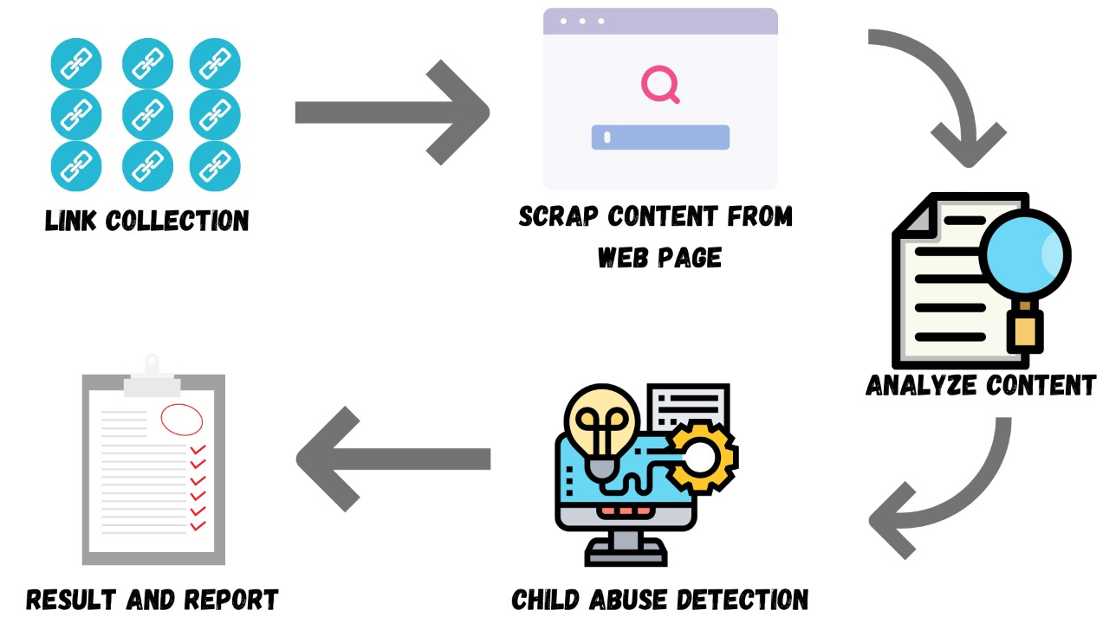
Proposed system
The Idea involves Image Processing to detect Abusive Content, also we are planning to use NLP to perform sentimental analysis on the scraped data, while other ideas might include different approaches to solve the same problem.

Slide 5
Requirement gathering techniques
Survey/ Questionnaire
Research
Brainstorming
Observation

Slide 6
Hardware Requirements
Any Smartphone/Laptop with strong Internet connection

Slide 7





Software Requirements

Slide 8
Expected Planning
January 1. Requirement Gathering 2. Learning Concepts
February 1. Implementing Image based models
April 1. Finishing up & final Changes
March 1. Implementing Sentimental Analysis

Slide 9
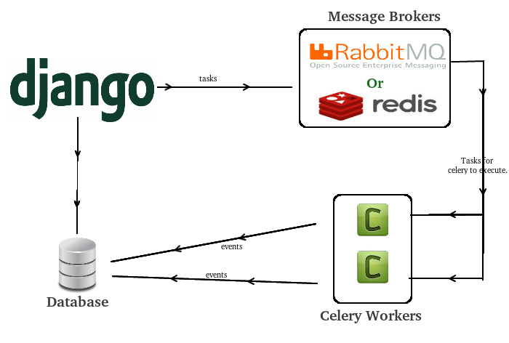
Working

Slide 10
Implementation

Slide 11
Future Enhancements
To use the data to hack the website & permanently close it.
To find the website’s owner by finding tor IP-address.
To make a security web filter for private organizations.
To Use image detection to catch some criminals who commit child abuse

Slide 12
References
https://docs.python.org/3/
https://docs.djangoproject.com/en/4.0/
https://docs.opencv.org/4.x/d9/df8/tutorial_root.html
https://www.tensorflow.org/api_docs/
https://beautiful-soup-4.readthedocs.io/en/latest/
https://youtu.be/iGWbqhdjf2s
https://youtu.be/o2BYWYS73G0

Slide 13
Thank You…
Created By:
Jeet Undaviya (19DCE142)
Raj Soni (D20DCE176)
Tanmay Damle (19DCE021)
Yash Kavaiya (19DCE056)

