Slide 1


Solution By: Binary Squad
PSID: INTL-CCR-19
Team Leader: Jeet Undaviya

Slide 2

Idea Introduction
Protectnetic - Child Abuse Prevention
IDEA-OUTCOME – HEADLINE-
Tech Stack
1. Python /
Django
2. HTML
3. JS/CSS
4. Bootstrap
Resources Used
1. OpenCV
2. TensorFlow
3. Beautiful Soup
4. Selenium
5. Tor-socks (for proxy)
6. Requests (to scrape websites)
Any Third Party API/Services used
Currently None
To make a website for scraping the dark web website, analyse the content in it and generate a report for the required details in problem statement (psid:INTL-CCR-19) & throw an alert if child abusive content is found on the provided dark web website.

Slide 3

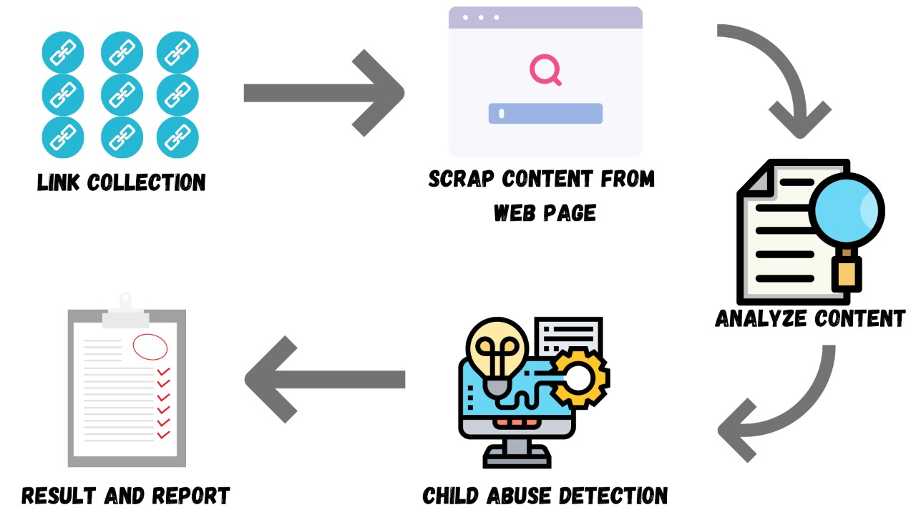
Your Approach Towards Idea
Approach
To scrape the dark web website, analyse the content in it and generate a report for the required details in problem statement (psid:INTL-CCR-19) & throw an alert if child abusive content is found on the provided dark web website.
We targeted the problem by gathering content about the given domain & analysing it’s contents & proposed the result based on our research.
We trained a ML model to detect child abusive content based on scrapped images from the dark web.
Future Enhancements:
To Train a ML model which detects child abusive content based on scrapped html.

Slide 4

Binary Squad
Member 1
Jeet Undaviya (Leader)
Member 2
Raj Soni
Member 3
Tanmay Damle
Member 4
Meet Sheth
Member 5
Yash Kavaiya

Slide 5
Development Pipeline
Documentation
1. ReadME.md
2. Installation Docs.
3. Help Docs.
Any Third party API used : Currently None
Proposed Development
1. Collect Links
2. Scrape Links
3. Train ML Model to detect age & Sexual Content.
4. Put it all together
5. Make Website
Proposed UI and functional flow
Flow :
Home Page ->
Search Page (Enter any dark web link) ->
Result Page ->
Report and Results
Our Repository Links and References:
Git Repo
2. Diggy Spidey
Step A
Step B
Step C
Step D
Step E

Slide 6
Vision of Innovation/Idea/Solution
How your idea is different and innovative form other ideas ?
Our Idea involves Image Processing to detect Abusive Content, also we are planning to use NLP to perform sentimental analysis on the scraped data, while other ideas might include different approaches to solve the same problem.
Explain How you developed Idea ?
By researching about dark web & problem statement we figured out what the problem was & brainstormed what can be the possible outcomes to the said problem.
How much time it will take in conversion as a final product ?
– 2.5 Months Tentatively
Any early stage innovation detected while developing the solution ?
Currently None

Slide 7
Thank you for your time!

