Slide 1
Automation Testing Services
Open Source Automation Solutions – Selenium Framework
Selenium O2
June 2017

Slide 2

Contents
Selenium Framework
Introduction
Components
Functionality
Benefits
Improvements
Case Studies
2
Notes:
GENERIC

Slide 3

Introduction
What is Selenium Framework
A hybrid framework for selenium based automation.
This framework comes with various features to Batch run, to provide test data from excel files, to generate screenshots, to generate reports in html and excel formats and to validate expected result with actual result
Why Selnium Framework
Intended Audience
Ease of use
Better reporting with screen capture
Maintainable object repository
Customized validation
Better Test Data management
Who works on selenium based automation testing and want to jump start the automation with test data, batch run, and reporting capabilities

Slide 4
Components
Framework components
Batch test runner
Environment setup
Data Driven support
Object repository
Validations
Custom reporting
Forms filling
Web Tables handling
Utilities
Test Driver can select and run tests with Yes or No option from excel file in controller manner
Test Data Handler can load the Test Data for test cases from excel files
Validator can verify expected and actual values and can report to test result
DB Utility to verify if table or column existence and can execute sql query
Report Generator takes screenshots and generates test result in Html and Excel formats

Slide 5
Components – Batch test runner
S. No. | Test Case | Execute?
1 | UI_NG_01_Search_ValidSubscriberId | NO
2 | UI_NG_02_Search_SubscriberIdWith_InvaildCharcters | NO
3 | UI_NG_03_MemberDependentVerify | NO
4 | UI_NG_04_ClearBN_Work_Verification | NO
5 | UI_NG_05_TabOrder_AllMemScreens | Yes
6 | UI_NG_06_SubscriberId_DefaultFocus_Vrification | Yes
7 | UI_NG_08_SearchResults_Sorted_AscendingOrDescendingOrder | Yes
8 | UI_NG_09_CreateNewBN_MemSearchFails | NO
9 | UI_NG_10_NewSubscriber_AddedInFMS | NO
10 | UI_NG_11_Dependents_Added_ExistingSubscriber | NO
11 | UI_NG_12_MultipleDependents_Added_ExistingSubscriber | NO
Yes – to run a test
Can drive execution from excel file
Can run on Firefox, IE, Chrome

Slide 6
Components – Environment Setup
Property | Value
config_file | C:/fms-admin/config/FMS-Admin-NewUI-SmokeSuite-LX999.xls
objects_file | C:/fms-admin/objects/FMS-Admin-NewUI-UIObjects-LX999.xls
test_data_path | C:/fms-admin/testdata
report_path | C:/fms-admin/reports
report_file | C:/fms-admin/TestReport.csv
log_path | C:/fms-admin/reports
driver | firefox
driver_path | C:/java/browsers/ie/ie8/IEDriverServer.exe
timeout | 30
capture_screenshot_on | pass, fail
show_warning_as | warn
execution_environment | lx999
execution_build | 20160811b2
report_excel_template | C:/fms-admin/config/TestReportTemplate.xlsx
report_excel_filename | TestExecutionReport
FMS_URL | http://155.17.113.196:50801/FMSAdminConsole/
test_data_path | C:/seleniumprojects/fms-admin/testdata
Test data paths
Object repository paths
Report paths
Browser selection
Browser preferences
Application URL
Application Credentials
Supports adding new

Slide 7
Components – Data driven support

Slide 8
Components – Object repository

Slide 9
Components – Validations
assertEquals(expected, actual)
assertEquals(message, expected, actual)
assertEquals(expected, actual, delta)
assertEquals(message, expected, actual, delta)
assertFalse(condition)
assertFalse(message, condition)
assertTrue(message, condition)
assertNull(object)
assertNotNull(message, object)
assertSame(expected, actual)
assertElement
assertError
assertDone

Slide 10
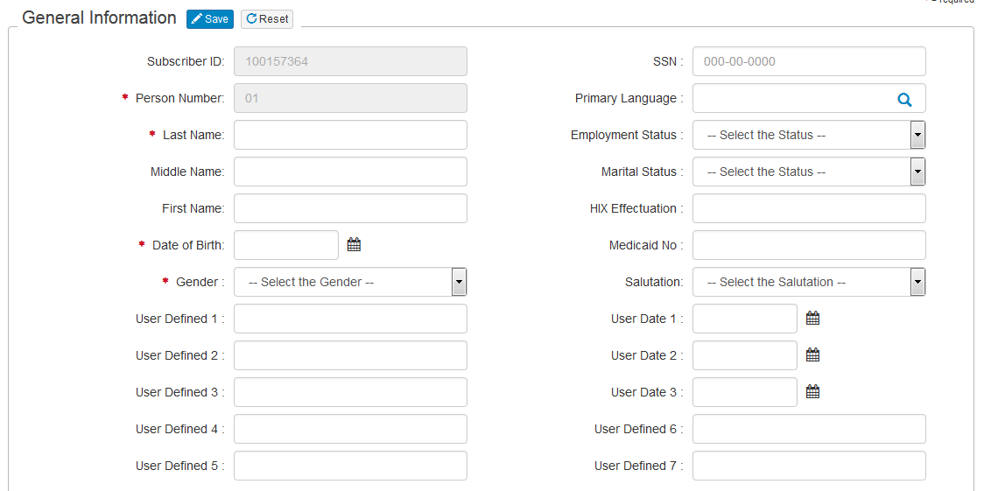
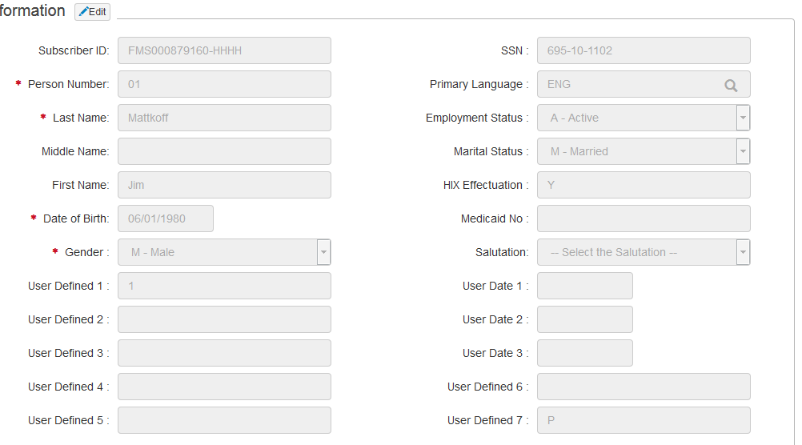
Components – Forms filling and verification
Fill - fills, submits and verifies the result for the forms in the application with static data
Fill - fills, submits and verifies the result for the forms in the application with dynamic data from excel
Verify fields – verifies if the field exist, displayed and enabled
Verify – verifies the form data with static data
Verify – verifies the form data with dynamic data from excel

Slide 11
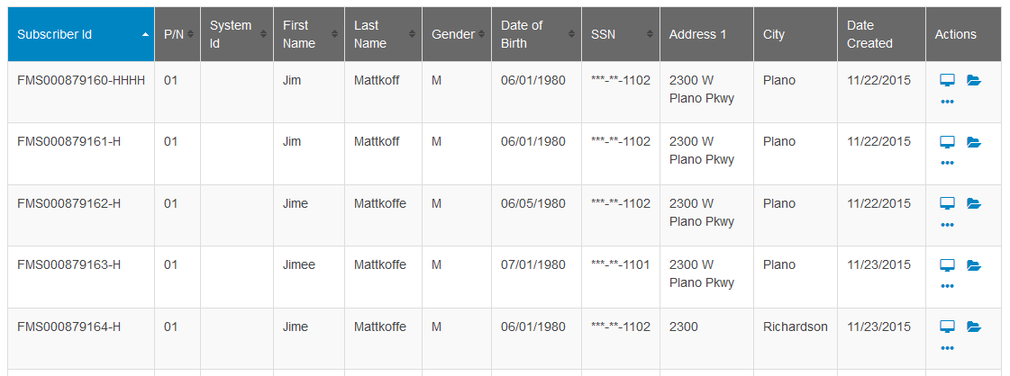
Components – Web tables handling
Table – gives column, rows and heading
Columns - gives column names and count
Rows - gives row count, row data
Cells – gives cell data

Slide 12
Components – Utilities
Excel file handling (open, save, get cell data, set cell data)
Database methods (open, run sql queries)
File handling (copy, delete, file existence)
Date conversions
Clipboard functions
Downloading files from urls
PDF validations

Slide 13
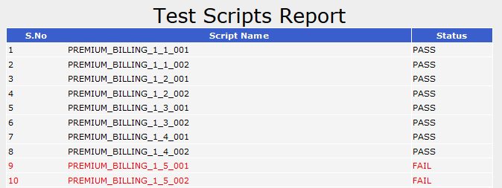
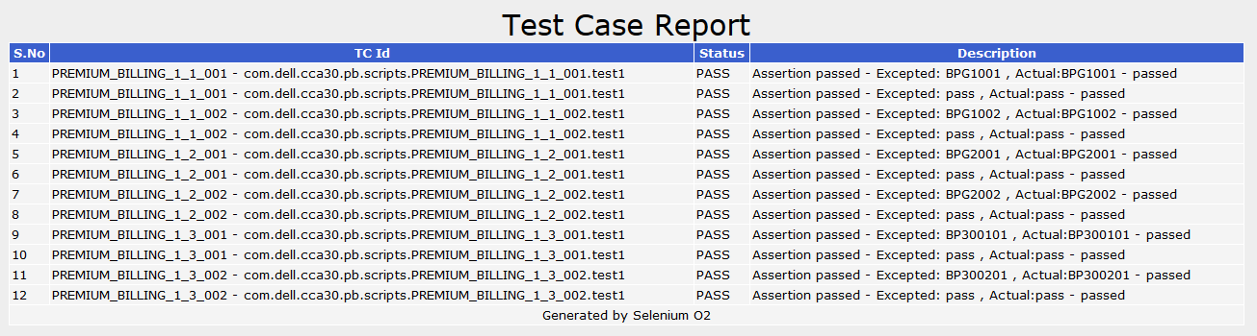
Components – Custom reports
Generates HTML, Excel, Custom reports
Generates Script level result report
Generates Test case level report
Generates Screenshot at every step
Provides Expected value and Actual value

Slide 14
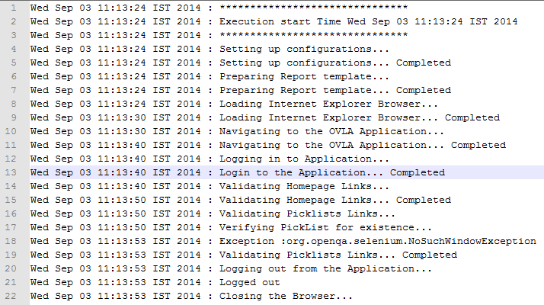
Components – Logging

Slide 15
Framework Benefits
Start automating right away
Control tests execution from excel file
Can read the test data from excel files
Helps to validate and report expected and actual values
Generates screenshots and reports
Works with IE, Firefox and Chrome browsers
Supports Database operations
Supports Windows, Mac and Unix/Linux platforms
Can be extended easily based on the business needs
Can plugin to any existing framework

Slide 16

Comparison
 | Without Framework | Test NG | Selenium O2
Batch Execution | No default support | Needs java and TestNG skills | Needs Excel skills
Parallel execution | No default support, possible with Selenium Grid | Supports | In Development, also possible with Selenium Grid
Data Driven support | No support | Supports with Data Providers (Need to write java code for providers) | Supports with Excel (No additional code required)
Test Assertions | No support | Supports for Boolean, Alpha Numeric, Numeric, Objects | Supports for Boolean, Alpha Numeric, Numeric, Objects and Web Element
Forms filling and verification | No support | No support | Can fill and verify forms against data in Excel
Recovery on exception | No default support | No default support | Supports on element operation level and test level
Reporting | No support | Xml and Html reporting – Developer friendly | Html, Excel reporting at script level and step level
Screenshots | No default support | No default support | Captures on fail or pass or on demand
Object repository | No support | No support | Supports Object repositories
HTML Table verification | No support | No support | Can get Table Data (cols, rows, cells)
Logging | No support | No support | Provides detailed execution log file

Slide 17
Case studies

Slide 18



Experian
IOL regression
GDG regression
Next Gen regression
JLL
OVLA
OLM
JLL site
Xcelys
FMS Admin
Premium Billing
Consumerism
HIX Portal
Volaris
Airlines

Slide 19
Experian
IOL test automation
IOL regression testing
GDG regression testing
Next Gen regression testing
Business Need
A worldwide powers electronic payments for financial institutions, retailers and processors around the world needed to automate payment transaction for an online banking product for three countries and needed to improve the quality of regression testing.
“ Appreciate your efforts, dedication and commitment to complete Silk Automation Phase I on schedule. The way the framework designed and written is certainly a value addition and it is going to help us in Phase II in covering a larger scope, also you have done a splendid job in customizing classic agent scripts to open agent, though there was a technical challenge in carrying out this task.” Regunathan Ravi, Resource Manager
Solution
Built Automation Framework using SilkTest to support multiple browsers like IE6, IE7, IE8 & FF3.6.8
Converted silk test scripts from classic agent to open agent to support multiple browsers and speed up execution
Supported test execution across operating systems - Windows XP, Windows 7 and Win Vista environments Phase wise automation to incrementally automate 32 payment products across 3 countries with common function documented first so as to reduce scripting time for new functionalities
Organized test cases in the form of Test Plan, which helped schedule intended test activities and also system scheduling for better utilization of resources
Generated results in the form of res, pdf and HTML file formats
Key Benefits
70% reduction in scripting effort: Designed Silk Test Automation Framework, which reduced the scripting effort by 70% for similar products
30% reduction in execution effort: Over all regression testing cycle time was reduced from 3 weeks (pure manual testing) to less that 2 weeks (combination of manual and automation)
Extensive coverage by supporting testing on multiple browsers & operating systems: Supports multiple browser (IE7, IE8 & Mozilla Firefox 3.6.8) and Windows XP, Windows 7 and Win Vista environments using a single automation framework
Notes:
The customer
ACI Worldwide powers electronic payments for financial institutions, retailers and processors around the world with the broadest, most integrated suite of electronic payment software in the market.
Business Need: Automation of payment transaction for an Online Banking Product for 3 countries to improve quality of regression testing
Areas of Business Serviced: Payment Products in Online Banking
Geographies: Singapore, Malaysia, China
Project Locations: India
From Regunathan Ravi (Resource Manager), ACI Worldwide:
“Appreciate your efforts, dedication and commitment to complete Silk Automation Phase I on schedule. The way the framework designed and written is certainly a value addition and it is going to help us in Phase II in covering a larger scope, also you have done a splendid job in customizing classic agent scripts to open agent, though there was a technical challenge in carrying out this task.”
The Solution
Building Automation Framework using SilkTest to support multiple browsers like IE6, IE7, IE8 & FF3.6.8. This was achieved by using option set file of silk test where respective settings are loaded during execution
Conversion of silk test scripts from classic agent to open agent to support multiple browsers and also speed up execution.
Supported test execution across operating systems - Windows XP, Windows 7 and Win Vista environments.
Phase wise automation to incrementally automate 32 payment products across 3 countries with common function documented first so as to reduce scripting time for new functionalities
Test data is maintained using spread sheet. Test cases use the data from the spread sheet and data driven testing is performed.
Single point of change that needs to be done if there are any changes to business functions or global variables.
Test cases are organized in the form of Test Plan which helps scheduled intended test activities and also system scheduling done for better utilization of resources.
Results are generated in the form of res, pdf and HTML file formats.
Benefits
Reduction in Scripting Effort by 70% - Designed Silk Test automation Framework that reduced the Scripting effort by 70% for similar products
Reduction in Execution Effort by 30% - Over all Regression Testing Cycle time was reduced from 3 weeks (Pure Manual Testing) to less that 2 weeks (combination of Manual and Automation)
Extensive coverage by supporting testing on Multiple Browsers and OS : Supports multiple browser (IE7, IE8 and Mozilla Firefox 3.6.8) and Windows XP, Windows 7 and Win Vista environments using a single Automation frame work. .

Slide 20
JLL
Three Testing POCs
OVLA Automation
OLM Automation
JLL German and French
Business Need
To Automate Testing by using Selenium Automation tool in order to reduce time and resource. JLL team were manually testing scenarios like Flat file validation, links validations in the site created, which was more time consuming when done manually.
Tester needs to validate both the positive and negative test cases like whether the links which are mentioned to be available and present.
Similarly Flat file validation, a file will be generated which was tested manually with respect to the requirements. File data should be in the same pattern that is mentioned in the requirements, so we automated by creating the pattern matching technique to validate it.
Scenarios Automated
.
Login and Logout
Validation of Links available in Homepage
Validation of Pick Lists Links
Validating the sub links in each Pick lists
Validating the Flat file against Specifications File

Slide 21
Hilton
Three Applications
Hilton Hotels
Business Need
Testers need to manually execute a set of regression suite and should ensure whether the application is working accordingly. In the regression suite, we identified few test cases which are automatable and which will reduce the manual execution time to a major extend.
Scenarios Automated
Create User
Book, Modify & Cancel the Reservation
Request for Pricing
Sign In
All the scenarios were created by combining separate business components which has reduced the re-scripting to a greater extend.
Scenario | Time Taken (in Minutes)
 | Manual | Automation
Create User | 10 | 1
Book, Modify & Cancel the Reservation | 30 | 4
Logo Checking | 10 | 4
Request for Pricing | 20 | 5
Email Subscription | 15 | 6
Notes:
Customer: ICAP Trade Capture
Overview
Dell developed test pack (manual and automation) for trade capture application which can be used for regression testing during future releases of trade capture
Scope
Dell developed test pack (manual and automation) for trade capture application which can be used for regression testing during future releases of trade capture
Contract:
T&M with Cap, USD 83,524
Technology
HP QTP for Automation
Tenure
7 months (Feb 2010 to Aug 2010)
Challenges and achievements
Offshore connectivity took longer than expected due to several constraints
Application used OLG ActiveX controls not supported by HP QTP
Work around was developed using user defined functions to over QTP limitations
Delivered 102 automation test scripts
Additional 8 partial scripts were delivered because of application limitation inhibiting complete automation of scenarios
Model
Offshore & Onsite
1 Onsite and 2 Offshore
Project managed from offshore
Connectivity to ICAP environment was provided via Citrix with RSA tokens
Deliverables
High level test strategy
Project Plan
Regression Test plan
Manual test Cases
Automated Test scripts
Test logs and Test results
Benefits to ICAP
Automated Regression test suite enabling faster testing cycle and high confidence in application quality
Faster turnaround time for automating any new or critical functionality in future
Reduced fixed cost associated in maintaining the automation solution

Slide 22
Xcelys
Four Applications
FMS Admin
HIX Portal
Premium Billing
Consumerism
Business Need
The customer is a leading markets operator and provider of post trade risk mitigation and information services and needed testing services.
Dell developed a test pack (manual and automation) for trade capture application, which can be used for regression testing during future releases of trade capture
Solution
Since the application used OLG ActiveX controls not supported by HP QTP, a workaround was developed using user defined functions to over QTP limitations
Delivered 102 automation test scripts; additional 8 partial scripts were delivered because of application limitation inhibiting complete automation of scenarios
High level test strategy; regression test plan; manual test cases; automated test scripts; test logs and test results
Key Benefits
Automated regression test suite, enabled faster testing cycle and high confidence in application quality
Faster turnaround time for automating any new or critical functionality in future
Reduced fixed cost associated in maintaining the automation solution
Notes:
Customer: ICAP Trade Capture
Overview
Dell developed test pack (manual and automation) for trade capture application which can be used for regression testing during future releases of trade capture
Scope
Dell developed test pack (manual and automation) for trade capture application which can be used for regression testing during future releases of trade capture
Contract:
T&M with Cap, USD 83,524
Technology
HP QTP for Automation
Tenure
7 months (Feb 2010 to Aug 2010)
Challenges and achievements
Offshore connectivity took longer than expected due to several constraints
Application used OLG ActiveX controls not supported by HP QTP
Work around was developed using user defined functions to over QTP limitations
Delivered 102 automation test scripts
Additional 8 partial scripts were delivered because of application limitation inhibiting complete automation of scenarios
Model
Offshore & Onsite
1 Onsite and 2 Offshore
Project managed from offshore
Connectivity to ICAP environment was provided via Citrix with RSA tokens
Deliverables
High level test strategy
Project Plan
Regression Test plan
Manual test Cases
Automated Test scripts
Test logs and Test results
Benefits to ICAP
Automated Regression test suite enabling faster testing cycle and high confidence in application quality
Faster turnaround time for automating any new or critical functionality in future
Reduced fixed cost associated in maintaining the automation solution

