Slide 1




ELITE HACK CHALLENGE
ELITE HACK CHALLENGE- In collaboration with CSI Hyderabad Chapter
24th February to 25th February,2023.
HACK- Health, Agriculture, Culture, Know your security
Team No: 23 Team Name: TECH INFINITEX
IDEA NAME: HealthGenie

Slide 2


OUTLINE
Problem Statement
Proposed Methodology
Test Results
Innovation Elements
Value and Impact

Slide 3
PROBLEM STATEMENT(S)
Objective: The primary objective of a hospital management system is to improve patient care, increase efficiency, and reduce costs by streamlining processes and workflows.
Data security and privacy are crucial issues for hospital management systems. These systems store sensitive information such as patient records, medical history, and financial data. Any breach of data can lead to serious consequences for both patients and healthcare providers.
The complexity and poor user experience of hospital management systems can affect their adoption and usage by healthcare providers. The user interface of these systems should be intuitive and easy to use, to reduce the chances of errors and increase efficiency.

Slide 4
PROPOSED METHODOLOGY
Our proposed healthcare management solution utilizes advanced technologies such as quantum cryptography, IoT sensors, blockchain, and machine learning to optimize patient care and administrative tasks.
We offer features such as a location-based service to find nearby hospitals, a chatbot for instant patient assistance, and a BMI calculator with personalized nutritional recommendations. Our platform also includes a yoga asanas guide, face recognition technology for patient identification, and machine learning algorithms for X-ray image analysis.
Normal features such as email communication, insurance views, and appointment scheduling are also available on our platform to further streamline healthcare management.
Our solution enhances transparency, security, and efficiency in healthcare management, enabling healthcare organizations to provide high-quality care to patients.

Slide 5
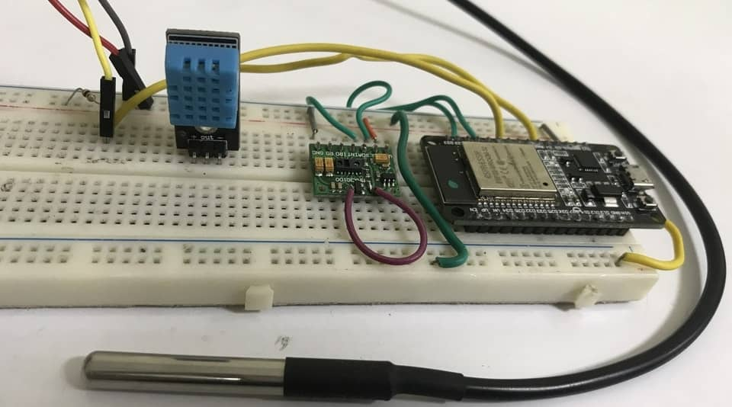
TEST RESULTS

Slide 6
INNOVATION ELEMENTS
Collaboration among stakeholders is essential to creating an efficient, secure, and accessible hospital management system.
Ideation helps generate innovative ideas to meet evolving needs, such as patient communication through chatbots and wellness support through yoga asanas.
Implementation involves developing and deploying features like face recognition for patient identification, color blindness/site checking games, and machine learning for X-ray predictions.
Value Creation measures success and ensures continued value over time, with features like appointment scheduling, insurance views, and direct mail communication.

Slide 7
VALUE AND IMPACT
The features for a hospital management system have the potential to bring about significant positive impact on current society in the following ways:
Improving healthcare access and reducing healthcare disparities.
Enhancing patient outcomes through improved accuracy of diagnoses and reduced errors.
Increasing security and privacy of patient data, reducing the risk of data breaches and identity theft.
Reducing operational costs, optimizing processes, and providing more personalized care to patients, ultimately leading to a more sustainable healthcare system.

Slide 8
TEAM MEMBERS
Guradi Vinay Reddy : Phoneno: 9133558192, EmailId: guradivinay33@gmail.com, LinkedIn: https://www.linkedin.com/in/vinay-reddy-840305208
Dammalapati Pranav : Phoneno: 6262993939, EmailId: dammalapatipranav@gmail.com, LinkedIn: https://www.linkedin.com/in/dammalapati-pranav-8a86a1200
NagaSai Vuppala: Phoneno: 6304619257, EmailId: nagasaivuppala2003@gmail.com, LinkedIn: https://www.linkedin.com/in/nagasai-vuppala-432805220
Sravani nvs : Phoneno: 9573916415, EmailId: nvssravani@gmail.com, LinkedIn: https://www.linkedin.com/in/sravani-nvs-3b642a255

