Slide 1

We Are Super Awesome.
HELLO!
Ignota antiopam eam ut, mel no animal aperiam, ex nulla reformidans has. Duo ne nonumy eirmod, ex est albucius adipiscing. Nibh dicit an sea, vide dicam no est. Altera theophrastus contentiones mei ei, eos in eius ignota insolens.

Slide 2


Slide 3

Fullscreen Portfolio

Slide 4
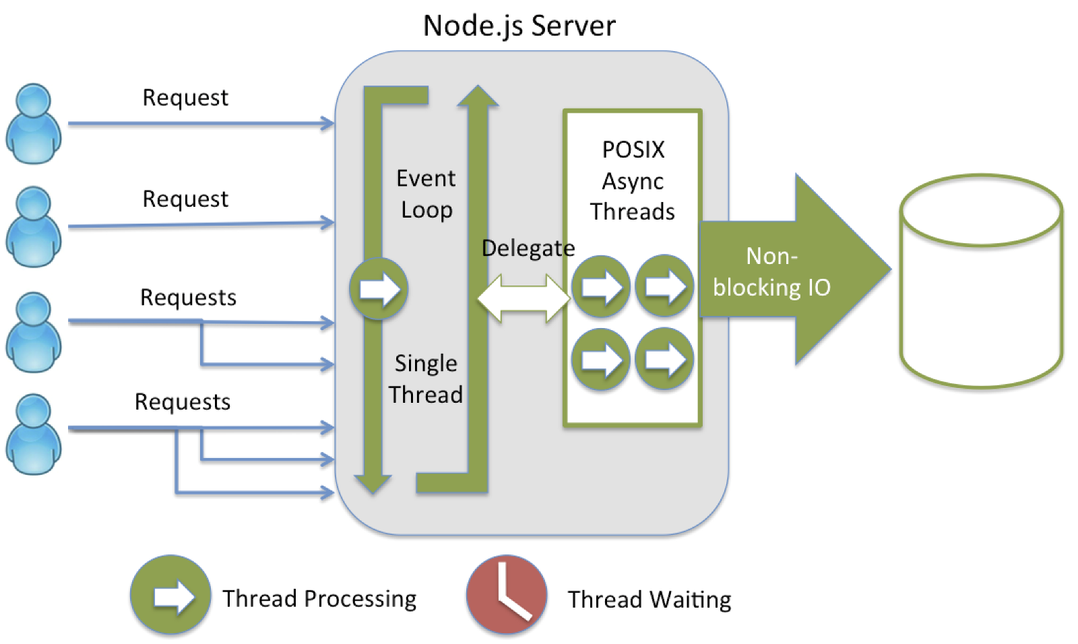

Slide 5

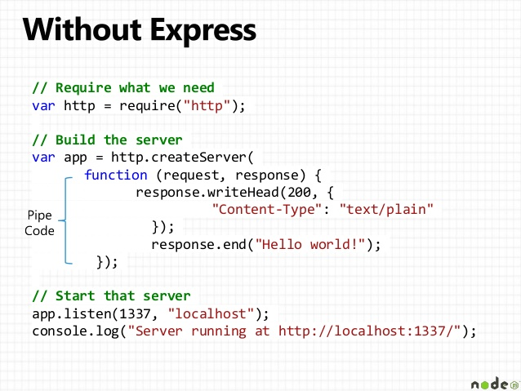
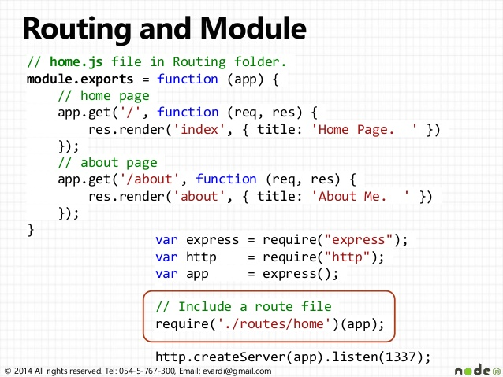
Fullscreen Portfolio

Slide 6


Slide 7
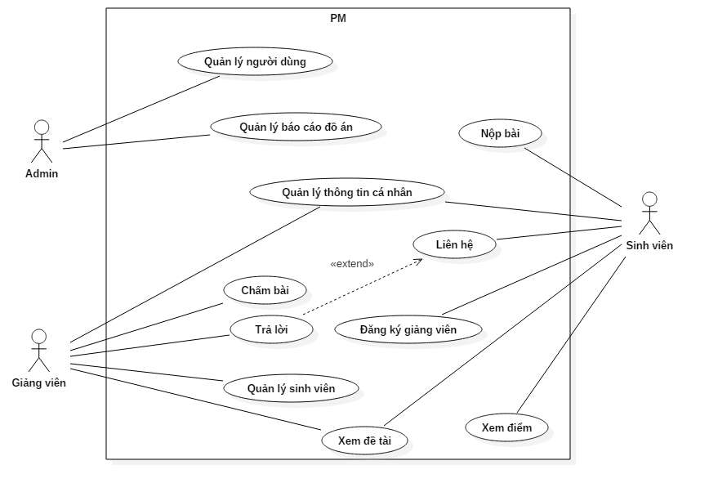

Slide 8
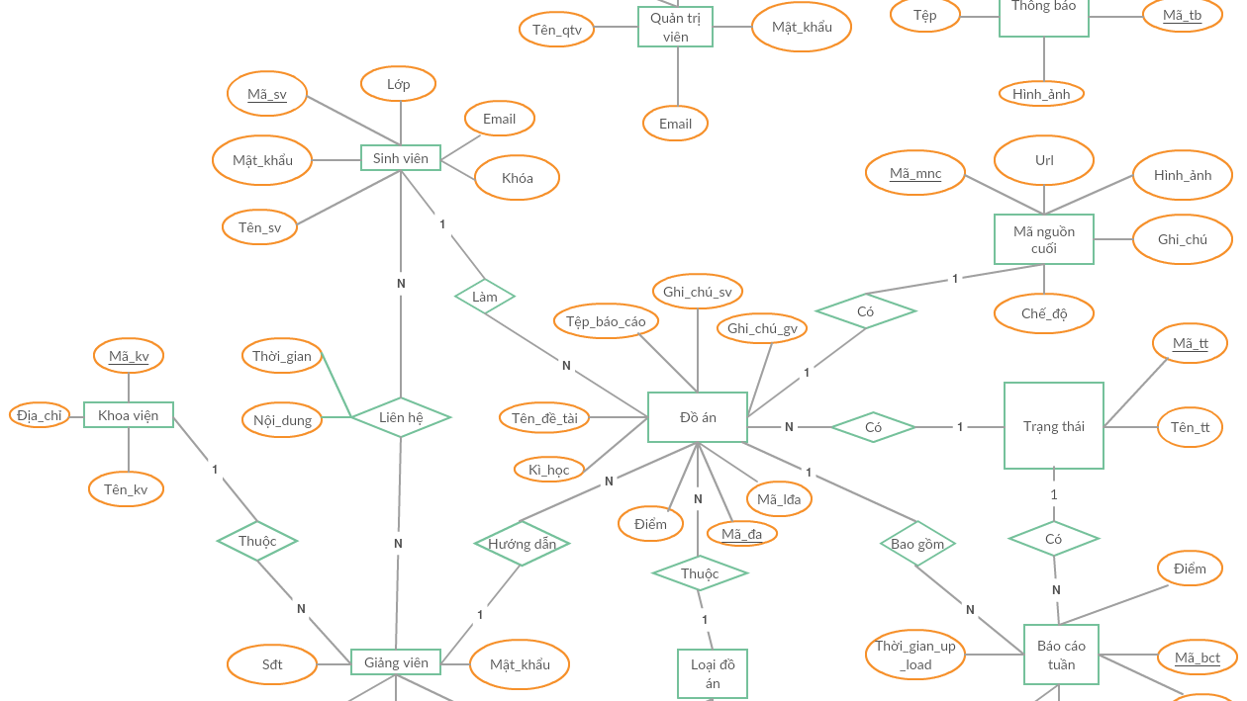

Slide 9
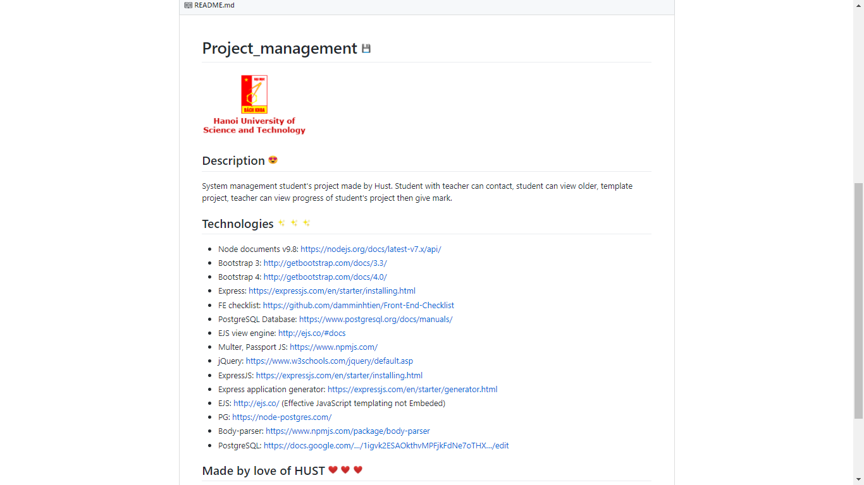

Slide 10
Thank You for Watching!
Any Questions?
See us at: https://github.com/damminhtien/project_management

